Slide 1
ASP.NET Deployment
Sayed Ibrahim Hashimi
@SayedIHashimi
SayedHa@Microsoft.com

Slide 2
Resources
https://github.com/sayedihashimi/netconf2014
http://msbuildbook.com
http://sedodream.com
http://www.asp.net/mvc/tutorials/deployment/visual-studio-web-deployment/command-line-deployment

Slide 3
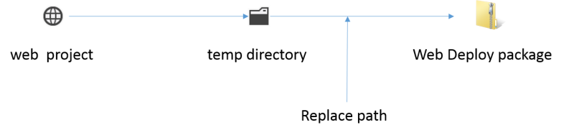

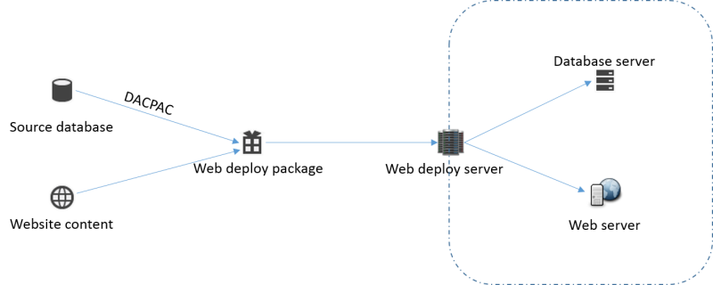
Gather files
Transform files
Publish
Build project

