Slide 1
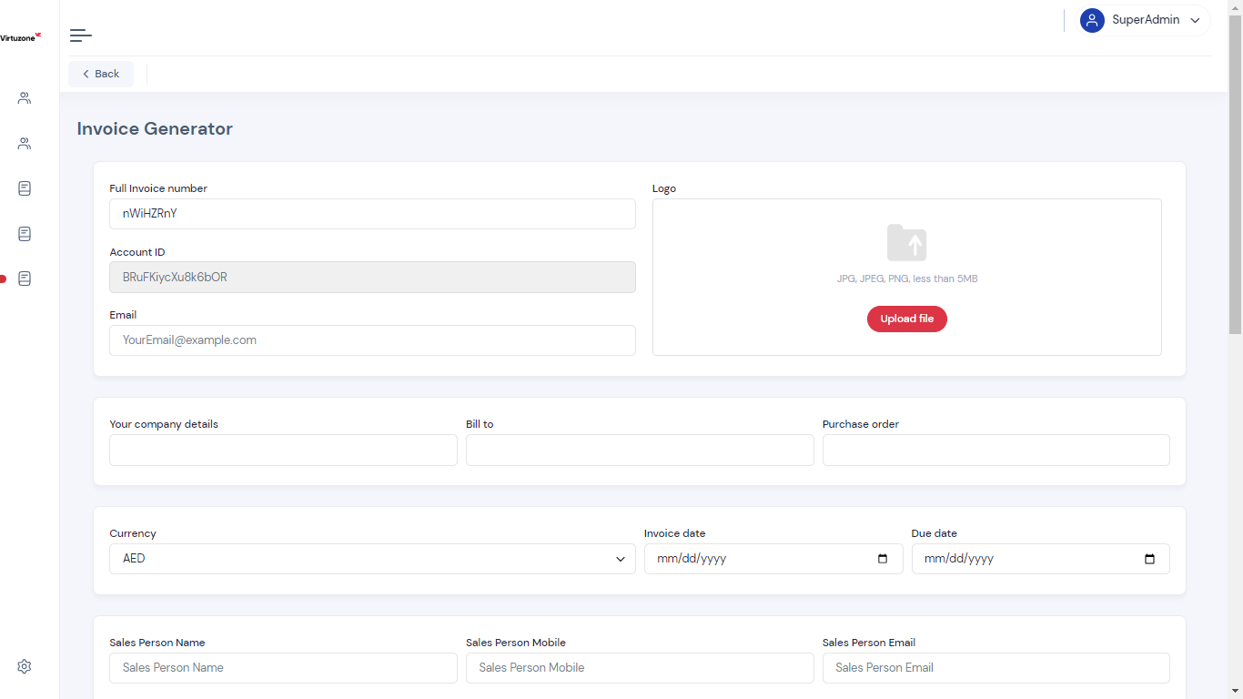
Logo needs to be standardized/company. No option to put any other logo except for 1.
Invoice number must be an option to enter, or you can put an option such as autofill.
Account ID – Does this have any relevance?
Change Purchase Order as Purchase Order Number
Change as Sales Person Number

Slide 2
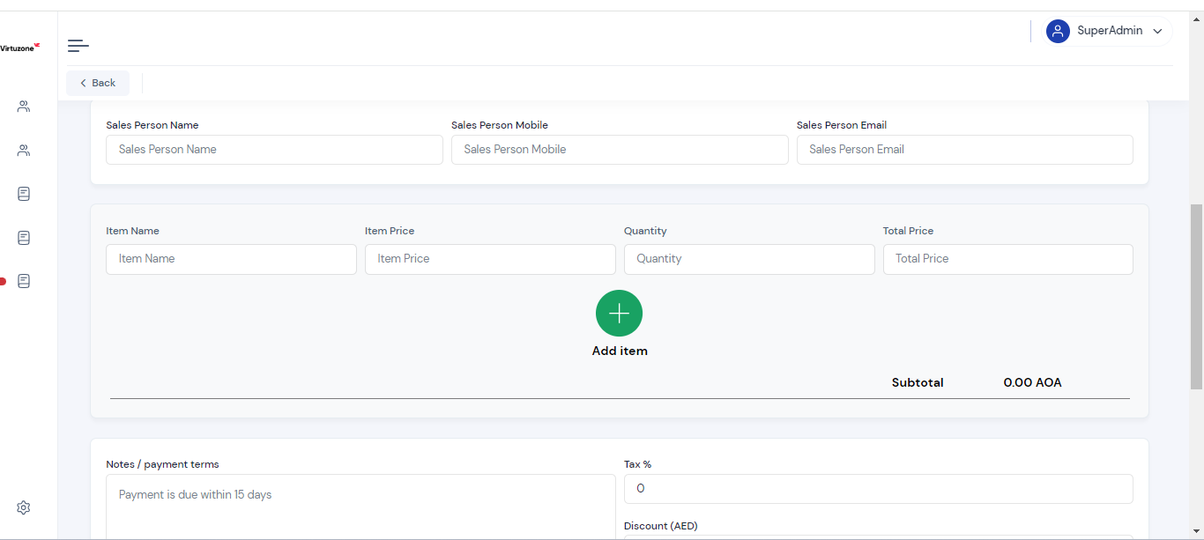
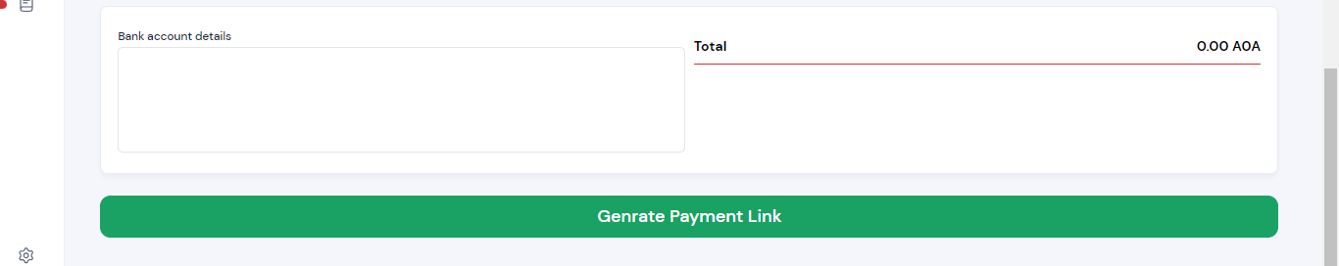
Change AOA to AED. Make it before the Figure
Make sure the decimal points are proper
We need to save the Notes/Payment Terms (the last updated one only)
We need to save the bank details. The last updated one.
Correct the spelling of Generate.

Slide 3
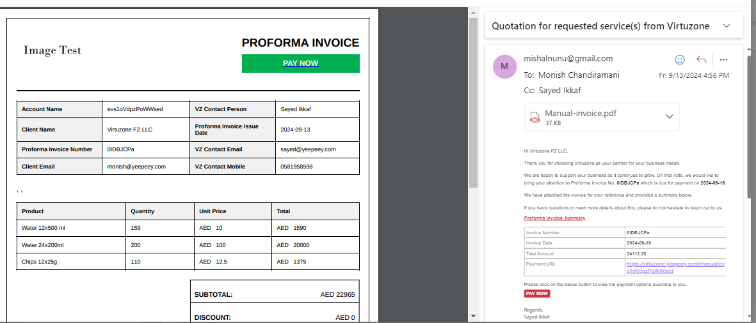
Logo is missing from the invoice attachment
Decimal points needs to be followed
Also follow the USD currency style
Payment terms/Notes not reflecting on the invoice
Bank Account Details not reflecting on the invoice
TAX Rate (5%): Needs to be written like this

Slide 4
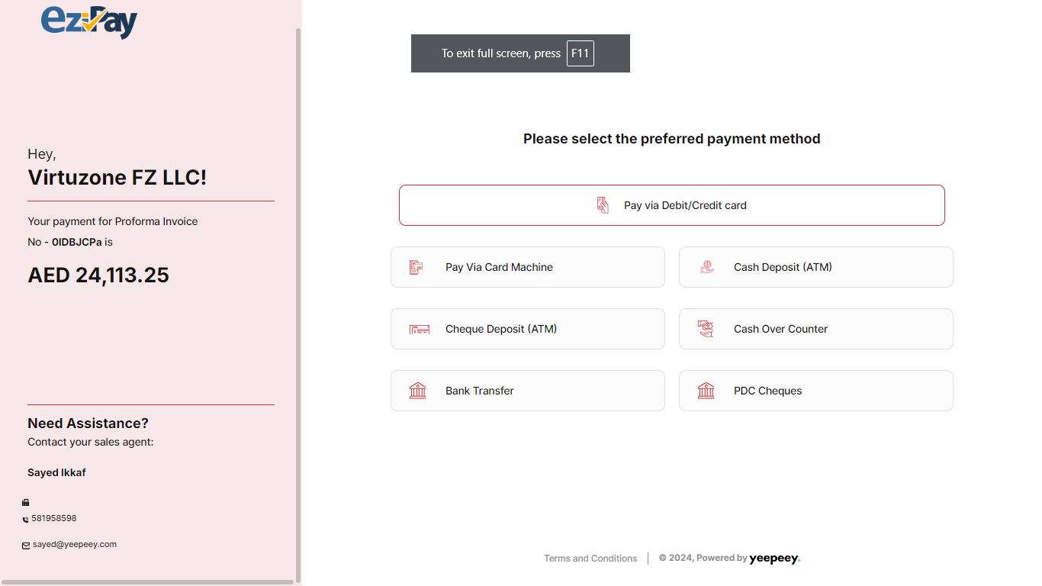
Why do we need a scroll up and down on the left side?
The alignment is missing at the footer

