Slide 1
Design CMOS Power Amplifiers for Enhanced Gain and
Bandwidth Using 90nm CMOS Technology.
Presented by
Md. Sayedul
1702079
Jakaria Khan Skib
1702092
Supervised by
Jitu Prakash Dhar
Assistant Professor,
Dept. of EEE, CUET
Department of Electrical and Electronic Engineering
Chittagong University of Engineering and Technology

Slide 2
Presentation Outline
Background
Literature Review
Objectives
Contribution
Methodology
Case Study
Matching Network(MN) Design
Two stage PA with MN
Result Analysis
Performance Comparison Table
References

Slide 3
Background
The increasing demand for faster data transfer rates and dependable connectivity in numerous applications, including 5G networks, satellite communications, and radar systems, has been driving the demand for high-performance wireless communication systems. Power amplifiers are essential in these systems for supplying enough power and amplification to permit effective signal transmission.
A number of enormous improvements in semiconductor technology have been made as a result of the expansion of the wireless communication sector. The most notable development among them is in CMOS technology. Transistors have the surprising advanced property of increasing speed while using less power in digital circuits and costing less as their size is lowered.
The development of CMOS technology has greater advantages than gallium arsenide (GaAs)and gallium nitride(GaN) technologies in the use of wireless communication[1].Also, CMOS technology minimizes fabrication costs and circuit power dissipation [2].

Slide 4
Background (continued..)
Fig.1: Block diagram of complementary metal–oxide semiconductor (CMOS) power amplifier. © “Design of high efficiency two stage power amplifier in 0.13µm rf cmos technology for 2.4ghz wlan application,” International Journal of VLSI Design & Communication Systems, vol. 4, pp. 31–40, 08 2013.

Slide 5
Background (continued..)
One approach in achieving high efficiency in a wide band power amplifier is to use a two stage amplifier design. In this design, the first stage amplifies the input signal and the second stage provides additional gain and power[3].
Another approach to achieving high efficiency in a power amplifier is to use a superimposed dual-band configuration[4].
The use of 90nm CMOS technology in the design of power amplifiers allows for high level of miniaturization making it suitable for small device. The use of this technology also enables high performance of power efficiency and linearity[5].

Slide 6
Literature Review
The paper titled “A k-band high-op1db common-drain power amplifier with neutralization technique in 90-nm cmos technology” (Y.Chang et al. 2019) [6] faces problem of constructing wideband power amplifiers (PAs) with high power added efficiency (PAE).
The next paper [7] has solved the problem of wideband PA and has worked on low-power, full-band, low-noise amplifier for ultra-wideband receivers.
A popular and efficient method for achieving wideband features is the use of staggered tuning technique. This method includes designing the driver and main stages at two different center frequencies[8].
Furthur improvement has been done by lowering insertion loss, minimizing size of PA, developing high frequency PA, increasing power added efficiency (PAE) and high power gain [9] [10].

Slide 7
Objectives
The main objectives of the work are:
To increase gain of power amplifier using two stage CMOS power amplifier.
To maintain wideband performance of the amplifier.
To design input and inter-stage matching network for impedance matching.

Slide 8
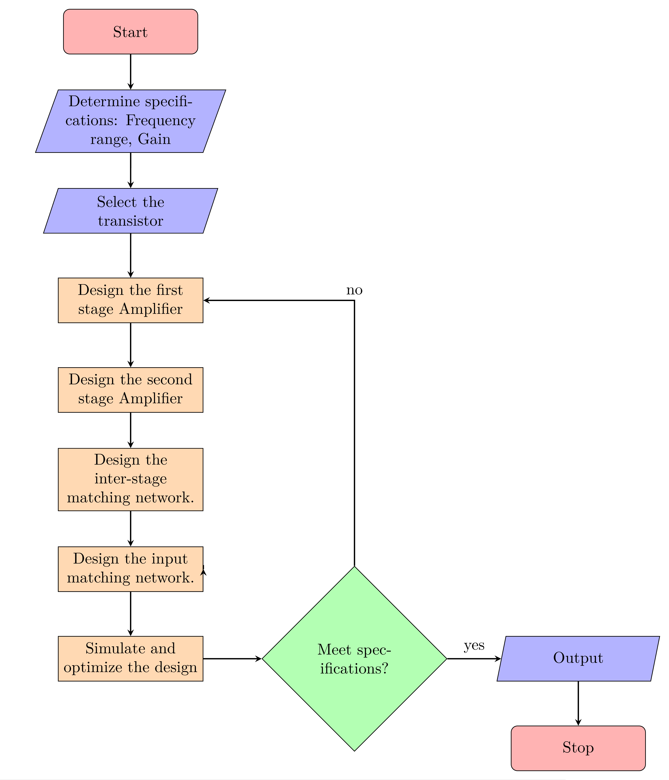
Methodology

Slide 9
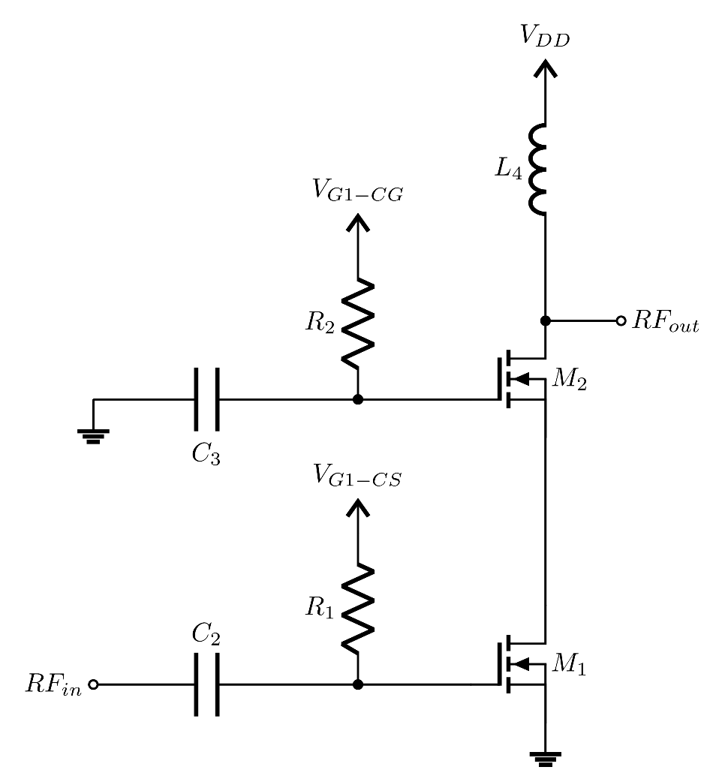
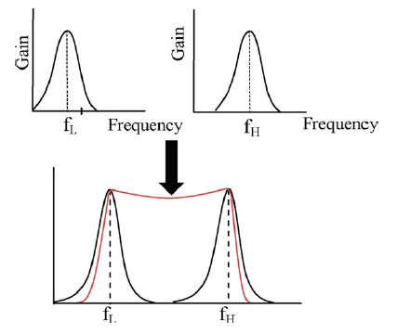
Methodology (continued..)
CS
CG
Fig.2. Illustration of broadband frequency response. © Rohana Sapawi
Fig.4. Cascode PA

Slide 10
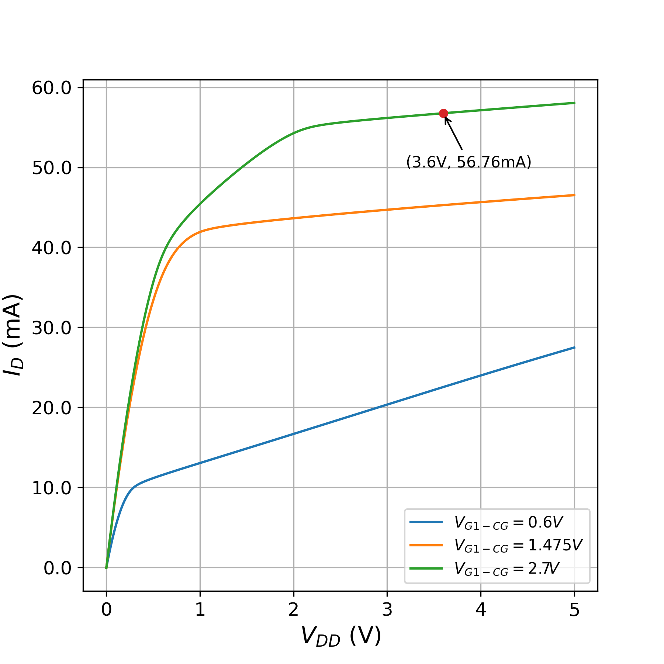
Methodology (continued..)
Fig.4. Cascode PA
Fig.5. Operating point analysis of cascode PA

Slide 11
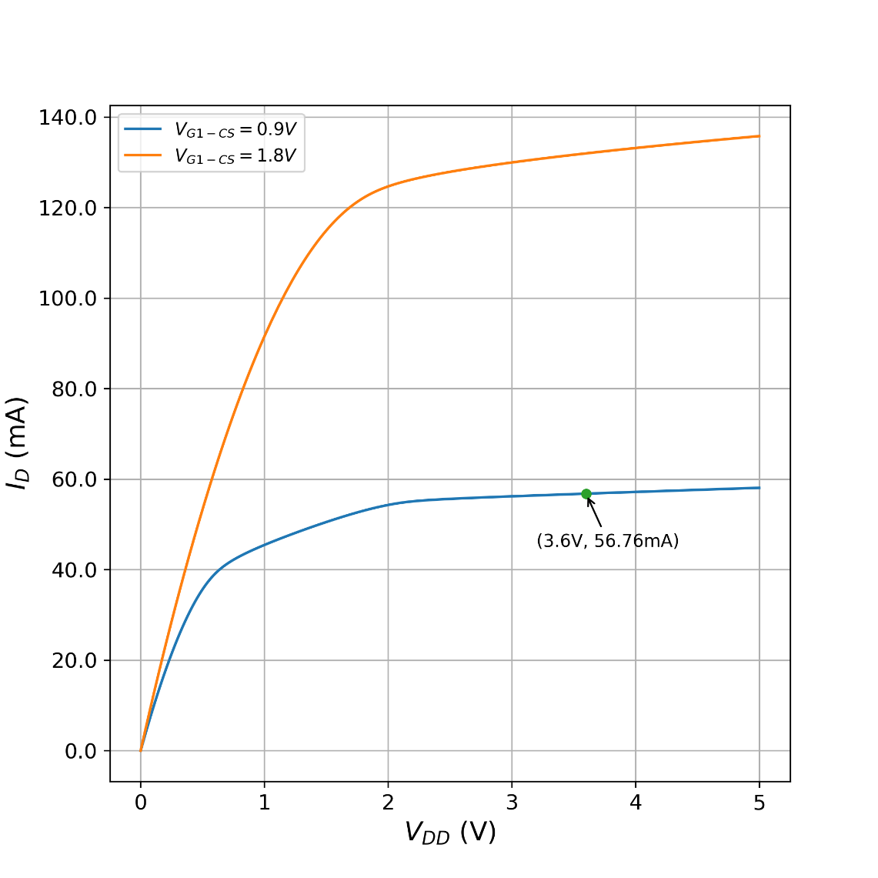
Methodology (continued..)
Fig.6. Cascode PA
Fig.7. Operating point analysis of cascode PA

Slide 12
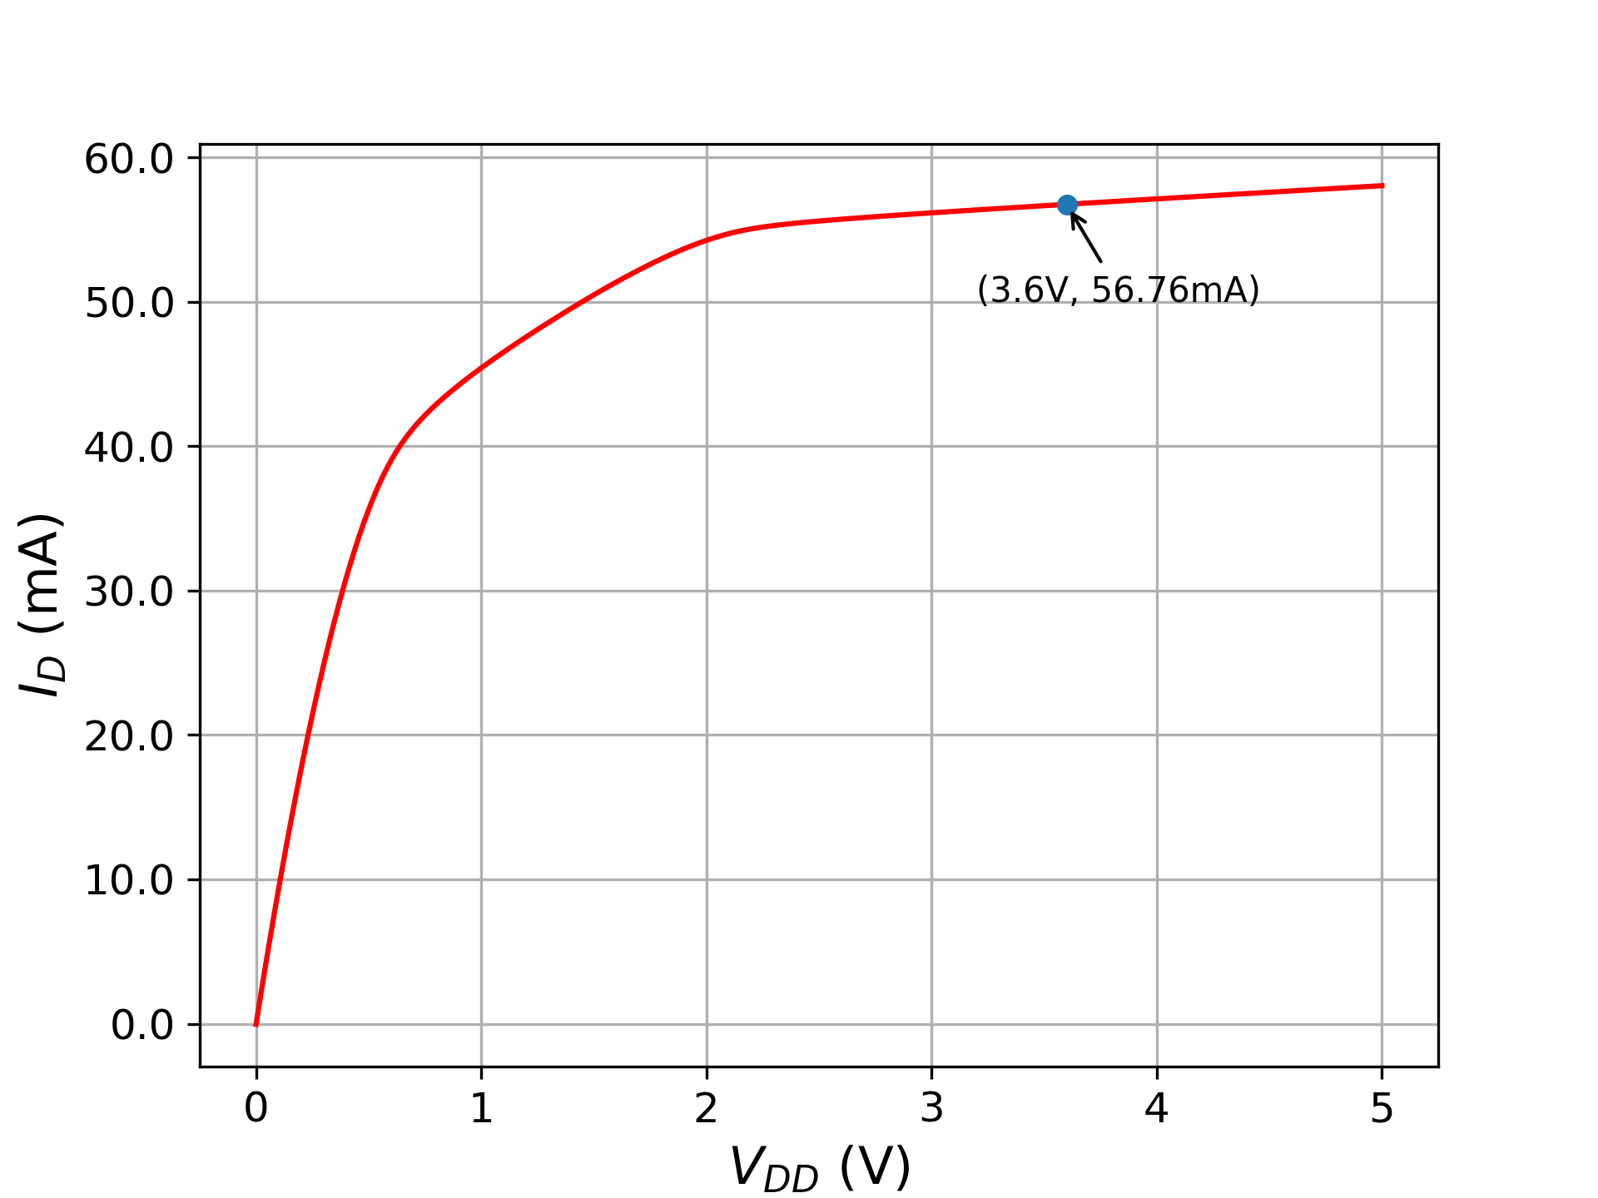
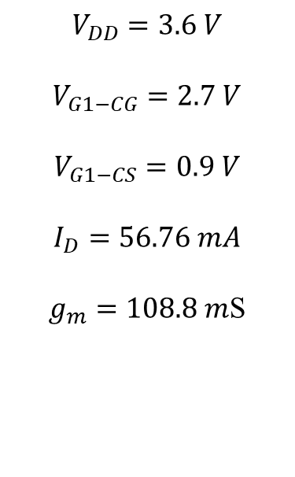
Methodology (continued..)
$$V_{DD}=3.6 V$$
$$V_{G1−CG}=2.7 V$$
$$V_{G1−CS}=0.9 V$$
$$I_{D}=56.76 mA$$
$g_{m}=108.8 m$S
Fig.8. Operating point analysis of cascode PA

Slide 13
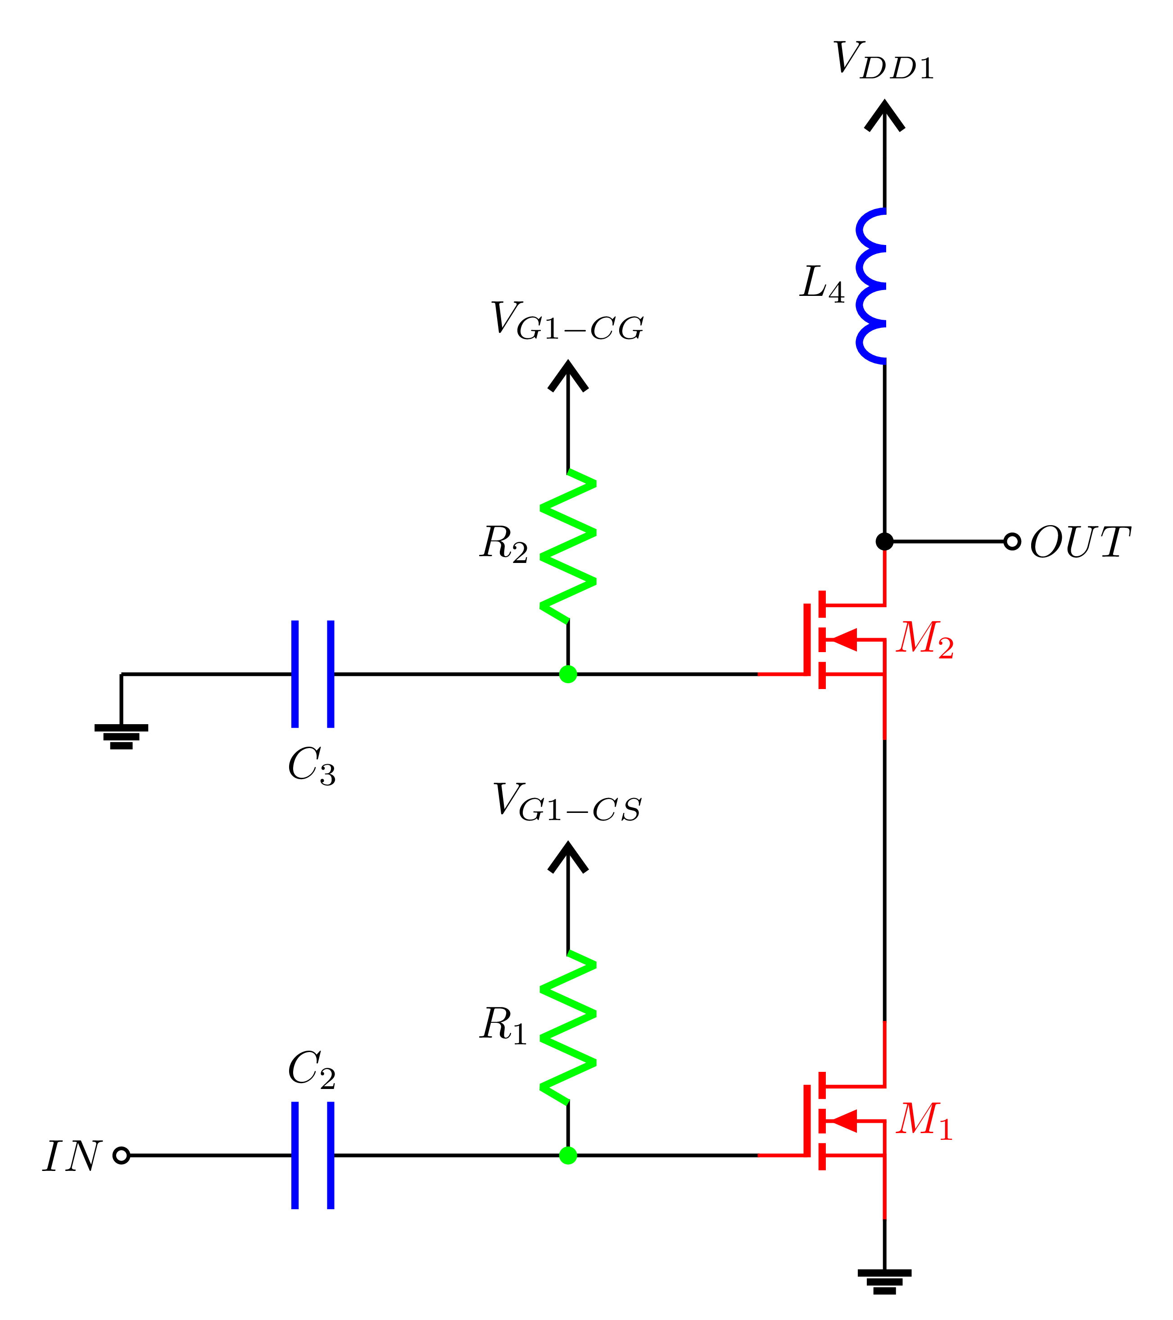
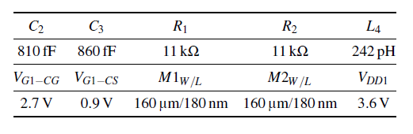
Single Stage PA

Slide 14
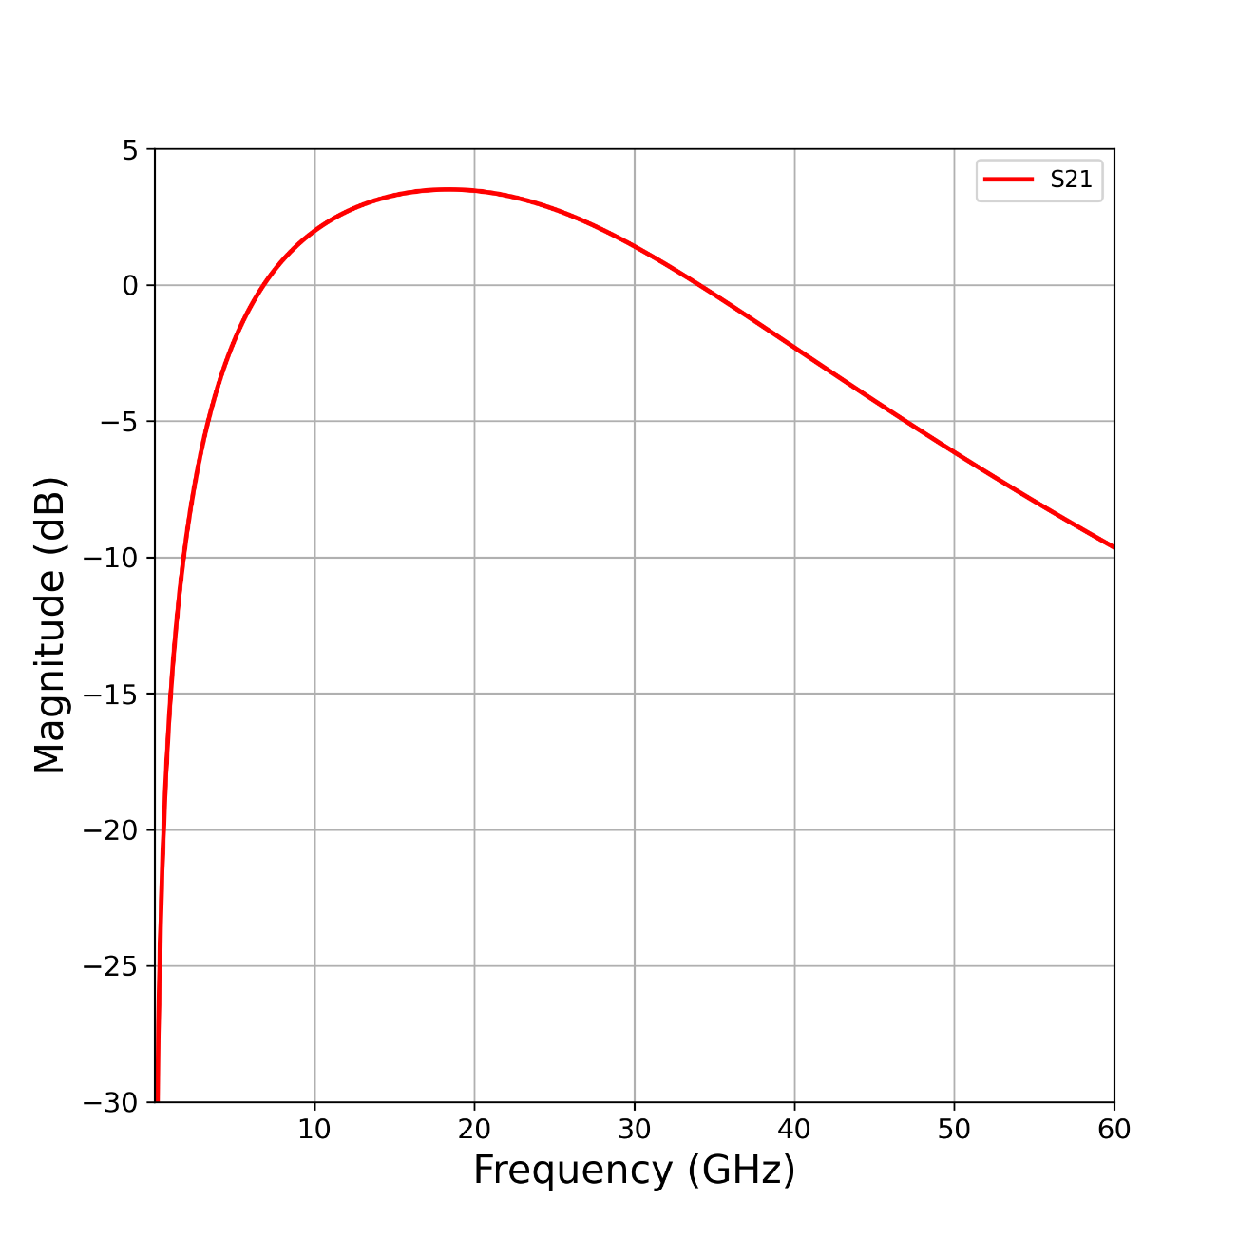

Single Stage PA
Max gain=3.78dB @ 18GHz
Fig.11. Single stage power amplifier
Fig.12. $S_{21}$of single stage power amplifier

Slide 15
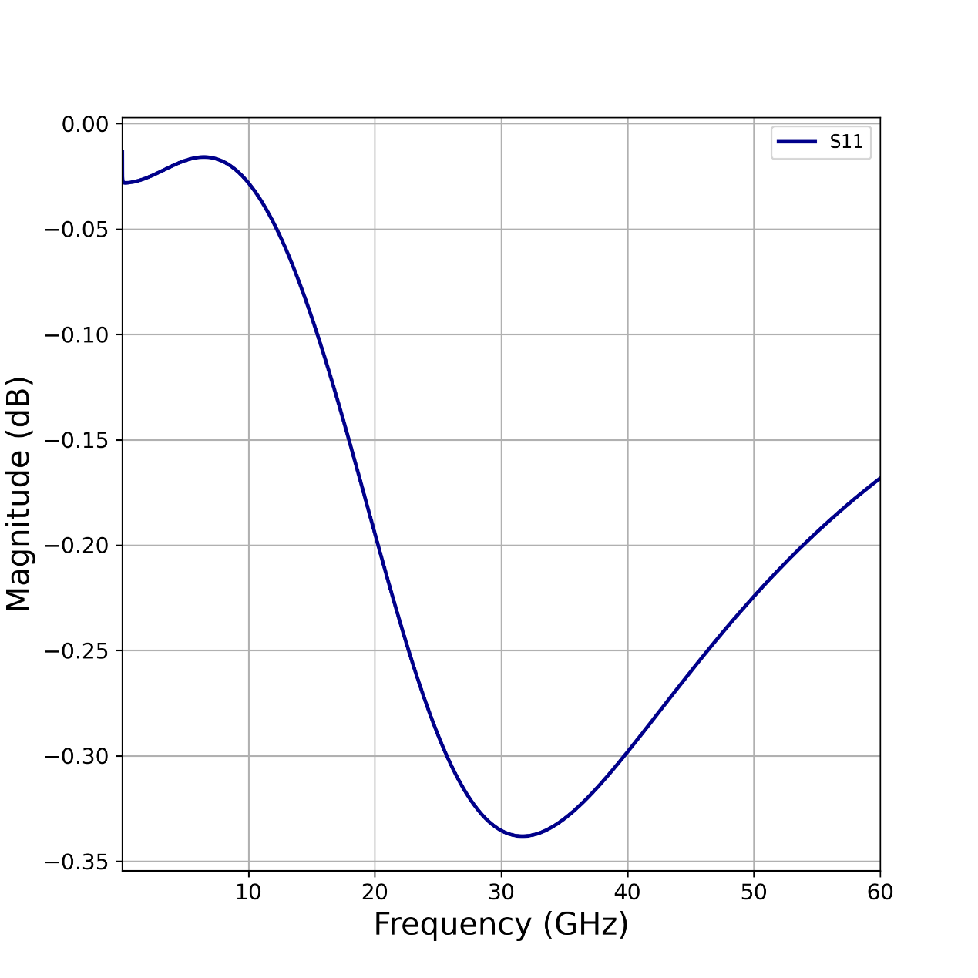

Single Stage PA
Fig.9. Single stage power amplifier
Fig.10. $S_{11}$of single stage power amplifier

Slide 16
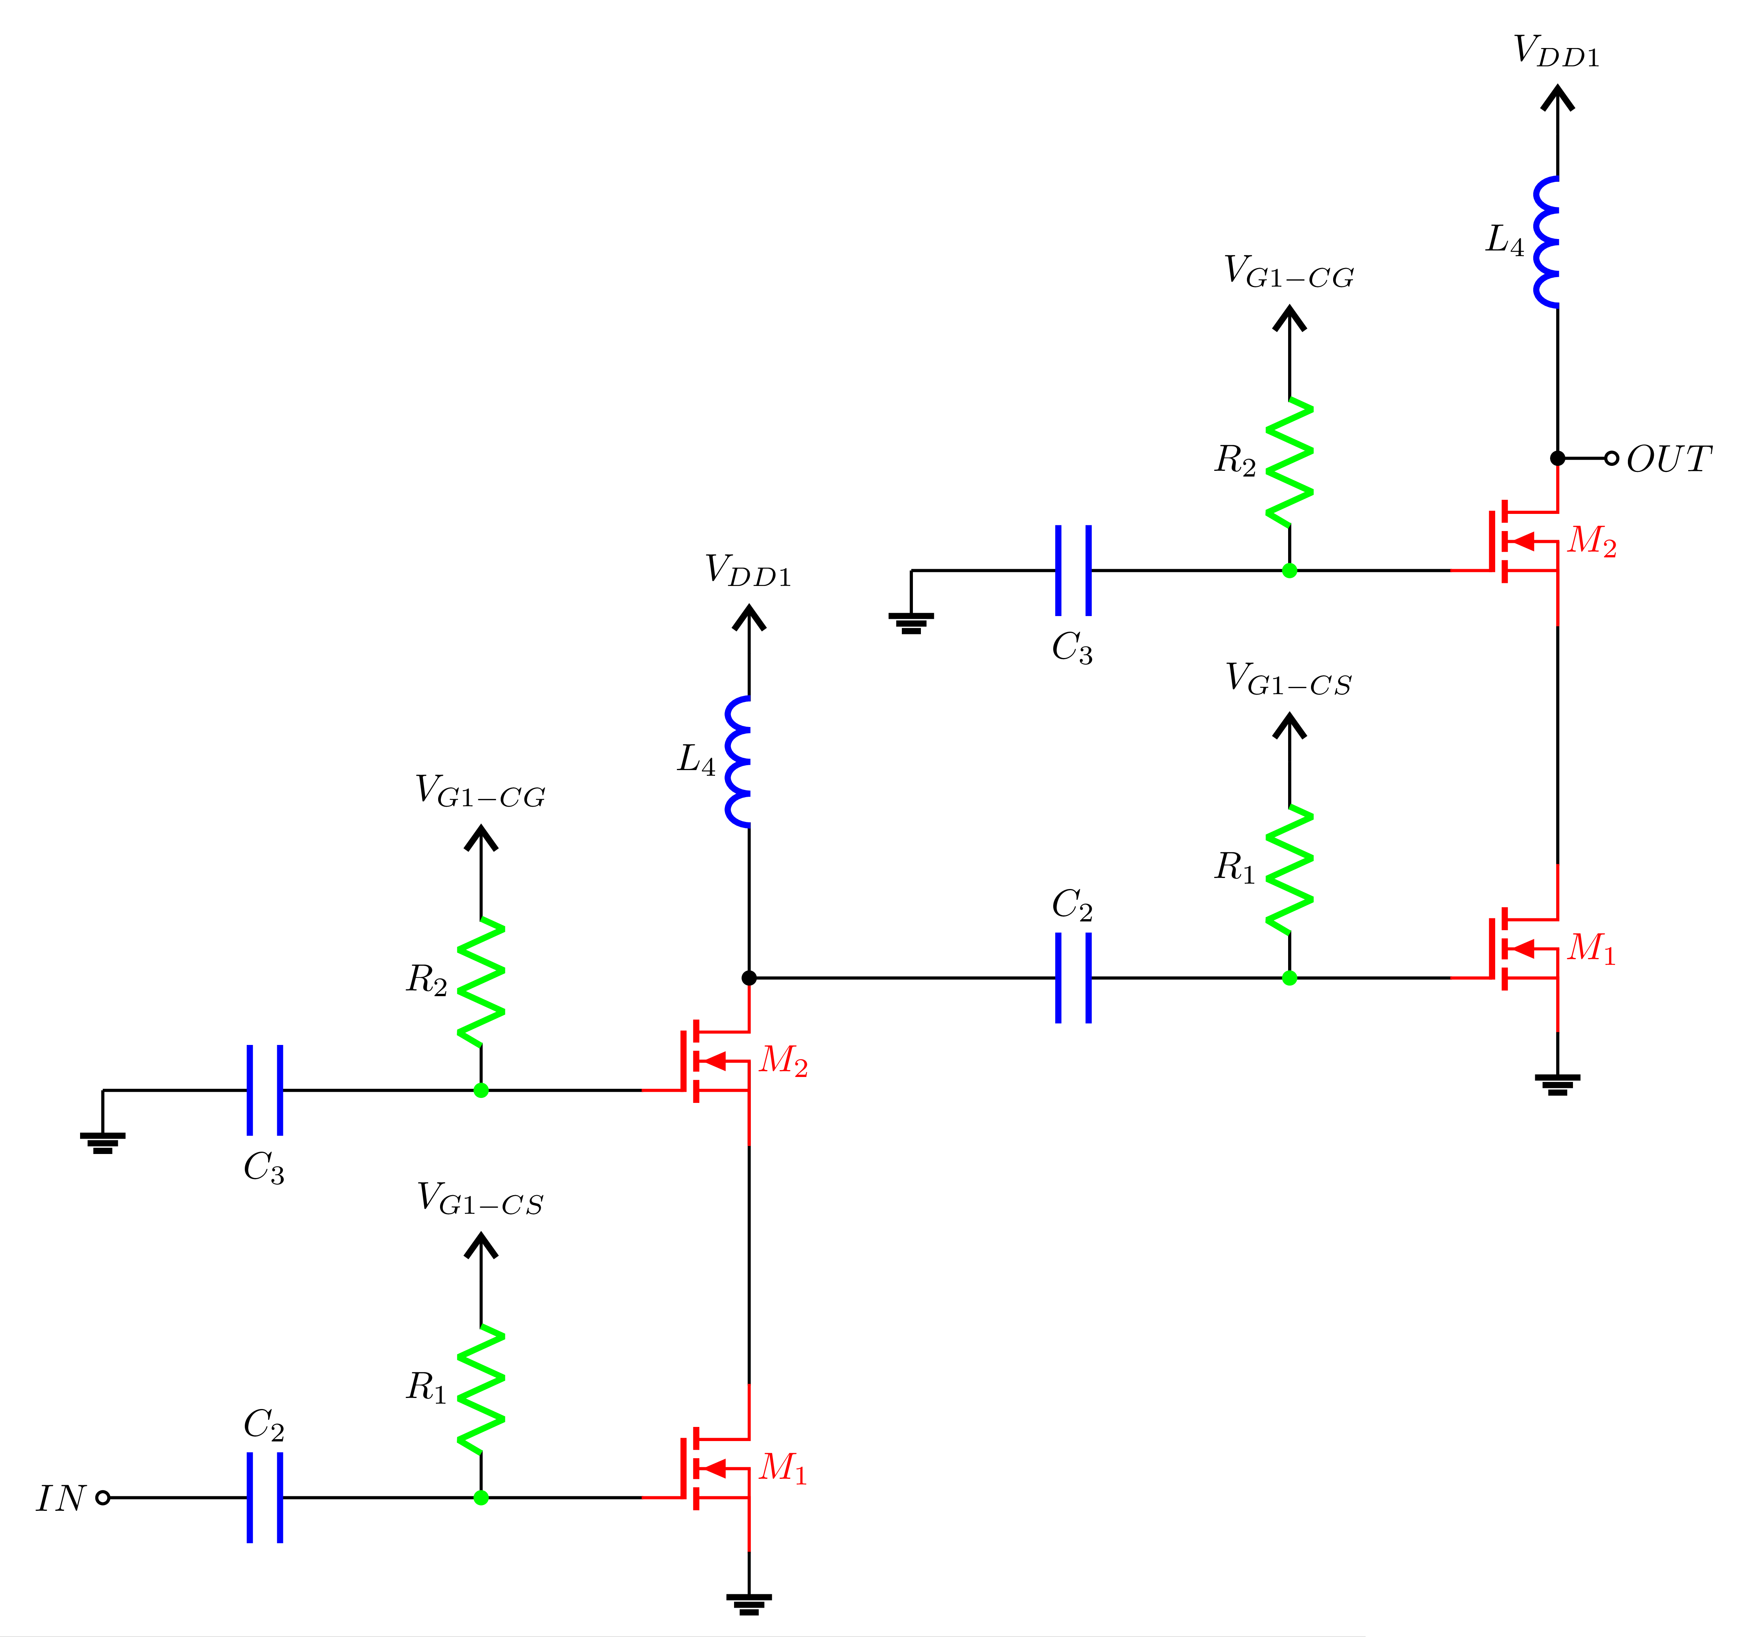
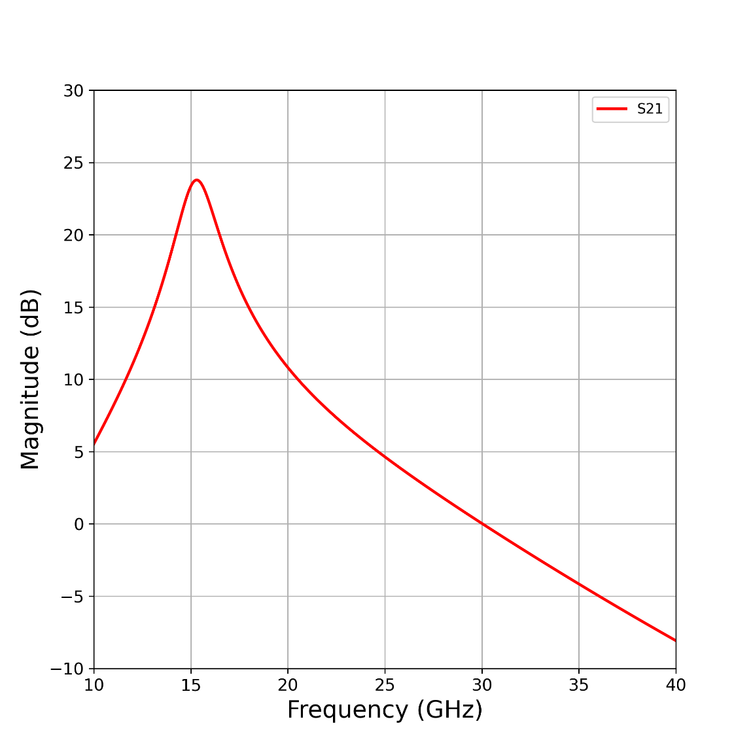

Two Stage PA
Max gain=24dB @ 15GHz
Fig.15. Two stage power amplifier
Fig.16. $S_{21}$of two stage power amplifier

Slide 17
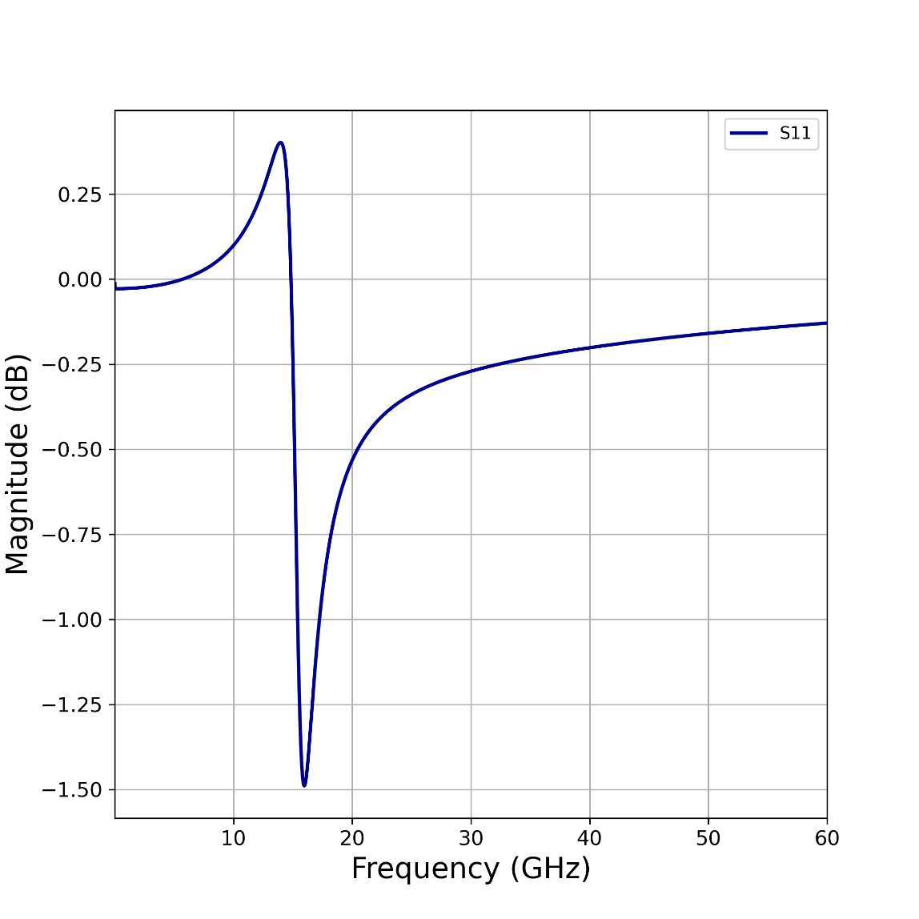

Two Stage PA
Fig.13. Two stage power amplifier
Fig.14. $S_{11}$of two stage power amplifier

Slide 18
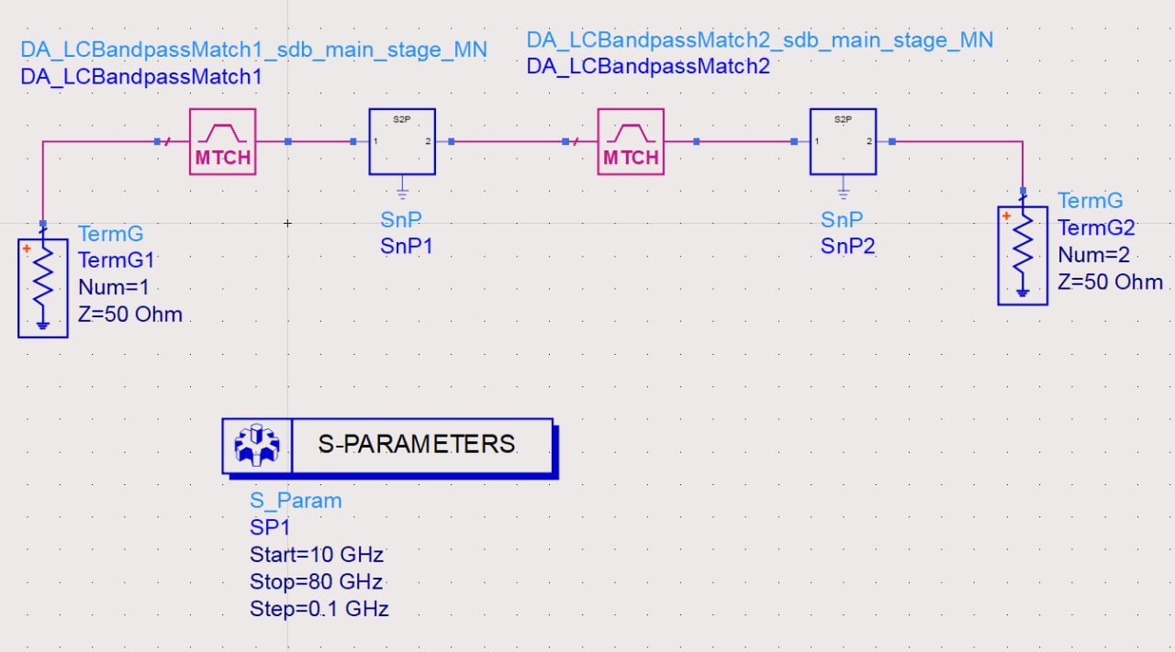
Matching Network Design
Fig.17. Input and inter-stage matching network design using ADS

Slide 19
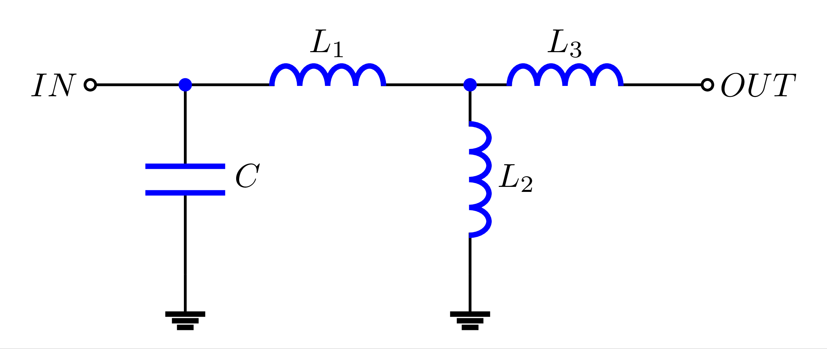
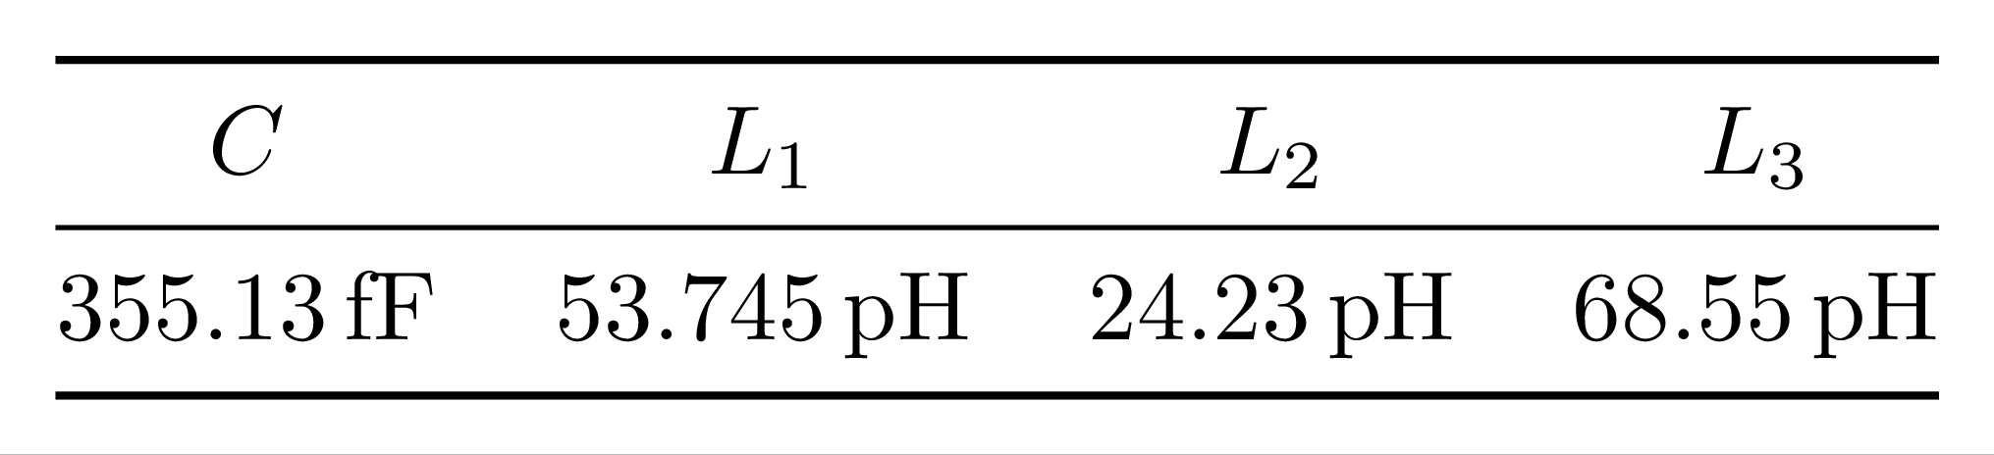
Matching Network Design
Fig.18. Input matching network

Slide 20
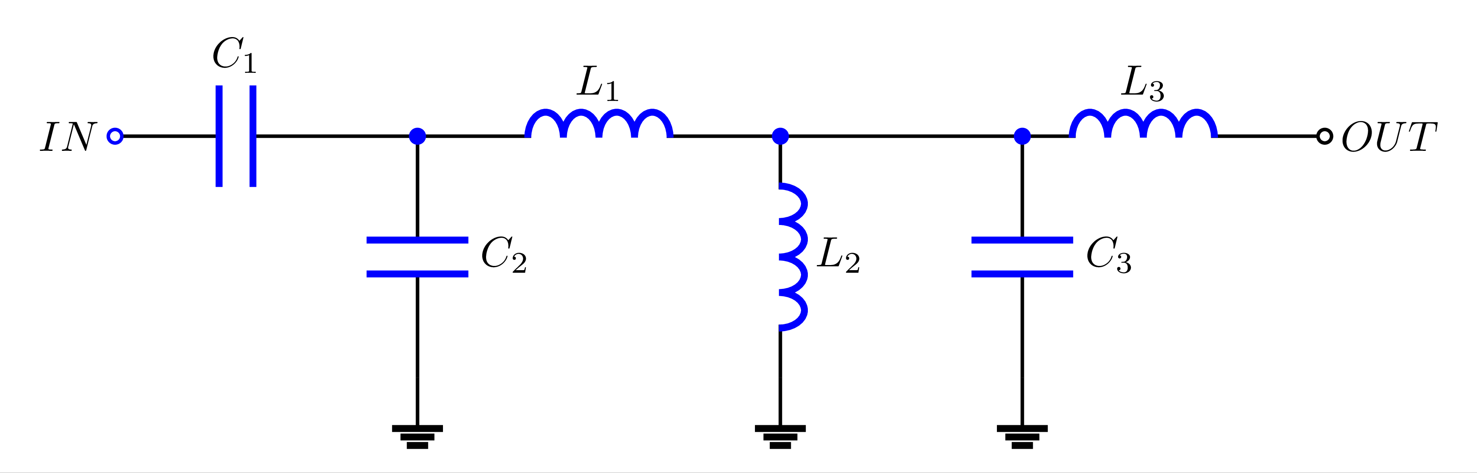
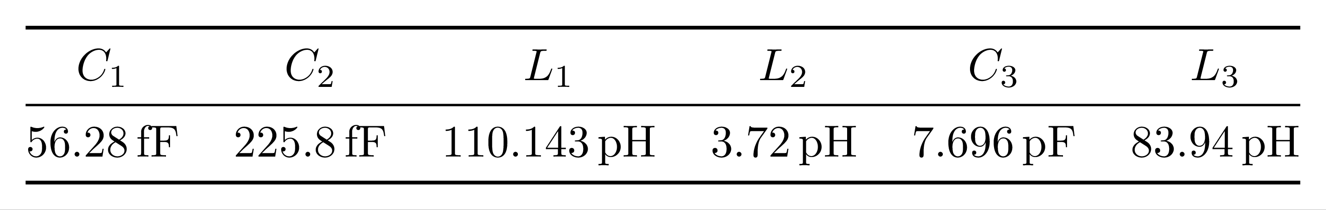
Matching Network Design
Fig.19. Inter-stage matching network

Slide 21
Two Stage PA with MN
Inter-stage matching network
Input matching network
Fig.20. Two stage power amplifier with input and inter-stage matching network.

Slide 22
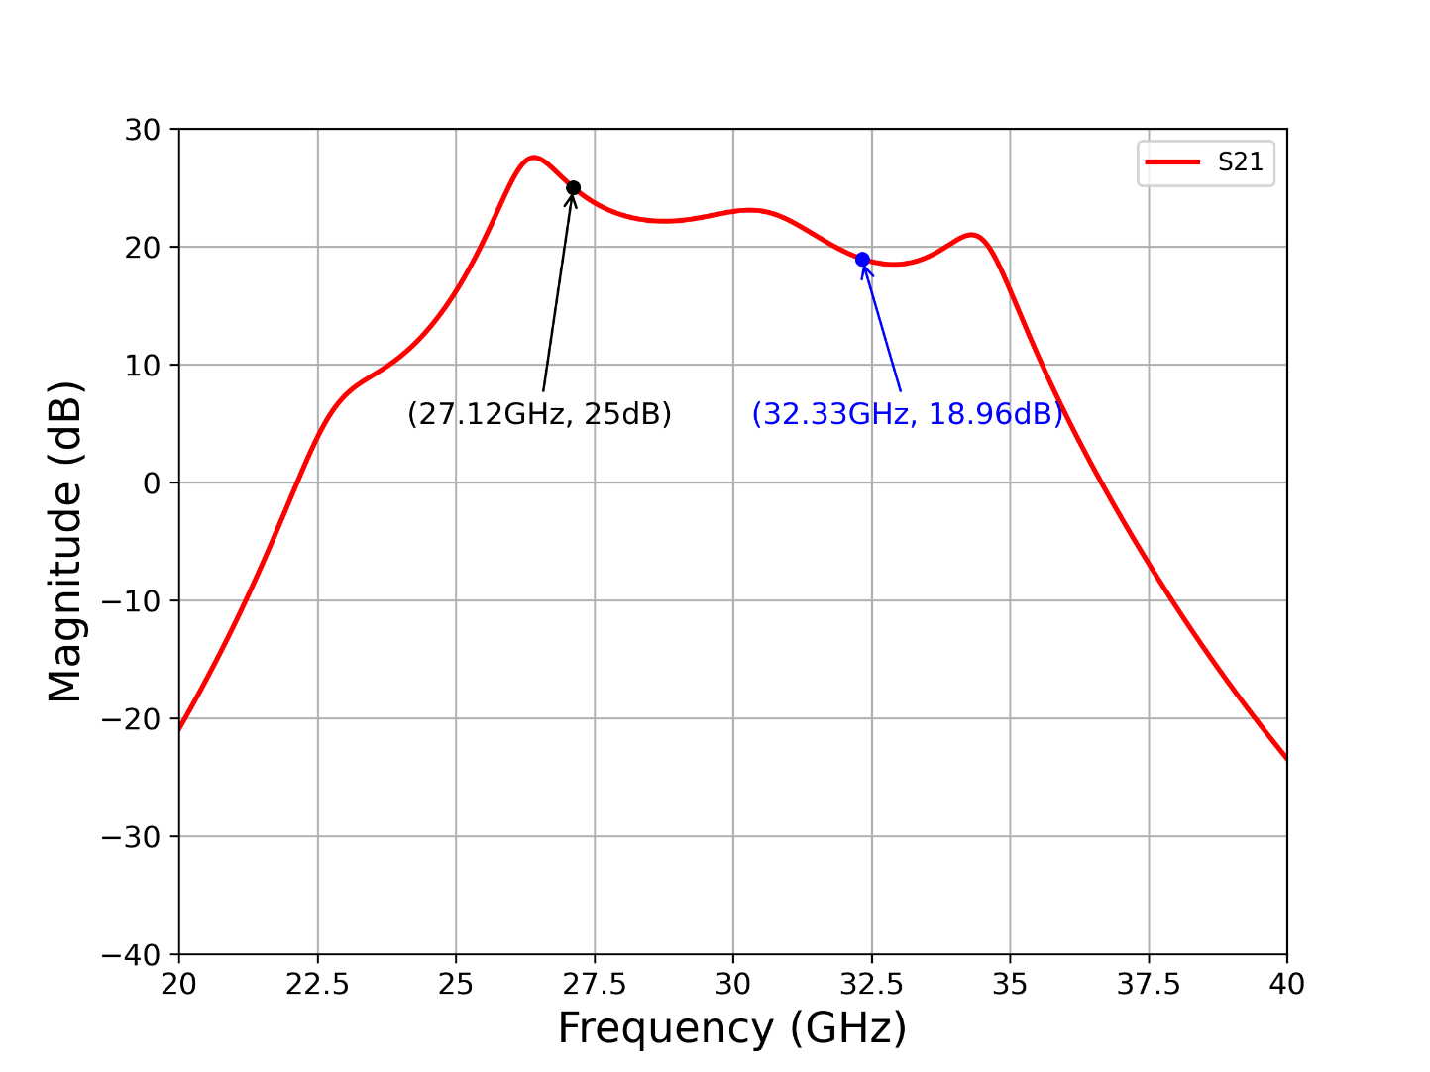
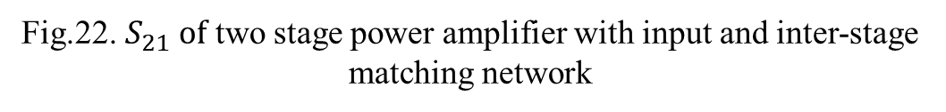
Two Stage PA with MN
Avg gain=21.78dB @ 25-35GHz
Max gain=27.55dB @ 26.41GHz
Fig.22. $S_{21} of$ two stage power amplifier with input and inter-stage matching network

Slide 23
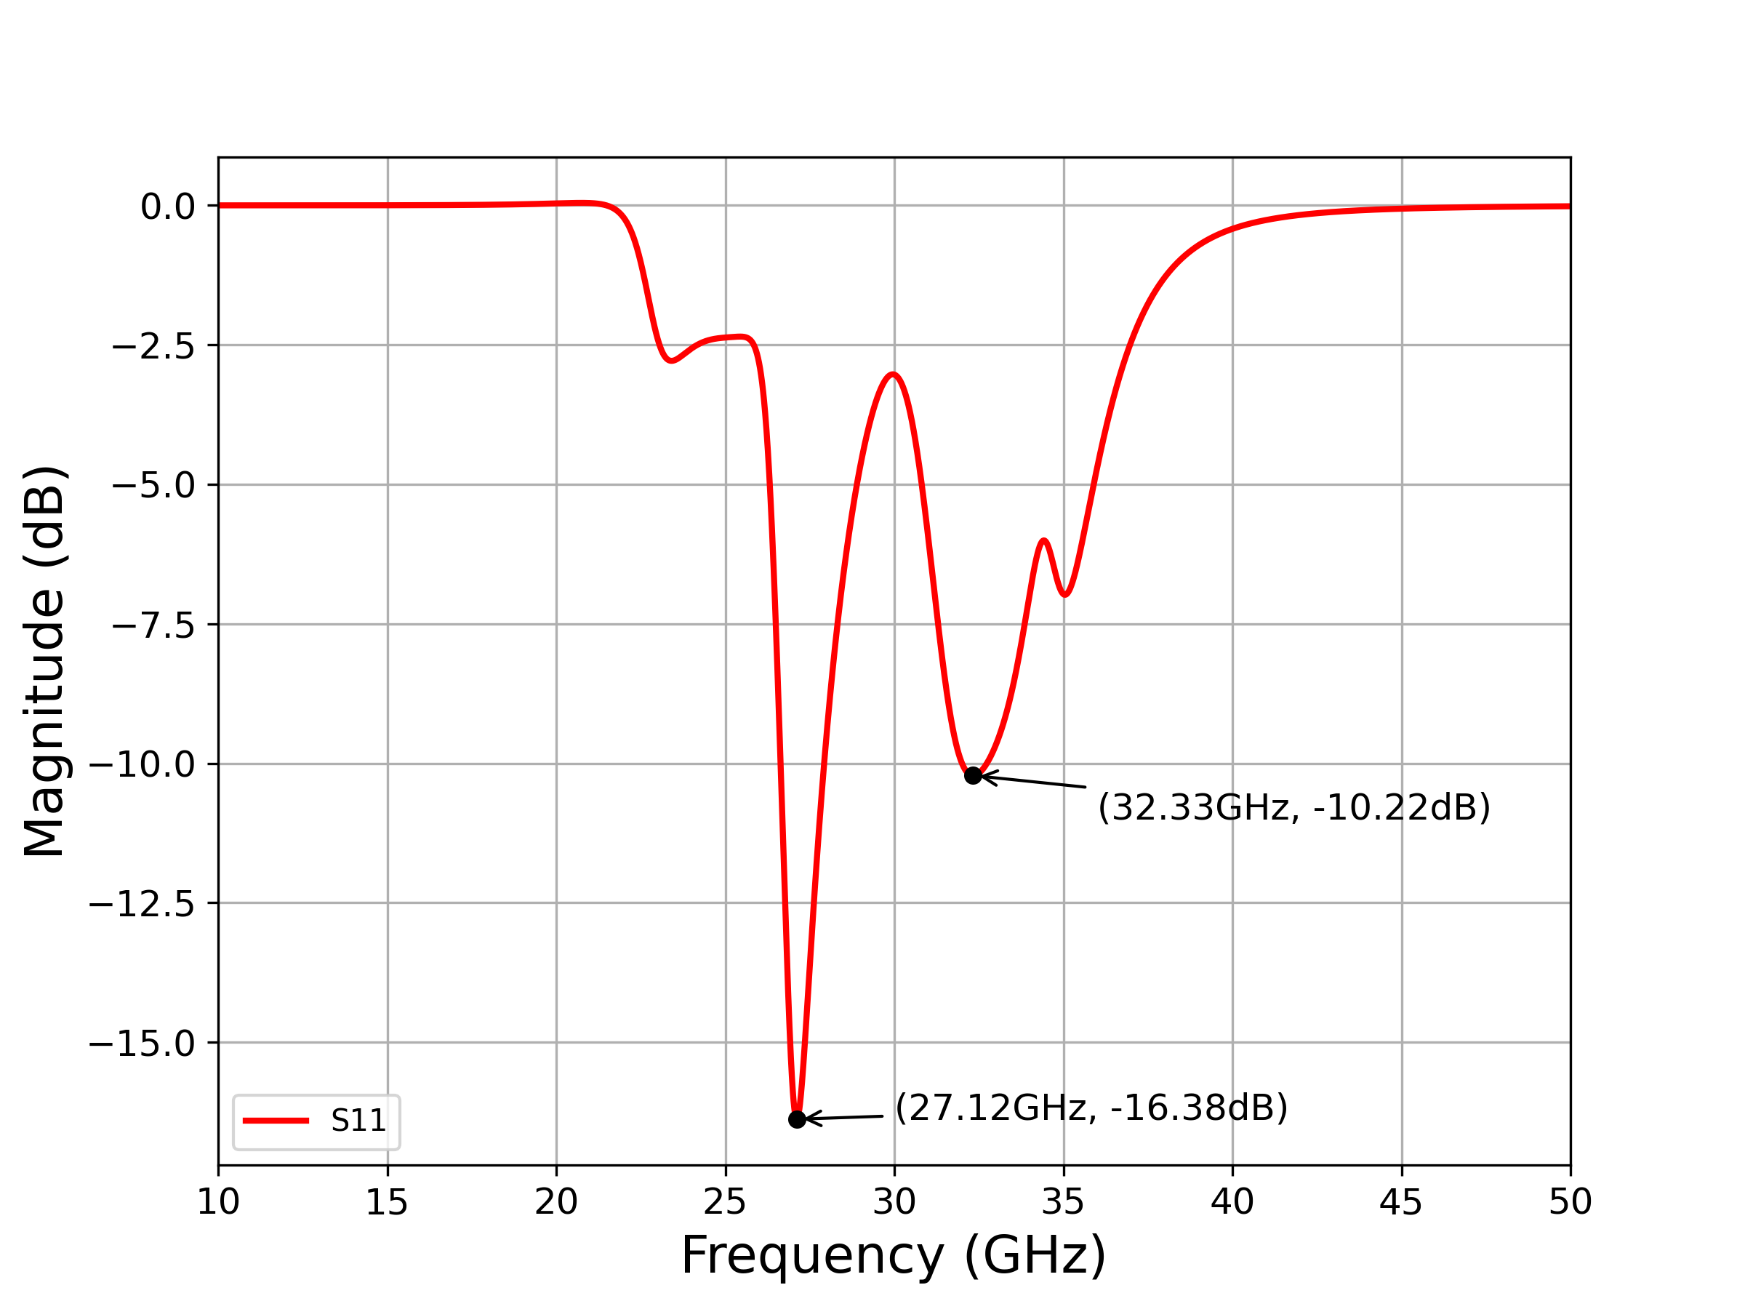
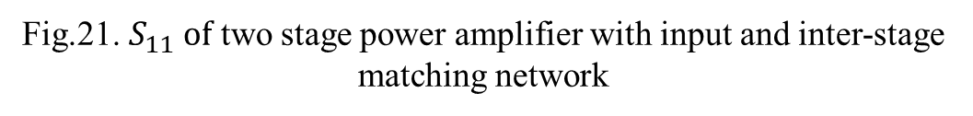
Two Stage PA with MN
Fig.21. $S_{11} of$ two stage power amplifier with input and inter-stage matching network

Slide 24
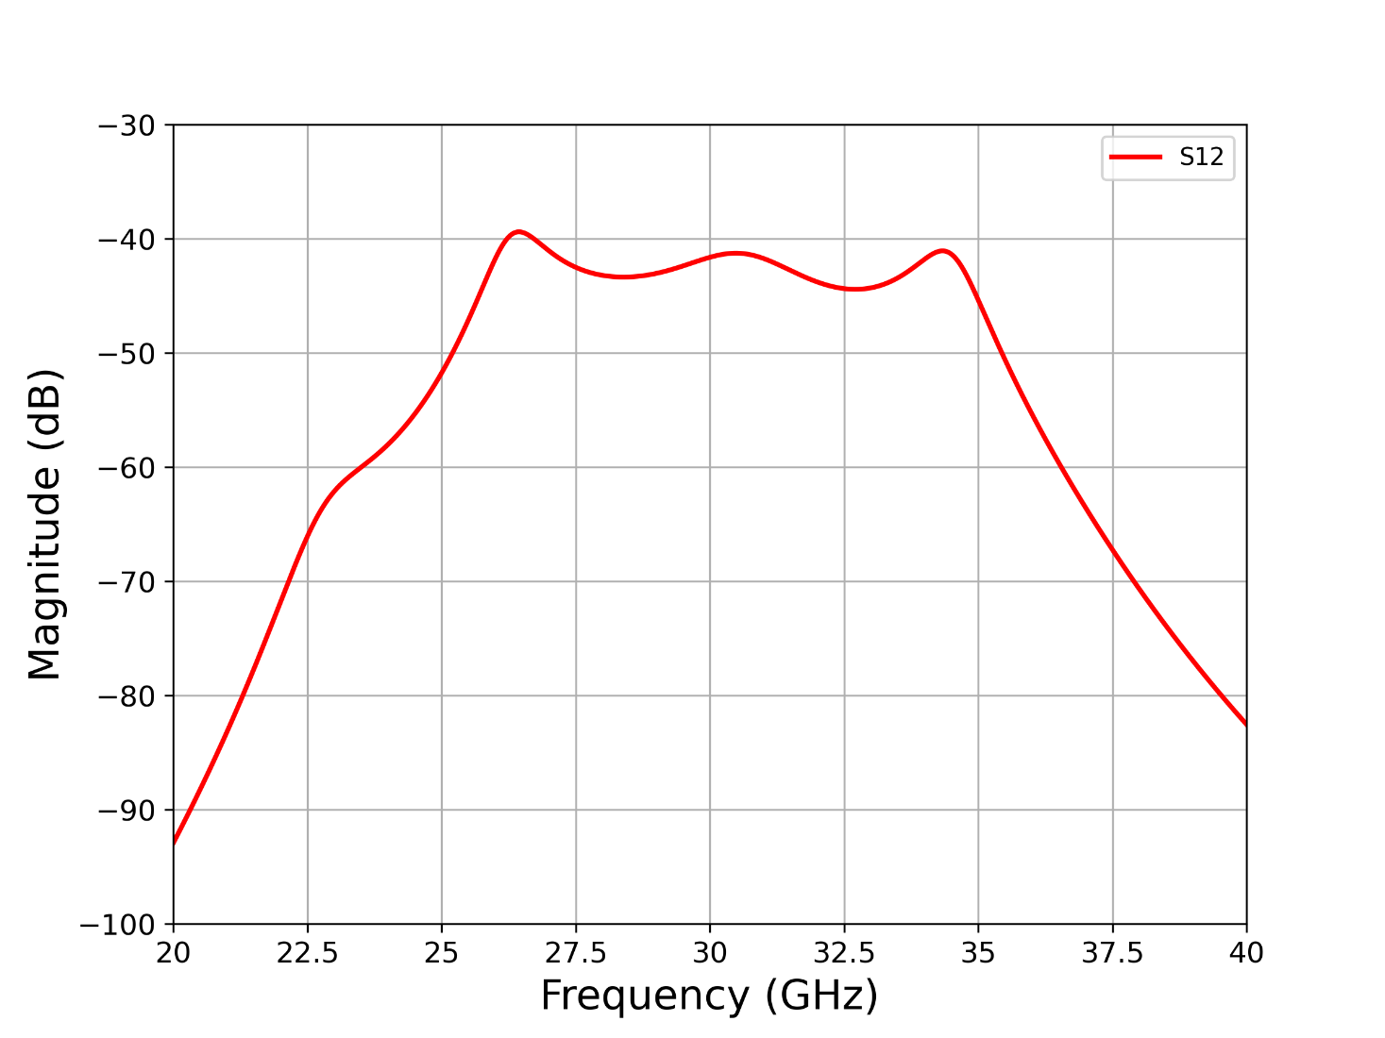
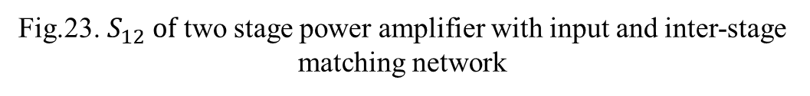
Two Stage PA with MN
Fig.23. $S_{12} of$ two stage power amplifier with input and inter-stage matching network

Slide 25
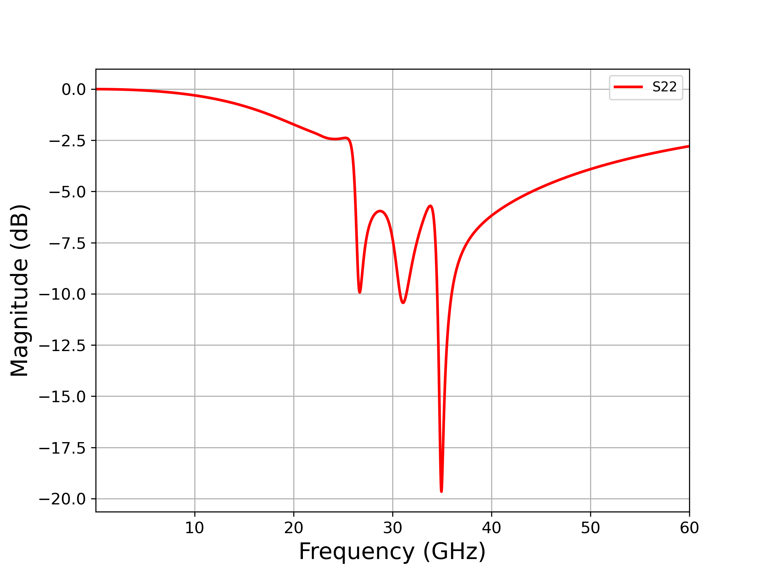
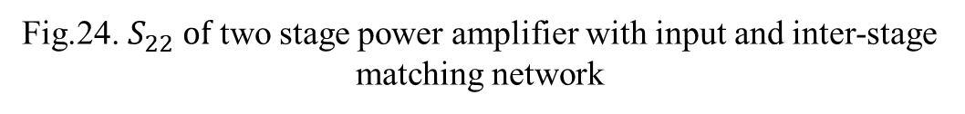
Two Stage PA with MN
Fig.24. $S_{22} of$ two stage power amplifier with input and inter-stage matching network

Slide 26
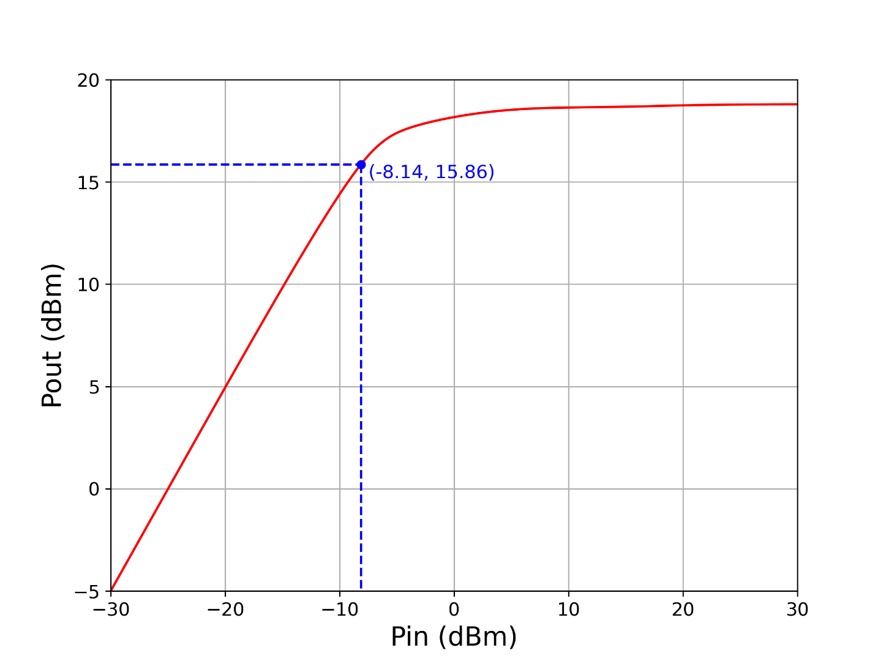
Two Stage PA with MN
Fig.25. P1db compression curve of a two-stage power amplifier
with input and inter-stage matching network.

Slide 27
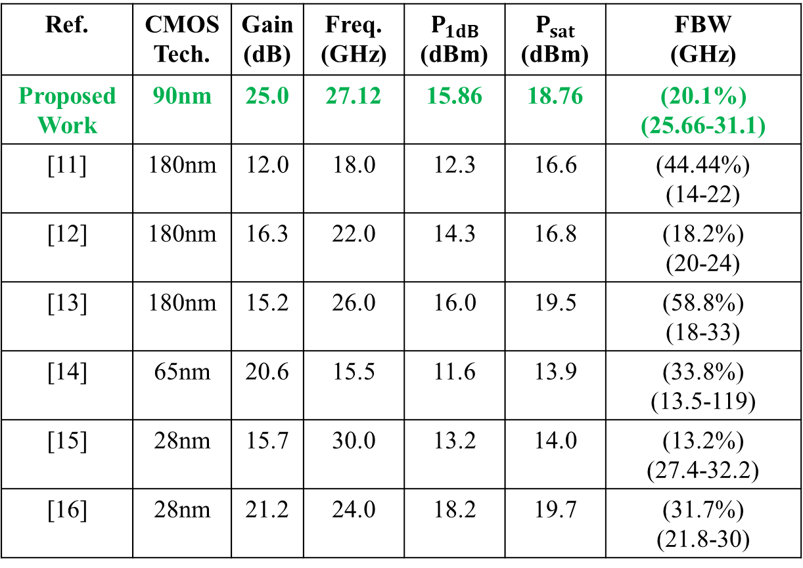
Performance Comparison Table
Ref. | CMOS Tech. | Gain (dB) | Freq. (GHz) | $$P_{1dB}$$ (dBm) | $$P_{sat}$$ (dBm) | FBW (GHz)
Proposed Work | 90nm | 25.0 | 27.12 | 15.86 | 18.76 | (20.1%) (25.66-31.1)
[11] | 180nm | 12.0 | 18.0 | 12.3 | 16.6 | (44.44%) (14-22)
[12] | 180nm | 16.3 | 22.0 | 14.3 | 16.8 | (18.2%) (20-24)
[13] | 180nm | 15.2 | 26.0 | 16.0 | 19.5 | (58.8%) (18-33)
[14] | 65nm | 20.6 | 15.5 | 11.6 | 13.9 | (33.8%) (13.5-119)
[15] | 28nm | 15.7 | 30.0 | 13.2 | 14.0 | (13.2%) (27.4-32.2)
[16] | 28nm | 21.2 | 24.0 | 18.2 | 19.7 | (31.7%) (21.8-30)

Slide 28
Conclusion
In conclusion, the study looked into CMOS power amplifier design and optimization for improved gain and bandwidth in the 25GHz to 35GHz frequency range.
Due to parasitic capacitances, the first single-stage power amplifier design had trouble matching input impedances and had lower gain. However, the cascaded power amplifier showed increased gain performance at a lower frequency by adding a second stage and using a staggered tuning strategy.
In order to achieve better impedance matching, the design also included matching networks, which led to increased gain and decreased return loss. Gain, bandwidth, and matching performance of the power amplifier were successfully increased by the optimization efforts.

Slide 29
References
[1] S. N. Ali, P. Agarwal, S. Gopal, S. Mirabbasi, and D. Heo, “A 25–35 ghz neutralized continuous class-f cmos power amplifier for 5g mobile communications achieving 26% modulation pae at 1.5 gb/s and 46.4% peak pae,” IEEE Transactions on Circuits and Systems I: Regular Papers, vol. 66, no. 2, pp. 834–847, 2019.
[2] M. Bhuiyan, Y. Zijie, J. Yu, M. B. I. Reaz, N. Kamal, and T.-G. Chang, “Active inductor based fully integrated cmos transmit/ receive switch for 2.4 ghz rf transceiver,” Anais da Academia Brasileira de Ciências, vol. 88, 05 2016.
[3] Q. Cai, W. Che, G. Shen, and Q. Xue, “Wideband high-efficiency power amplifier using d/crlh bandpass filtering matching topology,” IEEE Transactions on Microwave Theory and Techniques, vol. 67, no. 6, pp. 2393–2405, 2019.
[4] C. Ramella, A. Piacibello, R. Quaglia, V. Camarchia, and M. Pirola, “High efficiency power amplifiers for modern mobile communications: The load-modulation approach,” Electronics, vol. 6, p. 96, 11 2017.
[5] C.-C. Lin, C.-H. Yu, H.-C. Kuo, and H.-R. Chuang, “Design of 60-ghz 90-nm cmos balanced power amplifier with miniaturized quadrature hybrids,” in 2014 IEEE Topical Conference on Power Amplifiers for Wireless and Radio Applications (PAWR), pp. 52–54, 2014.

Slide 30
References (continued..)
[6] Y. Chang, Y. Wang, and H. Wang, “A k-band high-op1db common-drain power amplifier with neutralization technique in 90-nm cmos technology,” IEEE Microwave and Wireless Components Letters, vol. 29, no. 12, pp. 795–797, 2019.
[7] R.-M. Weng, C.-Y. Liu, and P.-C. Lin, “A low-power full-band low-noise amplifier for ultra-wideband receivers,” IEEE Transactions on Microwave Theory and Techniques, vol. 58, no. 8, pp. 2077–2083, 2010.
[8] R. Sapawi, R. Pokharel, M. D.A.A, H. Kanaya, and K. Yoshida, “A 0.9–3.5 ghz high linearity, good efficiency cmos broadband power amplifier using stagger tuning technique,” Microwave and Optical Technology Letters, vol. 54, 12 2012.
[9] J. Shim, T. Yang, and J. Jeong, “Design of low power cmos ultra wide band low noise amplifier using noise canceling technique,” Microelectronics Journal, vol. 44, pp. 821–826, 09 2013.
[10] M. H. Taghavi, P. Ahmadi, L. Belostotski, and J. W. Haslett, “A stagger-tuned transimpedance amplifier,” IEEE Transactions on Very Large Scale Integration (VLSI) Systems, vol. 24, no. 4, pp. 1460–1469, 2016.
[11] O. Z. Alngar, A. Barakat, and R. K. Pokharel, “High pae cmos power amplifier with
44.4% fbw using superimposed dual-band configuration and dgs inductors,” IEEE Microwave
and Wireless Components Letters, vol. 32, no. 12, pp. 1423–1426, 2022.

Slide 31
References (continued..)
[12] Y.-N. Jen, J.-H. Tsai, C.-T. Peng, and T.-W. Huang, “A 20 to 24 ghz+16.8 dbm fully integrated power amplifier using 0.18 mm cmos process,” IEEE Microwave and Wireless
Components Letters, vol. 19, no. 1, pp. 42–44, 2009.
[13] C.-W. Kuo, H.-K. Chiou, and H.-Y. Chung, “An 18 to 33 ghz fully-integrated darlington power amplifier with guanella-type transmission-line transformers in 0.18um
cmos technology,” IEEE Microwave and Wireless Components Letters, vol. 23, no. 12,
pp. 668–670, 2013.
[14] B. Chen, L. Lou, K. Tang, Y. Wang, J. Gao, and Y. Zheng, “A 13.5–19 ghz 20.6-db
gain cmos power amplifier for fmcw radar application,” IEEE Microwave and Wireless
Components Letters, vol. 27, no. 4, pp. 377–379, 2017.
[15] S. Shakib, H.-C. Park, J. Dunworth, V. Aparin, and K. Entesari, “A highly efficient and linear power amplifier for 28-ghz 5g phased array radios in 28-nm cmos,” IEEE Journal of Solid-State Circuits, vol. 51, no. 12, pp. 3020–3036, 2016.
[16] J. Lee and S. Hong, “A 24–30 ghz 31.7% fractional bandwidth power amplifier with an adaptive capacitance linearizer,” IEEE Transactions on Circuits and Systems II: Express Briefs, vol. 68, no. 4, pp. 1163–1167, 2021.

Slide 32
Thank You

Slide 33
Questions & Answer

