Slide 1
Department of Computer Science & Engineering (CSE)
Course Title: Data Structures and Algorithms-I Sessional
Shahriar Rahman Khan
Lecturer
Dept. of CSE, MIST
Course Code: CSE 204
Credit Hr: 1.50
Contact Hr: 3.00

Slide 2
Definition of Merge Sort
Merge sort is one of the most efficient sorting algorithms.
It works on the principle of Divide and Conquer.
Merge sort repeatedly breaks down a list into several sublists until each sublist consists of a single element and merging those sublists in a manner that results into a sorted list.

Slide 3
Time Complexity of Merge Sort
Time complexity of Selection, Bubble and Insertion Sort in worst case is O(n^2).
The time complexity of Merge Sort is O(n*Log n) in all the 3 cases (worst, average and best).

Slide 4
How Merge Sort Works?
Top-down Approach:
The top-down merge sort approach is the methodology which uses recursion mechanism. It starts at the Top and proceeds downwards, with each recursive turn asking the same question such as “What is required to be done to sort the array?” and having the answer as, “split the array into two, make a recursive call, and merge the results.”, until one gets to the bottom of the array-tree.

Slide 5
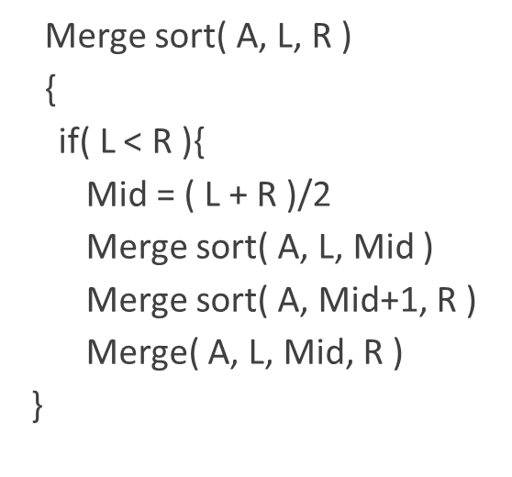
Merge Sort Algorithm

Slide 6
Let’s go to the Simulation

Slide 7
L=0
Mid=4
R=8
A
7 | 2 | 9 | 4 | 3 | 8 | 6 | 1 | 5

Slide 8
L=0
Mid=4
R=8
A
7 | 2 | 9 | 4 | 3 | 8 | 6 | 1 | 5
MS(0, 4)
L=0
Mid=2
R=4
7 | 2 | 9 | 4 | 3

Slide 9
L=0
Mid=4
R=8
A
7 | 2 | 9 | 4 | 3 | 8 | 6 | 1 | 5
MS(0, 4)
L=0
Mid=2
R=4
7 | 2 | 9 | 4 | 3
MS(0, 2)
L=0
Mid=1
R=2
7 | 2 | 9

Slide 10
L=0
Mid=4
R=8
A
7 | 2 | 9 | 4 | 3 | 8 | 6 | 1 | 5
MS(0, 4)
L=0
Mid=2
R=4
7 | 2 | 9 | 4 | 3
MS(0, 2)
L=0
Mid=1
R=2
7 | 2 | 9
MS(0, 1)
L=0
R=1
7 | 2

Slide 11
L=0
Mid=4
R=8
A
7 | 2 | 9 | 4 | 3 | 8 | 6 | 1 | 5
MS(0, 4)
L=0
Mid=2
R=4
7 | 2 | 9 | 4 | 3
MS(0, 2)
L=0
Mid=1
R=2
7 | 2 | 9
MS(0, 1)
L=0
R=1
7 | 2
MS(0, 0)
L=R=0
7

Slide 12
L=0
Mid=4
R=8
A
7 | 2 | 9 | 4 | 3 | 8 | 6 | 1 | 5
MS(0, 4)
L=0
Mid=2
R=4
7 | 2 | 9 | 4 | 3
MS(0, 2)
L=0
Mid=1
R=2
7 | 2 | 9
MS(0, 1)
L=0
R=1
7 | 2
MS(0, 0)
MS(1, 1)
L=R=0
L=R=1
7
2

Slide 13
L=0
Mid=4
R=8
A
7 | 2 | 9 | 4 | 3 | 8 | 6 | 1 | 5
MS(0, 4)
L=0
Mid=2
R=4
7 | 2 | 9 | 4 | 3
MS(0, 2)
L=0
Mid=1
R=2
7 | 2 | 9
MS(0, 1)
L=0
R=1
M(0,0,1)
2 | 7
MS(0, 0)
MS(1, 1)
L=R=0
L=R=1
7
2

Slide 14
L=0
Mid=4
R=8
A
7 | 2 | 9 | 4 | 3 | 8 | 6 | 1 | 5
MS(0, 4)
L=0
Mid=2
R=4
7 | 2 | 9 | 4 | 3
MS(0, 2)
L=0
Mid=1
R=2
7 | 2 | 9
MS(0, 1)
MS(2, 2)
L=0
R=1
L=R=2
M(0,0,1)
2 | 7
9
MS(0, 0)
MS(1, 1)
L=R=0
L=R=1
7
2

Slide 15
L=0
Mid=4
R=8
A
7 | 2 | 9 | 4 | 3 | 8 | 6 | 1 | 5
MS(0, 4)
L=0
Mid=2
R=4
7 | 2 | 9 | 4 | 3
MS(0, 2)
M(0,1,2)
L=0
Mid=1
R=2
2 | 7 | 9
MS(0, 1)
MS(2, 2)
L=0
R=1
L=R=2
M(0,0,1)
2 | 7
9
MS(0, 0)
MS(1, 1)
L=R=0
L=R=1
7
2

Slide 16
L=0
Mid=4
R=8
A
7 | 2 | 9 | 4 | 3 | 8 | 6 | 1 | 5
MS(0, 4)
L=0
Mid=2
R=4
7 | 2 | 9 | 4 | 3
MS(0, 2)
MS(3, 4)
M(0,1,2)
L=0
Mid=1
R=2
L=3
Mid=3
R=4
2 | 7 | 9
4 | 3
MS(0, 1)
MS(2, 2)
L=0
R=1
L=R=2
M(0,0,1)
2 | 7
9
MS(0, 0)
MS(1, 1)
L=R=0
L=R=1
7
2

Slide 17
L=0
Mid=4
R=8
A
7 | 2 | 9 | 4 | 3 | 8 | 6 | 1 | 5
MS(0, 4)
L=0
Mid=2
R=4
7 | 2 | 9 | 4 | 3
MS(0, 2)
MS(3, 4)
M(0,1,2)
L=0
Mid=1
R=2
L=3
Mid=3
R=4
2 | 7 | 9
4 | 3
MS(0, 1)
MS(2, 2)
MS(3, 3)
L=0
R=1
L=R=2
L=R=3
M(0,0,1)
2 | 7
9
4
MS(0, 0)
MS(1, 1)
L=R=0
L=R=1
7
2

Slide 18
L=0
Mid=4
R=8
A
7 | 2 | 9 | 4 | 3 | 8 | 6 | 1 | 5
MS(0, 4)
L=0
Mid=2
R=4
7 | 2 | 9 | 4 | 3
MS(0, 2)
MS(3, 4)
M(0,1,2)
L=0
Mid=1
R=2
L=3
Mid=3
R=4
2 | 7 | 9
4 | 3
MS(0, 1)
MS(2, 2)
MS(3, 3)
MS(4, 4)
L=0
R=1
L=R=2
L=R=3
L=R=4
M(0,0,1)
2 | 7
9
4
3
MS(0, 0)
MS(1, 1)
L=R=0
L=R=1
7
2

Slide 19
L=0
Mid=4
R=8
A
7 | 2 | 9 | 4 | 3 | 8 | 6 | 1 | 5
MS(0, 4)
L=0
Mid=2
R=4
7 | 2 | 9 | 4 | 3
MS(0, 2)
MS(3, 4)
M(0,1,2)
L=0
Mid=1
R=2
L=3
Mid=3
R=4
2 | 7 | 9
M(3,3,4)
3 | 4
MS(0, 1)
MS(2, 2)
MS(3, 3)
MS(4, 4)
L=0
R=1
L=R=2
L=R=3
L=R=4
M(0,0,1)
2 | 7
9
4
3
MS(0, 0)
MS(1, 1)
L=R=0
L=R=1
7
2

Slide 20
L=0
Mid=4
R=8
A
7 | 2 | 9 | 4 | 3 | 8 | 6 | 1 | 5
MS(0, 4)
M(0,2,4)
L=0
Mid=2
R=4
2 | 3 | 4 | 7 | 9
MS(0, 2)
MS(3, 4)
M(0,1,2)
L=0
Mid=1
R=2
L=3
Mid=3
R=4
2 | 7 | 9
M(3,3,4)
3 | 4
MS(0, 1)
MS(2, 2)
MS(3, 3)
MS(4, 4)
L=0
R=1
L=R=2
L=R=3
L=R=4
M(0,0,1)
2 | 7
9
4
3
MS(0, 0)
MS(1, 1)
L=R=0
L=R=1
7
2

Slide 21
L=0
Mid=4
R=8
A
7 | 2 | 9 | 4 | 3 | 8 | 6 | 1 | 5
MS(0, 4)
MS(5, 8)
L=0
Mid=2
R=4
L=5
Mid=6
R=8
M(0,2,4)
2 | 3 | 4 | 7 | 9
8 | 6 | 1 | 5
MS(0, 2)
MS(3, 4)
M(0,1,2)
L=0
Mid=1
R=2
L=3
Mid=3
R=4
2 | 7 | 9
M(3,3,4)
3 | 4
MS(0, 1)
MS(2, 2)
MS(3, 3)
MS(4, 4)
L=0
R=1
L=R=2
L=R=3
L=R=4
M(0,0,1)
2 | 7
9
4
3
MS(0, 0)
MS(1, 1)
L=R=0
L=R=1
7
2

Slide 22
L=0
Mid=4
R=8
A
7 | 2 | 9 | 4 | 3 | 8 | 6 | 1 | 5
MS(0, 4)
MS(5, 8)
L=0
Mid=2
R=4
L=5
Mid=6
R=8
M(0,2,4)
2 | 3 | 4 | 7 | 9
8 | 6 | 1 | 5
MS(0, 2)
MS(3, 4)
MS(5, 6)
M(0,1,2)
L=0
Mid=1
R=2
L=3
Mid=3
R=4
L=5
Mid=5
R=6
2 | 7 | 9
M(3,3,4)
3 | 4
8 | 6
MS(0, 1)
MS(2, 2)
MS(3, 3)
MS(4, 4)
L=0
R=1
L=R=2
L=R=3
L=R=4
M(0,0,1)
2 | 7
9
4
3
MS(0, 0)
MS(1, 1)
L=R=0
L=R=1
7
2

Slide 23
L=0
Mid=4
R=8
A
7 | 2 | 9 | 4 | 3 | 8 | 6 | 1 | 5
MS(0, 4)
MS(5, 8)
L=0
Mid=2
R=4
L=5
Mid=6
R=8
M(0,2,4)
2 | 3 | 4 | 7 | 9
8 | 6 | 1 | 5
MS(0, 2)
MS(3, 4)
MS(5, 6)
M(0,1,2)
L=0
Mid=1
R=2
L=3
Mid=3
R=4
L=5
Mid=5
R=6
2 | 7 | 9
M(3,3,4)
3 | 4
8 | 6
MS(0, 1)
MS(2, 2)
MS(5, 5)
MS(3, 3)
MS(4, 4)
L=0
R=1
L=R=2
L=R=3
L=R=4
L=R=5
M(0,0,1)
2 | 7
9
4
3
8
MS(0, 0)
MS(1, 1)
L=R=0
L=R=1
7
2

Slide 24
L=0
Mid=4
R=8
A
7 | 2 | 9 | 4 | 3 | 8 | 6 | 1 | 5
MS(0, 4)
MS(5, 8)
L=0
Mid=2
R=4
L=5
Mid=6
R=8
M(0,2,4)
2 | 3 | 4 | 7 | 9
8 | 6 | 1 | 5
MS(0, 2)
MS(3, 4)
MS(5, 6)
M(0,1,2)
L=0
Mid=1
R=2
L=3
Mid=3
R=4
L=5
Mid=5
R=6
2 | 7 | 9
M(3,3,4)
3 | 4
8 | 6
MS(0, 1)
MS(2, 2)
MS(5, 5)
MS(6, 6)
MS(3, 3)
MS(4, 4)
L=0
R=1
L=R=2
L=R=3
L=R=4
L=R=5
L=R=6
M(0,0,1)
2 | 7
9
4
3
8
6
MS(0, 0)
MS(1, 1)
L=R=0
L=R=1
7
2

Slide 25
L=0
Mid=4
R=8
A
7 | 2 | 9 | 4 | 3 | 8 | 6 | 1 | 5
MS(0, 4)
MS(5, 8)
L=0
Mid=2
R=4
L=5
Mid=6
R=8
M(0,2,4)
2 | 3 | 4 | 7 | 9
8 | 6 | 1 | 5
MS(0, 2)
MS(3, 4)
MS(5, 6)
M(0,1,2)
L=0
Mid=1
R=2
L=3
Mid=3
R=4
L=5
Mid=5
R=6
2 | 7 | 9
M(3,3,4)
3 | 4
M(5,5,6)
6 | 8
MS(0, 1)
MS(2, 2)
MS(5, 5)
MS(6, 6)
MS(3, 3)
MS(4, 4)
L=0
R=1
L=R=2
L=R=3
L=R=4
L=R=5
L=R=6
M(0,0,1)
2 | 7
9
4
3
8
6
MS(0, 0)
MS(1, 1)
L=R=0
L=R=1
7
2

Slide 26
L=0
Mid=4
R=8
A
7 | 2 | 9 | 4 | 3 | 8 | 6 | 1 | 5
MS(0, 4)
MS(5, 8)
L=0
Mid=2
R=4
L=5
Mid=6
R=8
M(0,2,4)
2 | 3 | 4 | 7 | 9
8 | 6 | 1 | 5
MS(0, 2)
MS(3, 4)
MS(5, 6)
MS(7, 8)
M(0,1,2)
L=0
Mid=1
R=2
L=3
Mid=3
R=4
L=5
Mid=5
R=6
L=7
Mid=7
R=8
2 | 7 | 9
M(3,3,4)
3 | 4
M(5,5,6)
6 | 8
1 | 5
MS(0, 1)
MS(2, 2)
MS(5, 5)
MS(6, 6)
MS(3, 3)
MS(4, 4)
L=0
R=1
L=R=2
L=R=3
L=R=4
L=R=5
L=R=6
M(0,0,1)
2 | 7
9
4
3
8
6
MS(0, 0)
MS(1, 1)
L=R=0
L=R=1
7
2

Slide 27
L=0
Mid=4
R=8
A
7 | 2 | 9 | 4 | 3 | 8 | 6 | 1 | 5
MS(0, 4)
MS(5, 8)
L=0
Mid=2
R=4
L=5
Mid=6
R=8
M(0,2,4)
2 | 3 | 4 | 7 | 9
8 | 6 | 1 | 5
MS(0, 2)
MS(3, 4)
MS(5, 6)
MS(7, 8)
M(0,1,2)
L=0
Mid=1
R=2
L=3
Mid=3
R=4
L=5
Mid=5
R=6
L=7
Mid=7
R=8
2 | 7 | 9
M(3,3,4)
3 | 4
M(5,5,6)
6 | 8
1 | 5
MS(0, 1)
MS(2, 2)
MS(5, 5)
MS(6, 6)
MS(7, 7)
MS(3, 3)
MS(4, 4)
L=0
R=1
L=R=2
L=R=3
L=R=4
L=R=5
L=R=6
L=R=7
M(0,0,1)
2 | 7
9
4
3
8
6
1
MS(0, 0)
MS(1, 1)
L=R=0
L=R=1
7
2

Slide 28
L=0
Mid=4
R=8
A
7 | 2 | 9 | 4 | 3 | 8 | 6 | 1 | 5
MS(0, 4)
MS(5, 8)
L=0
Mid=2
R=4
L=5
Mid=6
R=8
M(0,2,4)
2 | 3 | 4 | 7 | 9
8 | 6 | 1 | 5
MS(0, 2)
MS(3, 4)
MS(5, 6)
MS(7, 8)
M(0,1,2)
L=0
Mid=1
R=2
L=3
Mid=3
R=4
L=5
Mid=5
R=6
L=7
Mid=7
R=8
2 | 7 | 9
M(3,3,4)
3 | 4
M(5,5,6)
6 | 8
1 | 5
MS(0, 1)
MS(2, 2)
MS(5, 5)
MS(6, 6)
MS(7, 7)
MS(8, 8)
MS(3, 3)
MS(4, 4)
L=0
R=1
L=R=2
L=R=3
L=R=4
L=R=5
L=R=6
L=R=7
L=R=8
M(0,0,1)
2 | 7
9
4
3
8
6
1
5
MS(0, 0)
MS(1, 1)
L=R=0
L=R=1
7
2

Slide 29
L=0
Mid=4
R=8
A
7 | 2 | 9 | 4 | 3 | 8 | 6 | 1 | 5
MS(0, 4)
MS(5, 8)
L=0
Mid=2
R=4
L=5
Mid=6
R=8
M(0,2,4)
2 | 3 | 4 | 7 | 9
8 | 6 | 1 | 5
MS(0, 2)
MS(3, 4)
MS(5, 6)
MS(7, 8)
M(0,1,2)
L=0
Mid=1
R=2
L=3
Mid=3
R=4
L=5
Mid=5
R=6
L=7
Mid=7
R=8
2 | 7 | 9
M(3,3,4)
3 | 4
M(5,5,6)
6 | 8
M(7,7,8)
1 | 5
MS(0, 1)
MS(2, 2)
MS(5, 5)
MS(6, 6)
MS(7, 7)
MS(8, 8)
MS(3, 3)
MS(4, 4)
L=0
R=1
L=R=2
L=R=3
L=R=4
L=R=5
L=R=6
L=R=7
L=R=8
M(0,0,1)
2 | 7
9
4
3
8
6
1
5
MS(0, 0)
MS(1, 1)
L=R=0
L=R=1
7
2

Slide 30
L=0
Mid=4
R=8
A
7 | 2 | 9 | 4 | 3 | 8 | 6 | 1 | 5
MS(0, 4)
MS(5, 8)
L=0
Mid=2
R=4
L=5
Mid=6
R=8
M(0,2,4)
2 | 3 | 4 | 7 | 9
M(5, 6, 8)
1 | 5 | 6 | 8
MS(0, 2)
MS(3, 4)
MS(5, 6)
MS(7, 8)
M(0,1,2)
L=0
Mid=1
R=2
L=3
Mid=3
R=4
L=5
Mid=5
R=6
L=7
Mid=7
R=8
2 | 7 | 9
M(3,3,4)
3 | 4
M(5,5,6)
6 | 8
M(7,7,8)
1 | 5
MS(0, 1)
MS(2, 2)
MS(5, 5)
MS(6, 6)
MS(7, 7)
MS(8, 8)
MS(3, 3)
MS(4, 4)
L=0
R=1
L=R=2
L=R=3
L=R=4
L=R=5
L=R=6
L=R=7
L=R=8
M(0,0,1)
2 | 7
9
4
3
8
6
1
5
MS(0, 0)
MS(1, 1)
L=R=0
L=R=1
7
2

Slide 31
L=0
Mid=4
R=8
M(0, 4, 8)
A
1 | 2 | 3 | 4 | 5 | 6 | 7 | 8 | 9
MS(0, 4)
MS(5, 8)
L=0
Mid=2
R=4
L=5
Mid=6
R=8
M(0,2,4)
2 | 3 | 4 | 7 | 9
M(5, 6, 8)
1 | 5 | 6 | 8
MS(0, 2)
MS(3, 4)
MS(5, 6)
MS(7, 8)
M(0,1,2)
L=0
Mid=1
R=2
L=3
Mid=3
R=4
L=5
Mid=5
R=6
L=7
Mid=7
R=8
2 | 7 | 9
M(3,3,4)
3 | 4
M(5,5,6)
6 | 8
M(7,7,8)
1 | 5
MS(0, 1)
MS(2, 2)
MS(5, 5)
MS(6, 6)
MS(7, 7)
MS(8, 8)
MS(3, 3)
MS(4, 4)
L=0
R=1
L=R=2
L=R=3
L=R=4
L=R=5
L=R=6
L=R=7
L=R=8
M(0,0,1)
2 | 7
9
4
3
8
6
1
5
MS(0, 0)
MS(1, 1)
L=R=0
L=R=1
7
2

Slide 32
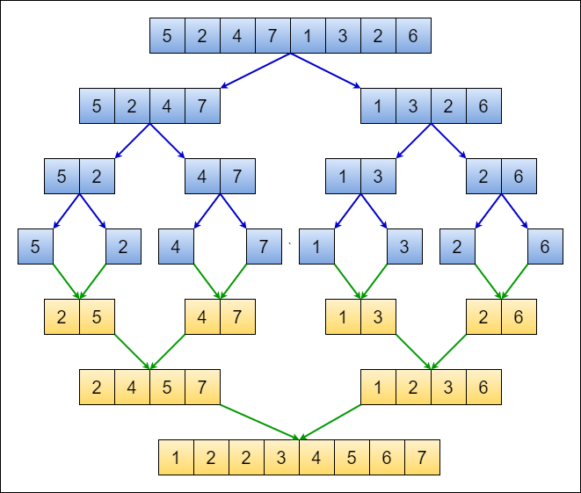

Slide 34
How Merge Function Works

Slide 35
i
j
2 | 3 | 4
1 | 5
k

Slide 36
i
j
2 | 3 | 4
1 | 5
k
1

Slide 37
i
j
2 | 3 | 4
1 | 5
k
2
1

Slide 38
i
j
2 | 3 | 4
1 | 5
k
3
1 | 2

Slide 39
i
j
2 | 3 | 4
1 | 5
k
4
1 | 2 | 3

Slide 40
i
j
2 | 3 | 4
1 | 5
k
5
1 | 2 | 3 | 4

Slide 42
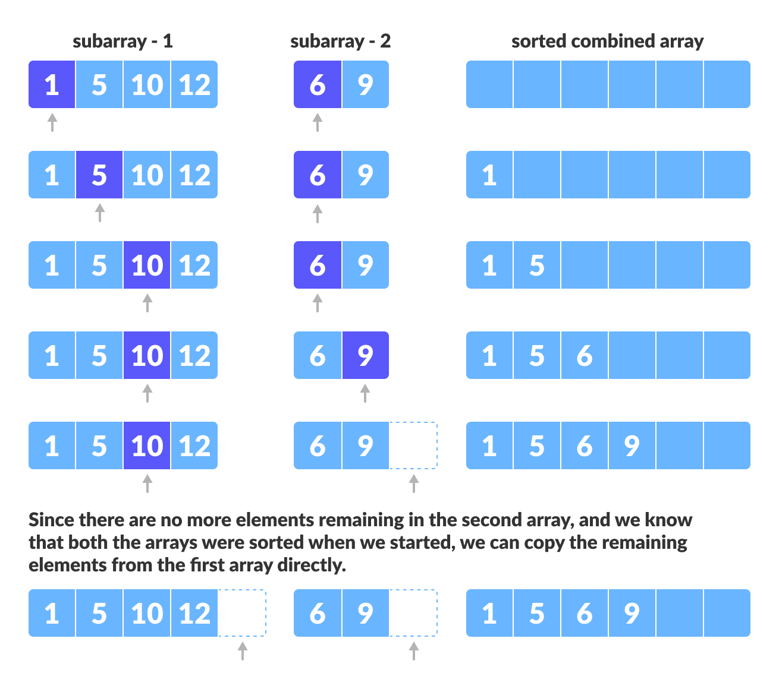

Slide 43
What’s the real scenario actually??
7 | 2 | 9 | 4 | 3 | 8 | 6 | 1 | 5

Slide 44

Enjoying the Class??
Okay! Then let’s dive into some coding

Slide 45
Drawbacks of Merge Sort
Slower comparative to the other sort algorithms for smaller tasks.
Merge sort algorithm requires an additional memory space of 0(n) for the temporary array.
It goes through the whole process even if the array is sorted.

Slide 46
Good news!
The class is over…
Thank you!

