Slide 1
Department of Computer Science & Engineering (CSE)
Course Title: Data Structures and Algorithms-I Sessional
Shahriar Rahman Khan
Lecturer
Dept. of CSE, MIST
Course Code: CSE 204
Credit Hr: 1.50
Contact Hr: 3.00

Slide 2
Some Real Life Scenarios
Scenario 1
Scenario 2

Slide 3
What is Stack?
Stack??
Stack??
Stack??
Stack??
Stack??

Slide 4
Definition of Stack
A stack is a data structure in which items can be inserted only from one end and get items back from the same end.

Slide 5
Difference Between Linear Data Structures
Data Structure
Linear Data Structure
Non Linear Data Structure
Array
Linked List
Stack

Slide 6
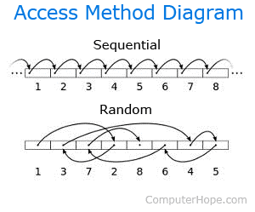
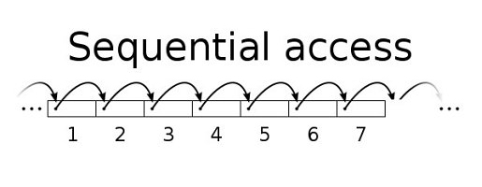
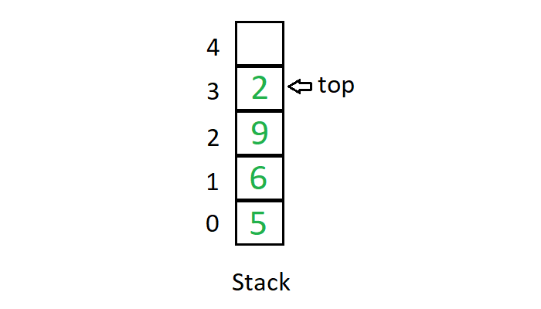
Difference Between Linear Data Structures
Array
Random Access in a constant time
Linked List
Sequential Access is possible
Stack
Limited Access is possible

Slide 7
Going Deep Into Stack
LET’S GO!!

Slide 8
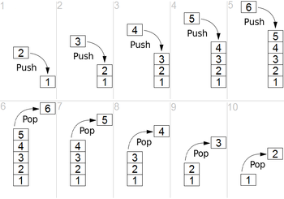
Stack Rules
Insertion and deletion is only possible from one end, that’s from top
You can’t insert or delete an element from bottom or left or right

Slide 9
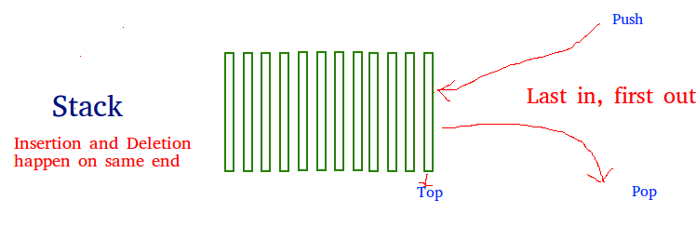
Stack Order
Consider an example of plates stacked over one another in the canteen. The plate which is at the top is the first one to be removed, i.e. the plate which has been placed at the bottommost position remains in the stack for the longest period of time. So, it can be simply seen to follow LIFO(Last In First Out)/FILO(First In Last Out) order.

Slide 10
Stack Operations
Push(x) - to insert element in the Stack.
Pop() - to delete element from stack.
Peek()/Top() - to display element at top.
isEmpty() - to check if the Stack is empty or not.
isFull() - to check if the Stack is full or not.
Except these basic operations, you can do many operations like Sorting array using Stacks, Reverse individual words, find the min or max value from the stack, reverse the stack etc.

Slide 11
Push(X) Operation
Let, This is our stack.
Now if we push an element in this stack, what will happen?
Let, we call the function push(5).
It seems like, the element has dropped in the bottom of the stack.
Then if we push second element, let’s say push(7).
It has dropped on top of the element 5.
Now, is it possible that, if we want the next element to be at index 3?
The answer is NO! The next element will always drop on the current top element.
4
3
2
1
0
6
7
5
Stack SIZE=5

Slide 12
Overflow Condition
8
Let, we call the function push(2).
Then, we call the function push(3).
Then, we call the function push(6).
Now, if we push the 6th element, let’s say push(8). What will happen?
Yes, it will not be able to push in the stack, as the stack has reached it’s maximum size, which is 5.
This is called overflow condition of stack.
4
3
2
1
0
6
3
2
7
5
Stack SIZE=5

Slide 13
Pop() Operation
Now let’s say, we want to delete the element at index 2.
Can we do that without hampering the elements at index 3 and index 4?
No, we can’t do that as long as this is stack!
First, we have to delete/remove/ pop the element at index 4.
Then, we have to delete/remove/ pop the element at index 3.
Finally, we have to delete/remove/ pop the element at index 2.
So, have you understood the concept LIFO – Last In First Out? We pushed the element 6 at last, but we are popping out element 6 at first. That’s LIFO.
4
3
2
1
0
6
3
2
7
5
Stack SIZE=5

Slide 14
Underflow condition
Now, let’s pop out the element at index 1 and index 0.
We call the function Pop(). That will pop out 7.
Then, we again call the function Pop(). That will pop out 5 from the stack.
Now, we try to call the function Pop() again. What do you think will happen?
There is nothing in the stack, the stack is empty.
So, if we try to pop out something from an empty stack, the situation will be called underflow Condition of a stack.
I hope, you have understood the push and pop function and the overflow and underflow condition.
4
3
2
1
0
7
5
Stack SIZE=5

Slide 15
Top variable
Now, how to track which element is on top of the stack?
To do that, a variable named top is introduced.
Initially, the value of the top = -1.
Top = -1 means the stack is empty. So, before pushing an element into the stack, top must be incremented. That’s top++.
Now, if we insert the next element 7, what should be done?
Two steps:
Increment the top variable: top++
Insert the element in the top position, array[top]=7
4
3
2
1
0
7
5
top
Stack SIZE=5

Slide 16
Top variable
Now, when we pop something, what do we do?
We delete the topmost element from the stack.
If we want to return the topmost element, then the steps are:
Store the topmost value in a variable: temp = arr[top]
Decrement variable top: top --
Return temp
If we don’t want to return the topmost element, just want to delete it, then
We simply just decrement top: top --
Suppose, we decrement top. What will happen to element 7?
It will be treated as garbage value.
Next time, when I will push an element (say 3) to the stack, it will overwrite 7.
4
3
2
1
0
top
7
3
5
Stack SIZE=5

Slide 17

Enjoying the Class??
IF NO, THEN LET’S HAVE A 5 MINUTES BREAK!!

Slide 18
Understanding Memory Structure
So far, we have talked about stack, but what do we need to create a stack?
An array to store elements of a stack
Variable named top
Size of the array
Now, suppose you have to maintain 1000 stacks, will you declare these variables 1000 times?
Then, what’s the solution? Using class!
class Stack{
int top;
int capacity;
int *arr; };
Now, in future, whatever number of stacks we may need, we just have to declare a variable of Stack type, where we can access these 3 variables automatically.
4
3
2
1
0
top
7
5
Stack SIZE=5

Slide 19
Understanding Memory Structure
class Stack{
int top;
int capacity;
int *arr; };
Now for this Stack, we are declaring an object of this Stack class.
Stack s1(5);
4
3
2
1
0
top
7
d
top
5
capacity
arr
Stack SIZE=5

Slide 20
Understanding Memory Structure
class Stack{
int top;
int capacity;
int *arr; }
Now we have to create this array, and the address of this array will be stored in *arr.
arr = new int[capacity];
1016
1012
1008
1004
1000
d
top
capacity
(base address)
arr
1000
top
Stack SIZE=5

Slide 21


Still Enjoying the Class??
OKAY! THEN LET’S DIVE INTO SOME CODING

Slide 22
Declaration of Stack
Stack(int n){
top=-1;
capacity=n;
arr = new int[capacity];
}
int main(){
Stack stk(5);
}
1016
1012
1008
1004
1000
d
top
-1
capacity
5
(base address)
arr
1000
top
Stack SIZE=5

Slide 23
Stack Using Dynamic Array
A LITTLE BIT MORE CONCEPT

Slide 24
Basic of Dynamic Array
In previous case, there was a condition called overflow condition, when stack reached it’s maximum capacity.
Now what’s the solution to overcome this problem?
Yes, dynamic array!
What we will do now is, we will follow these steps:
We will keep pushing elements into the stack
Check if the stack is full
If full, then create an array of double capacity
Copy all the element from previous array to new array
Release the memory of previous array
Go to step 1
As we are increasing the size of array during runtime, that’s why this is called stack using dynamic array.
4
3
2
1
0
7
5
Stack SIZE=5

Slide 25
6
7
1
2
4
6
7
1
2
4
8
8
9
9
6
7
1
2
4
6
7
d
top
1
capacity
2
arr
1000
2000
4

Slide 26
Stack Using Linked List
A LITTLE BIT MORE CONCEPT

Slide 27
Stack Using Linked List
Here, we have to implement stack using linked list, but with restrictions.
We know in stack, insertion and deletion is done only from one end!
The behavior of stack can be easily implement in Linked List.
We already know how to create a linked list.
To insert a new node:
First we create a new node
It has an address
Now we have to insert it in linked list from one end, only then it will perform as stack.
It has 2 ways:
At end of the list (tail)
At beginning of the list (head)
100
200
400
head
100
2 | 200
NULL
4 | 400
6 | 0
450
3

Slide 28
Stack Using Linked List
Here, Inserting/deleting a node at end of the linked list takes O(n) time.
But in stack, operations like push(x), pop(), isEmpty() these takes O(1) time.
To insert a new node at end of list:
Go to first node, then next node, then next node
After reaching last node, insert the node
100
200
400
head
100
NULL
2 | 200
4 | 400
6 | 0
450
3 | 0

Slide 29
Stack Using Linked List
Here, Inserting/deleting a node at end of the linked list takes O(n) time.
But in stack, operations like push(x), pop(), isEmpty() these takes O(1) time.
To insert a new node at end of list:
Go to first node, then next node, then next node
After reaching last node, insert the node
To delete last node, it follows same process
Go to first node, then next node, then next node
After reaching the second last node, break the link with last node
Set the address field to 0
Release memory of the last node
Both operation takes O(n) time
450
3
100
200
400
head
100
2 | 200
NULL
4 | 400
6 | 0

Slide 30
Stack Using Linked List
So, how to insert/delete from beginning of the linked list?
100
200
400
head
2 | 200
NULL
4 | 400
6 | 0
450
450
3 | 100

Slide 31
Your Task for Next Week
Implement stack using Linked List
Change the code if necessary
Details of the assignment will be given soon
Don’t be afraid, it’s easy, if you have followed this class and previous classes carefully!!

Slide 32
GOOD NEWS! THE CLASS IS OVER… THANK YOU

