Slide 1
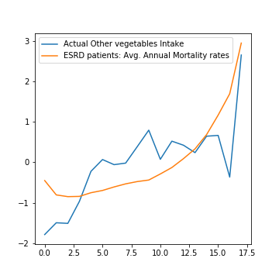
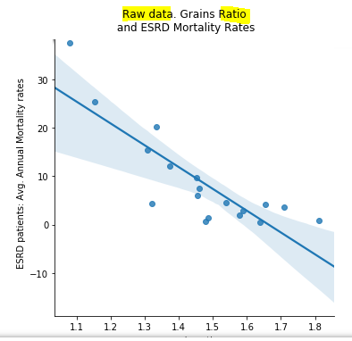
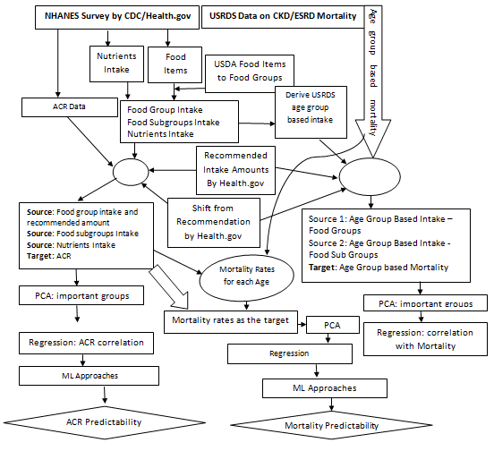
2018-2019 M.Sc. in Data Science and Analytics
Dietary patterns on the cause (ACR) and mortality of Chronic Kidney Disease (CKD) patients
Sayed Ahmed Supervisor: Dr. Youcef Derbal
Chronic kidney disease (CKD) leading to End Stage Renal Disease (ESRD) is very prevalent today such as over 30 millions of Americans have CKD. CKD/ESRD and other interrelated diseases such as Hypertension, Heart Diseases, and Diabetes cause a majority of the early deaths. In addition to kidney failure, CKD is also a major cause of death from stroke, and heart diseases. Studies show that drugs as well as lifestyle choices can prevent CKD, slow the progression of CKD, delay dialysis and kidney transplantation; consequently can prevent early deaths. There are many studies on the effect of drugs to control CKD and related complications. However, there are few studies on the effect of diets and lifestyles on the cause (ACR) and mortality of CKD patients. This research has identified the association between dietary patterns and mortality/survival of CKD patients. This research also studied the effect of dietary patterns on CKD measures such as Albumin Creatinine ratio.
Objective
CKD patients commonly are given dietary advice based on individual nutrients or chemicals or on individual food items instead of whole eating patterns. That advice is challenging to adhere to. There is limited evidence that adherence can prevent clinical complications. Studying the whole dietary patterns rather than single nutrient or food item is an emerging trend for CKD/ESRD patient diets.
Chen at al. found that higher plant protein ratio causes lower mortality for patients in stage 3 or higher ( eGFR < 60) though not for stage 1 and 2. Gutiérrez et al’s study on 5 empirically derived dietary patterns found that diets rich in processed and fried foods were associated with higher mortality in CKD patients. However, diets rich in fruits and vegetables were found to be protective. Study by Huang et al on Mediterranean diet found that adhering to this diet has a lower likelihood of having CKD in elderly men. They also found that adherence can improve survival. Study by Muntner et al. on Life’s Simple 7 factors’ (Smoke, Activity, BMI, Diet, Blood Pressure, Cholesterol, and Glucose) effect in getting ESRD shows that people who have ideal scores in more of these factors have lower likelihood of getting ESRD. Study by Suruya et al found that patients with unbalanced diet were more likely to have adverse clinical outcomes. Ricardo et al found that adherence to a healthy lifestyle was associated with lower all-cause mortality risk in CKD.
Most of the studies primarily used statistical methods such as regression, Cox’s hazard model of regression, and PCA in very few cases. Primarily direct clinical data of patients for several years were studied. One study also used dataset from CDC and NHANES. This research primarily utilized public datasets. For association and prediction, PCA, Regression, and several machine learning approaches are heavily utilized. For food groups and subgroups categorization utilized the USDA categorization. Recommended amounts for food groups provided by CDC/Health.gov is used
Food Groups and Mortality
Grains (-0.84) and Fruits (-0.43) have strong negative correlations with CKD mortality. Data shows that when Grains and Fruits are taken less, mortality is high. Vegetables show positive (0.58) correlation i.e. when vegetables intakes are high, mortality is also high. This contradicts with other study and doctors’ recommendation. As ratio to high recommended amount used and the correlation is not very strong, moderate vegetable intake for older patients can be further studied.
Food Subgroups and Mortality
Other vegetables (0.68), Red and orange vegetables (0.55), and Starchy vegetables (0.44) have positive correlations with mortality. Data Exploration shows that mortality is low when the intake amounts are low, and mortality is high when intake amounts are high. Food subgroups such as Alcoholic beverages (-0.79), Added Sugars/Sugars and sweets (-0.64), Whole grains (-0.61), and ‘Nuts, Seeds, and Soy Products’ (-0.55) show the most negative correlations with CKD mortality. This negative correlation does not conform to current medical knowledge.
Food Groups, Food Nutrients, and Albumin Creatinine Ratio association
The experiments using PCA and Regression showed negligible effect on ACR with food groups and subgroups. However, Dairy, and ‘Sugars, Sweets, and Beverages’, have higher and positive though negligible (0.02) affect than the others where Fruits (-0.01) showed negative effect. For nutrients Poly unsaturated fatty acids (-0.02), iron (-0.02) have negative correlation where Choline (0.02) showed positive correlation.
Test set ACR Prediction
The best test set accuracies for ACR value prediction are found using the approaches such as: 10 Fold Cross Validation Polynomial Regression (95%), Polynomial Bayesian with Cross Validation (68%), Polynomial Regression (57%), Bayesian on Polynomial fit (41%), Cross Validation with Polynomial Random Forest Regression (21%)
Background
Results
Methodology
Chronic Kidney Disease leading to End Stage Renal Disease is very prevalent today; also treatment options such as dialysis and transplantation are very limited and many die waiting for the right treatment. Many studies focused on drugs where some studies focused on diets and food items. Studies were limited to statistical approaches primarily. This research has utilized both statistical approaches and machine learning approaches to find association of CKD Mortality and Survival with Dietary Patterns. The outcome matches with other studies in some cases where contradicts in other cases. The outcome requires further study and investigation using the patient specific dataset in cases where we utilized aggregated public dataset (USRDS Mortality). Effect of dietary patterns on a CKD measure such as ACR is also studied. This study did not find any strong association of ACR with food groups and subgroups. ML studies showed that ACR values could well be predicted in the test dataset; the best performing approach was 10 Fold Cross Validation for Polynomial Regression (95%)
Conclusions

