Slide 1

House Property Sales Time Series
Data Date: 2007 - 2019

Slide 2
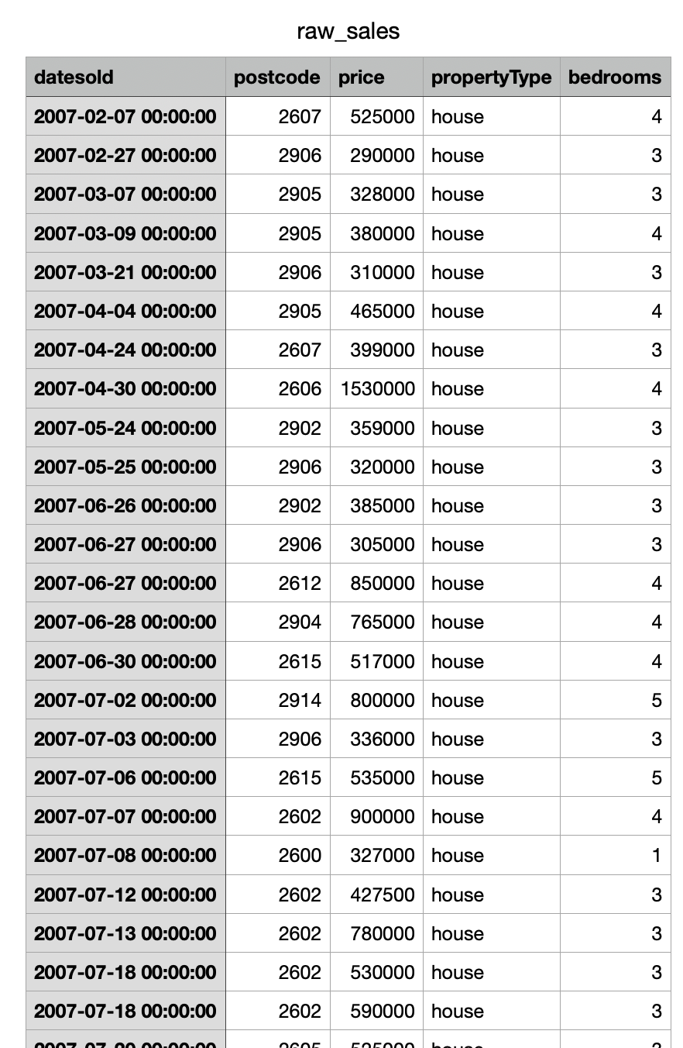
House Property Sales Time Series
Context
A multivariate time series has more than one time-dependent variable. Each variable depends not only on its past values but also has some dependency on other variables.
We have accumulated property sales data for the 2007-2019 period for one specific region. The data contains sales prices for houses and units with 1,2,3,4,5 bedrooms. These are the cross-depended variables.

Slide 3

House Property Sales Time Series
Variable of Interest: The primary variable of interest appears to be Sales, which we aim to analyze or forecast over time.
Time Series Context: The data includes a Month column, indicating that this is a monthly time series dataset.
Goal: The aim is likely to understand trends, seasonality, and forecast future sales based on historical patterns.

Slide 4
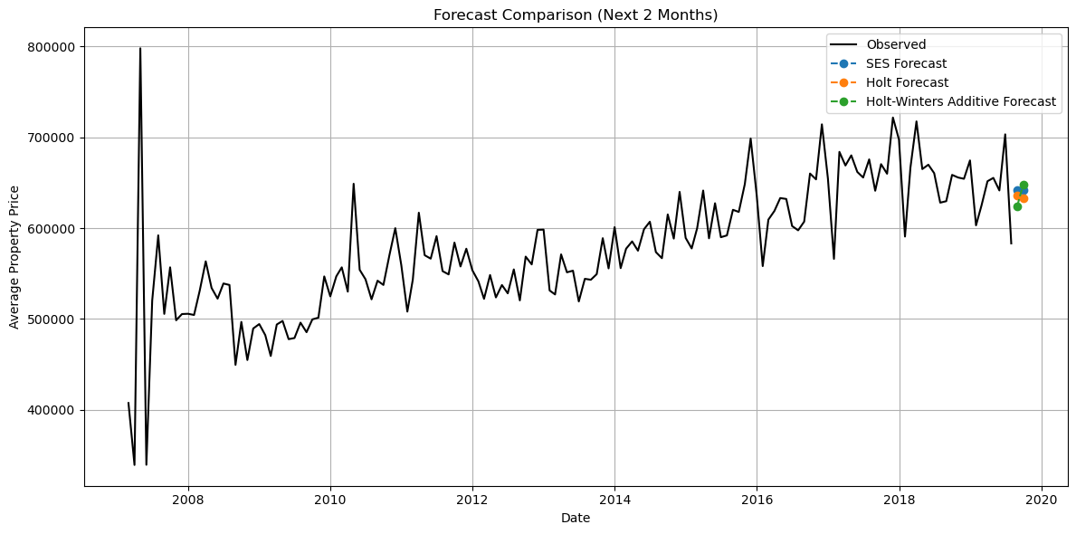
House Property Sales Time Series
Comparing 3 Forecast Model
1.Simple Exponential Smoothing
2.Holt’s Linear Trend (Additive Trend)
3.Holt-Winters Seasonal (Additive Seasonality + Trend)
August 2019
September 2019

Slide 5
Simple Exponential Smoothing assumes no trend or seasonality — so the forecast remains flat. Holt’s Model incorporates a linear trend, predicting a slight decline. Holt-Winters includes both trend and seasonality, showing a more dynamic pattern with an increase in the price.
Forecast Result:
Model Type | August 2019 | September 2019
Simple Exponential Smoothing | $641,993 | $641,993
Holt’s Linear Trend | $640,493 | $639,425
Holt-Winters Additive | $624,468 | $647,789

Slide 6
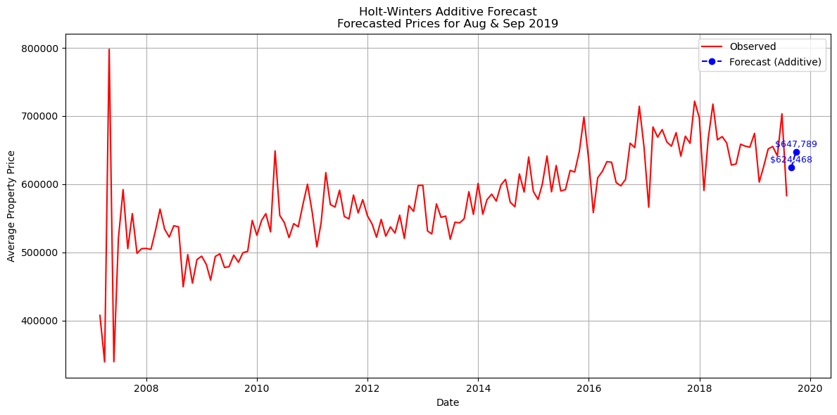
Based on the last comparing, I select the Holt-Winters. August 2019: $624,467.92 September 2019: $647,789.21

Slide 7
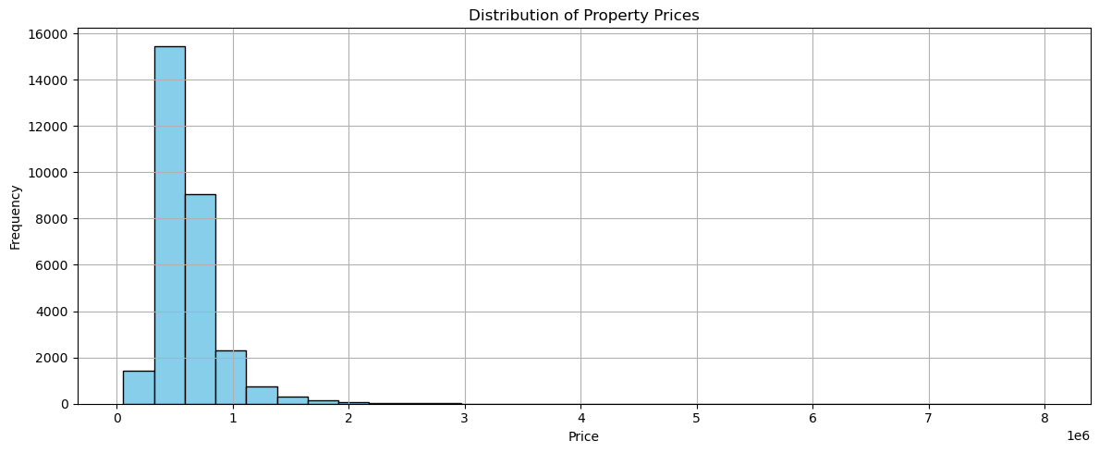
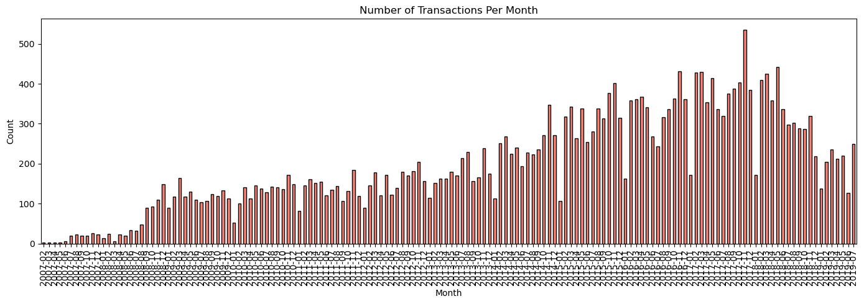
histogram of property sale prices.
Number of sales per month

Slide 8
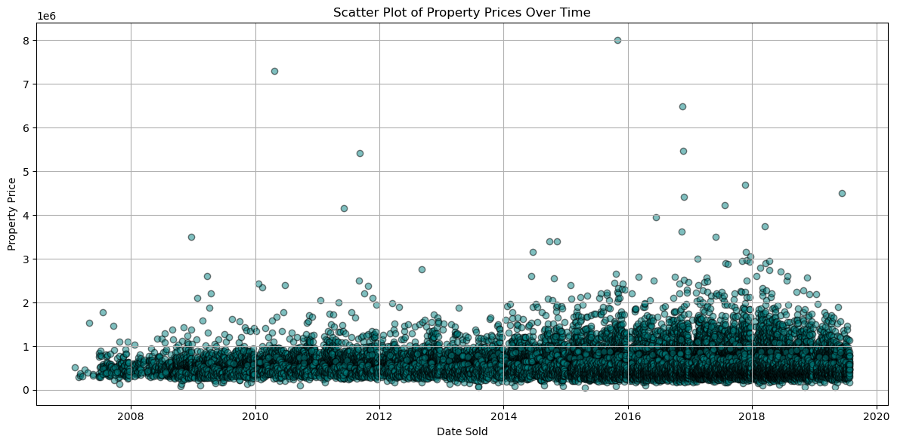
Each dot represents a property that was sold. The x-axis shows the sale date. The y-axis shows the price of each property. You can spot price trends over time, like increasing or fluctuating prices.

Slide 9
House Property Sales Time Series
Why the Holt-Winters Additive Model was Chosen:
The dataset involves monthly property sale prices over time, which clearly show:
Trend: The property prices are steadily increasing, indicating a long-term growth pattern.
Seasonality: Prices exhibit repeated fluctuations at regular intervals (monthly/quarterly cycles).
The Holt-Winters Additive is ideal for time series data that demonstrate:
A linear trend (growing or declining),
Seasonal variations of relatively constant magnitude.
This model was selected because it balances:
Responsiveness to recent changes (through exponential smoothing),
Accuracy in modeling consistent seasonal effects,
Capability to generate future forecasts, such as for August and September 2019, with meaningful confidence.

