Slide 1

Optimizing Production With Linear Programming: A Case Study From Hartman Company

Slide 2
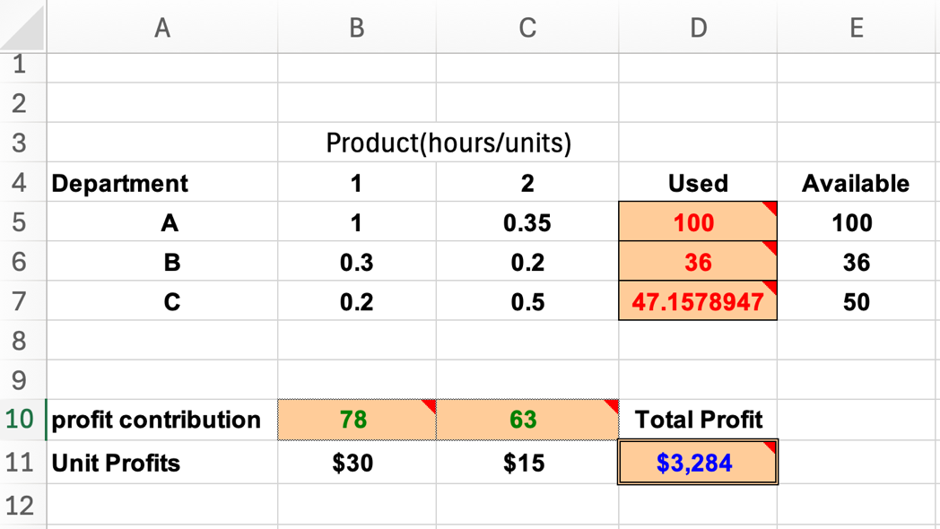
Optimizing Production with Linear Programming:
At Hartman Company, we recently tackled a classic operations research challenge: how to maximize profit while managing labor constraints across three departments.

Slide 3
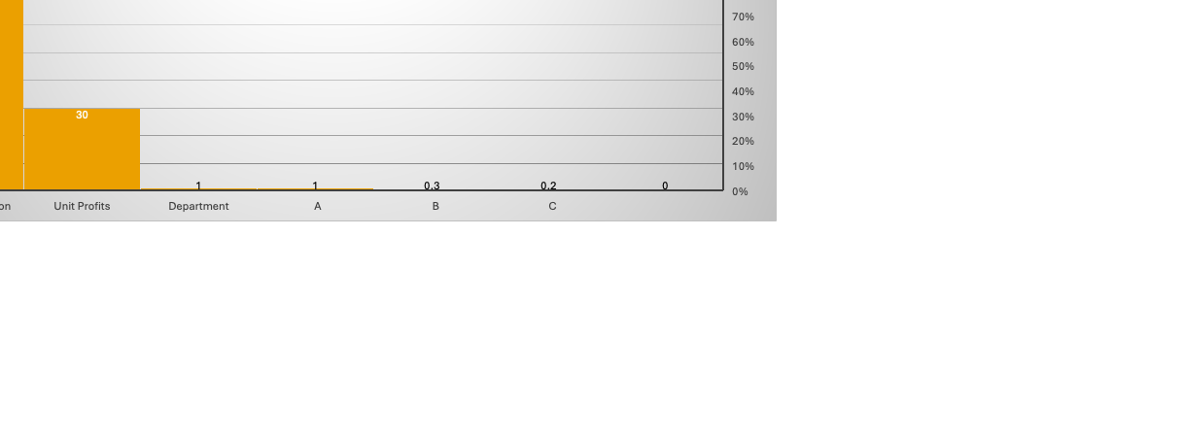
Linear Programming Model (No Overtime) Objective Function: Maximize Z=30X1+15X2Z=30X1​+15X2​ Subject to labor constraints: Department A: 1X1+0.35X2≤1001X1​+0.35X2​≤100 Department B: 0.3X1+0.2X2≤360.3X1​+0.2X2​≤36 Department C: 0.2X1+0.5X2≤500.2X1​+0.5X2​≤50 X1,X2≥0X1​,X2​≥0 Solution: Product 1: 78 units Product 2: 63 units Total Profit: $3,284

Slide 4
Department | Sum of 1
A | 1
B | 0.3
C | 0.2
Grand Total | 1.5

Slide 5
🔍 The Problem: We needed to determine the optimal production quantities for two products, considering: Labor availability in Departments A, B, and C Profit contributions of $30 and $15 per unit Fixed labor hours and potential for paid overtime

Slide 6
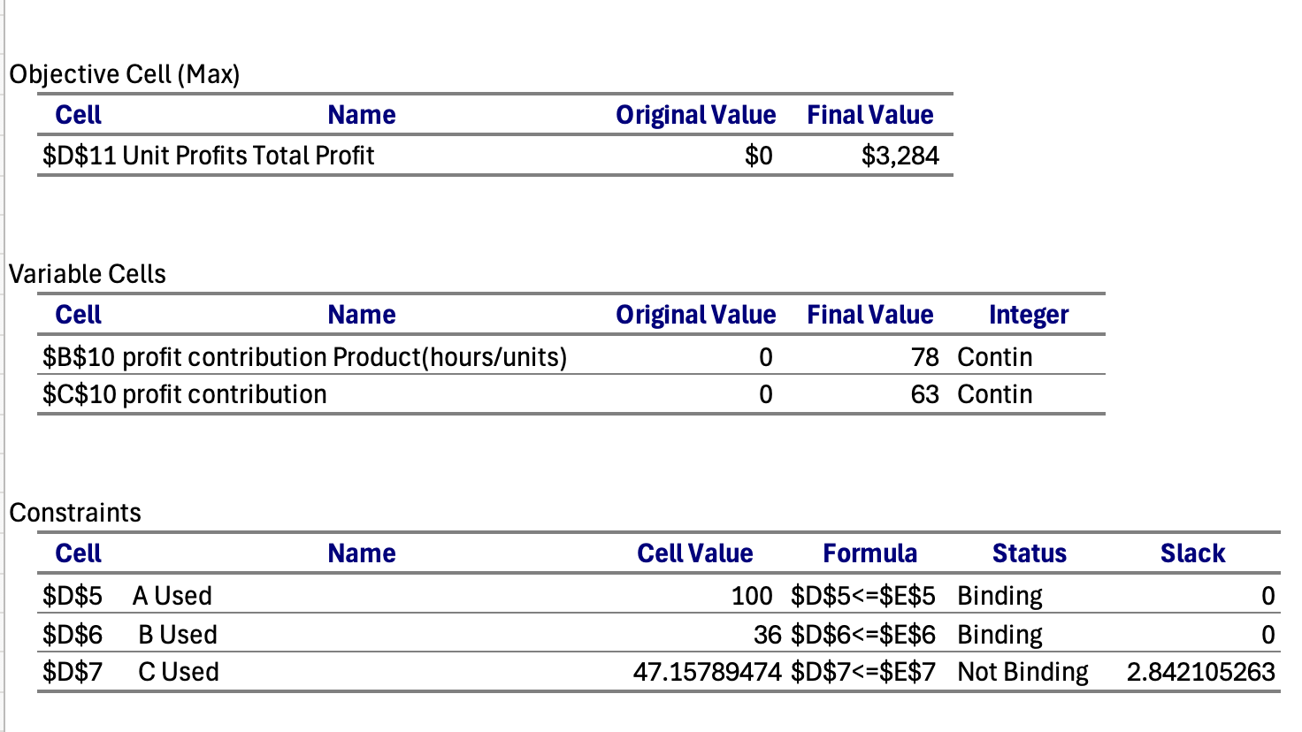
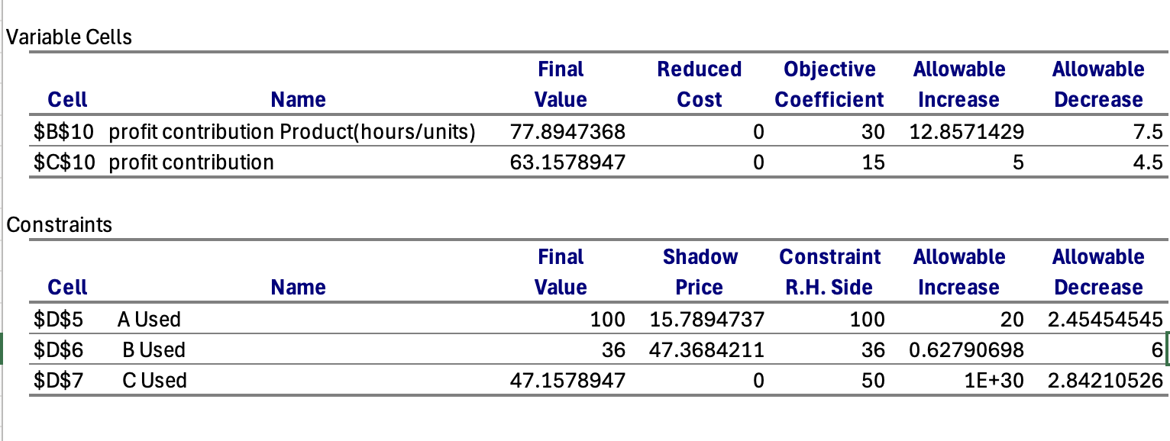
Sensitivity Analysis (No Overtime) 💡 The Solution: Using linear programming and Solver, we developed and analyzed multiple scenarios: overtime recommendations based on the Sensitivity Report: from the constraint table, we analyze the shadow prices to determine which departments would benefit from overtime and how much we should pay per extra labor hour: department A: shadow price: $15.79, adding one more hour of labor increases profit by 15.79. department B: shadow price: $47.37, adding one more hour of labor increases profit by 47.37. department C: shadow price: $0, no increase. I recommend department B: highest shadow price: $47.37, can pay up to 47.37 per hour for overtime.

Slide 7
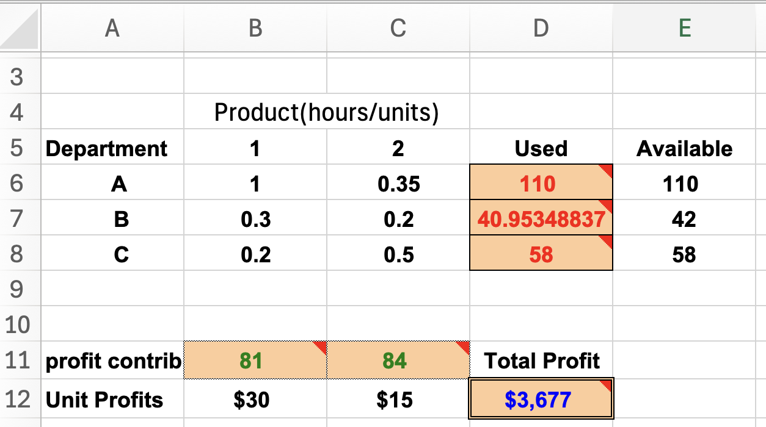
Extended Model with Overtime Overtime is allowed with the following limits and costs:
New Objective Function: Maximize Z=30X1+15X2−18oA−22.5oB−12oCZ=30X1​+15X2​−18oA​−22.5oB​−12oC​
Solution:
Product 1: 81 units
Product 2: 84 units
Gross Profit: $3,677
Overtime Cost: $276
Net Profit: $3,400.5

Slide 8
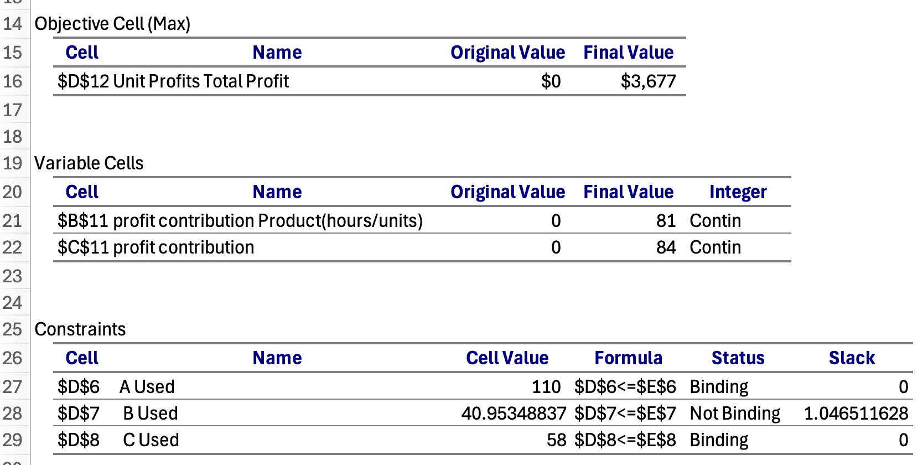
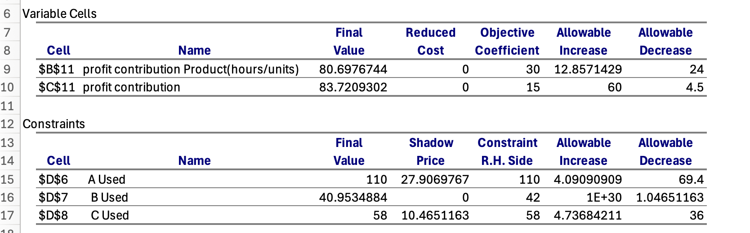
Updated Sensitivity Analysis (With Overtime) 🔍 Insight: Overtime in Department A is highly profitable. Department C is marginally profitable. Department B should avoid overtime.
Department | Shadow Price ($/hr) | Overtime Cost | Profitable?
A | 27.91 | 18 | ✅ Yes
B | 0 | 22.5 | ❌ No
C | 10.47 | 12 | ✅ Yes (marginal)

Slide 9
overtime recommendations based on the Sensitivity Report:
Shadow Prices & Recommendations for Overtime:
department A: shadow price: $27.91, adding one more hour of increases profit by 27.91.
department B: shadow price: 0,
department C: shadow price: $10.47, adding one more hour of increases profit by 10.47.
Pay for overtime in Dept A up to $27.91 per hour (cost is $18, so it's profitable).
Without Overtime: $3,677
With Overtime (A = 10 hours, C = 8 hours): $3,400.5

Slide 10
📈 Visual Insights
Profit comparison charts
Labor usage vs availability
Profit vs overtime hours
Shadow price and profitability tables
Slack and constraint binding tables

