Slide 1
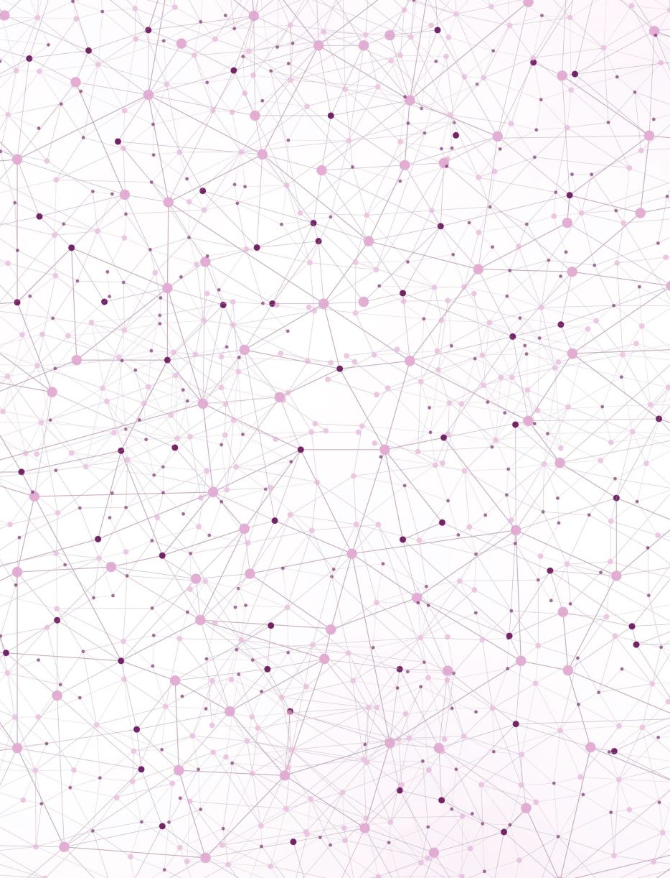
Generating Skin Rash Images Using Textual Commands with a Diffusion Model
Sayeed Ahmed
002191535

Slide 2

Problem Description
The accurate depiction of skin rashes based on textual descriptions is a significant challenge in medical imaging. This project aims to develop a model that generates realistic images of skin rashes based on user input.
This approach can enhance medical training, assist in diagnostics, and provide a valuable tool for educational purposes, particularly in regions with limited access to dermatological expertise.

Slide 3
Technical Approach
The project finetunes the various component within the Stable Diffusion pipeline. The approach includes custom dataset preparation, model training with GPU optimization, and integration with the Stable Diffusion framework to generate images of skin conditions based on textual descriptions.
Install Libraries
Prepare Dataset
Load Pretrained Models
Finetune the Diffusion model components
Integrate and Save Model
Generate and display Image

Slide 4

Environment Setup and Libraries
Environment:
Google Colab(L4 GPU & T4 GPU)
Libraries Overview:
Core Libraries for Diffusion Model: Torch, diffusers, transformers
Data Processing and Management: PIL, pandas, sklearn
Model Training Optimization: accelerate
API Development and Deployment: fastapi, uvicorn, pyngrok
Additional Utilities: os, datetime, base64, BytesIO

Slide 5
Data Preparation
Data Source:
SCIN (Skin Condition Image Network) Dataset by Google
The SCIN dataset comprises over 10,000 images contributed by more than 5,000 volunteers. Each contribution includes images of common dermatology conditions, along with selfreported demographic information, symptoms, and Fitzpatrick skin type (sFST).
In addition to userprovided data, each image is labeled by dermatologists with the condition and Fitzpatrick skin type (eFST).
Key Features and Fields:
scin_cases.csv:
case_id: Unique identifier for each case, ensuring consistency across dataset releases.
age_group: Categorized age ranges, such as AGE_18_TO_29, AGE_30_TO_39, etc.
sex_at_birth: Userreported sex, including FEMALE, MALE, and OTHER_OR_UNSPECIFIED.
fitzpatrick_skin_type: Userreported skin type based on sun exposure responses, ranging from FST1 (lightest) to FST6 (darkest).
body_parts_: Boolean fields indicating the body parts affected by the skin condition (e.g., HEAD_OR_NECK, ARM, LEG).
condition_duration: Reported duration of the skin condition, ranging from ONE_DAY to SINCE_CHILDHOOD.
scin_labels.csv:
dermatologist_skin_condition_label_name: List of skin conditions diagnosed by dermatologists, with confidence scores.
weighted_skin_condition_label: A normalized score representing the most likely skin condition based on dermatologist input.
monk_skin_tone_label_us/india: Skin tone classification based on the Monk Skin Tone Scale, labeled by trained laypersons in the US and India.

Slide 6
Data Preparation
Data Processing: To create a structured dataset that includes all necessary information for tagging and generating descriptive text.
The data processing starts by merging the cases.csv and labels.csv files using the case_id field. This creates a unified dataset that combines user reported information and dermatologist provided labels.
Key Fields Extracted: Condition, Body Part, image_shot_type, combined_race, skin_type_category, Image Path.
Tagging Images with Metadata: A custom script is employed to manually tag each image with relevant metadata, including the affected body part and condition.
Process:
Conditions: Automatically identified based on directory structure.
User Interaction: The user selects the appropriate body part from predefined options for each image.
Generating Descriptive Text for Each Image: A custom function generates descriptive text for each image, incorporating the metadata fields such as Condition, Body Part, image_shot_type, and skin_type_category.
Final Metadata CSV: The generated text descriptions and processed image paths are saved in metadata.csv. The final dataset included 427 images with a balanced images for 9 conditions - Acne, Allergic Contact Dermatitis, Eczema, Folliculitis, Herpes Simplex, Herpes Zoster, Psoriasis, Tinea, Urticaria)
Example Output:
training_imgs/4548551644236086193.png, a close up photo of herpes simplex skin condition on arms on white skin"

Slide 7
Model Finetuning – Initial Approach
Initial Approach: The goal was to finetune the CLIP model using the custom dataset of skin condition images paired with descriptive text. This finetuned model would then be integrated with a Stable Diffusion pipeline to generate images based on textual prompts.
Training Setup:
Model: openai/clipvitbasepatch32
Optimizer: AdamW
Learning rate: 5e5
Loss function: Contrastive loss function
Batch Size: 32
Training Duration: 3 epochs
Issue Encountered:
After successfully finetuning the CLIP model, I attempted to integrate it with the Stable Diffusion pipeline. However, an issue arose due to a mismatch between the hidden state dimensions of the finetuned CLIP model and the UNet component of the Stable Diffusion model. The UNet was configured to expect embeddings of a specific size, which did not align with the output size of the finetuned CLIP model.
Resolution Attempt:
Adjusted the cross_attention_dim of the UNet to match the hidden size of the text encoder.
Iterated over the attention blocks of the UNet to adjust the linear layer dimensions accordingly.
Outcome:
Despite these adjustments, the integration faced challenges, indicating the need for an alternative approach to ensure compatibility between the finetuned CLIP model and the Stable Diffusion pipeline.

Slide 8
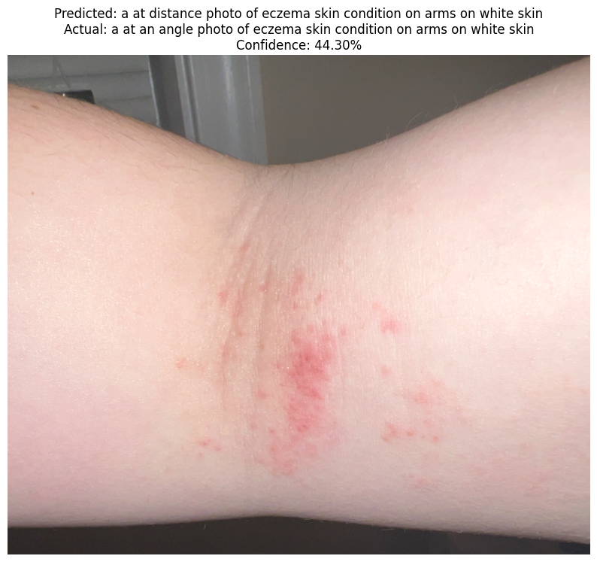
Example output
Output: Image: /content/drive/MyDrive/CLIP_training_data/training_imgs/-9170015725324326381.png
Actual Prompt: a at an angle photo of eczema skin condition on arms on white skin
Predicted Label: a at an angle photo of eczema skin condition on arms on white skin
Prediction Confidence: 35.33%
True Label Confidence: 35.33%

Slide 9
Model Finetuning – Next Approach
Next Approach: The focus shifted from finetuning the entire CLIP model to specifically finetuning the text encoder component of the Stable Diffusion pipeline.
Training Setup:
Model: CompVis/stablediffusionv14 (text encoder component)
Tokenizer: CLIPTokenizer
Optimizer: AdamW
Learning rate: 1e5
Loss function: Mean pooling of pooler_output
Batch Size: 8
Training Duration: 10 epochs
Gradient Clipping: Max norm of 1.0
Validation: Performed after each epoch, with the best model saved based on validation loss

Slide 10
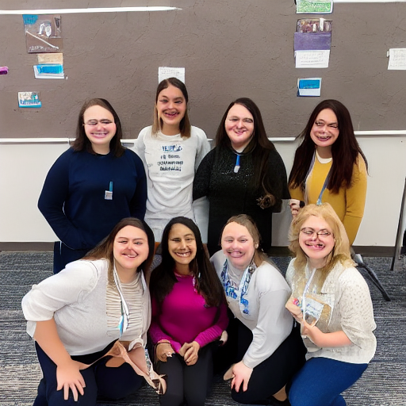
Example Output
Prompt:
a close up photo of herpes simplex skin condition on arms on white skin

Slide 11
Model Finetuning – Final Model
Change Compared to Previous Method:
Focus Shift: The focus shifted from finetuning the entire CLIP model to specifically finetuning the text encoder component of the Stable Diffusion pipeline.
Batch Size: Reduced batch size from 32 to 8 to better manage memory and optimize training with mixed precision.
Training Duration: Increased training epochs from 3 to 10 to allow the model more time to converge.
Gradient Accumulation: Utilized gradient accumulation and clipping to stabilize training and prevent exploding gradients, which was more aggressively tuned compared to the previous method.
Issue Encountered:
The finetuned text encoder was successfully trained and integrated into the Stable Diffusion pipeline. However, during the testing phase, it was observed that the generated images did not meet the expected quality. The loss function applied during the training may have affected the quality of the image generation.
Resolution Attempt:
Explored different configurations, including adjustments to the gradient accumulation strategy and validation processes. Checkpoints were saved after every epoch to allow rollback to the best performing model.
Outcome:
The integration was successful, and the model performed better than before. However, there is still room for improvement in the quality of the generated images, possibly by finetuning other components of the Stable Diffusion pipeline or experimenting with different loss functions during training.

Slide 12
Model Finetuning – Final Model
Approach: The goal was to finetune the UNet component of the Stable Diffusion model using a custom dataset of skin condition images paired with descriptive text. The finetuned model would then be used to generate images based on specific textual prompts.
Training Setup:
Model: CompVis/stablediffusionv14 (UNet component)
Tokenizer: CLIPTokenizer
Optimizer: AdamW
Learning rate: 1e5
Loss function: Mean Squared Error (MSE)
Batch Size: 1 (with gradient accumulation steps set to 4)
Training Duration: 2 epochs
Mixed Precision: Enabled (`fp16`) to optimize training speed and memory usage

Slide 13
Model Finetuning
Process:
Model Preparation: The training process involved freezing the text encoder and VAE, and only training the UNet model. The models were prepared for training using the `Accelerator` library.
Training Loop:
Images were converted to latent space using the VAE, and random noise was added to these latents. The UNet model was then conditioned on the text embeddings provided by the text encoder and trained to predict the noise residual.
Gradient accumulation was used to simulate a larger batch size, and gradients were clipped to ensure stable training.
Outcome:
Model Integration: After training, the finetuned UNet model was integrated into the original Stable Diffusion pipeline, replacing the default UNet component.
Image Generation: The finetuned model was successfully used to generate images based on specific prompts
Model Deployment: The final finetuned model was pushed to Hugging Face, making it accessible for future use and sharing.

Slide 14
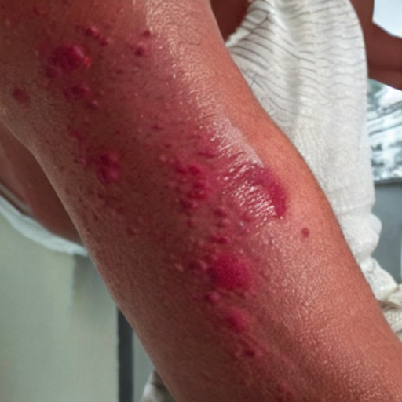
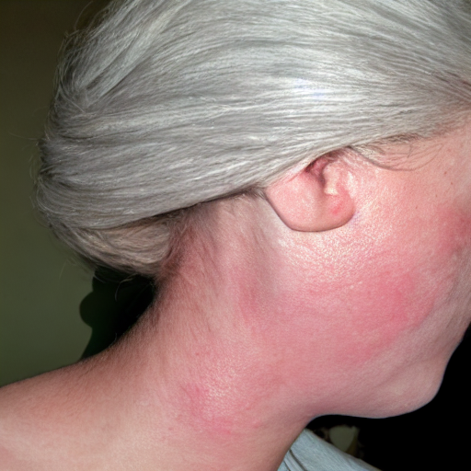
Outputs
Generate a photo of herpes on arms on brown skin
Create a highly detailed and realistic image showing the neck of a person with white skin. The neck should display a typical eczema infection, characterized by a clearly visible rash.

Slide 15

Chat Application
Application Setup:
Backend:
Framework: FastAPIDeployment hosted via ngrok for public access
API Endpoints:
/generate_image: Accepts JSON payload with color, rash_type, and body_part, generates an image, and returns it in base64 format.
Frontend:
Framework: Streamlit
Features:
User Inputs: Fields for Skin Color, Rash Type, and Body Part.
Image Display: Generated images are displayed directly in the UI.

Slide 16
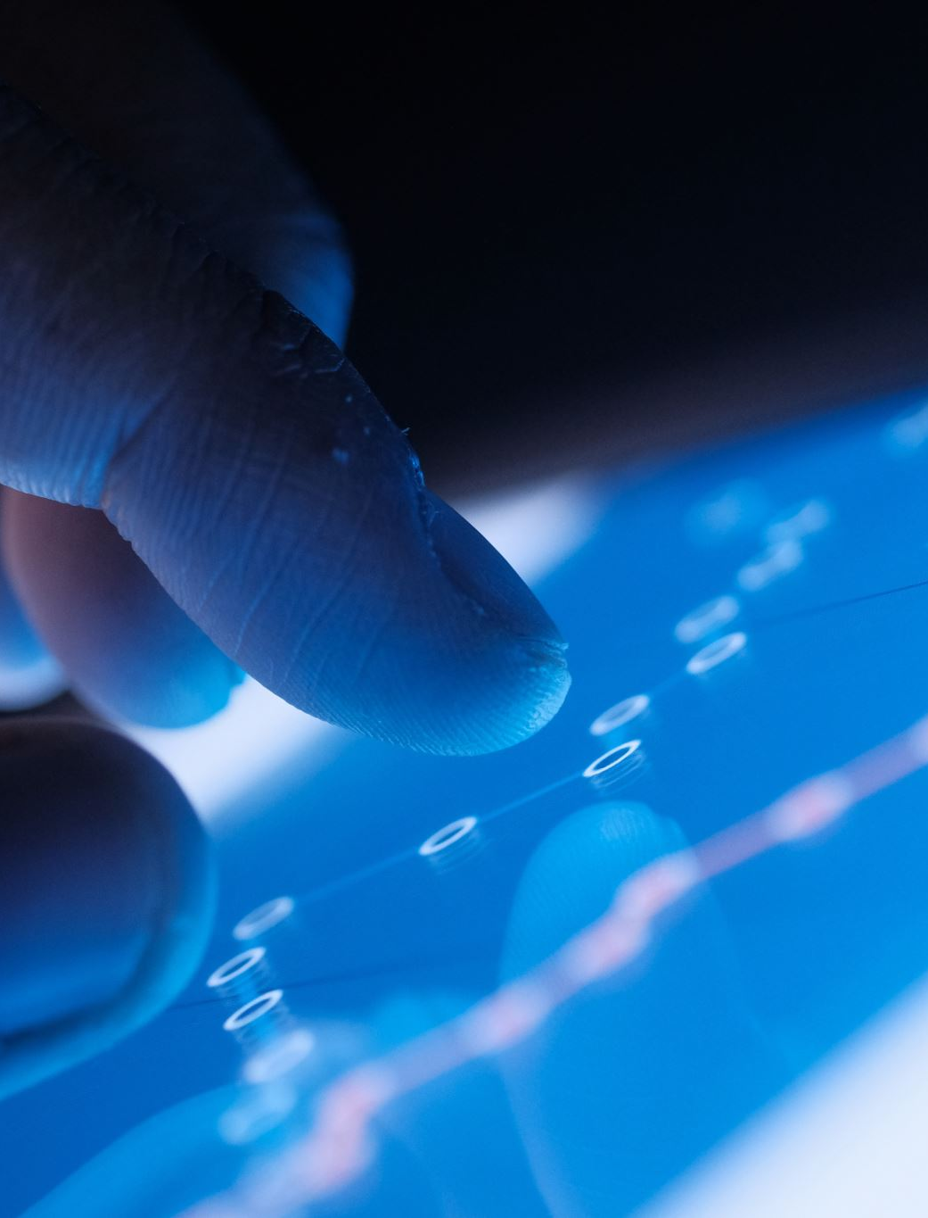
Future Enhancements
Expand the dataset to include more diverse skin conditions and varying severity levels to improve model generalization.
Utilize data augmentation techniques such as image rotation, flipping, and color adjustment to artificially expand the dataset, increasing the model's ability to handle diverse cases.
Develop tools within the chat application for users to annotate or refine generated images, potentially feeding back into model retraining.

Slide 17

Demo

Slide 18
Thank You

