Slide 1
UNDP Intern Data Test
Sayeed Ahmed

Slide 2
Exploratory Data Analysis
In order to get the required domain knowledge, I referred the websites of Armed Conflict Location & Event Data Project (ACLED) and Europe Media Monitor.
Before proceeding with the analysis, I performed EDA on the datasets to get a better understanding of the data.
I performed tasks like displaying the first few rows, shape, missing values, and basic statistics of both datasets to gain an understanding of the data.

Slide 3
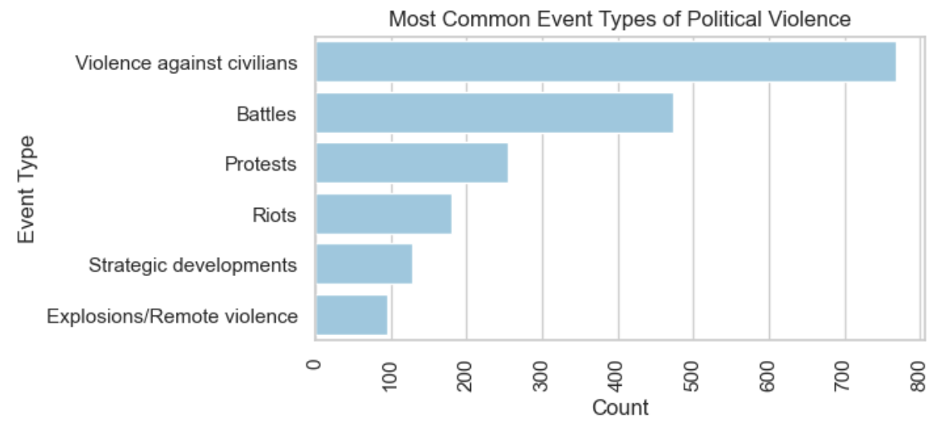
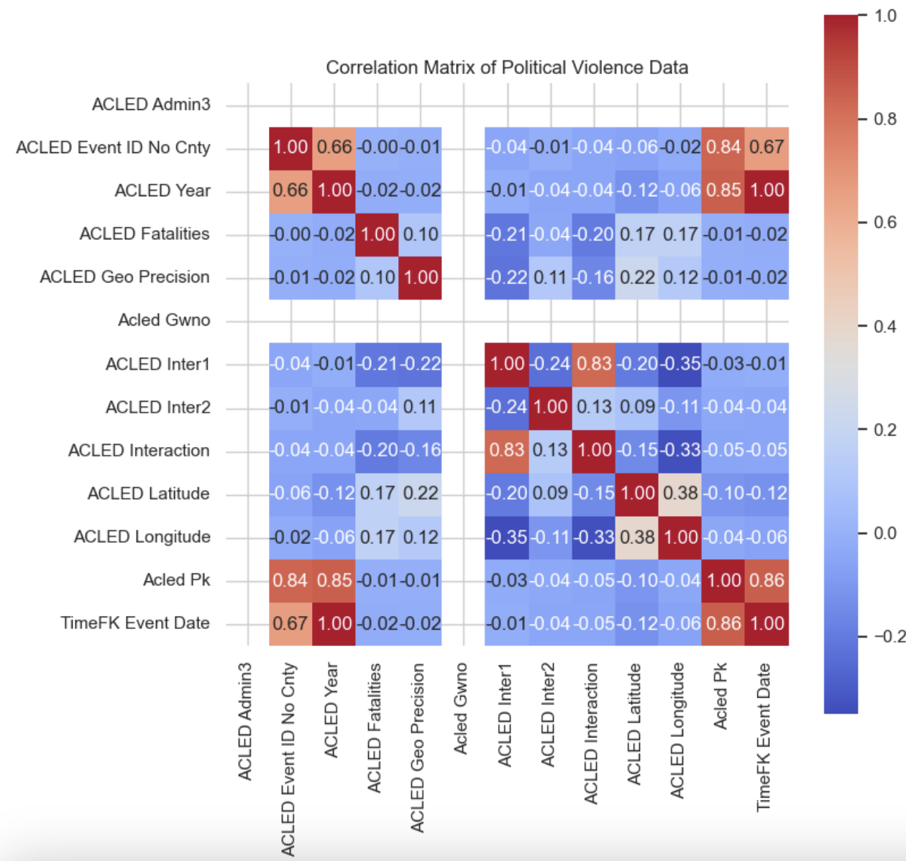
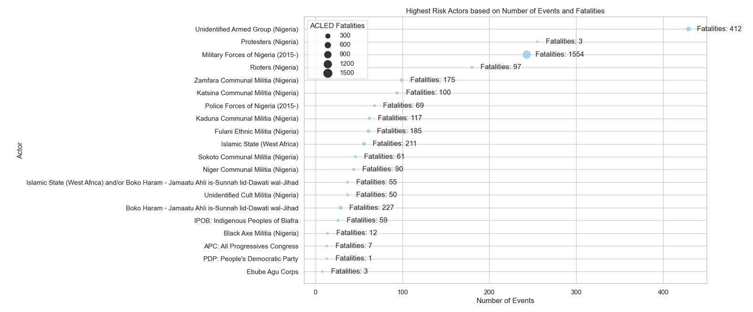
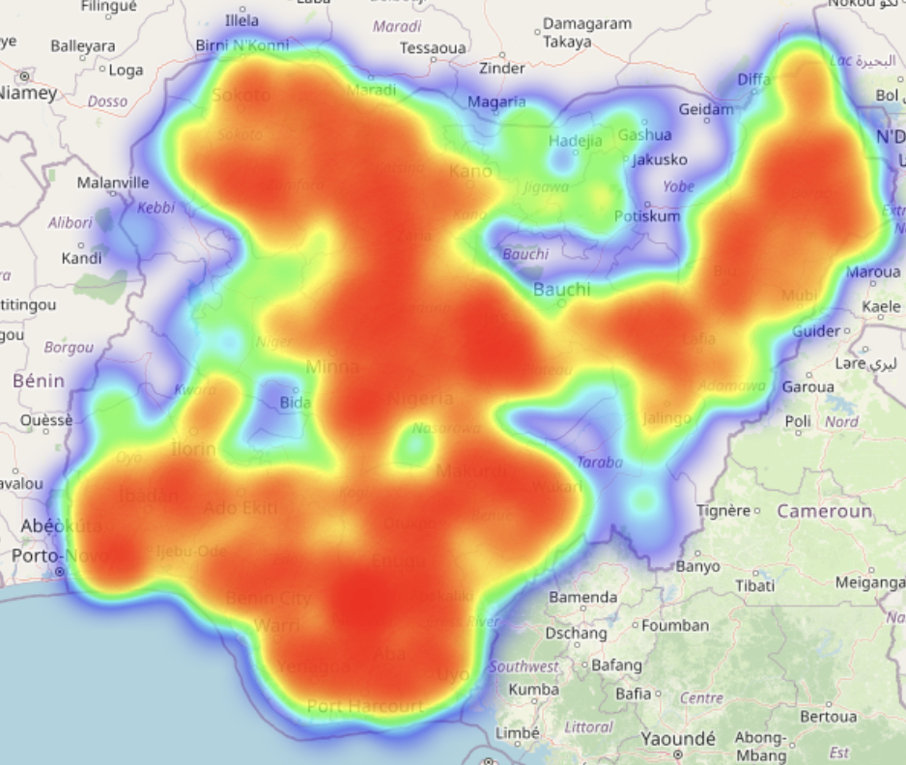
d) What features of this data set have the most associative or predictive value?
1: What is the violence profile in Nigeria in the given time period?
b) Which actors are the highest risk actors? (Fatality vs Number of Events)
c) What is the geographic profile of the political violence?

Slide 4
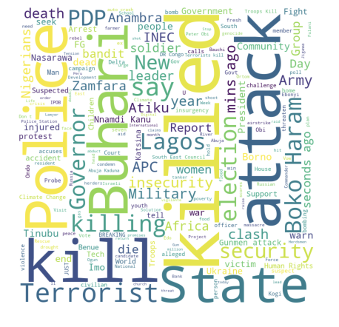
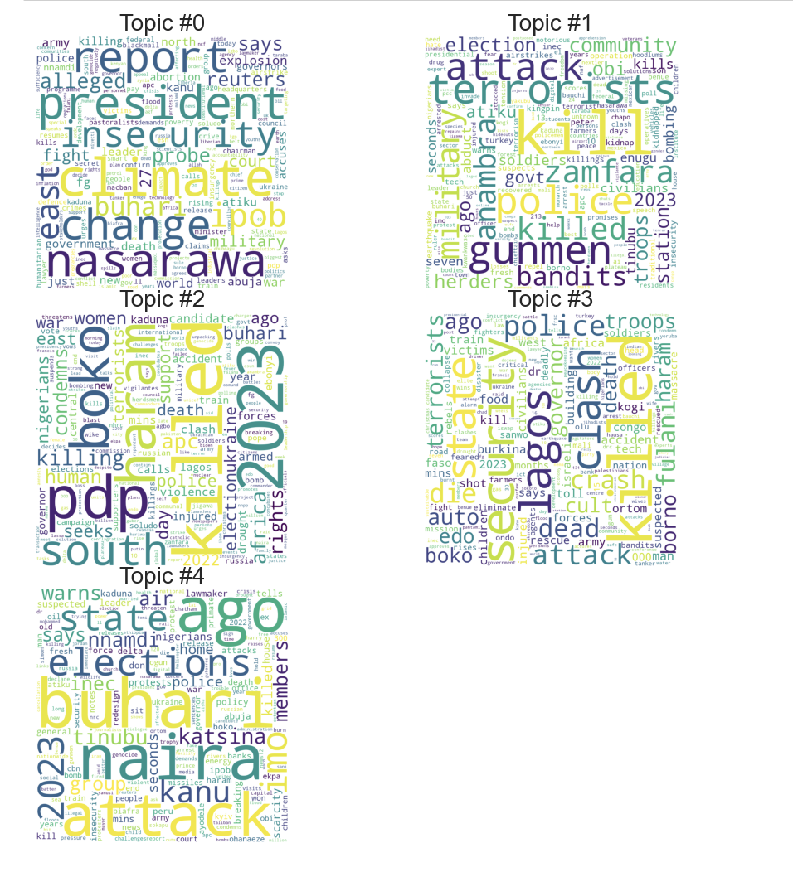
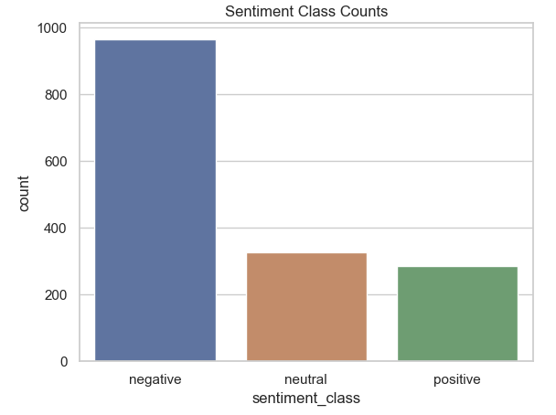
2: What are the key news trends during the period attached?
a) What are the key trending themes?
b: Is there a key sentiment in the news?

Slide 5
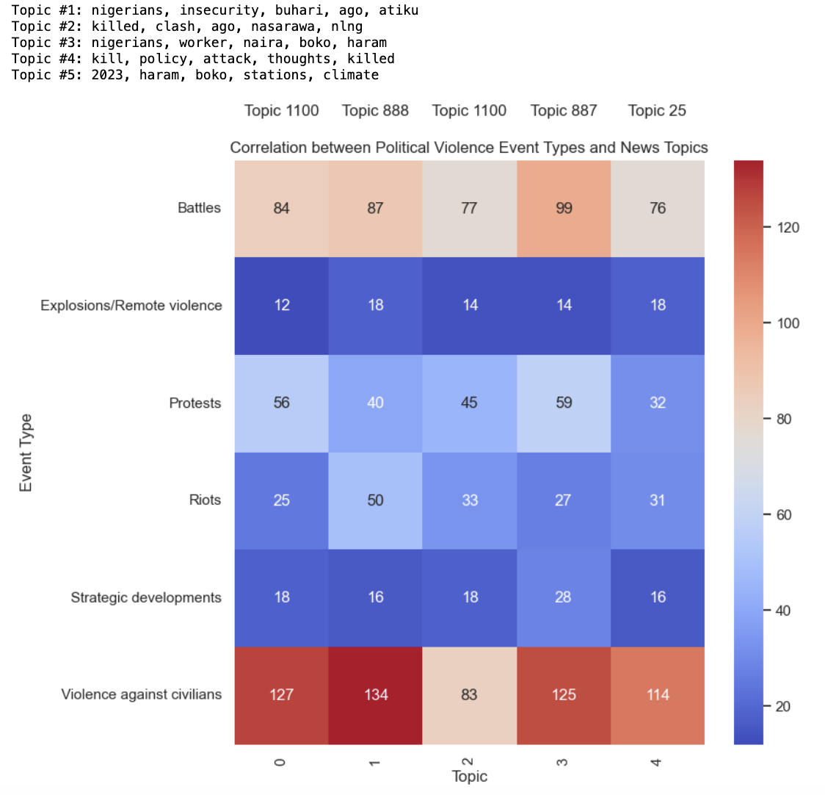
3: Is there a correlation between political violence event types and the key news trending in the region?

Slide 6
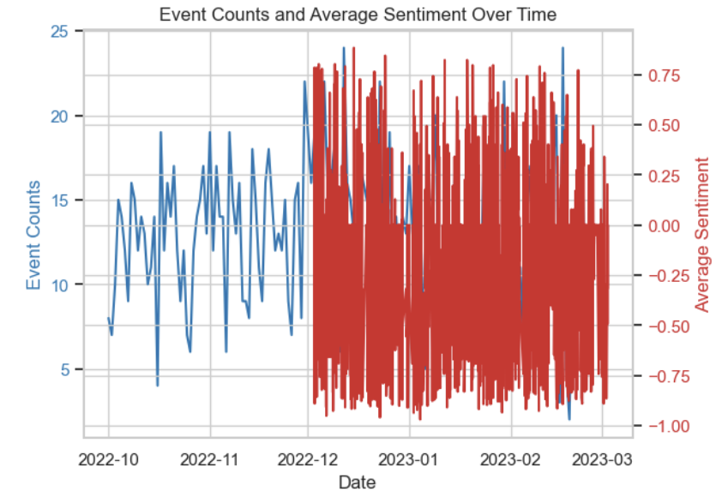
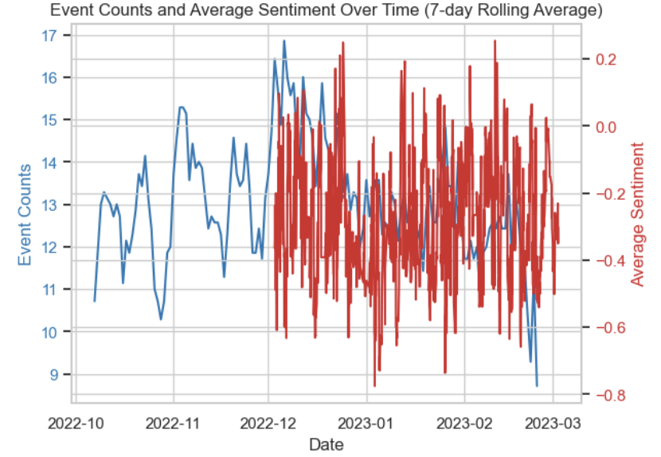
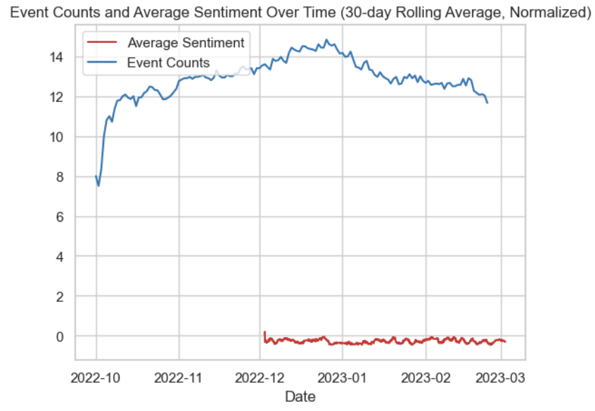
4: Additional analysis
Time Series Analysis of Political Violence and News Sentiment

