Slide 1

Travel Agent Chatbot
Sayeed Ahmed
002191535

Slide 2

Problem Description
Creating a travel agent chatbot that can handle both general travel and proprietary information queries for a travel agent application
Goals:
Develop a user-friendly interface for seamless query input and response visualization
Implement accurate intent detection to correctly route user queries
Provide relevant responses from appropriate sources (database or general knowledge)
Ensure data privacy for proprietary information

Slide 3

Data Sources
Custom-built sample dataset:
Utilized ChatGPT to create synthetic data for the following data tables:
Travel packages table: package_id, package_name, country, city, duration_days, price_usd, package_description, package_type
Flights table: flight_id, airline, departure_city, arrival_city, departure_time, arrival_time, price, days_of_week
Hotels table: hotel_id, name, city, country, star_rating, price_per_night, amenities
OpenAI's GPT 3.5 model for general knowledge and query processing

Slide 4
Technical Approach - Overview
Frontend Streamlit
Backend
Flask
Database
SQLite
Natural Language Processing
NLTK
Large Language Model
GPT-3.5-turbo

Slide 5
Implementation Details

Slide 6
Implementation - Backend
Flask server with RESTful API Key components:
IntentDetector class for query classification
Implements intent detection
Database class for SQL query execution
Handles connection to SQLite database and executes parameterized queries
OpenAIClient class for GPT interactions
Manages API calls to OpenAI for query processing and general knowledge retrieval
TravelAgentChatbot class for orchestrating the chat flow
Coordinates intent detection, query processing, and response generation
Error handling and logging mechanisms for robust operation

Slide 7
Intent Detection
Two-step intent detection process:
User Query
Keyword-based matching
Match Score
Threshold
Meets Threshold
Does not meet Threshold
Output: Intent
GPT-based classification
Intent

Slide 8

Intent Detection - Keyword-based matching
Utilizes a predefined set of keywords for each intent:
package_info: 'package', 'tour', 'vacation', 'holiday', 'itinerary', 'trip', 'travel plan'
flight_info: 'flight', 'airplane', 'airport', 'airline', 'depart', 'arrive'
hotel_info: 'hotel', 'accommodation', 'stay', 'room', 'book', 'reservation’
Applies text preprocessing techniques to improve matching accuracy:
Tokenization: Breaking down the query into individual words.
Lowercasing: Converting all tokens to lowercase to ensure uniformity.
Stop Words Removal: Removing common words that do not contribute to the intent (e.g., 'the', 'is', 'at').
Lemmatization: Reducing words to their base or root form (e.g., 'running' to 'run').
Threshold-based matching to determine intent:
Calculates a score based on the number of keyword matches.
If the score exceeds a predefined threshold, the intent is determined.

Slide 9
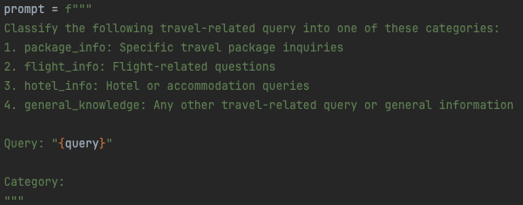
Intent Detection - GPT-based classification
Leverages the power of GPT-3.5-turbo for more nuanced intent detection
When keyword-based matching is inconclusive, the query is classified using a prompt designed for intent detection.
Prompt:

Slide 10
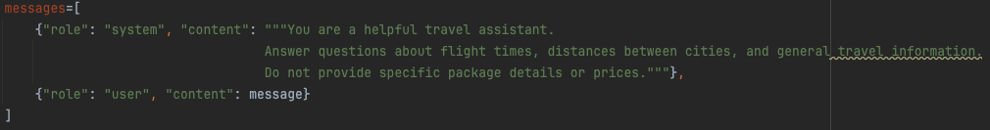
General Questions Intent Handling
Class OpenAIClient
The OpenAIClient class is initialized with an API key.
Query ChatGPT:
The query_chatgpt method directly queries ChatGPT for general travel-related questions.
Provides responses related to flight times, distances, and other general travel information.

Slide 11
Database Interaction
Database Setup
Database Choice: SQLite used for simplicity and ease of setup.
Tables Created:
travel_packages: Stores information about various travel packages.
flights: Contains details about flights.
hotels: Holds information on hotel accommodations.
Database Class
Establishes the database connection using SQLAlchemy.
Executing Queries:
Takes an SQL query as input and executes it.
Retrieves and returns the query results, including column names and rows.

Slide 12
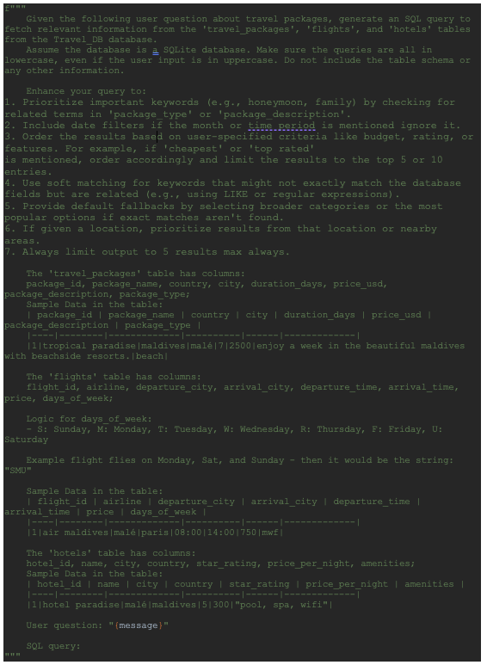
Database Interaction – SQL Generator
Generate SQL Query:
The generate_sql_query method generates SQL queries based on user questions.
Uses a predefined prompt to instruct GPT-3.5-turbo to generate SQL queries. The generated query is extracted and cleaned before returning.

Slide 13
Flow Summary
User Query: User inputs a travel-related question.
Intent Detection: Determine if the query requires general knowledge or proprietary data.
General Query: Use ChatGPT to answer generic travel questions
Query Generation: Use ChatGPT to generate an SQL query if proprietary data is needed.
Execute Query: Run the generated SQL query against the SQLite database using the execute_sql_query method.
Format Results: Convert raw SQL results into a user-friendly format and display.

Slide 14
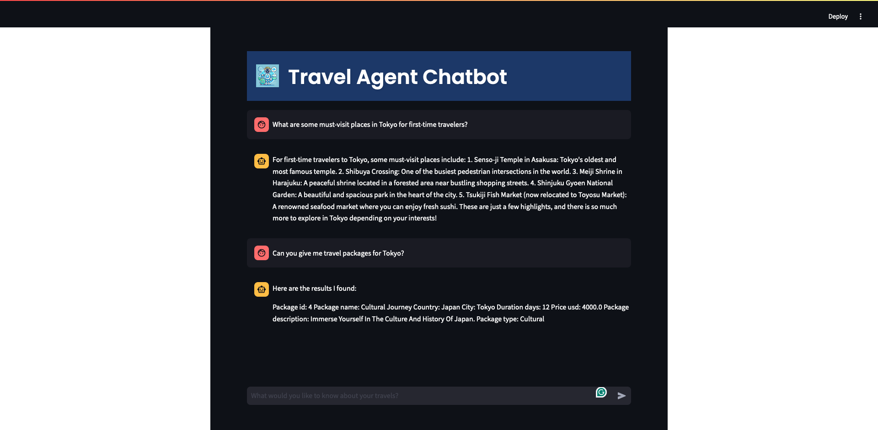
Implementation - FrontEnd

Slide 15

Demo

Slide 16
Conclusion
Achievements:
Successfully implemented a travel agent chatbot handling both general knowledge and proprietary information queries.
Current Limitation:
The chatbot currently lacks context awareness across the conversation, limiting its ability to maintain coherent, multi-turn interactions.
Future Improvement:
Implement context-aware methodologies to enhance the chatbot's ability to maintain conversation history and provide more relevant, personalized responses over multiple interactions.

