Slide 1


Chapter 6 Wireless and Mobile Networks
A note on the use of these ppt slides:
We’re making these slides freely available to all (faculty, students, readers). They’re in PowerPoint form so you see the animations; and can add, modify, and delete slides (including this one) and slide content to suit your needs. They obviously represent a lot of work on our part. In return for use, we only ask the following:
Computer Networking: A Top Down Approach 6th edition Jim Kurose, Keith Ross Addison-Wesley March 2012
If you use these slides (e.g., in a class) that you mention their source (after all, we’d like people to use our book!)
If you post any slides on a www site, that you note that they are adapted from (or perhaps identical to) our slides, and note our copyright of this material.
Thanks and enjoy! JFK/KWR
All material copyright 1996-2012
J.F Kurose and K.W. Ross, All Rights Reserved
The course notes are adapted for Bucknell’s CSCI 363
Xiannong Meng
Spring 2016

Slide 2
Ch. 6: Wireless and Mobile Networks
Background:
Number of wireless (mobile) phone subscribers now exceeds number wired phone subscribers (5-to-1)!
World has about 6 billion cell phone subscribers (2011 statistics) (http://www.huffingtonpost.com/2012/10/11/cell-phones-world-subscribers-six-billion_n_1957173.html)
China has about 1.2 billion mobile phones (2014), India 1.1 billions (2016), U.S. 327 millions (2014) (http://en.wikipedia.org/wiki/List_of_countries_by_number_of_mobile_phones_in_use)
Though not all are digital/network ready, they potentially will be.

Slide 3
Ch. 6: Wireless and Mobile Networks
Background:
# wireless Internet-connected devices
laptops, Internet-enabled phones promise anytime untethered Internet access
two important (but different) challenges
wireless: communication over wireless link
mobility: handling the mobile user who changes point of attachment to network

Slide 4
Chapter 6 outline
6.1 Introduction
Wireless
6.2 Wireless links, characteristics
CDMA
6.3 IEEE 802.11 wireless LANs (“Wi-Fi”)
6.4 Cellular Internet Access
architecture
standards (e.g., GSM, 4G LTE)
Mobility
6.5 Principles: addressing and routing to mobile users
6.6 Mobile IP
6.7 Handling mobility in cellular networks
6.8 Mobility and higher-layer protocols
6.9 Summary

Slide 5



















Elements of a wireless network
network
infrastructure

Slide 6



Elements of a wireless network
wireless hosts
laptop, smartphone
run applications
may be stationary (non-mobile) or mobile
wireless does not always mean mobility
network
infrastructure

Slide 7

Elements of a wireless network
base station
typically connected to wired network
relay - responsible for sending packets between wired network and wireless host(s) in its “area”
e.g., cell towers, 802.11 access points
network
infrastructure

Slide 8
Elements of a wireless network
wireless link
typically used to connect mobile(s) to base station
also used as backbone link
multiple access protocol coordinates link access
various data rates, transmission distance
network
infrastructure

Slide 9
Characteristics of selected wireless links
200
802.11n
54
802.11a,g
802.11a,g point-to-point
5-11
802.11b
4G: LTE WIMAX
4
3G: UMTS/WCDMA-HSPDA, CDMA2000-1xEVDO
Data rate (Mbps)
1
802.15
.384
2.5G: UMTS/WCDMA, CDMA2000
.056
2G: IS-95, CDMA, GSM
Indoor
10-30m
Outdoor
50-200m
Mid-range
outdoor
200m – 4 Km
Long-range
outdoor
5Km – 20 Km

Slide 10
Acronym in wireless communication
4G LTE: 4th Generation Long Term Evolution
UMTS: Universal Mobile Telecommunications System
HSPDA: High-Speed Downlink Packet Access
EVDO: Enhanced Voice-Data Optimized
GSM: Global System for Mobile Communications
802.11a,g point-to-point
4G: LTE WIMAX
3G: UMTS/WCDMA-HSPDA, CDMA2000-1xEVDO
802.15
2G: IS-95, CDMA, GSM

Slide 11
Elements of a wireless network
infrastructure mode
base station connects mobiles into wired network
handoff: mobile changes base station providing connection into wired network
network
infrastructure

Slide 12
Elements of a wireless network
ad hoc mode
no base stations
nodes can only transmit to other nodes within link coverage
nodes organize themselves into a network: route among themselves

Slide 13
Wireless network taxonomy
single hop
multiple hops
host connects to
base station (WiFi,
WiMAX, cellular)
which connects to
larger Internet
host may have to
relay through several
wireless nodes to
connect to larger
Internet: mesh net
infrastructure
(e.g., APs)
no base station, no
connection to larger
Internet. May have to
relay to reach other
a given wireless node
MANET, VANET
no
infrastructure
no base station, no
connection to larger
Internet (Bluetooth,
ad hoc nets)

Slide 14
Chapter 6 outline
6.1 Introduction
Wireless
6.2 Wireless links, characteristics
CDMA
6.3 IEEE 802.11 wireless LANs (“Wi-Fi”)
6.4 Cellular Internet Access
architecture
standards (e.g., GSM)
Mobility
6.5 Principles: addressing and routing to mobile users
6.6 Mobile IP
6.7 Handling mobility in cellular networks
6.8 Mobility and higher-layer protocols
6.9 Summary

Slide 15
Wireless Link Characteristics (1)
important differences from wired link ….
decreased signal strength: radio signal attenuates as it propagates through matter (path loss)
interference from other sources: standardized wireless network frequencies (e.g., 2.4 GHz) shared by other devices (e.g., phone); devices (motors) interfere as well
multipath propagation: radio signal reflects off objects, arriving at destination at slightly different times
…. make communication across (even a point to point) wireless link much more “difficult”

Slide 16
Wireless Link Characteristics (2)
SNR: signal-to-noise ratio
larger SNR – easier to extract signal from noise (a “good thing”)
SNR versus BER tradeoffs
given physical layer: increase power -> increase SNR->decrease BER
given SNR: choose physical layer that meets BER requirement, giving highest thruput
SNR may change with mobility: dynamically adapt physical layer (modulation technique, rate)
10⁻¹
10⁻²
10⁻³
BER
10⁻⁴
10⁻⁵
10⁻⁶
10⁻⁷
10
20
30
40
SNR(dB)
QAM256 (8 Mbps)
QAM16 (4 Mbps)
BPSK (1 Mbps)

Slide 17

Wireless network characteristics
Multiple wireless senders and receivers create additional problems (beyond multiple access):
A
B
C
C
A’s signal
strength
C’s signal
strength
B
A
Hidden terminal problem
B, A hear each other
B, C hear each other
A, C can not hear each other means A, C unaware of their interference at B
space
Signal attenuation:
B, A hear each other
B, C hear each other
A, C can not hear each other interfering at B

Slide 18
Code Division Multiple Access (CDMA)
unique “code” assigned to each user; i.e., code set partitioning
all users share same frequency, but each user has own “chipping” sequence (i.e., code) to encode data
allows multiple users to “coexist” and transmit simultaneously with minimal interference (if codes are “orthogonal”)
encoded signal = (original data) • (chipping sequence)
decoding: (encoded signal) • (chipping sequence)
Note: operator • means inner product

Slide 19
CDMA encode/decode
channel output Z_{i,m}
Z_{i,m}= d_{i}.c_{m}
data
bits
d₀ = 1
1
1
1
1
1
d₁ = -1
1
1
1
-
-
-
-
1
-
-
-
1
-
1
1
1
1
1
sender
1
1
slot 1
channel
output
slot 0
channel
output
1
1
1
1
1
code
1
1
-
-
-
1
-
1
1
1
-
-
-
1
-
1
1
1
slot 1
slot 0
M
D_{i} = Σ Z_{i,m}.c_{m}
m=1
M
received
input
1
1
1
1
1
1
1
1
d₀ = 1
-
-
-
-
1
-
-
-
1
-
1
1
1
1
1
1
d₁ = -1
1
slot 1
channel
output
slot 0
channel
output
1
1
1
1
1
code
1
1
-
-
-
1
-
1
1
1
-
-
-
1
-
1
1
1
receiver
slot 1
slot 0

Slide 20
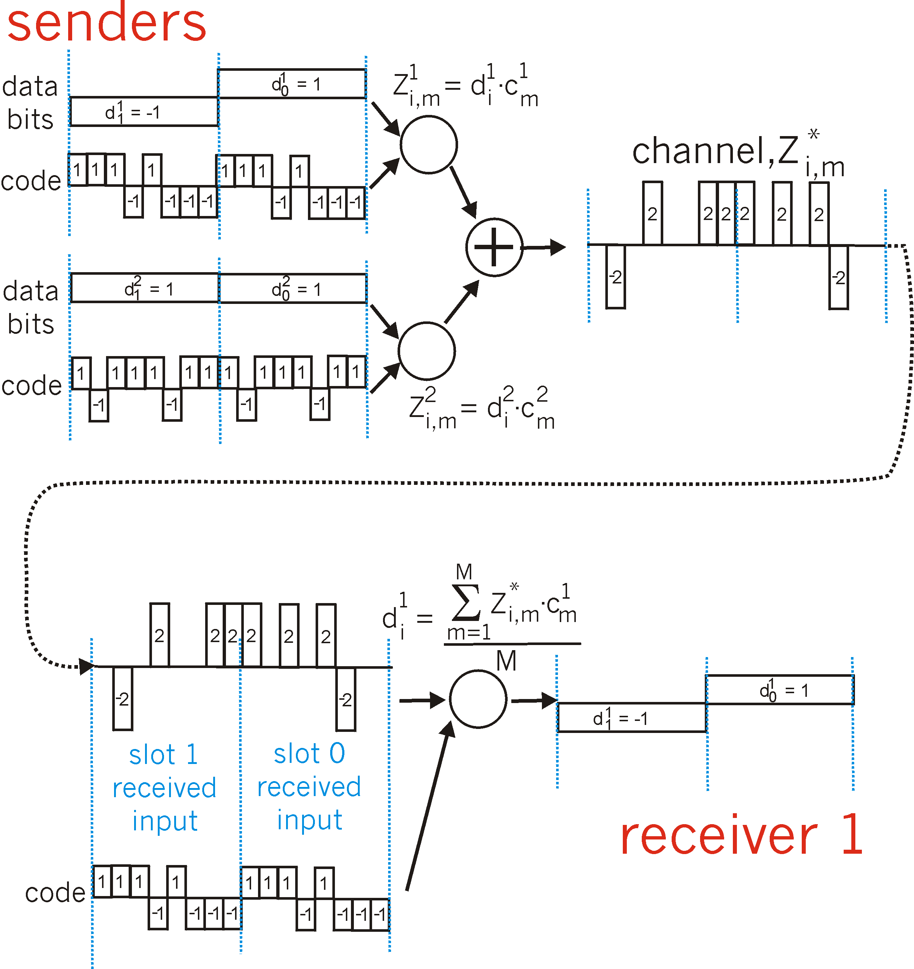
CDMA: two-sender interference
channel sums together transmissions by sender 1 and 2
Sender 1
Sender 2
using same code as sender 1, receiver recovers sender 1’s original data from summed channel data!

Slide 21
Exercises
Compute and make sure you understand that the chipping codes used in the example are orthogonal [1,1,1,-1,1,-1,-1,-1], [1,-1,1,1,1,-1,1,1]
What are the data bits 1 and -1 sent if the chipping code is [1,-1,1,-1,1,-1,1,-1]?
Can you recover the same data bits using the given chipping code?

