Slide 1
Foundations of data science
By Mohammed Sayeed(1si18cs057) and Varun Mnm(1si18cs052)

Slide 2
ACTIVITY Description :
This is a Presentation on the simulation of building decision tree algorithm from a dataset

Slide 3


Activity requirements ? 🤔
1 What is the Programming Language we are using ?
2.What is Tool or Software we are using ?
Python Google collaborator

Slide 4


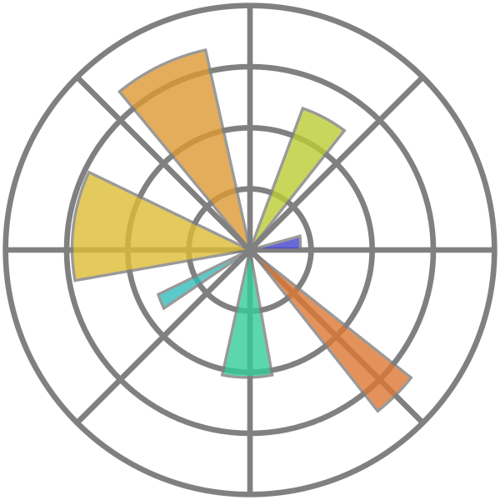
Dependencies or libraries
1. NumPy 2.Pandas 3.Matplotlib

Slide 5

What is the dataset we are using ?
Drug Set and Analysis
Amount of different drugs consumed by an individual with respect to Blood Pressure and Cholesterol
sources : https://www.Kaggle.com/gangliu/drugsets

Slide 6
What is Decision Tree ?
Decision tree is an algorithm which is mainly applied to data classification scenarios. It is a tree structure where each node represents the features and each edge represents the decision taken. Starting from the root node we go on evaluating the features for classification and take a decision to follow a specific edge. Whenever a new data point comes in , recursively same method is applied again and again and then the final conclusion is taken when all the required features are studied or applied to the classification scenario. Decision tree algorithm is a supervised learning model used in predicting a dependent variable with a series of training variables.

Slide 7
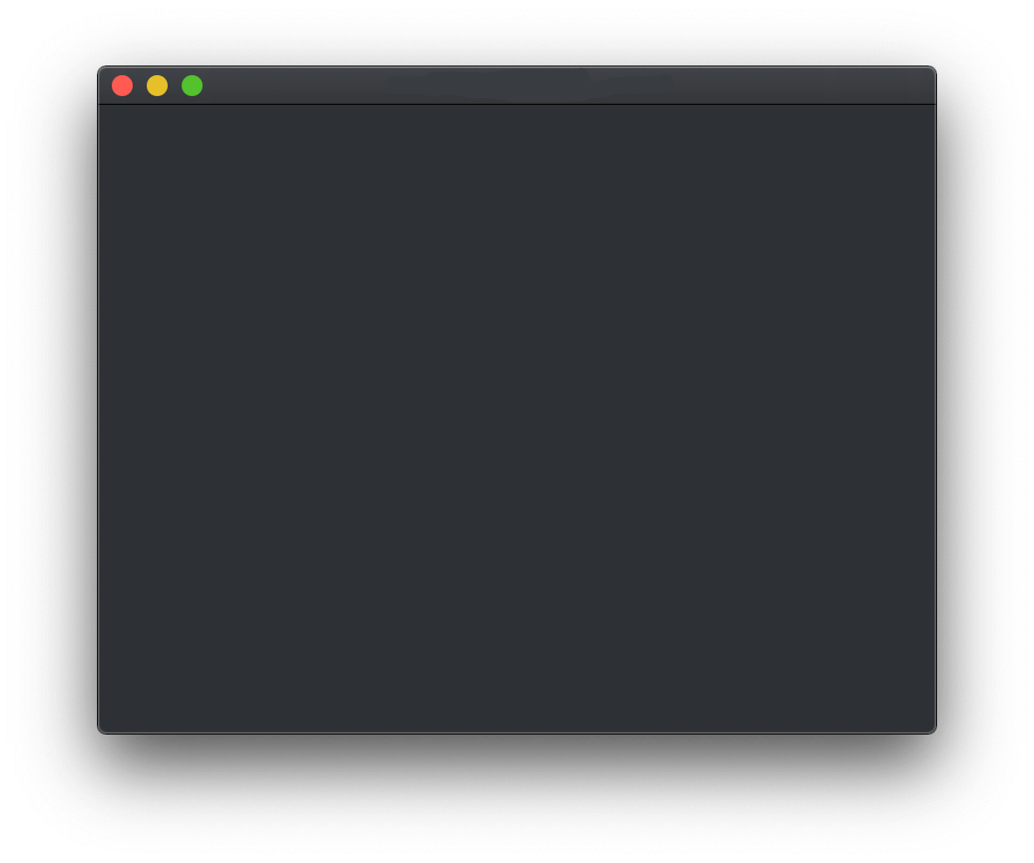
Steps involved in building Decision tree
1.Pre-processing the data
2.Converting the Dependent variable
3.Training the Dataset
4.Getting the result from Trained Data set

Slide 8
1.Pre-processing the data
In this step we pre-process the our data to get numeric values for different text values we have in the data. This is useful to train and test the sample data about the decision to use certain drug for a given value of age, sex, BP etc.

Slide 9
2.Converting the dependent varible
we also convert the dependent variable into numerical values so that it can be used in the training as well as the evaluation data set.

Slide 10
3.Training the dataset
Next we use 30 percent of the supplied data as a training data set. This will be use as the basis for creating the classification for the remaining 70 percentages which we will call as test data.

Slide 11
4.getting THE RESULT FROM TRAINED DATASET
Now we will apply the decision tree to see the result for the trained data set. Here we will create a tree image based on the input we have and using the criteria called entropy. And finally we calculate the accuracy of the decision tree.

Slide 12
Steps involved in building Decision tree
# The PreRequisites that we actually need
from six import StringIO
from sklearn import tree
import matplotlib.image as mpimg
import pydotplus
import matplotlib.pyplot as plt
from sklearn import metrics
import numpy as np
import pandas as pd
from sklearn.tree import DecisionTreeClassifier
from sklearn import preprocessing
from sklearn.model_selection import train_test_split

Slide 13
Steps involved in building Decision tree
# read and process the data
my_data = pd.read_csv("drug200.csv", delimiter=",")
my_data[0:5]
my_data.shape
X = my_data[['Age', 'Sex', 'BP', 'Cholesterol', 'Na_to_K']].values
le_sex = preprocessing.LabelEncoder()
le_sex.fit(['F', 'M'])
X[:, 1] = le_sex.transform(X[:, 1])
le_BP = preprocessing.LabelEncoder()
le_BP.fit(['LOW', 'NORMAL', 'HIGH'])
X[:, 2] = le_BP.transform(X[:, 2])

Slide 14
Steps involved in building Decision tree
#Training Dataset
le_Chol = preprocessing.LabelEncoder()
le_Chol.fit(['NORMAL', 'HIGH'])
X[:, 3] = le_Chol.transform(X[:, 3])
y = my_data["Drug"]
X_trainset, X_testset, y_trainset, y_testset = train_test_split(
X, y, test_size=0.3, random_state=3)

Slide 15
Steps involved in building Decision tree
# set up the tree properties
drugTree = DecisionTreeClassifier(criterion="entropy", max_depth=4)
drugTree
drugTree.fit(X_trainset, y_trainset)
predTree = drugTree.predict(X_testset)
print(predTree[0:5])
print(y_testset[0:5])
print(" Accuracy: ", metrics.accuracy_score(y_testset, predTree))
%matplotlib inline

Slide 16
Steps involved in building Decision tree
# building the image
dot_data = StringIO()
filename = "drugtree.png"
featureNames = my_data.columns[0:5]
targetNames = my_data["Drug"].unique().tolist()
out = tree.export_graphviz(drugTree, feature_names=featureNames, out_file=dot_data, class_names=np.unique(
y_trainset), filled=True, special_characters=True, rotate=False)
graph = pydotplus.graph_from_dot_data(dot_data.getvalue())
graph.write_png(filename)
img = mpimg.imread(filename)
plt.figure(figsize=(100, 200))
plt.imshow(img, interpolation='nearest')

Slide 17
Lets jump to the simulation part☺
By Mohammed Sayeed(1si18cs057) and MNM Varun(1si18cs057)

