Slide 1
Notes:
WCF Fundamentals
Monitoring WCF Services with AppFabric
Windows 7 | Presenter Mode

Slide 2

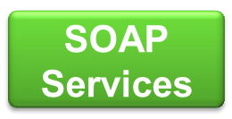









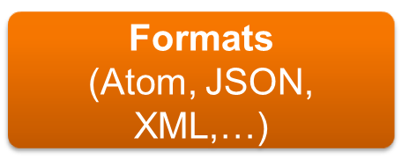

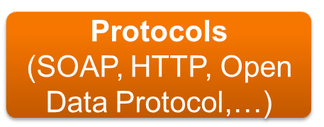
Programming Model
Service Model
Notes:
In the .NET platform we have a way to build services. That way is with WCF. I know that you thought WCF was just for SOAP services. We want you to think differently about it. It is a platform for building services that consists of a channel model that supports many different transports, formats and protocols.
It has a service model that allows you to describe the attributes of your service (if you want to)
And then on top of that is a programming model which provides you with a wide variety of choices for building services. Yes, you can still build the same old SOAP services with WCF or with Workflow (as Workflow Services) or you can build RESTful services using Web HTTP Services, Data Services and RIA services.
Today I’m going to focus on just two of these services. Whenever you see a picture like this you start asking which one should I use? It would be a simple answer if there was no overlap between capabilities, but there is overlap.
You could solve many of the same problems using the technologies I’m going to show you.
MIX 09
© 2009 Microsoft Corporation. All rights reserved. Microsoft, Windows, Windows Vista and other product names are or may be registered trademarks and/or trademarks in the U.S. and/or other countries.
The information herein is for informational purposes only and represents the current view of Microsoft Corporation as of the date of this presentation. Because Microsoft must respond to changing market conditions, it should not be interpreted to be a commitment on the part of Microsoft, and Microsoft cannot guarantee the accuracy of any information provided after the date of this presentation.
MICROSOFT MAKES NO WARRANTIES, EXPRESS, IMPLIED OR STATUTORY, AS TO THE INFORMATION IN THIS PRESENTATION.

Slide 3







Only WCF Services can leverage AppFabric
Notes:
You may think WCF is hard if you've tried it in the past, but it's just as easy as ASMX and now you get AppFabric, plus it’s extensible so you can take the implementation as far as you need to. There have been many enhancement to WCF 4 that greatly simplify building SOAP services with WCF 4, and with AppFabric to help with monitoring and configuration a lot of that complexity just disappears.
That said, you really should consider WCF if you are currently building ASMX services. From a features stand point ASMX is at the end of what it can do at Hello World, where as WCF is just getting started.

Slide 4

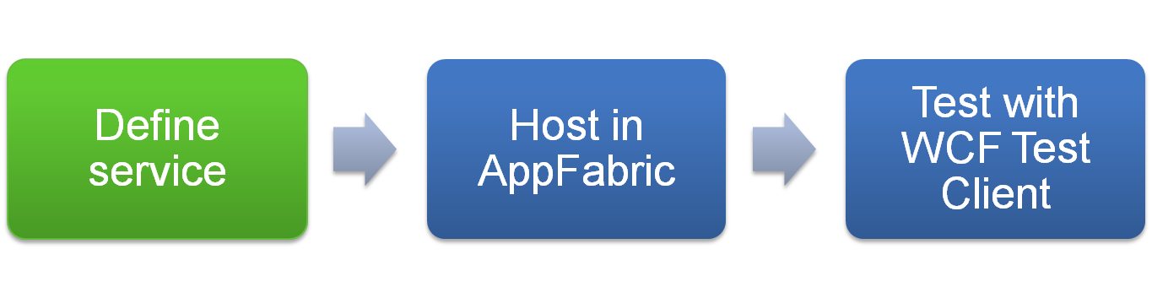
Notes:
Creating a service similar to an ASMX is made easy with WCF, requiring you to only define the service implementation within a single code file.
You could define your service contract interface and seperately implement that interface, but you don’t have to!
After that you host it and test. When developing in Visual Studio, the last two steps are just pressing F5 to start debugging your solution. The WCF Test Client can load automatically, so you don’t have to write a custom client application to test your service as you build it.

Slide 5

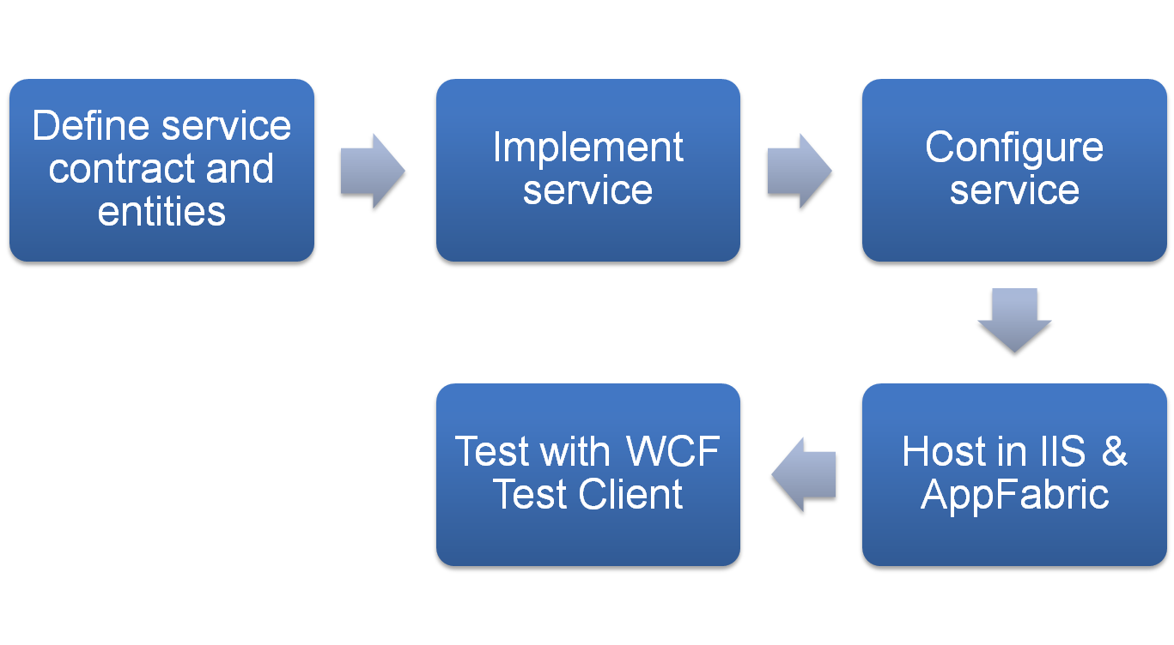
Notes:
In the previous slide, I think you’ll agree that the definition of your service contract and its implementation doesn’t have to be a big endeavor.
Let’s look in a little more detail at the typical process you take when building a WCF SOAP Service in Visual Studio. When you create a new WCF Service Application in Visual Studio, it will automatically follow the best practice principles of Service Oriented Architectures by separating your service contract definition from your service implementation- these will appear in separate code files. It will also provide a starting point you can modify for defining the complex types your service exposes to clients (these are referred to as Data Contracts).
Once both forms of contracts are defined you fill in the implementation for each of the service operations defined in your contract.
If you need to configure any aspects of your service you do this by editing the web.config added by the project template. For example, you may want to control if service metadata (the WSDL) is exposed, or if exception details are sent back to clients.
Next, you should consider hosting in IIS / AppFabric immediately so that you can take advantage of the AppFabric monitoring and configuration features while you are developing. To accomplish this you simply change a project setting from hosting using the Visual Studio Development server to instead create an use a Virtual Directory on the Local instance of IIS.
With that configuration in place, setting your service as the start page and your service as the startup project the F5 experience will attach the debugger to the IIS worker process, and launch the WCF Test Client for you to exercise your service.

Slide 6
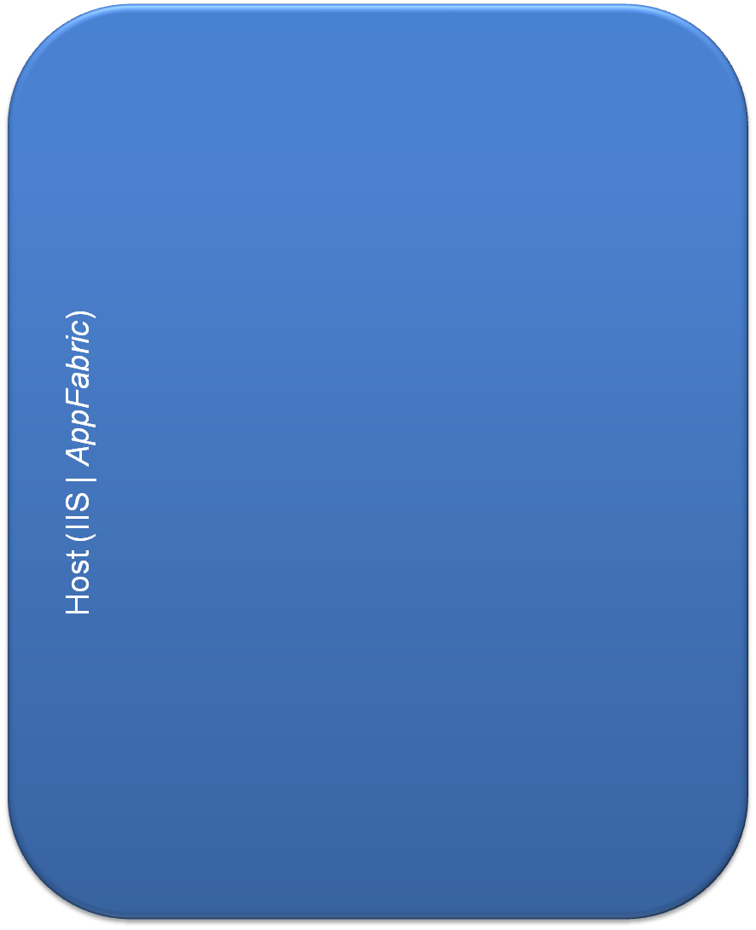
Key Service Concepts
Service Contract (ICalculator)
Data Contract
Operations (signatures)
double Add(double a, double b)
double GetArea(Rectangle r)
Rectangle
double width,
double height
Host
Service Implementation
Service Contract
Data Contract
Service Endpoint (Address, Binding Contract)
Service Behavior
Service Implementation (MyCalc: ICalculator)
Operations (implementation)
double Add(double a, double b)
double GetArea(Rectangle r)
Service Configuration (web.config)
Service Behaviors (Metadata)
Service Endpoint
Address (http://localhost/MyCalc.svc)
Binding(basicHttp)
Service Contract (ICalculator)
Notes:
Now that we’ve covered the general process, let’s take a look at the specific items that go into building a service.
Let’s say we want to build a simple calculation service. It needs to provide to functions to clients: Add (which will take two doubles and return their sum) and GetArea(which takes in a Rectangle complex type and returns the area of that rectangle).
We’ve already established where we will be hosting this service- in IIS with AppFabric.
<CLICK>
This is known as our Host.
<CLICK>
Next, we need to define the service contract, which consists of the signatures of the functions this service will expose to clients defined as an interface. These functions are called operations and the complete interface is what defines the service contract, ICalculator in this case.
<CLICK>
Our calculator service now has a service contract which defines an Add operation and a GetArea operation.
If you think about it, a client might well know about the primitive double type used by Add, but what is the structure of a Rectangle? To ensure that clients understand that a Rectangle is a type that has a Double Width and a Double Height, we need to define a Data Contract of rectangle.
<CLICK>
The Service Contract and Data Contract define what is visible externally to clients of the service. Next, we need to define the internal logic of these operations. We create a Service Implementation by implementing the interface described by the ServiceContract (ICalculator).
<CLICK>
Our service is now defined, but in order to describe how a client reaches it we must configure a Service Endpoint in the web.config. In our case, we want to expose the calculator service using the HTTP protocol. The service endpoint defines three things: the address at which the service can be reached (http://localhost/MyCalc.svc), the Binding (which among other things configures our service to use the HTTP transport protocol) and the Service Contract (ICalculator). Note that in many cases, the default values for service endpoints are sufficient and you don’t have to explicitly provide any of this in your configuration.
<CLICK>
Next, if we want to apply some control over features of our service, we configure these using Service Behaviors. For example, we typically want our service to expose its service metadata (e.g., the service and data contracts) via HTTP- this is done by adding a service behavior. Again, the configuration defaults in WCF 4 mean you end up only specifying the few behaviors you need and often times this means you don’t need to define any at all.
In the end, WCF 4 makes it easy to build services because:
It allows you to focus on your service implementation (light gray boxes), providing default configurations for the most common scenarios (dark gray boxes).
When you do need config, IIS Manager and AppFabric now provide the UI tools to help you.
Windows 7 | Presenter Mode

Slide 7
Notes:
In this demo, we show how easy it is to build a simple WCF service.
Create new project from the WCF Service Application project template
Examine SVC, SVC.CS and .config
- Different from ASMX: use of interface for service contract, data contract. These are optional, but considered a best practice.
Change project properties to use virtual directory and host within IIS (so we can use AppFabric from the very beginning).
Set svc as Start Page.
Show Service helper page in browser.
F5 Run.
Allow WCF Client to load.
Execute service with WCF Test client.
Windows 7 | Presenter Mode

Slide 8


Notes:
In previous versions, WCF was seen as hard because of the amount of configuration required. WCF introduces these items geared to reducing that burden:
File-Less (Config Based) Activation
As you saw in the demo, a service is typically exposed by means of an SVC file. In situations where you have 100’s or thousands of service, managing all of these files can be difficult. WCF 4 introduces a way to define the service endpoint without having to create a physical file. This is accomplished by adding the configuration shown to the web.config.
Inheritance Model for Configuration
The configuration model of web.configs is hierarchical from the server node, down thru the web site and application. WCF 4 introduces an inheritance model for WCF specific configuration that allows you to define common settings at a top-level node and use them lower down in the hierarchy. This way if you have lots of services that have a common configuration, you can defined this configuration once higher up and whenever you need to make changes you only change it in the single location instead of for every service.
Default Protocol Mapping
The default protocol mapping effectively applies a bunch of configuration based on the scheme of your service’s address. For example, the address of your service is http://localhost/Calculator.svc, then the scheme is HTTP. By default this means that WCF 4 will use the HTTP protocol for this service and apply a basicHttpBinding. However, you may want the default to use the wsHttpBinding instead. You can override this default protocol mapping by adding the configuration shown in your web.config.

Slide 9

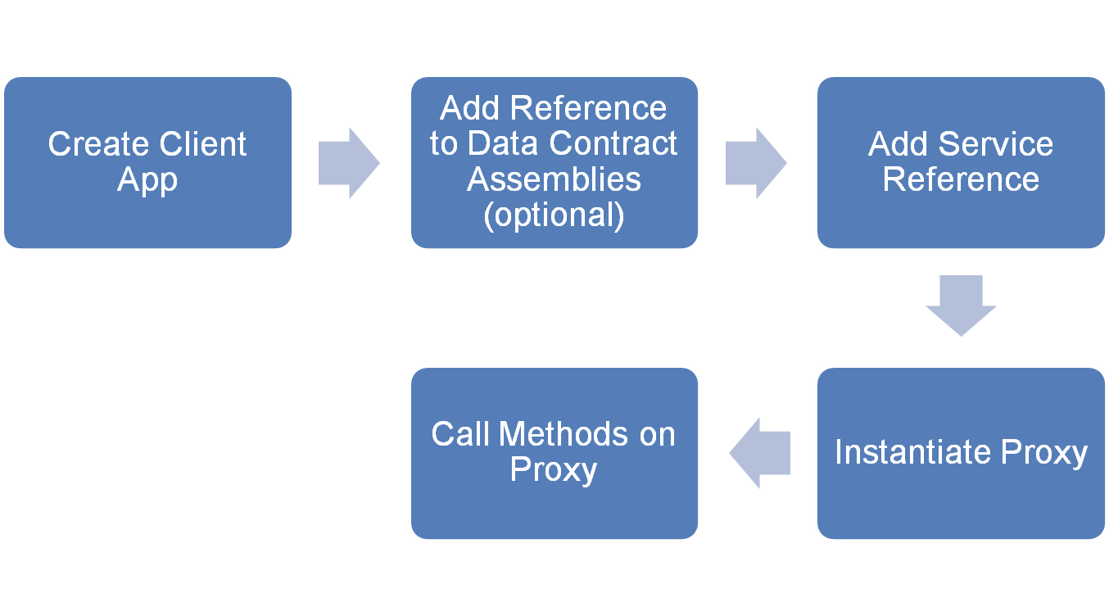
Notes:
When you want to call your service from another application, you will want to build a client proxy to it.
Within your client project in Visual Studio, this means adding a Service Reference to your project pointing to the address of your service’s metadata (WSDL). Behind the scenes a new set of types will be created for both the being able to invoke the operations on your service as well as for any complex types described by your services datacontracts.
You then simply instantiate an instance of the generated client type, referred to as a proxy to your service, and call the appropriate methods on it to invoke your service.
In situations where you may be calling multiple services that use the same complex types, for example they all share the Rectangle type, you will want to add a reference to the assembly containing the Rectangle type before you Add the Service Reference. By doing this, Visual Studio will not create new types for the Rectangle, it will use the types available in the referenced assembly. To understand why this is important lets take the example of using two services that have the Rectangle type. If we do not reuse the types from the Data Contract assemblies, then each service reference has its own definition of the Rectangle type. Simply put this means that a Rectangle in service A is not the same as Rectangle in service B. This means that if the result of calling an operation on Service A is a rectangle, and you wish to pass this rectangle to Service B you end up having to create an instance of the Rectangle defined by the reference to Service B and copy the values to it. On the other hand, if you re-use the types from a data contract assembly, then you can simply pass the result from an operation on Service A directly to Service B.
Windows 7 | Presenter Mode

Slide 10
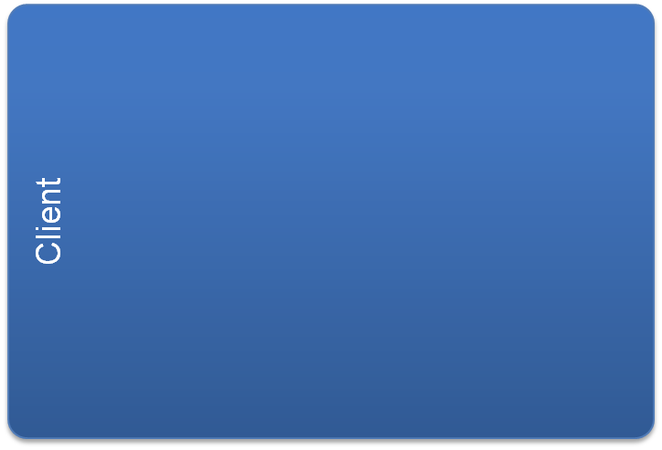


Key Client Concepts
Proxy Instance (MyCalcClient)
proxy.Add(5,2)
Client Configuration (app.config)
Proxy
Endpoints
Messages
Service Instance
Client Endpoint
Address (http://localhost/MyCalc.svc)
Binding(basicHttp)
Service Contract (ICalculator)
Add(5,2)
7
Service Instance
Notes:
Returning to our example of the Calculator service, let’s examine how a call from our proxy looks.
First we need to create an instance of our proxy.
<CLICK>
By default this will use the configuration added by Visual Studio to the app.config when you used Add Service Reference. This configuration defines how to reach the service, and what protocols to use within a Client Endpoint.
<CLICK>
Calling the Add operation the proxy causes a message (that contains the name of the operation to invoke as well as the values of the parameters) to be built up and sent to the service instance.
<CLICK>
The service then send the result by means of a response message.
Windows 7 | Presenter Mode

Slide 11


Notes:
Best practices for using a proxy
Not using USING
Wrap try/catch (Exception), abort proxy, throw
Close proxy
Windows 7 | Presenter Mode

Slide 12

Notes:
Create a new ASP.NET Web Application.
Open Default.aspx, replace the content with a text box, a button and a label.
Starting with Client ASP.NET site that contains text field (for value of GetData parameter) and Invoke button.
Add Service Reference to Typical Service. Point out discover button (helpful when service is in same solution).
Fill in button handler to call GetData on service, passing in text field value. Assign return value of call to text of label.
Run the website.
Enter a number in the text box and click the button. Observe the result appears in the label.
Windows 7 | Presenter Mode

Slide 13

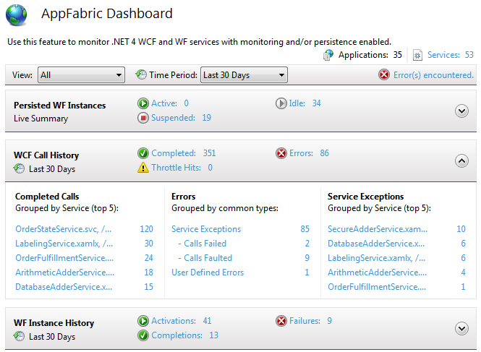
Notes:
AppFabric Provides a lot of UI Support for WCF Services. The primary entry point to these events is thru the AppFabric Dashboard available within IIS Manager at the Server, Site and Application levels.
The Dashboard offers a WCF Call History band, that enables you to see a summary of successfully completed calls, service exceptions, user defined errors as well when throttle limits have been hit.
Windows 7 | Presenter Mode

Slide 14
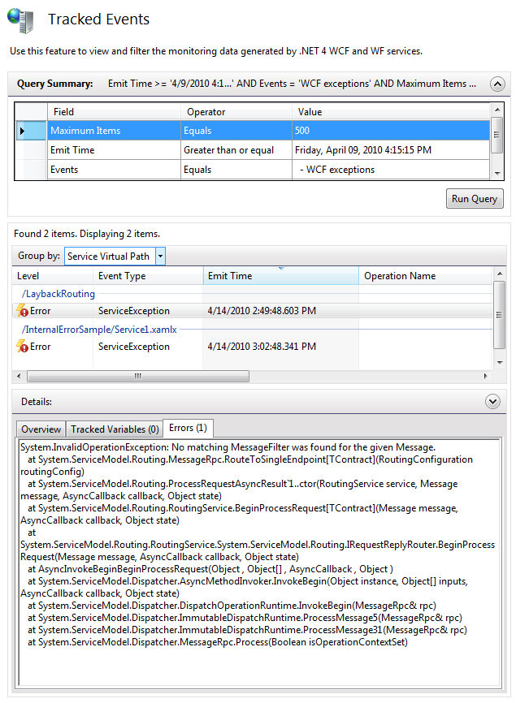
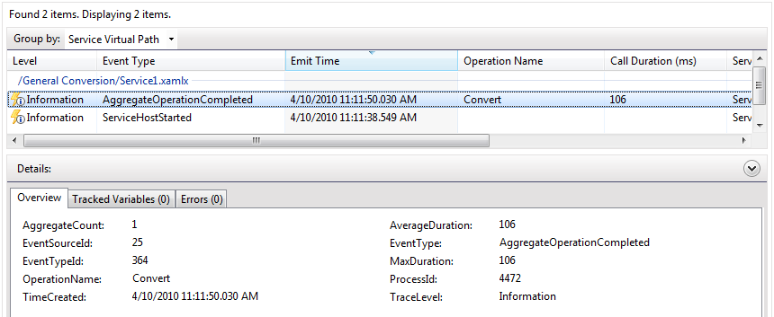
Tracked Events
Normal Operation: ServiceHost events
Aggregates for Operations
Completed Calls
Troubleshooting:
Throttling
Service Exceptions
User Defined Errors Failed Calls
Faulted Calls
Notes:
Drilling down from the Dashboard AppFabric provides the Tracked Events View which allows you to define a query for events of interest.
The Tracked Events view can be used to monitor the normal operation of WCF SOAP Services, such as an aggregate view of completed calls and their average duration, or when a Service Host is started.
It can also be used in troubleshooting to view exceptions or user defined errors, and the actual error message that was emitted.
Windows 7 | Presenter Mode

Slide 15

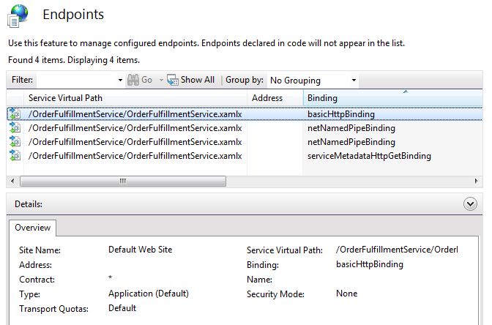
Notes:
You can use AppFabric to view a list of endpoints for services in single application or for all services in a website or even on the server.
From this view, you can select Application defined endpoints(e.g., non-System endpoints that are defined in a service’s web.config-defined) and configure them. For example, you can configure the Endpoint Address or Transport Quotas.
Windows 7 | Presenter Mode

Slide 16

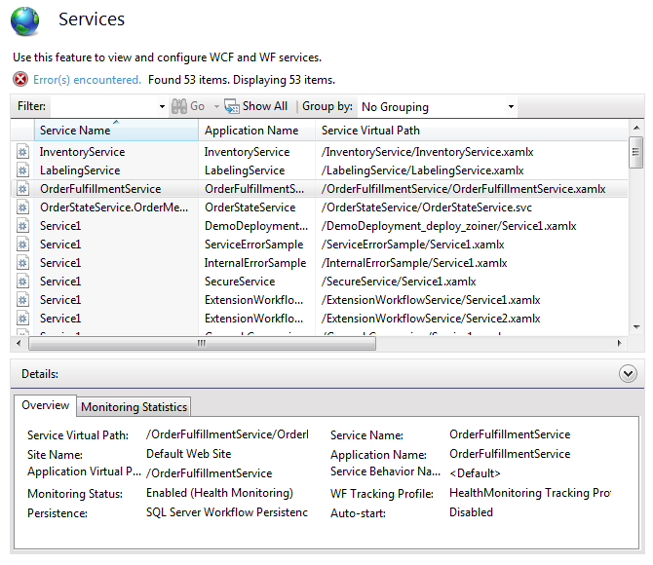
Notes:
You can also view a list of all services under the Server, Site or Application (depending on which node you have selected in the Connections Pane in IIS Manager)
In this view you can select a single service to get an at-a-glance- overview of its configuration. The Monitoring Statisics tab provides a dashboard of collected events for just the selected service (count of Calls Completed, Calls Received, Calls Faulted, Calls Failed).
With a single service selected you can also bring up a configuration dialog with support for enabling the Metadata endpoint, configuring Throttling, and Certificates.
Windows 7 | Presenter Mode

Slide 17

Notes:
Open IIS Manager and navigate to the Typical Service application previously created, and view its dashboard.
Call out the WCF Call History band, point out Completed Calls (which should show your recent call.
Click the entry under completed calls to drill into the listing of completed calls. Point out the event with the operation name Get is from a call to get the service metdata, when Add Service Reference was used. The calls to GetData occurred when invoked from the WCF Test Client and the Web Site respectively. Point out that the query can be changed to show different types of events, and show Grouping By Operation Name.
Call out the durations in Tracked Events, and that these are averages across an aggregate by default. The aggregation eases reading the listing by minimizing repeated events.
Back up to the Home view and open the Endpoints feature
Clear the filter.
Call out that's it's now easy to see what endpoints are listening, and what bindings they are using for all services in an application, across the website, or even across the entire server.
Back up to the Home view and open the Services feature. Point out this lets you see at a glance all the services in the application, website or server.
Select the service in the listing, examine the Overview tab and callout that it allows you to see the service's important configuration aspects without having to look at configuration.
Click the Monitoring Statistics tab, and show. This is another quick way to get a summary view of the service activity.
Conclude, that AppFabric provides a lot of tooling that helps you monitor your WCF Code Services and requires no setup other than hosting in IIS.
Windows 7 | Presenter Mode

Slide 18


DiagnosticSection config = (DiagnosticSection) WebConfigurationManager.GetSection("system.serviceModel/diagnostics");
providerId = new Guid(config.EtwProviderId);
myEventProvider = new EventProvider(providerId);
errorDescriptor = new EventDescriptor(ErrorEventId, Version, Channel, ErrorLevel, Opcode, Task, Keywords);
error event id's 301,302,303 mean error, warning, info respectively
myEventProvider.WriteEvent(ref errorDescriptor, title, serviceName, errorMessage);
WCFUserEventProvider eventWriter = new WCFUserEventProvider();
eventWriter.WriteErrorEvent(“AddOperation”, “An error occurred.”);
Notes:
You may have noticed in the AppFabric Dashboard a section of User Defined errors. Your WCF Services can emit custom events called user events that the AppFabric tooling can display, query for and summarize. The general pattern for creating a user defined event is the approach you follow for emitting any form of ETW event:
Get the ETW ProviderID from configuration, Create an EventProvider instance for that ID. Define and EventDescriptor that provides the severity of the event and then write the event.
Instead of writing this boilerplate code in every service, you can use the WCFUserEventProvider class provided with the WCF 4 samples and get your events written out in two lines.
Windows 7 | Presenter Mode

Slide 19
Notes:
In this demo we show he we create and use user defined events in the Fourth Coffee scenario and use AppFabric to view them.
Open the FourthCoffee solution.
Open the OrderStateService.svc.cs.
Examine the UpdateStatus method’s use of both an Error and Info event.
Open the WCF Test Client, and point it to the OrderStateService at http://localhost/OrderStateService/OrderStateService.svc
Execute the UpdateStatus method with an OrderId of -1.
Go to the AppFabric Dashboard and observe that a UserDefined Error appears in the WCF Call History band.
Click the link to drill into it.
Select the tracked event, and in the details pane click the Errors tab.
Observe it indicates that the order id was invalid.
Windows 7 | Presenter Mode

Slide 20
Introducing WCF Services
Notes:
Windows 7 | Presenter Mode

