Slide 1
KirchhoffNet Binary Classification
A physical neural network built from a SPICE circuit — trained with the simulator's own adjoint sensitivity, no PyTorch, no backprop library, no grid search.
binary_reg/ | KirchhoffNet Project

Slide 2
The Big Idea: Circuits as Neural Networks
- Traditional Neural Network
- y = activation(W . x + b)
- Gradients via backpropagation
- (chain rule through layers)
- Runs on GPU matrix multiplications
- KirchhoffNet (this project)
- Input -> starting voltage on a
- capacitor (initial condition)
- Computation -> the circuit's
- transient response over time
- Output -> voltage at node net4
- at the final time step
- Weights -> DC bias voltage
- sources (gate biases)
- Gradient -> adjoint sensitivity
- from the SPICE simulator
The physics of the circuit IS the computation — Kirchhoff's Current Law enforces the math. Hence "KirchhoffNet."
Section 2 — The Big Idea

Slide 3
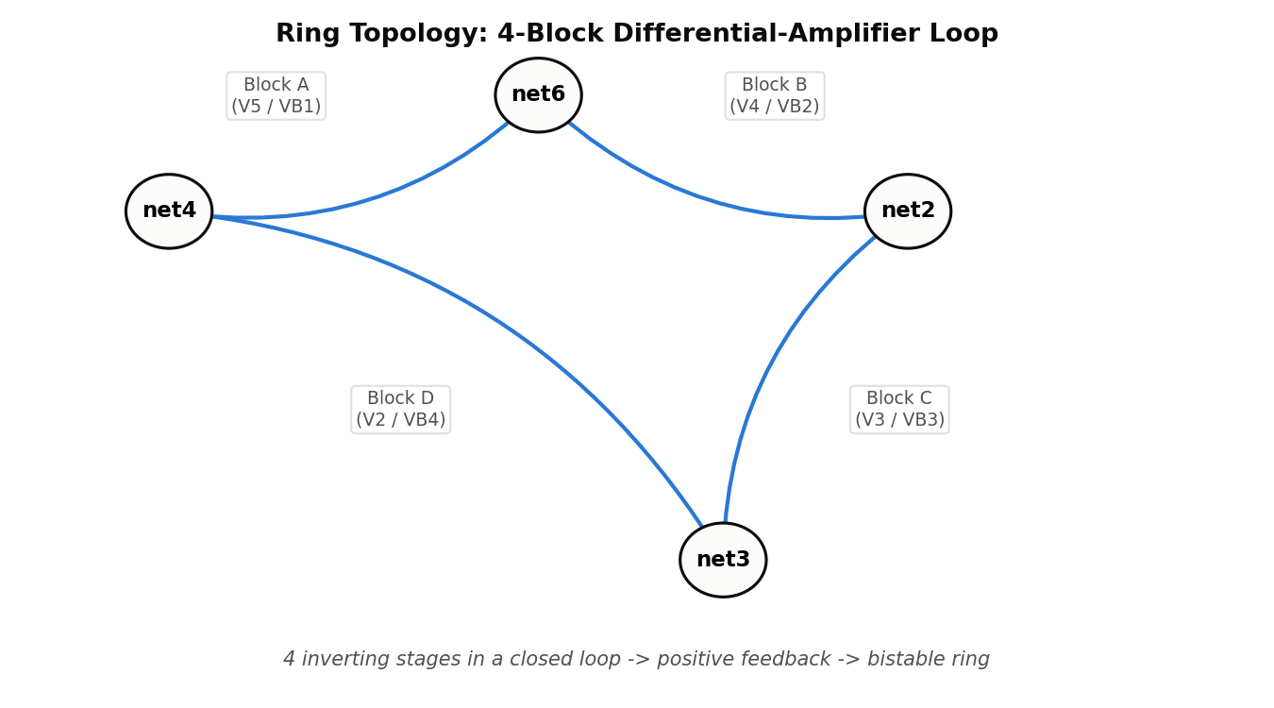
The Circuit: A Ring of 4 Differential Amplifiers
Section 3 — Circuit Topology

Slide 4
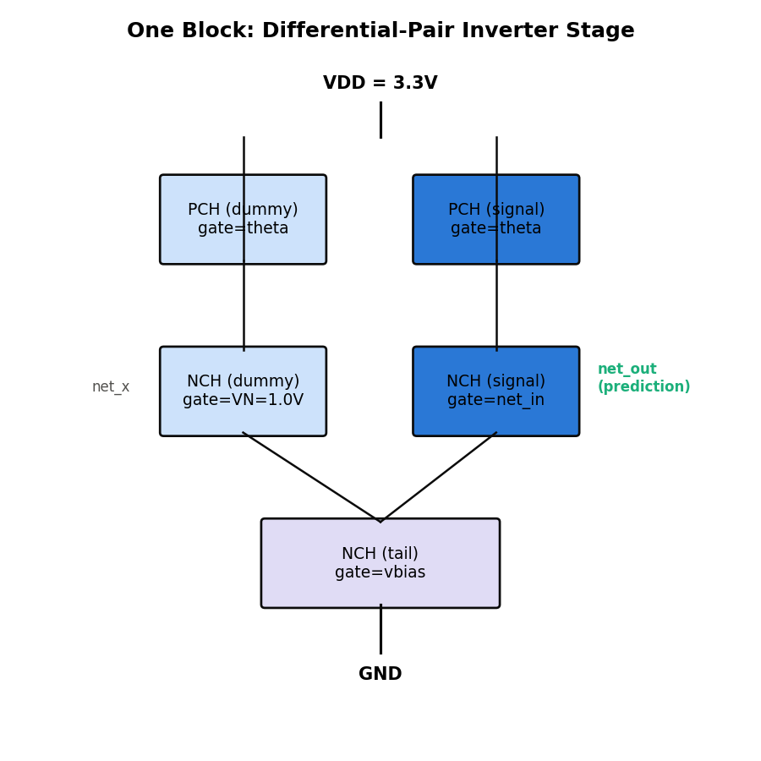
One Block: Differential-Pair Inverter Stage
- How it inverts:
- Dummy NMOS gate fixed at VN = 1.0V
- Signal NMOS gate driven by previous node
- net_in > VN -> signal branch wins -> output pulled LOW
- net_in < VN -> dummy branch wins -> output pulled HIGH
- One stage = one inverter relative to VN
Parameter | NMOS (NCH) | PMOS (PCH)
Threshold VTO | 0.531 V | -0.71 V
Process gain KP | 120 uA/V2 | 40 uA/V2
Channel modulation | 0.02 V-1 | 0.02 V-1
Timing: 0.1pF cap per node -> tau = R*C = 100ns. Diagnostics run to 100ns; final evaluation runs to 1us (10 tau) to guarantee full latch.
Section 3 — Circuit Topology

Slide 5
8 Circuit Parameters — Only 1 Is Trained
Name | Role | Init (V) | Trained?
V5 | PMOS gate bias, Block A (theta1) | 1.7 | No
V4 | PMOS gate bias, Block B (theta2) | 1.7 | No
V3 | PMOS gate bias, Block C (theta3) | 1.7 | No
V2 | PMOS gate bias, Block D (theta4) | 1.7 | YES
VB1 | Tail NMOS bias, Block A | 0.8 | No
VB2 | Tail NMOS bias, Block B | 0.8 | No
VB3 | Tail NMOS bias, Block C | 0.8 | No
VB4 | Tail NMOS bias, Block D | 0.8 | No
- Why only V2?
- V2 controls the PMOS load strength in Block D — the block
- that reads the classification input IC(net3) and drives net4.
- Lowering V2 -> stronger PMOS -> can override the NMOS
- differential even when IC(net3) is slightly above VN.
- This shifts the decision threshold from 1.0V toward 1.2V.
- Blocks A/B/C sustain the feedback loop, not the threshold.
- VBx changes affect the whole ring's time constant, risking
- failure to latch within tstop — so they stay fixed.
Section 3 — 8 Trainable Parameters

Slide 6
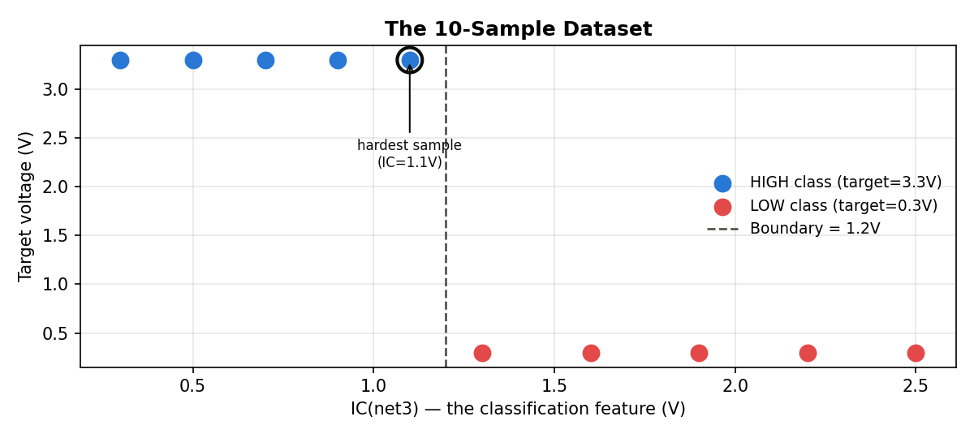
The Dataset: 10 Samples, Binary Classification
- Input encoding
- IC(net3) is the sole classification feature
- Set as capacitor initial condition:
- .IC V(net3) = 1.1
- The other 3 ring nodes (net4, net6, net2)
- are NOT inputs — they're biased toward the
- target attractor to help the ring latch
- correctly (see next slide).
5 HIGH-class samples (IC < 1.2V, target 3.3V) + 5 LOW-class samples (IC > 1.2V, target 0.3V). Boundary = 1.2V. Sample IC=1.1V is the hardest (closest to the boundary).
Section 4 — The Dataset

Slide 7
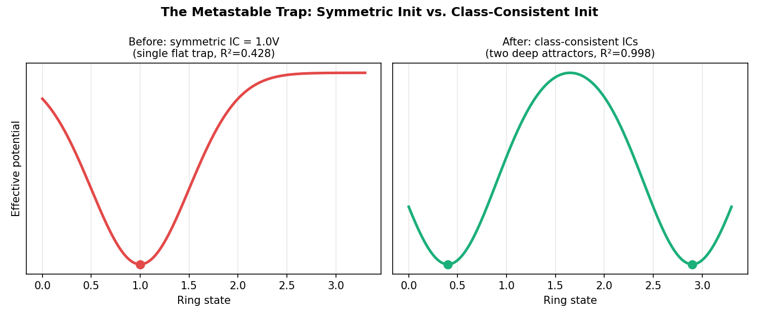
The Metastable Trap — and How We Escaped It
- Problem: with all ring nodes starting at the neutral VN=1.0V, 7 of 10 samples got permanently stuck near 1.2V — R² capped at 0.428, no matter how long the simulation ran.
- Root cause: a signal at net3 must travel Block D -> A -> B -> C before reinforcing itself. Blocks A/B/C see IC=VN (perfectly balanced) and amplify nothing — the perturbation dies before completing one loop.
- Fix: start the other 3 ring nodes near their target-class attractor instead of at the neutral midpoint. This gives the ring a strong initial slope, and the feedback loop fires immediately. R² jumped from 0.428 -> 0.998 before any training even began.
Section 6 — The Metastable Trap

Slide 8
How the Circuit Classifies
- Forward pass (one sample)
- 1. Write a SPICE netlist with current params + sample ICs
- 2. Run transient simulation (100ns train / 1us eval)
- 3. Read V(net4) at the final time step
- 4. That voltage is the circuit's prediction
- V(net4) ~ 3.3V -> predicted HIGH
- V(net4) ~ 0.4V -> predicted LOW
IC(net3) < 1.0V:
signal NMOS weaker than dummy
-> PMOS load wins -> net4 -> HIGH
IC(net3) > 1.0V:
signal NMOS stronger than dummy
-> NMOS wins -> net4 -> LOW
Training moves this threshold
from 1.0V toward 1.2V by shifting V2.
The R2 metric
R2 = 1 - SS_res / SS_tot
SS_res = sum( (predicted - target)^2 ) SS_tot = sum( (target - mean(target))^2 )
All 10 samples correct -> R2 ~ 0.998 (LOW attractor sits at ~0.4V, not exactly 0.3V)
Section 5 — How the Circuit Classifies

Slide 9
Training: Teacher-Student with Adjoint Sensitivity
We can't backprop through a SPICE simulator like PyTorch does. Instead we use the simulator's built-in adjoint engine to get dV(net4)/dV2 directly, inside a teacher-student framework:
Role | V2 value | Purpose
Student | starts at 1.70V (trainable) | Circuit being trained
Teacher | fixed at 1.60V | Proxy target — stronger PMOS in Block D
- Why train at 10ns but evaluate at 1us?
- At t=10ns (1/10 of tau): ring still transient, capacitors charging.
- dV(net4,10ns)/dV2 is large and meaningful for every sample.
- At t=1us (10x tau): ring fully latched to a binary attractor.
- This is the real classification output — used only for R2 evaluation.
- Training directly at 1us would give near-zero gradients (already decided).
Section 7 — Training Strategy

Slide 10
The Math Behind the Update Rule
Loss (MSE vs teacher @ 10ns): MSE = (1/N) * sum_i ( v_student(x_i,10ns) - v_teacher(x_i,10ns) )^2
Gradient: dMSE/dV2 = (2/N) * sum_i ( error_i * sens_V2_i )
sens_V2_i = dV(net4,t_final)/dV2 <- exactly the simulator's adjoint output
Update (sign-SGD, fixed step): V2_new = V2_old - LR * sign(g_V2) LR = 0.001 V/epoch
Why sign-SGD instead of a full gradient step? Sensitivity magnitude varies enormously across samples (~1e-3 near saturation to ~1e-8 already-saturated) — a raw gradient step would be dominated by whichever sample has the largest sensitivity. Sign-SGD is scale-invariant and is the simplest possible descent rule: one direction, one fixed step, no optimizer state.
Section 8 — The Math

Slide 11
What Is Adjoint Sensitivity?
- Forward problem
- Given circuit parameters + initial conditions, solve for V(t) at every node (standard SPICE transient simulation).
- Sensitivity problem
- How does the output V(net4, t_final) change if we nudge one parameter (e.g. V2) by a tiny amount? Naively this means re-running the whole simulation once per parameter (finite differences) — slow and numerically noisy.
- The adjoint method
- Solves one extra, backward-in-time linear system (using the same Jacobian factorization as the forward pass) to get exact derivatives d(output)/d(every parameter) simultaneously — no matter how many parameters exist, at roughly the cost of one extra forward-like solve.
- This is the circuit-domain equivalent of backpropagation, computed by the simulator itself rather than by an ML framework.
Section 9 — Adjoint Sensitivity

Slide 12
The Training Loop (One Epoch)
for each of the 10 samples:
1. write a SPICE netlist with current student params + sample ICs
2. run transient simulation to t = 10 ns WITH sensitivity=True
3. read v_pred = V(net4, 10ns)
4. read sens_V2 = dV(net4, 10ns) / dV2 <- from the adjoint engine
5. error_i = v_pred - teacher_target_i
6. accumulate: g_V2 += error_i * sens_V2_i
g_V2 /= 10 # average over all 10 samples
V2_new = V2_old - LR * sign(g_V2) # LR = 0.001 V per epoch
# then, forward-only (no sensitivity -- faster):
evaluate R2 at t = 1 us vs the true binary labels
Section 7 — Training Loop

Slide 13
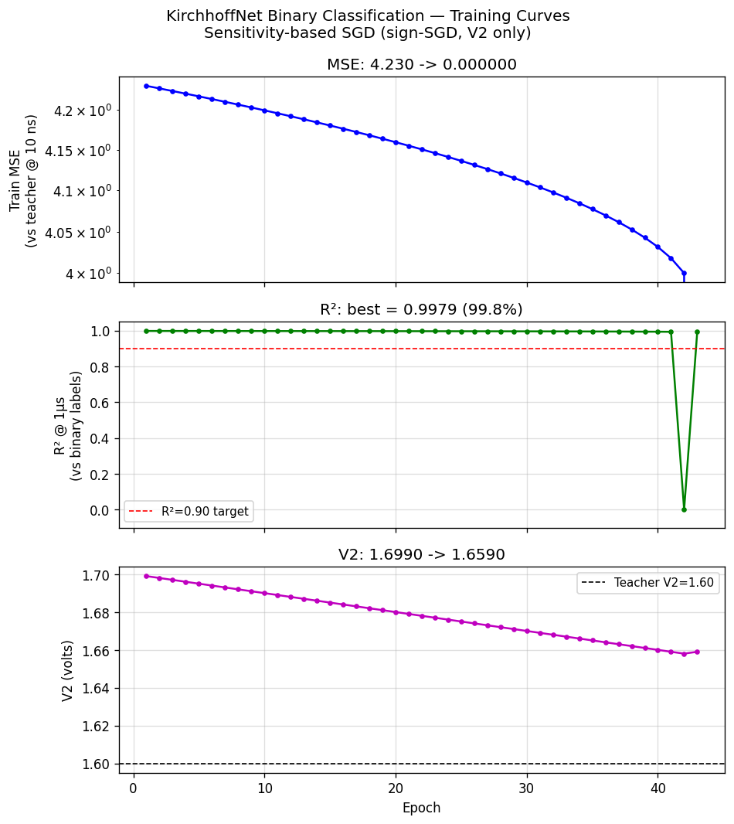
Results
Metric | Epoch 1 | Epoch 43
Train MSE | 4.230 | 0.000
R2 (vs labels) | 0.9979 | 0.9931*
V2 | 1.699 V | 1.659 V
- 43 epochs to converge (MSE < 1e-4 stop)
- Best R2 = 0.9979 (99.8% accuracy)
- All 10 samples classified correctly
- *Brief dip at epoch 42:
- V2 crosses the bifurcation point;
- one boundary sample briefly flips
- state, R2 dips to 0, then resolves
- back to 0.998 by epoch 43.
- Expected circuit behavior at a
- bifurcation — not a training bug.
Section 12 — Results

Slide 14
Design Decisions and Why
- Why only train V2, not all 8 parameters?
- V2 shifts Block D's threshold without affecting the ring's time constants; VBx changes affect slew rate ring-wide and risk failure to latch.
- Why teacher V2 = 1.60V?
- 0.10V lower than student init (1.70V) — a meaningfully stronger PMOS, still within safe operating range.
- Why LR = 0.001V per epoch?
- The threshold window is ~0.1V wide, so ~40 epochs is reasonable. A larger LR (0.005V) was tested and overshot the bifurcation point in one step, crashing R2 from 0.43 to -0.50.
- Why not Adam or another adaptive optimizer?
- Explicit requirement: the simplest training method possible. Sign-SGD with a fixed step has no momentum, no schedule, no optimizer state — and it works reliably for this circuit.
Section 13 — Design Decisions

Slide 15
Key Takeaways
-> A real SPICE circuit can be trained as a classifier using only the simulator's adjoint sensitivity — no ML framework needed.
-> Circuit topology matters: a 4-stage ring is inherently bistable (positive feedback); this is a feature for classification, not a bug.
-> Initial conditions can trap a system in a metastable state — class-consistent ICs fixed this project's R2 ceiling of 0.428 instantly.
-> The simplest possible optimizer (fixed-step sign-SGD on a single, well-chosen parameter) reliably reached R2 = 0.998 in 43 epochs.
-> Training and evaluation don't have to happen at the same simulated time — short-time transients give gradient signal; long-time settling gives ground truth.
KirchhoffNet Binary Classification — binary_reg/

