Slide 1
Kirchhoffnet Structure
A visual walkthrough of the closed-loop ring architecture and training flow
This system uses a simulated analog circuit as a nonlinear feature extractor for toy-data classification.
A 2D input is encoded into the initial state of a 10-stage closed-loop ring, the ring evolves for 100 ns, and the resulting node voltages are used to train a softmax readout.

Slide 2
System Overview
From raw input to class prediction
2D input
(x, y)
Encoder
2 -> 10 seeds
Closed-loop
10-stage ring
Readout
10 -> 2 scores
Softmax
probabilities
Simulator generated portion
The input is a point in 2D space. ( twomoon, circle, spiral)
The encoder maps it into 10 initial voltages for the circuit.
The ring acts as the hidden nonlinear feature extractor.
The final readout converts the circuit state into class scores.

Slide 3
2D Input Becomes 10 Initial Values
A simple linear encoding step
Input: x = [x1, x2]
For each node j: s_j = 1.65 + Wj1*x1 + Wj2*x2 + bj
The result is clipped to a safe voltage range [0.3, 3.0].
This creates 10 initial voltages: [s1, s2, ..., s10].
Example:
x = [1, -1]
s1 = 1.65 + 0.4*1 + 0.2*(-1) + 0.05
s2 = 1.65 - 0.3*1 + 0.6*(-1) + 0.02
s3 = 1.65 + 0.1*1 - 0.4*(-1) + 0.03
...
=> [s1, s2, ..., s10]

Slide 4
The Closed-Loop Ring as a Hidden Layer
The circuit evolves from the initial state and produces a richer representation
The circuit has 10 stages arranged in a loop.
Each stage has a signal path, a bias, and a reference.
The ring evolves for 100 ns from the initial seeds.
The values at h1...h10 are read out as the feature vector.
h9
h10
h1
h8
h2
h7
h3
h6
h4
h5

Slide 5
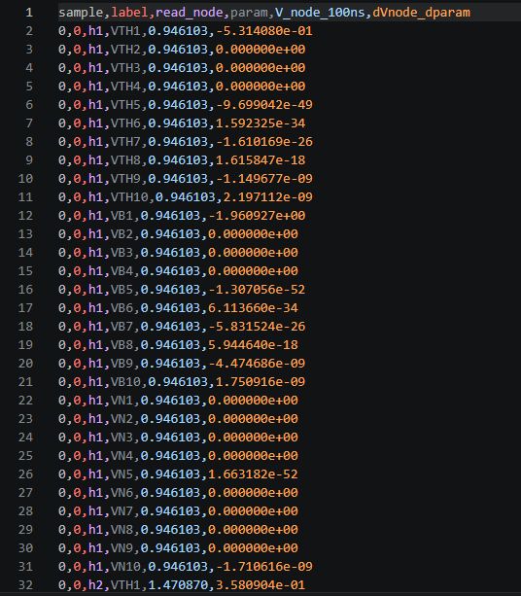
Sensitivity Values

Slide 6
From Circuit State to Classification Using Softmax
The 10 node voltages become 2 class scores
The final state is a 10-dimensional feature vector: [h1, h2, ..., h10].
These values are standardized and passed to a linear readout.
The readout outputs two scores: score0 and score1.
Softmax converts those scores to class probabilities.
score0 = w0,1*h1 + ... + w0,10*h10 + b0
score1 = w1,1*h1 + ... + w1,10*h10 + b1
P(class 0) = exp(score0) / (exp(score0) + exp(score1))
P(class 1) = exp(score1) / (exp(score0) + exp(score1))

Slide 7
Training Flow
How the model learns from the circuit
1. Write a SPICE netlist for the current circuit parameters.
2. Simulate the ring and record the node values at 100 ns.
3. Compute the readout loss and the circuit loss.
4. Use adjoint sensitivities to update the circuit parameters.
5. Update the readout weights with ordinary gradient descent.
Forward pass
Simulation -> h1..h10
Gradient via adjoint
Update circuit + readout

Slide 8
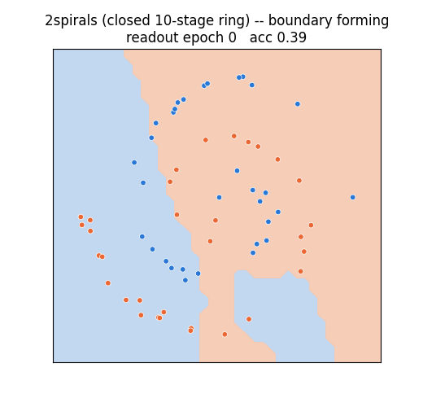
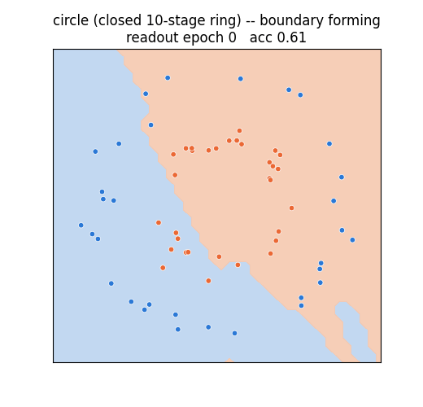
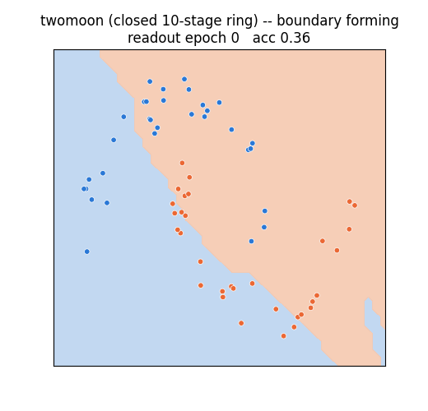
Dataset results

Slide 9
Design Constraint
Current CAD Model:
Hardware
Simulator
Training Algorithm
Inference Model
Not implementable in hardware
CAD to Hardware Conversion:
Hardware
Adjoint Circuit
Training Algorithm
Inference Model
Implementable in hardware

Slide 10
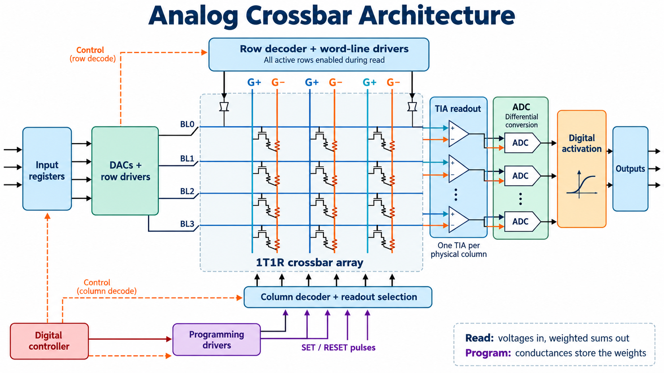

Slide 11
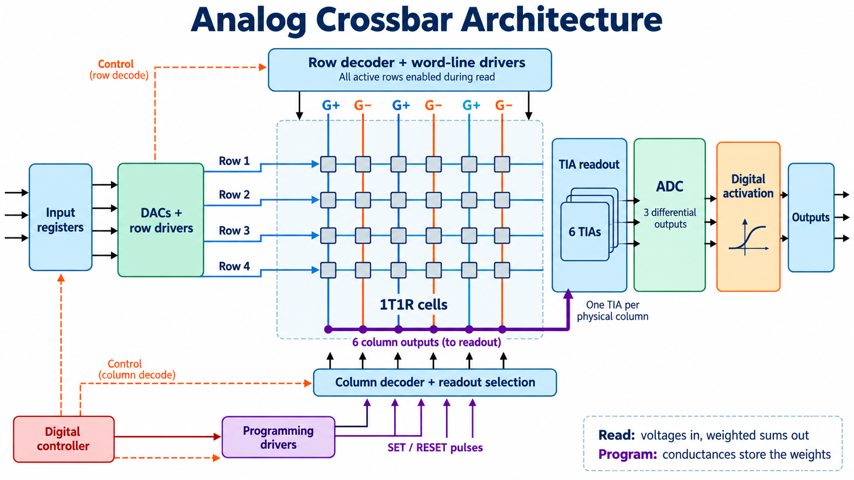

Slide 12
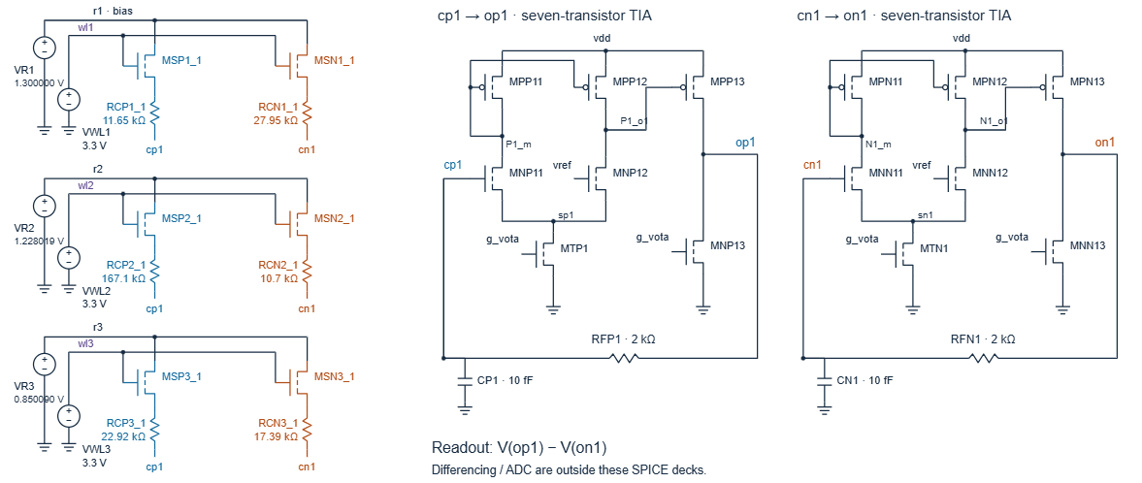
Crossbar parts

Slide 13
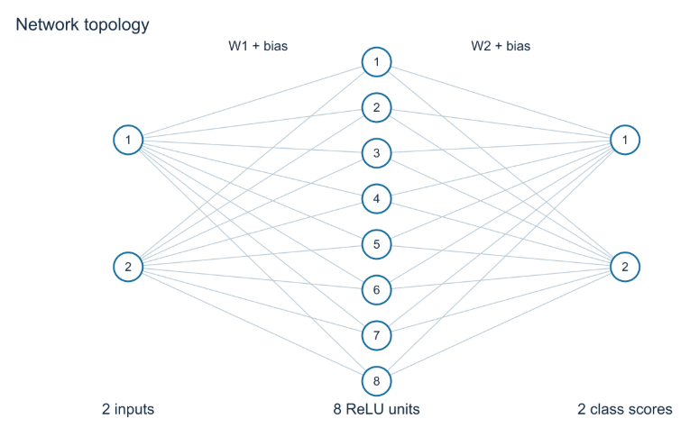
Digital MLP (2-8-2)

Slide 14
