Slide 1




Land Use Transformation and Future Projections in Char Kukri Mukri, Bangladesh: Insights from 47 Years of Satellite Data.
Participant Name: MD. SAYEM
Course Name: Data Science with Python
Batch No: 03
Serial No: 09-003-15
Phone: +8801518953195
Email: msayem20.glm@bu.ac.bd

Slide 2
Abstract
This study investigates land use and land cover (LULC) changes in Char Kukri Mukri Union, located in the southern coastal region of Bangladesh, from 1973 to 2020 using remote sensing and GIS technologies. The study utilizes multi-temporal Landsat satellite imagery and supervised classification techniques to analyze changes in three major land cover categories: forest, cropland, and wetlands. The findings reveal significant LULC transformations over the 47 years, with forest cover increasing by 366.9%, while wetlands experienced notable declines, particularly between 1973–1980 and 1990–2000. Cropland exhibited mixed trends, with periods of both expansion and contraction. The study further examines land area dynamics influenced by the geomorphological processes of the Lower Meghna River, highlighting fluctuations in the formation and erosion of chars (sedimentary landforms). Linear regression models were applied to predict future trends in LULC, projecting continued increases in forest area and variations in cropland and wetland extents up to 2040. These findings underscore the dynamic nature of coastal land use changes driven by natural processes and human interventions. The study provides valuable insights for sustainable land management, environmental conservation, and policymaking in vulnerable coastal regions like Char Kukri Mukri.
Keywords: Land Use and Land Cover (LULC), Remote Sensing, GIS, Char Kukri Mukri, Landsat Imagery, Coastal Dynamics, Linear Regression

Slide 3
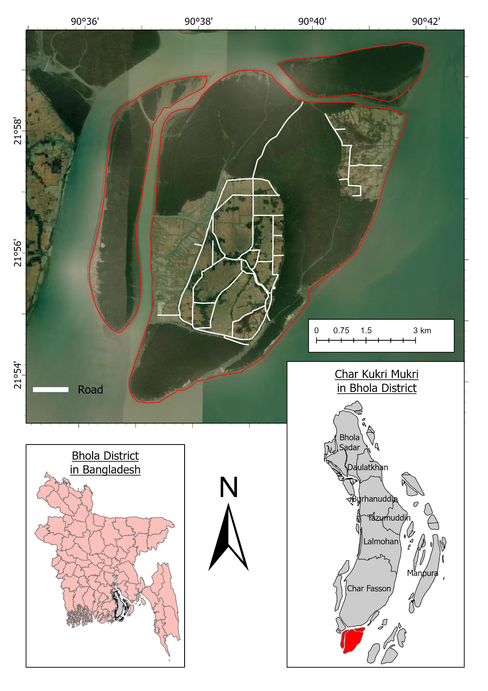
Study Area
Location: Southern Bhola District, Bangladesh
Geographical Coordinates:
21°59'31.3"N to 21°53'37.6"N and 90°36'07.6"E to 90°41'58.0"E
Population: Census data (10,185 in 2022).

Slide 4
Methodology
Data Sources:
Multi-temporal Landsat imagery (1973, 1980, 1990, 2000, 2010, 2020) from USGS Earth Explorer.
Data Processing:
Image Preprocessing: Radiometric and spatial enhancements.
Classification: Supervised classification using Maximum Likelihood Classifier (MLC).
Analysis:
LULC Change Detection
Char area analysis
Linear Regression for future prediction (2040).
Software: ArcGIS Pro, Python Libraries (Pandas, Matplotlib).

Slide 5
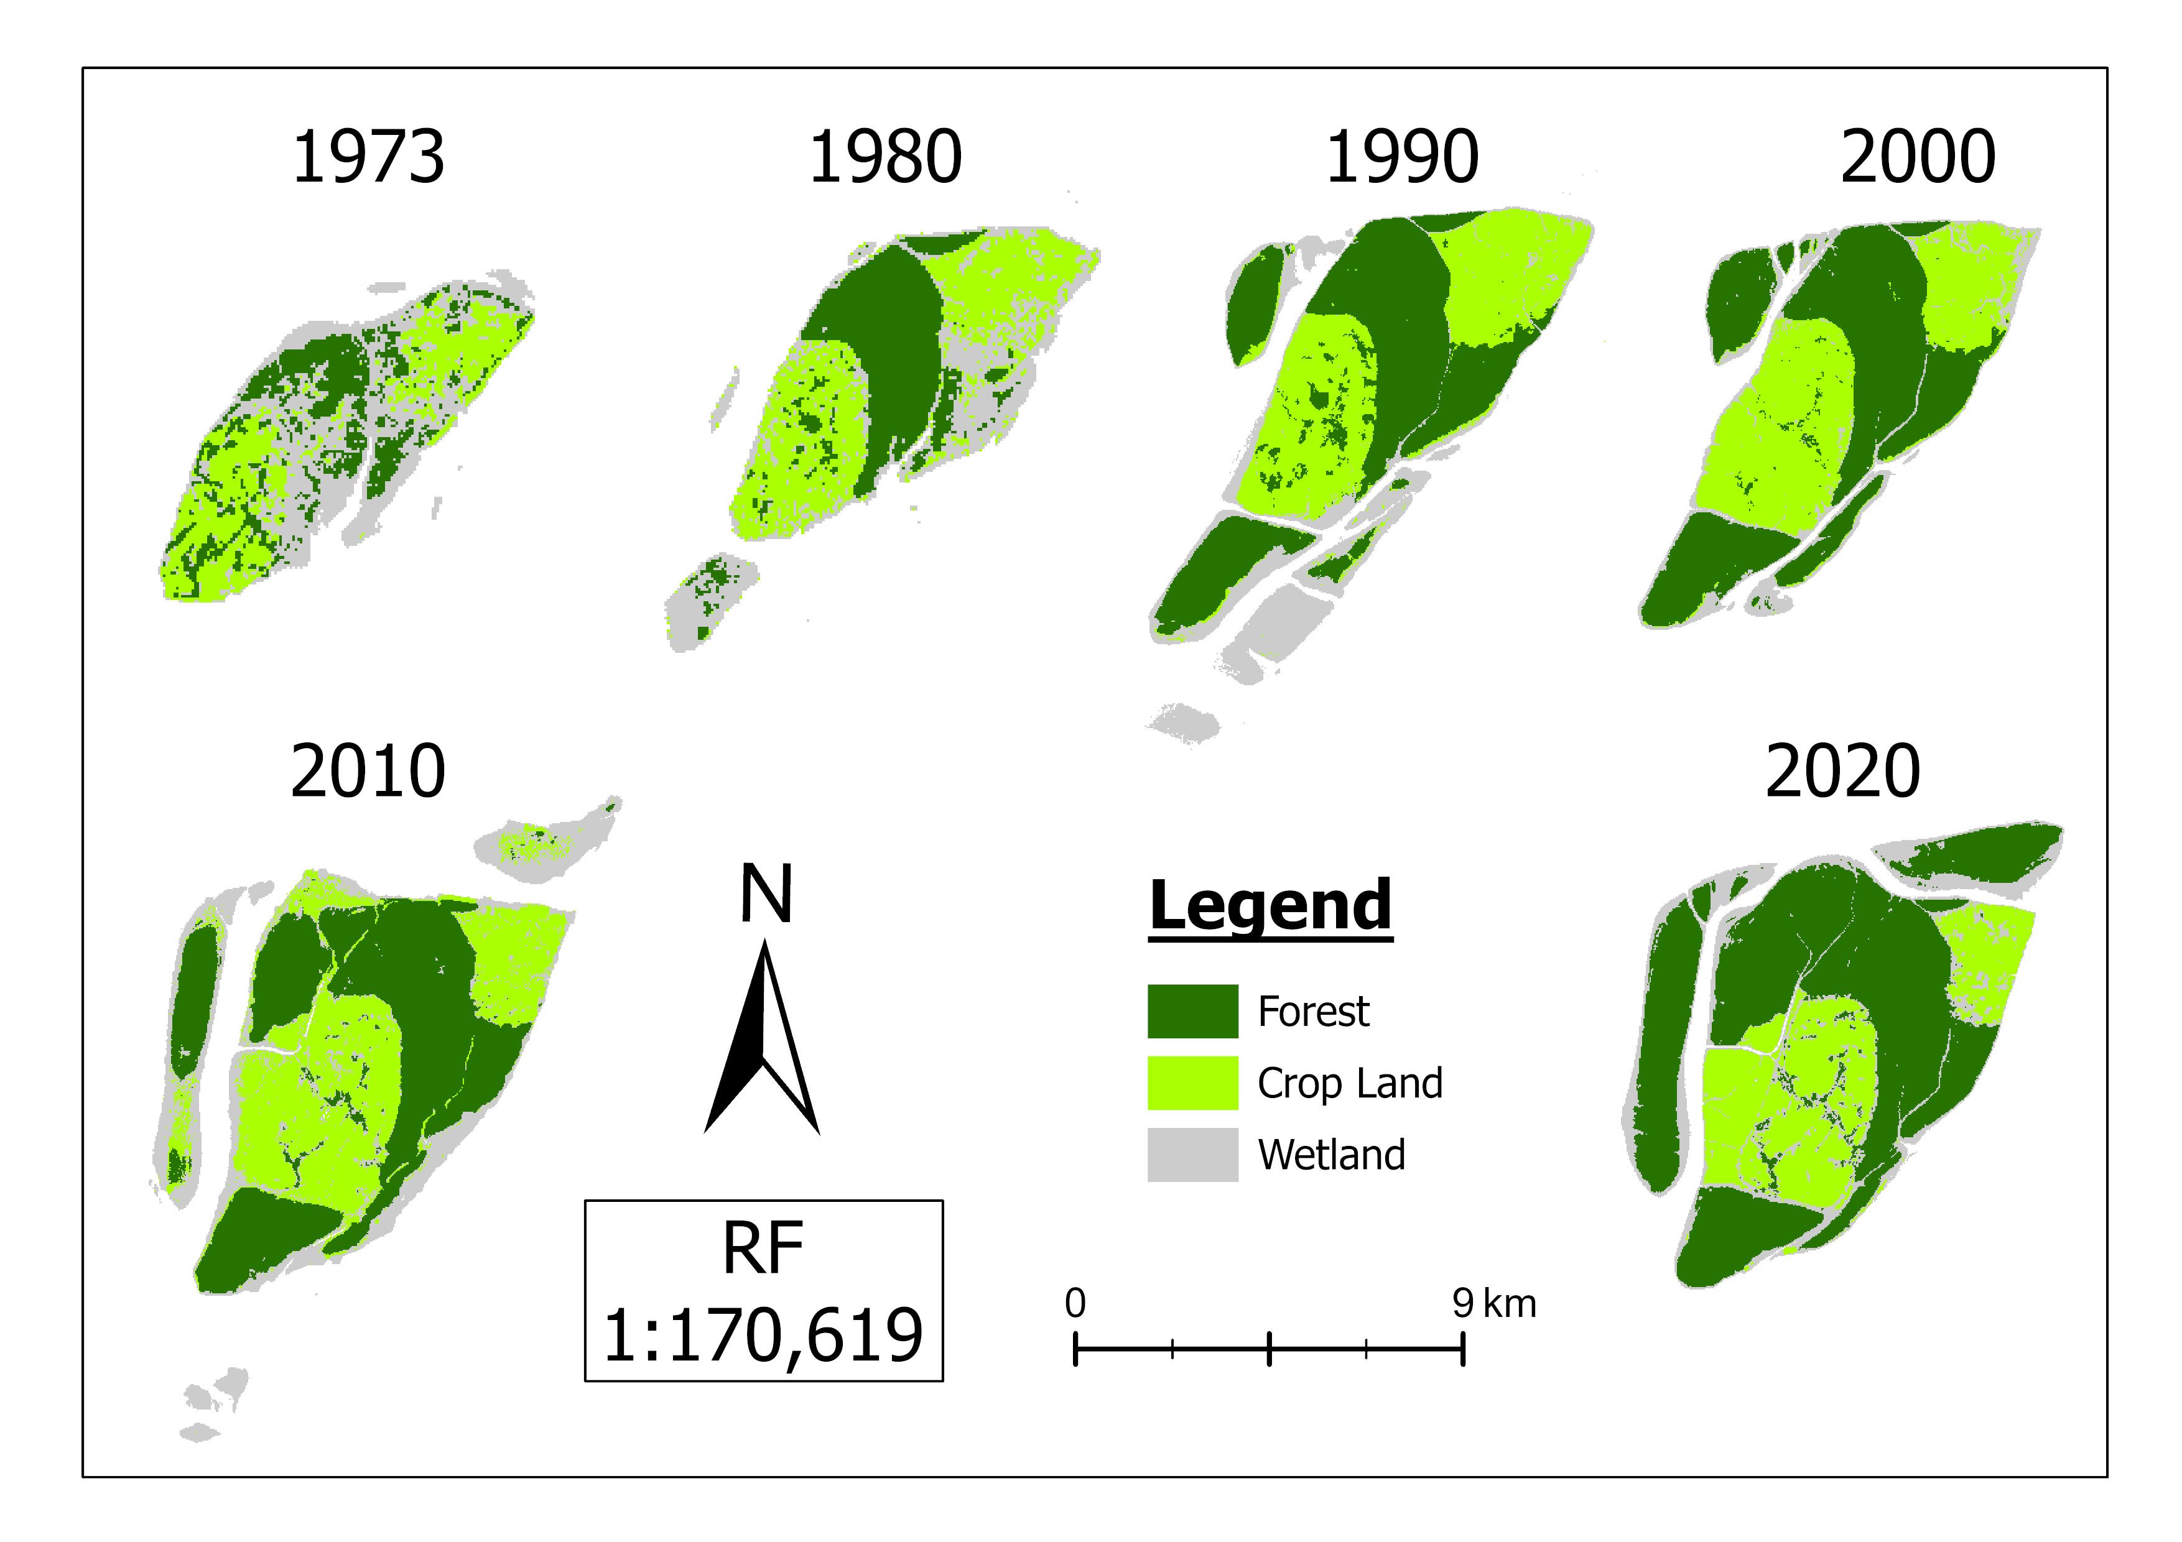
Result & Discussion
Land Use and Land Cover Change for the year 1973, 1980 1990, 2000, 2010, 2020

Slide 6
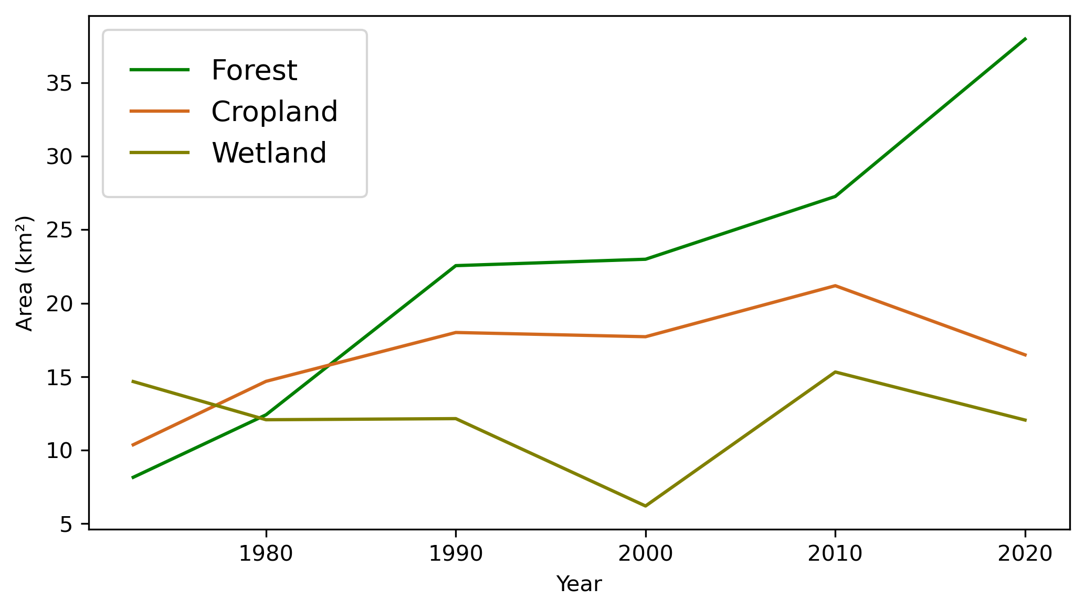
Trends in Forest, Cropland, and Wetland Areas in Char Kukri Mukri (1973–2020)

Slide 7
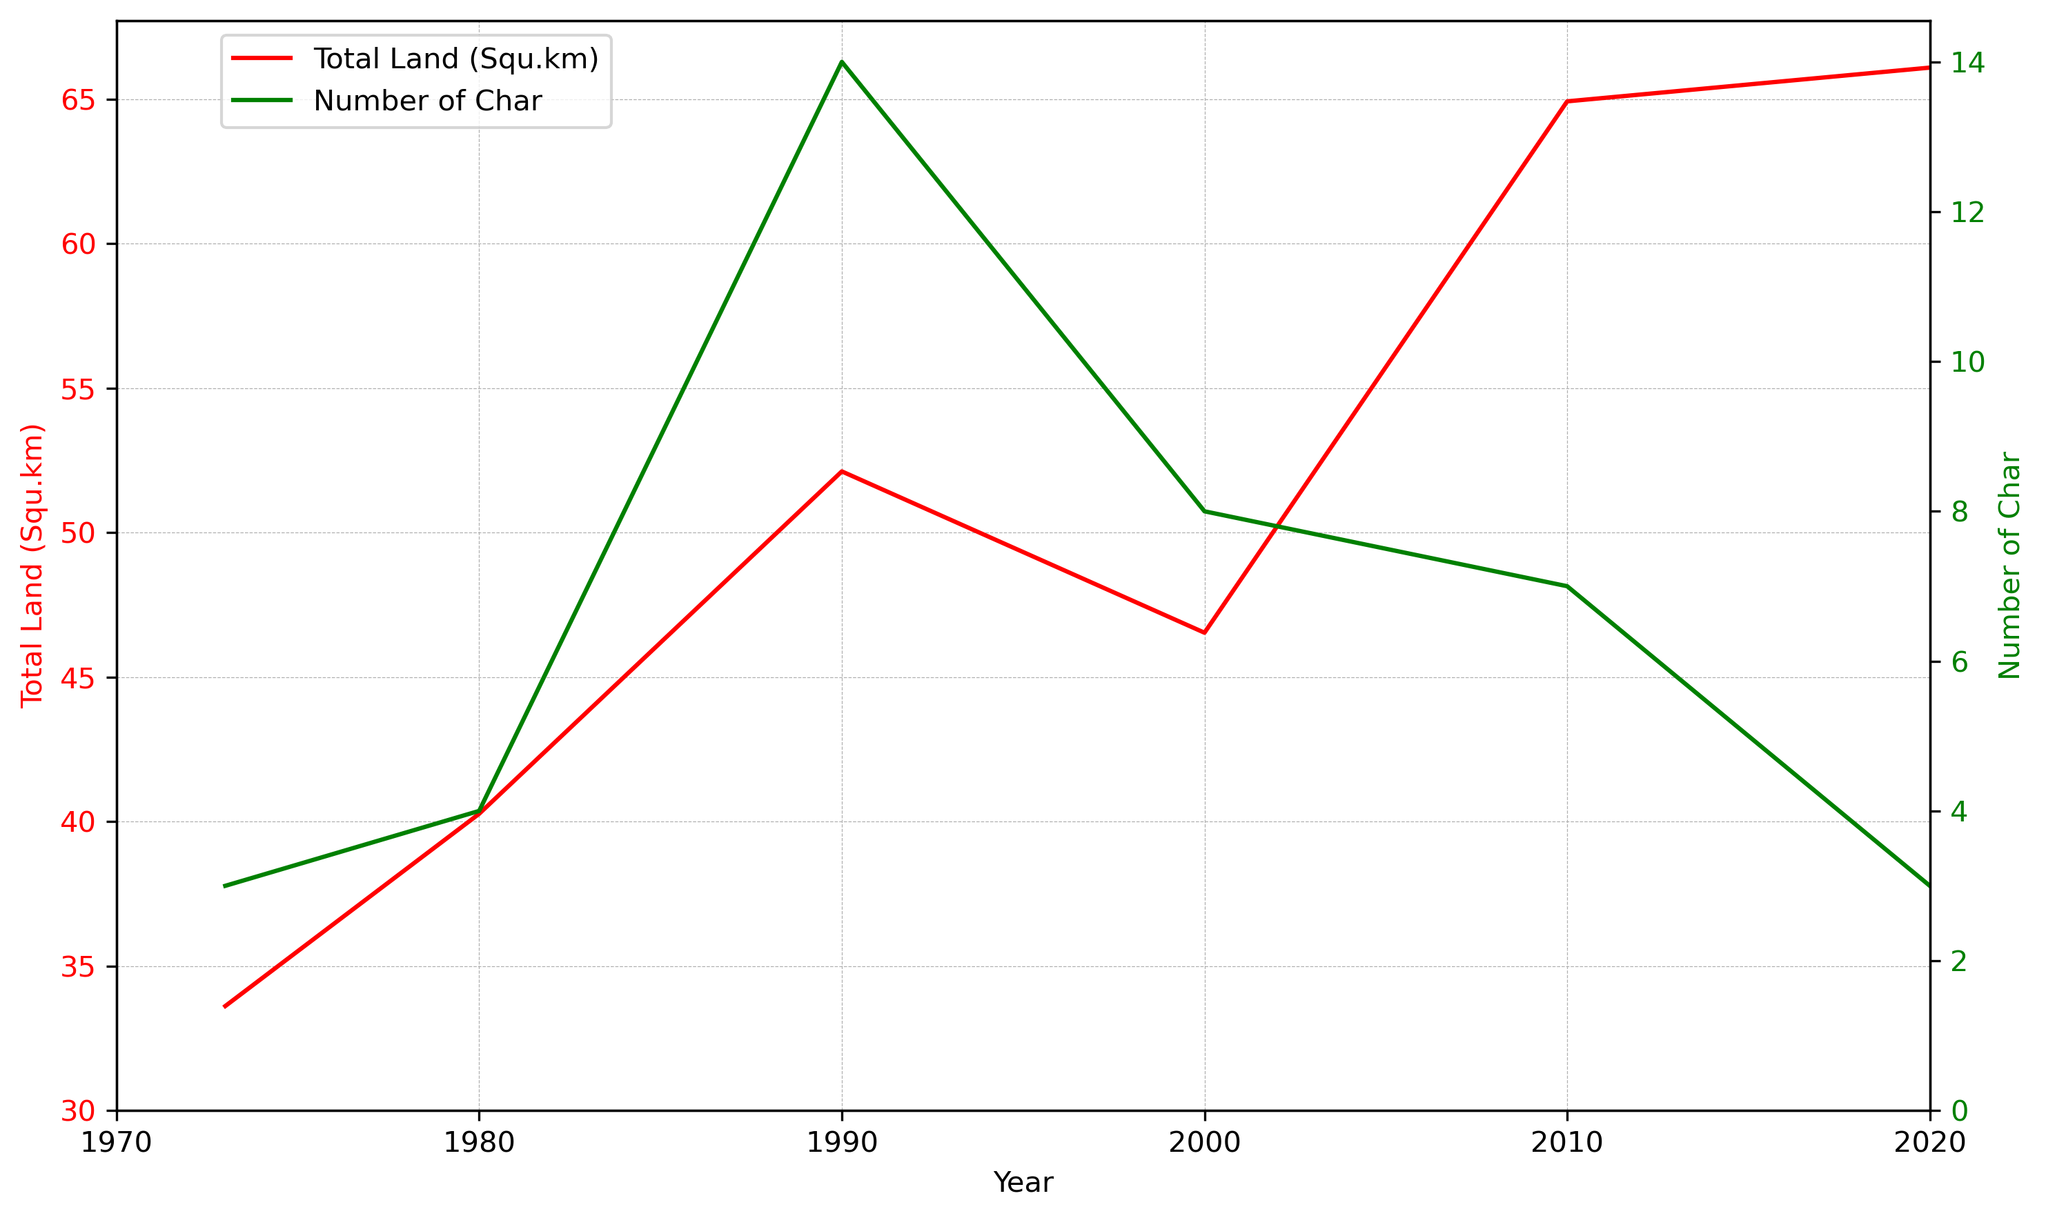
Changes in Total Land Area and Number of Chars in Char Kukri Mukri (1973–2020)

Slide 8
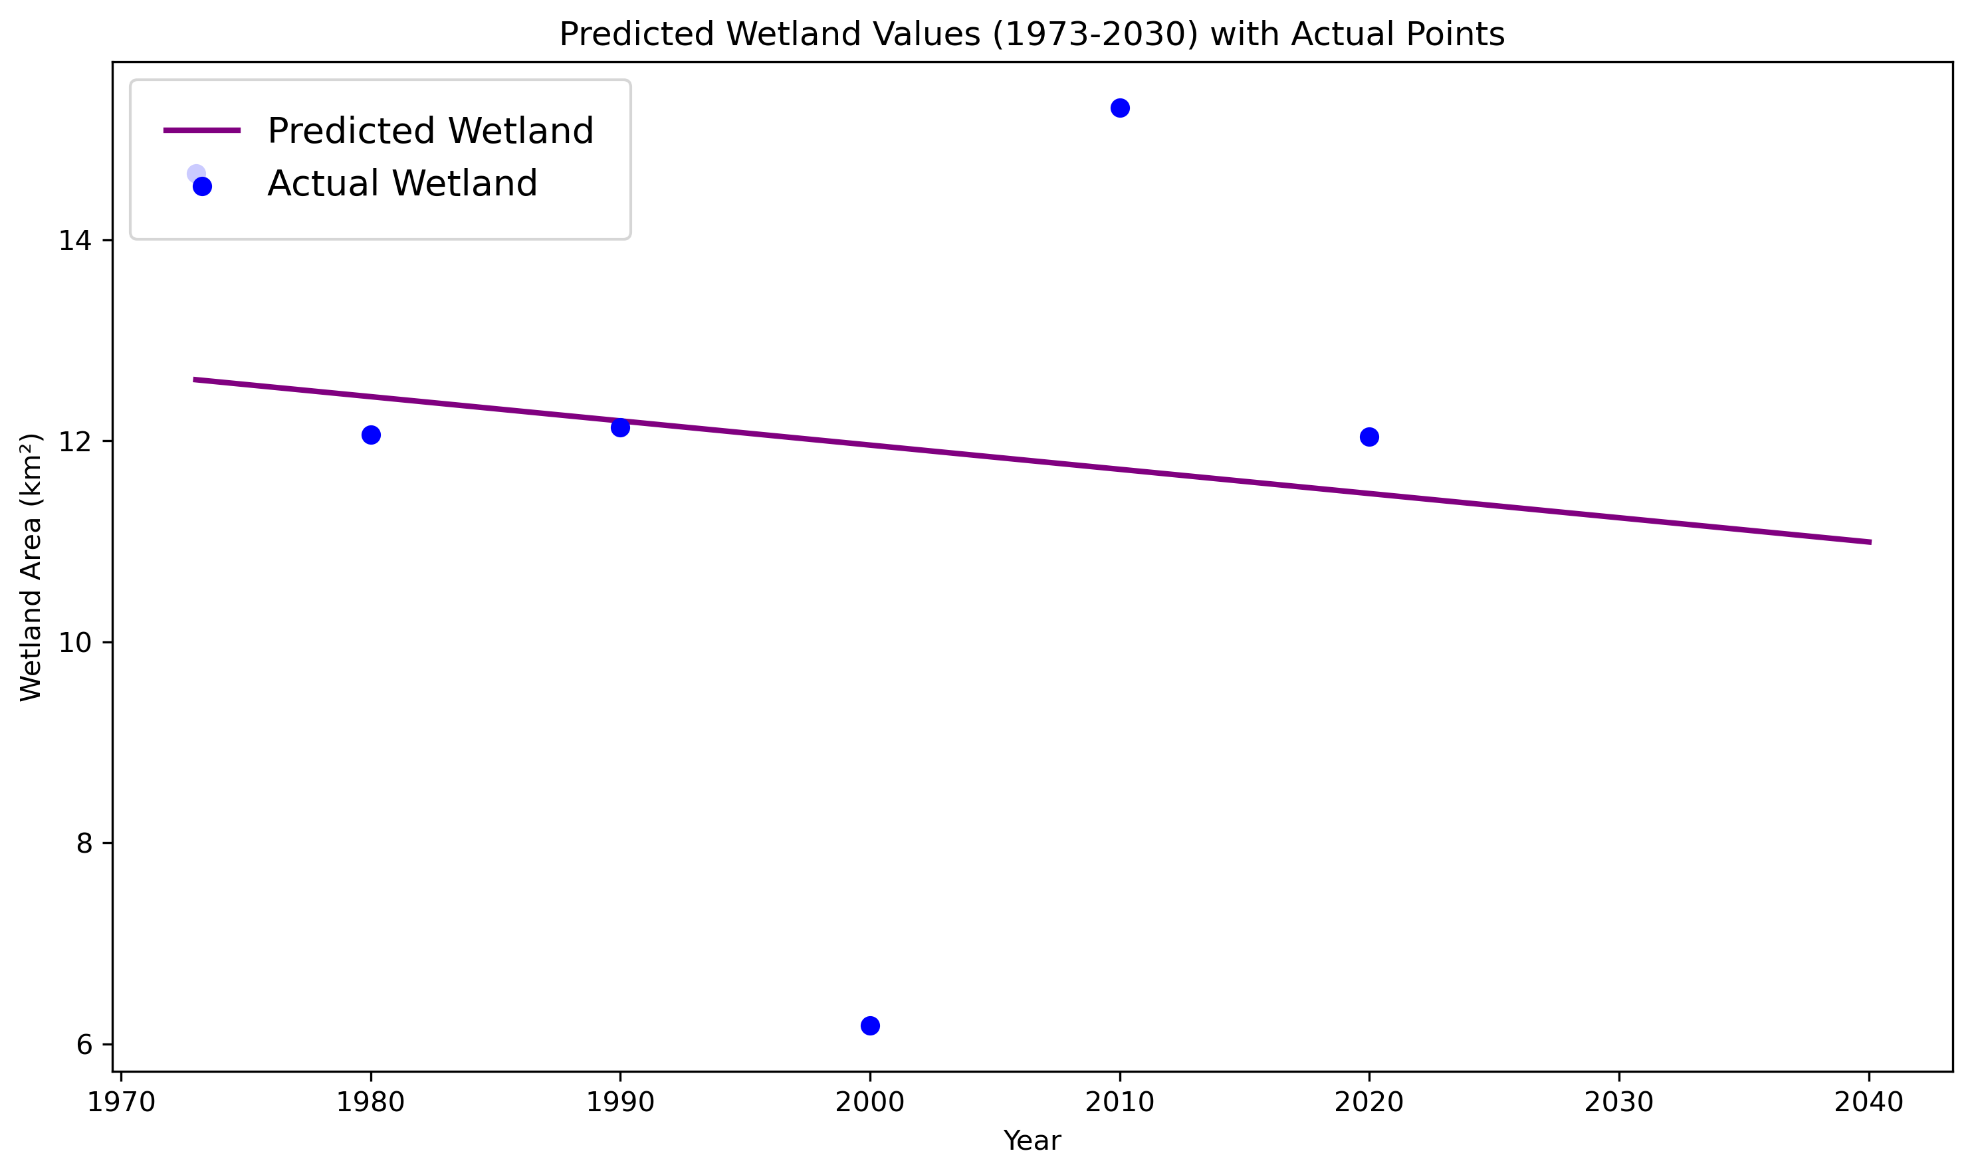
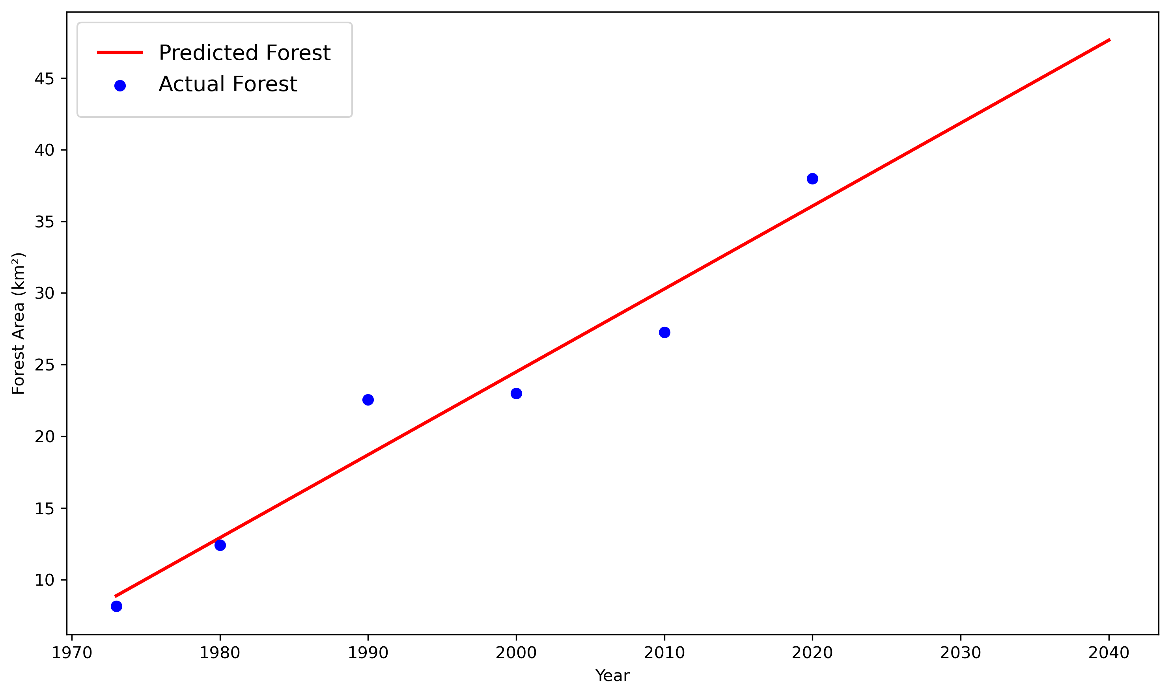
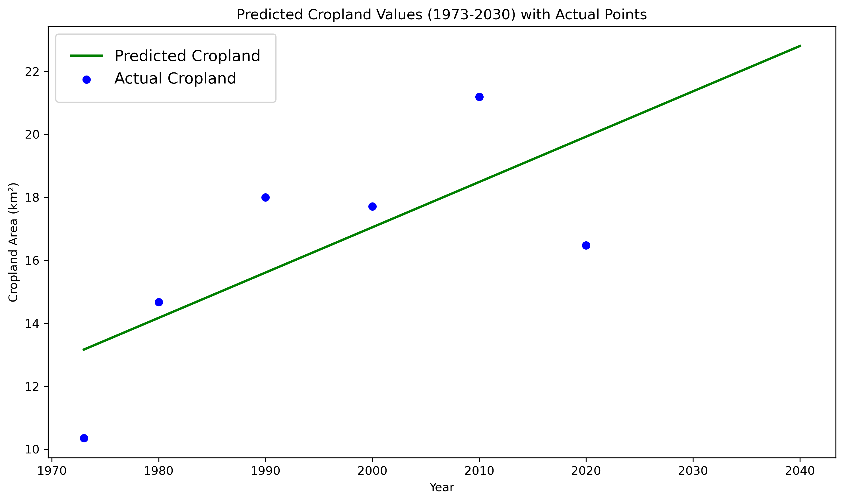
Predicting Future Land Use Changes in Char Kukri Mukri for 2040
Wetland
Forest
Cropland

Slide 9
Thank You

