Slide 1
Hospital Management System
A Database Project on
Submitted By: MD. SAYEM
Date: June 8, 2024

Slide 2
Project Overview
Objective: Develop a database system to manage hospital operations.
Platform: MySQL.
Key Features:
Patient and Doctor management.
Resource allocation (rooms, ambulances, staff).
Financial tracking.

Slide 3
Objectives
- Patient history tracking.
- Billing and payment details.
- Scheduling (appointments, room allocations).
- Feedback system for service improvement.

Slide 4
Entities
Ambulance
Appointment
Department
Disease
Doctor
Feedback
Lab Test
Medicine
Nurse
Patient
Payment
Room
Staff
Visitor

Slide 5
System Demonstration
Using XAMPP
Schema visualization.
Table details and records.
Demonstrates data integrity.

Slide 6
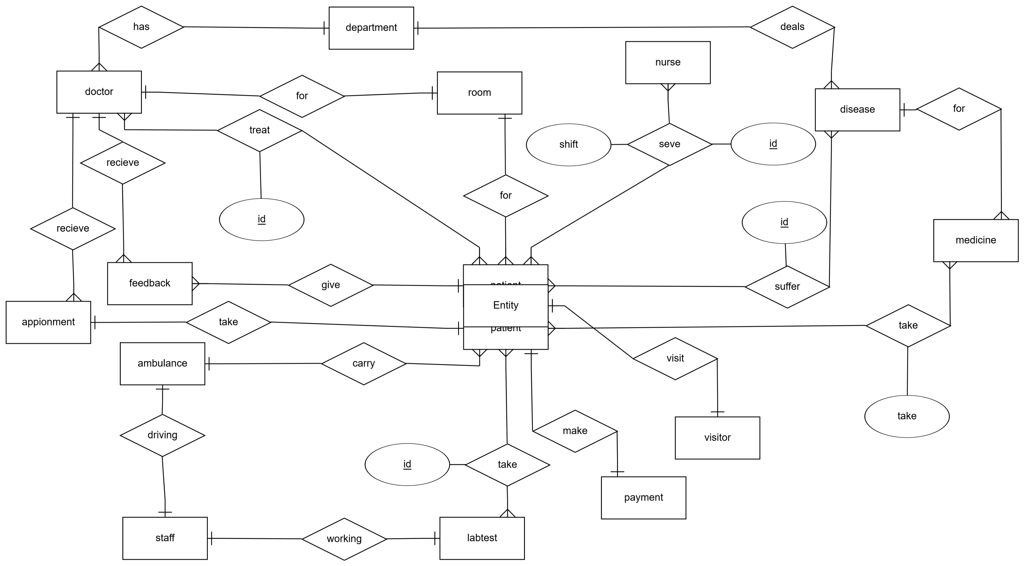
ER Diagram
Patient

Slide 7
SQL Query Examples
Display patient details.
Calculate the total cost for a patient.
Integration of multiple tables for comprehensive reports.

Slide 8
Challenges and Solutions
Challenges:
Complex relationships between entities.
Handling dynamic data updates.
Solutions:
Linking tables for many-to-many relationships.
Optimized SQL queries for performance.

Slide 9
Conclusion
Impact: Streamlined hospital management.
Future Work: Integration with web/mobile applications.

