Slide 1
CSE431: Natural Language Processing
Research Topic: Application of Natural Language Processing (NLP) in Detecting and Preventing Suicide Ideation: A Systematic Review
Presented By: Md Abu Sayem
ID: 20101458

Slide 2
Aims and Objectives
Conduct a comprehensive database search for research on the use of NLP for suicidal ideation.
Collect essential information on the detection and treatment effectiveness of the NLP approach, as well as its limitations.
Synthesize, analyze, and report findings from included studies.
Make future suggestions and identify prospective research areas.
Formulate recommendations for future efforts based on the findings of the included studies.

Slide 3
Contribution
This study aims to advance suicide prevention by examining and summarizing existing research on using NLP to detect suicidal thoughts.

Slide 4
Methodology: This qualitative study reviewed NLP and text analytics in identifying suicidal ideation, following PRISMA guidelines for transparent, high-quality reporting.
Inclusion & Exclusion:
Included peer-reviewed journal articles from the last 10 years in English, focusing on NLP/text mining on suicide and self-harm in various settings.
Excluded studies without NLP/text mining, secondary sources, non-English submissions.
Search Strategy:
The search approach utilized the Population, Phenomena of Interest, and Context (PICo) framework syntax.
Databases:
Five scientific and medical databases, namely PubMed, MEDLINE, Embase, PsycINFO, and Global Health via the OVID platform, were searched for relevant literature.

Slide 5
Results
Study Selection
Study Characteristics
Screening in Emergency Departments
Avoiding Perinatal Suicide
Digital Applications for Suicide Detection
Suicide Prevention Using Electronic Health Records EHR

Slide 6
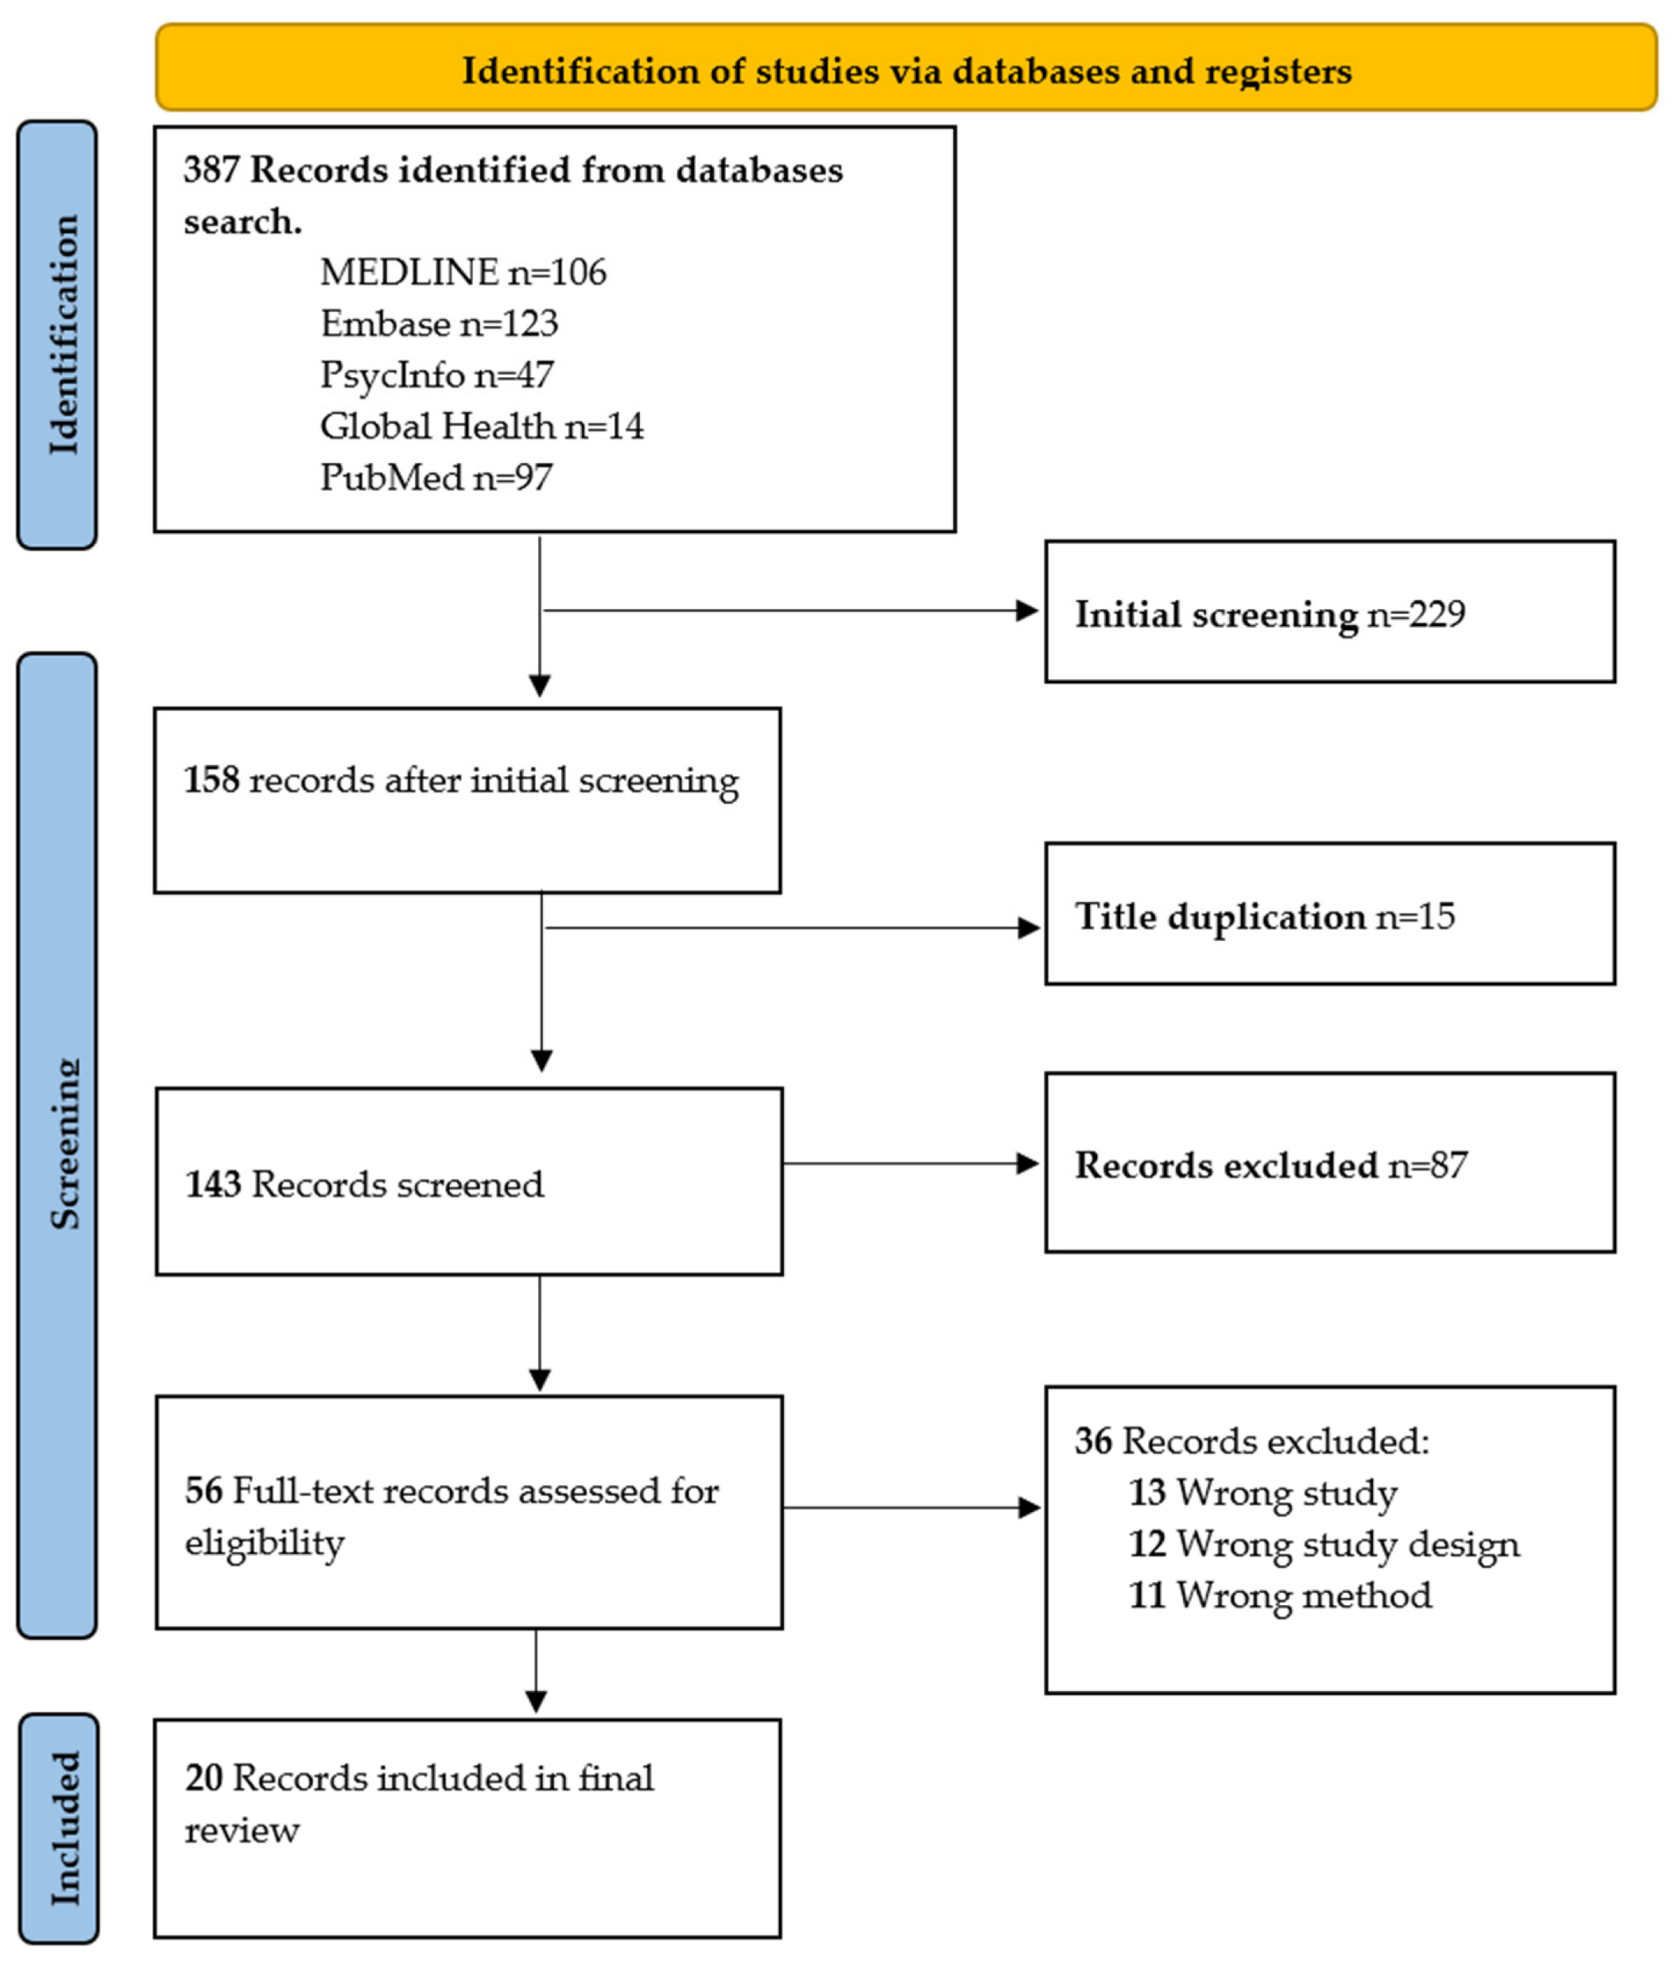
Study Selection
Initial search on 5 databases using OVID yielded 387 results, reduced to 158 records after deduplication and screening in Mendeley.

Slide 7
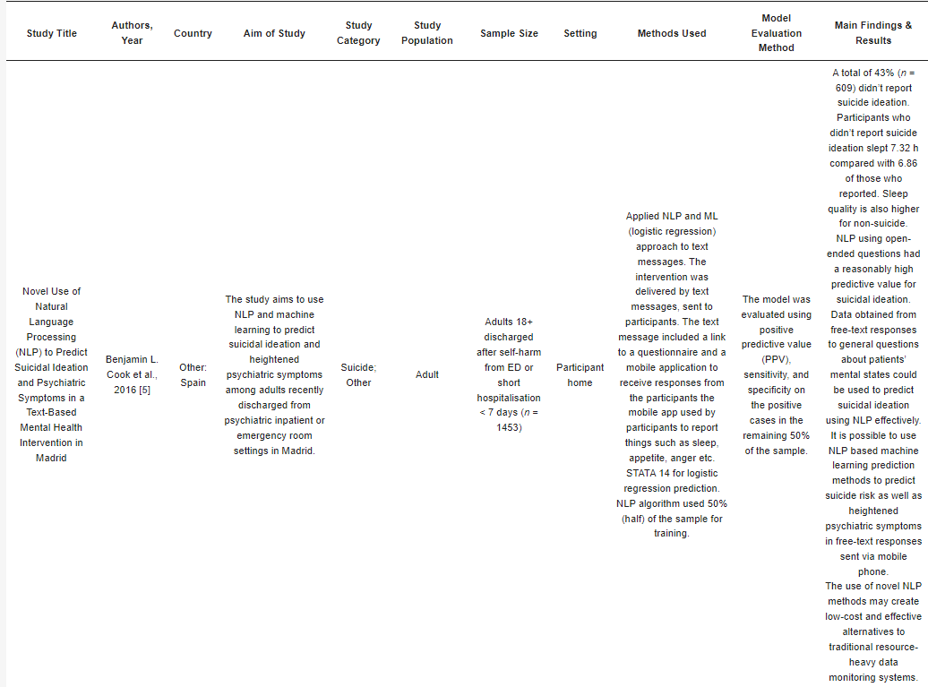
Study Characteristics

Slide 8
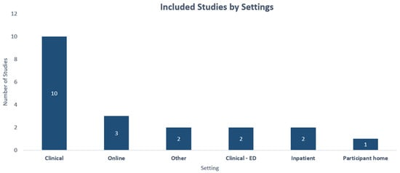

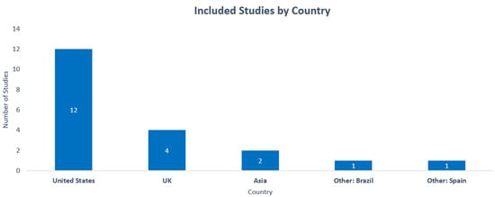

Slide 9
Conclusion
The research suggests NLP's potential in early suicide ideation detection and timely preventive actions.
It highlights the feasibility of passive surveillance through mobile apps, online activity, and social media for early suicide prevention in at-risk groups
Using race-specific terminologies in modeling has shown to enhance performance and accuracy within ethnic minority communities.
the application of artificial intelligence and machine learning offers new prospects to significantly enhance risk prediction and suicide prevention frameworks.

Slide 10
Limitations
Limitations include NLP's language specificity and its need for substantial data, making interpretation challenging due to complexity.
NLP algorithms demand significant computing power due to their computational intensity.

Slide 11
Synthesis
Analyzing findings from included studies consolidates knowledge and identifies trends in NLP for suicide prevention.
This bridges existing research with future applications, suggesting areas for prospective studies and fostering innovative approaches.

Slide 12
THE END
Thank You

