Slide 1
CSE431: Natural Language Processing
Research Topic: A decision model for ranking Asian Higher Education Institutes using an NLP-based text analysis approach
Submitted by: Md Abu Sayem
ID: 20101458

Slide 2
Aims and Objective
A decision model is essential for selecting the optimal higher education institute, considering various criteria.
This paper proposes a Natural Language Processing (NLP) based decision model for the identification of the best higher education institute using MCDM methods.

Slide 3
Contribution
Create a decision model for selecting the best institute based on various criteria
Use NLP text analysis to extract and format information.
Categorize criteria into 5 main areas with sub-criteria, considering their importance.
Apply subjective and objective weight assignment methods for criteria importance.
Define an objective function for generating ranking scores of alternatives

Slide 4
METHODOLOGIES
Data preprocessing
Criteria selection
Data matrix construction
Weight Assignment
Generation of Ranking grades
Objective function construction

Slide 5
Results
The NLP decision model aids in selecting the optimal higher education institute by evaluating various criteria
The Correlation coefficient of the sub-criteria decision matrix is obtained using a formula

Slide 6
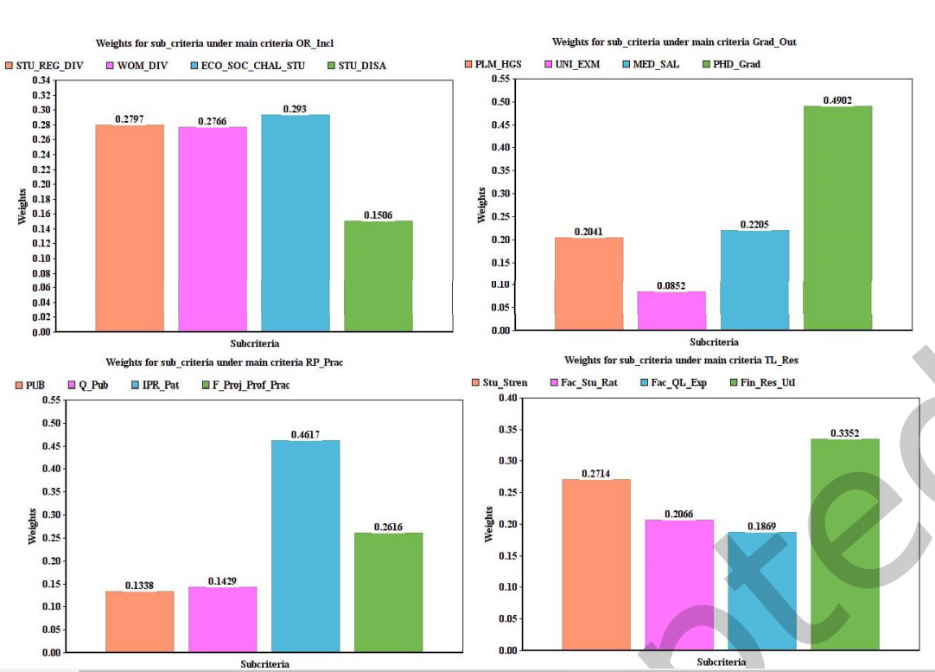

Slide 7
Conclusion
NIRF Framework Criteria
Decision Model Utilizing NLP
Ranking Methods and Alignment

Slide 8
Limitations
Provides better decisions for limited datasets only
The system has to be tested with a larger dataset

Slide 9
Synthesis
The paper's proposed NLP-based decision model for identifying the best higher education institute has potential applications in education and beyond
The incorporation of diverse criteria, NLP-driven text analysis, and MCDM methods paves the way for future advancements in decision-making processes across diverse domains

Slide 10
THE END
Thank you for listening.

