Slide 1


Course Code: CSE -314 Course Title : IPD
Presented by: Md Sayem Alam ID:201002007 Khaled Mahmud Saoun ID:201002096 Obaydullah Khan ID:201002093

Slide 2

TOPICS
E-commerce Website

Slide 3
Content
Introduction
UI describe of Project
Characteristics
DFD of Project
User diagram of project

Slide 4
Introduction
It is web based project
Simple to understand
User Friendly features
UI is very simple and interactive

Slide 5
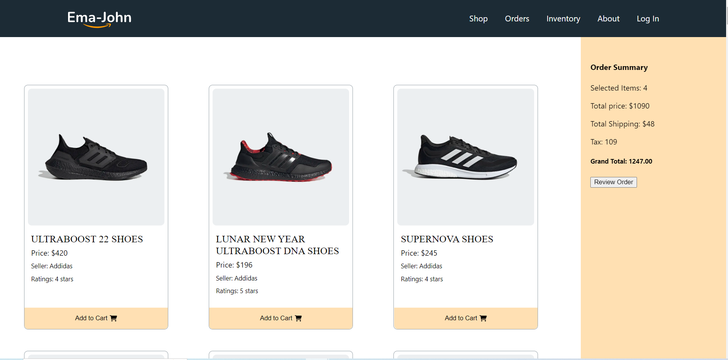
Home page of UI

Slide 6
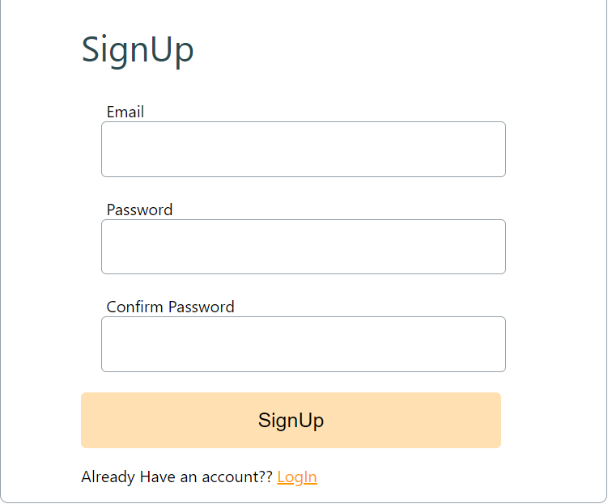
Sign Up System

Slide 7

Log In System

Slide 8
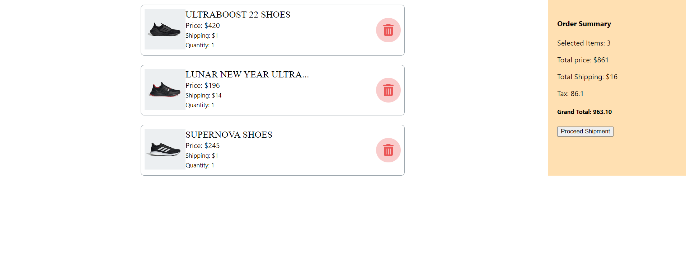
Order Page

Slide 9
Characteristics
User friendly UI
Strong Security System
User Friendly features
Attractive UI

Slide 10
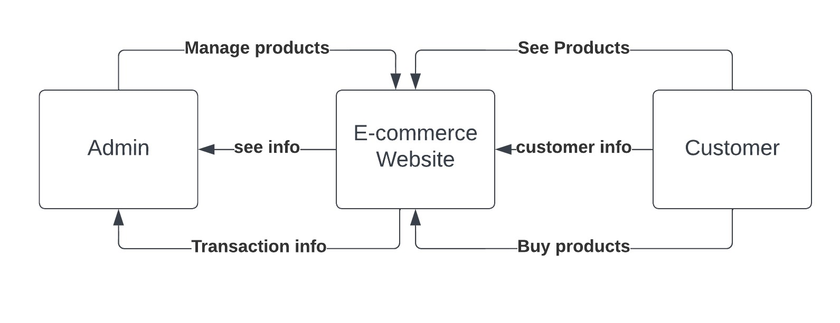
DFD of the project
Figure 1: Level 0

Slide 11
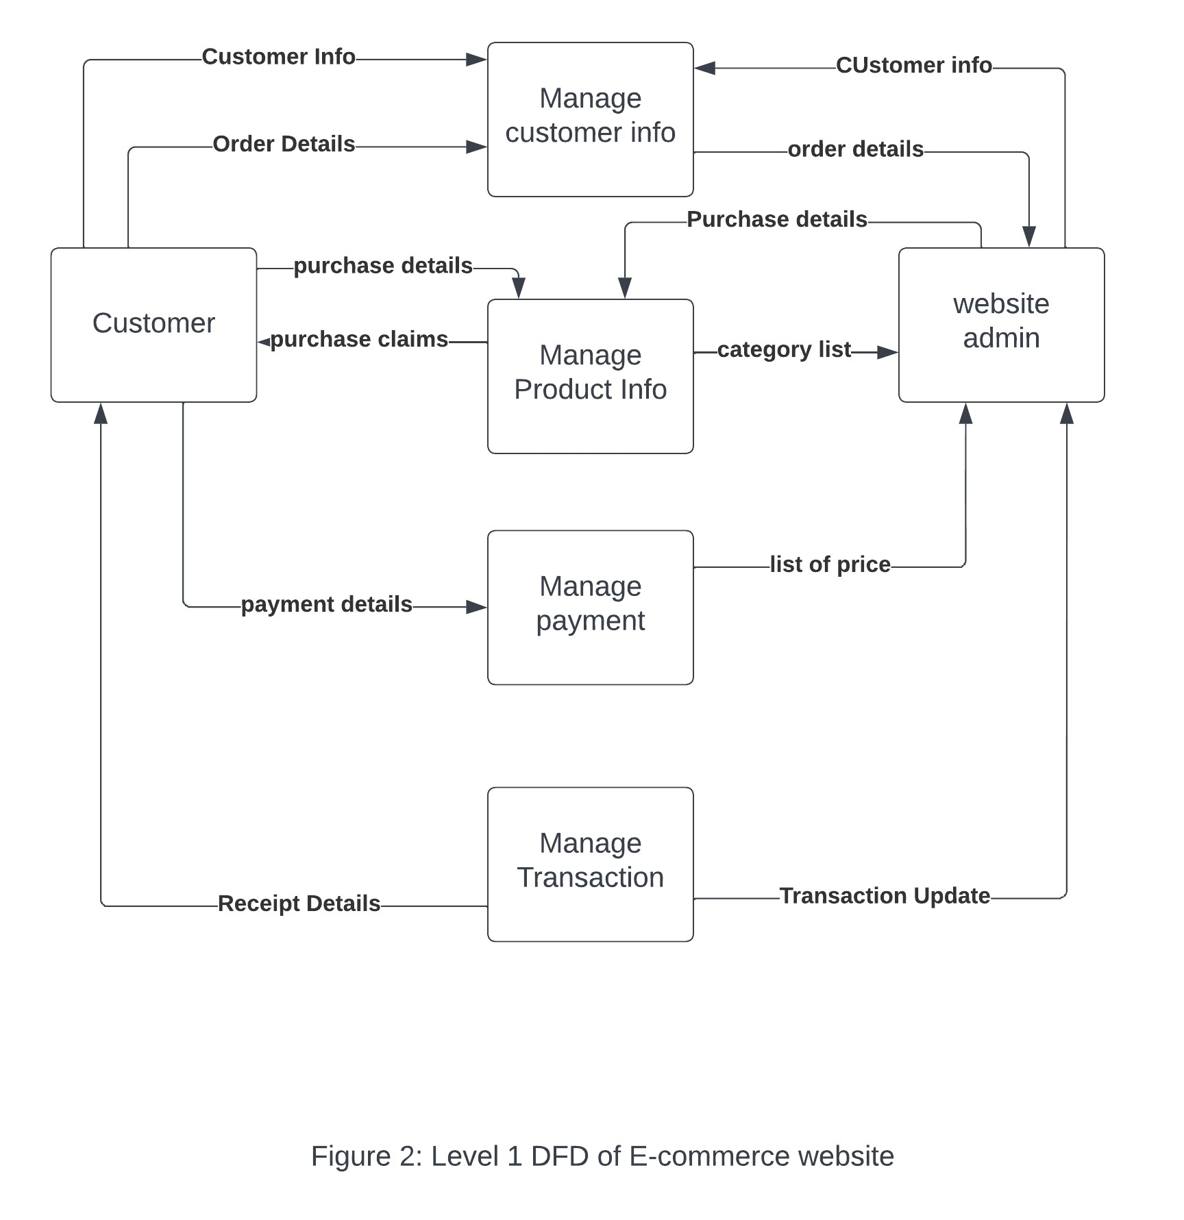
DFD of the project

Slide 12
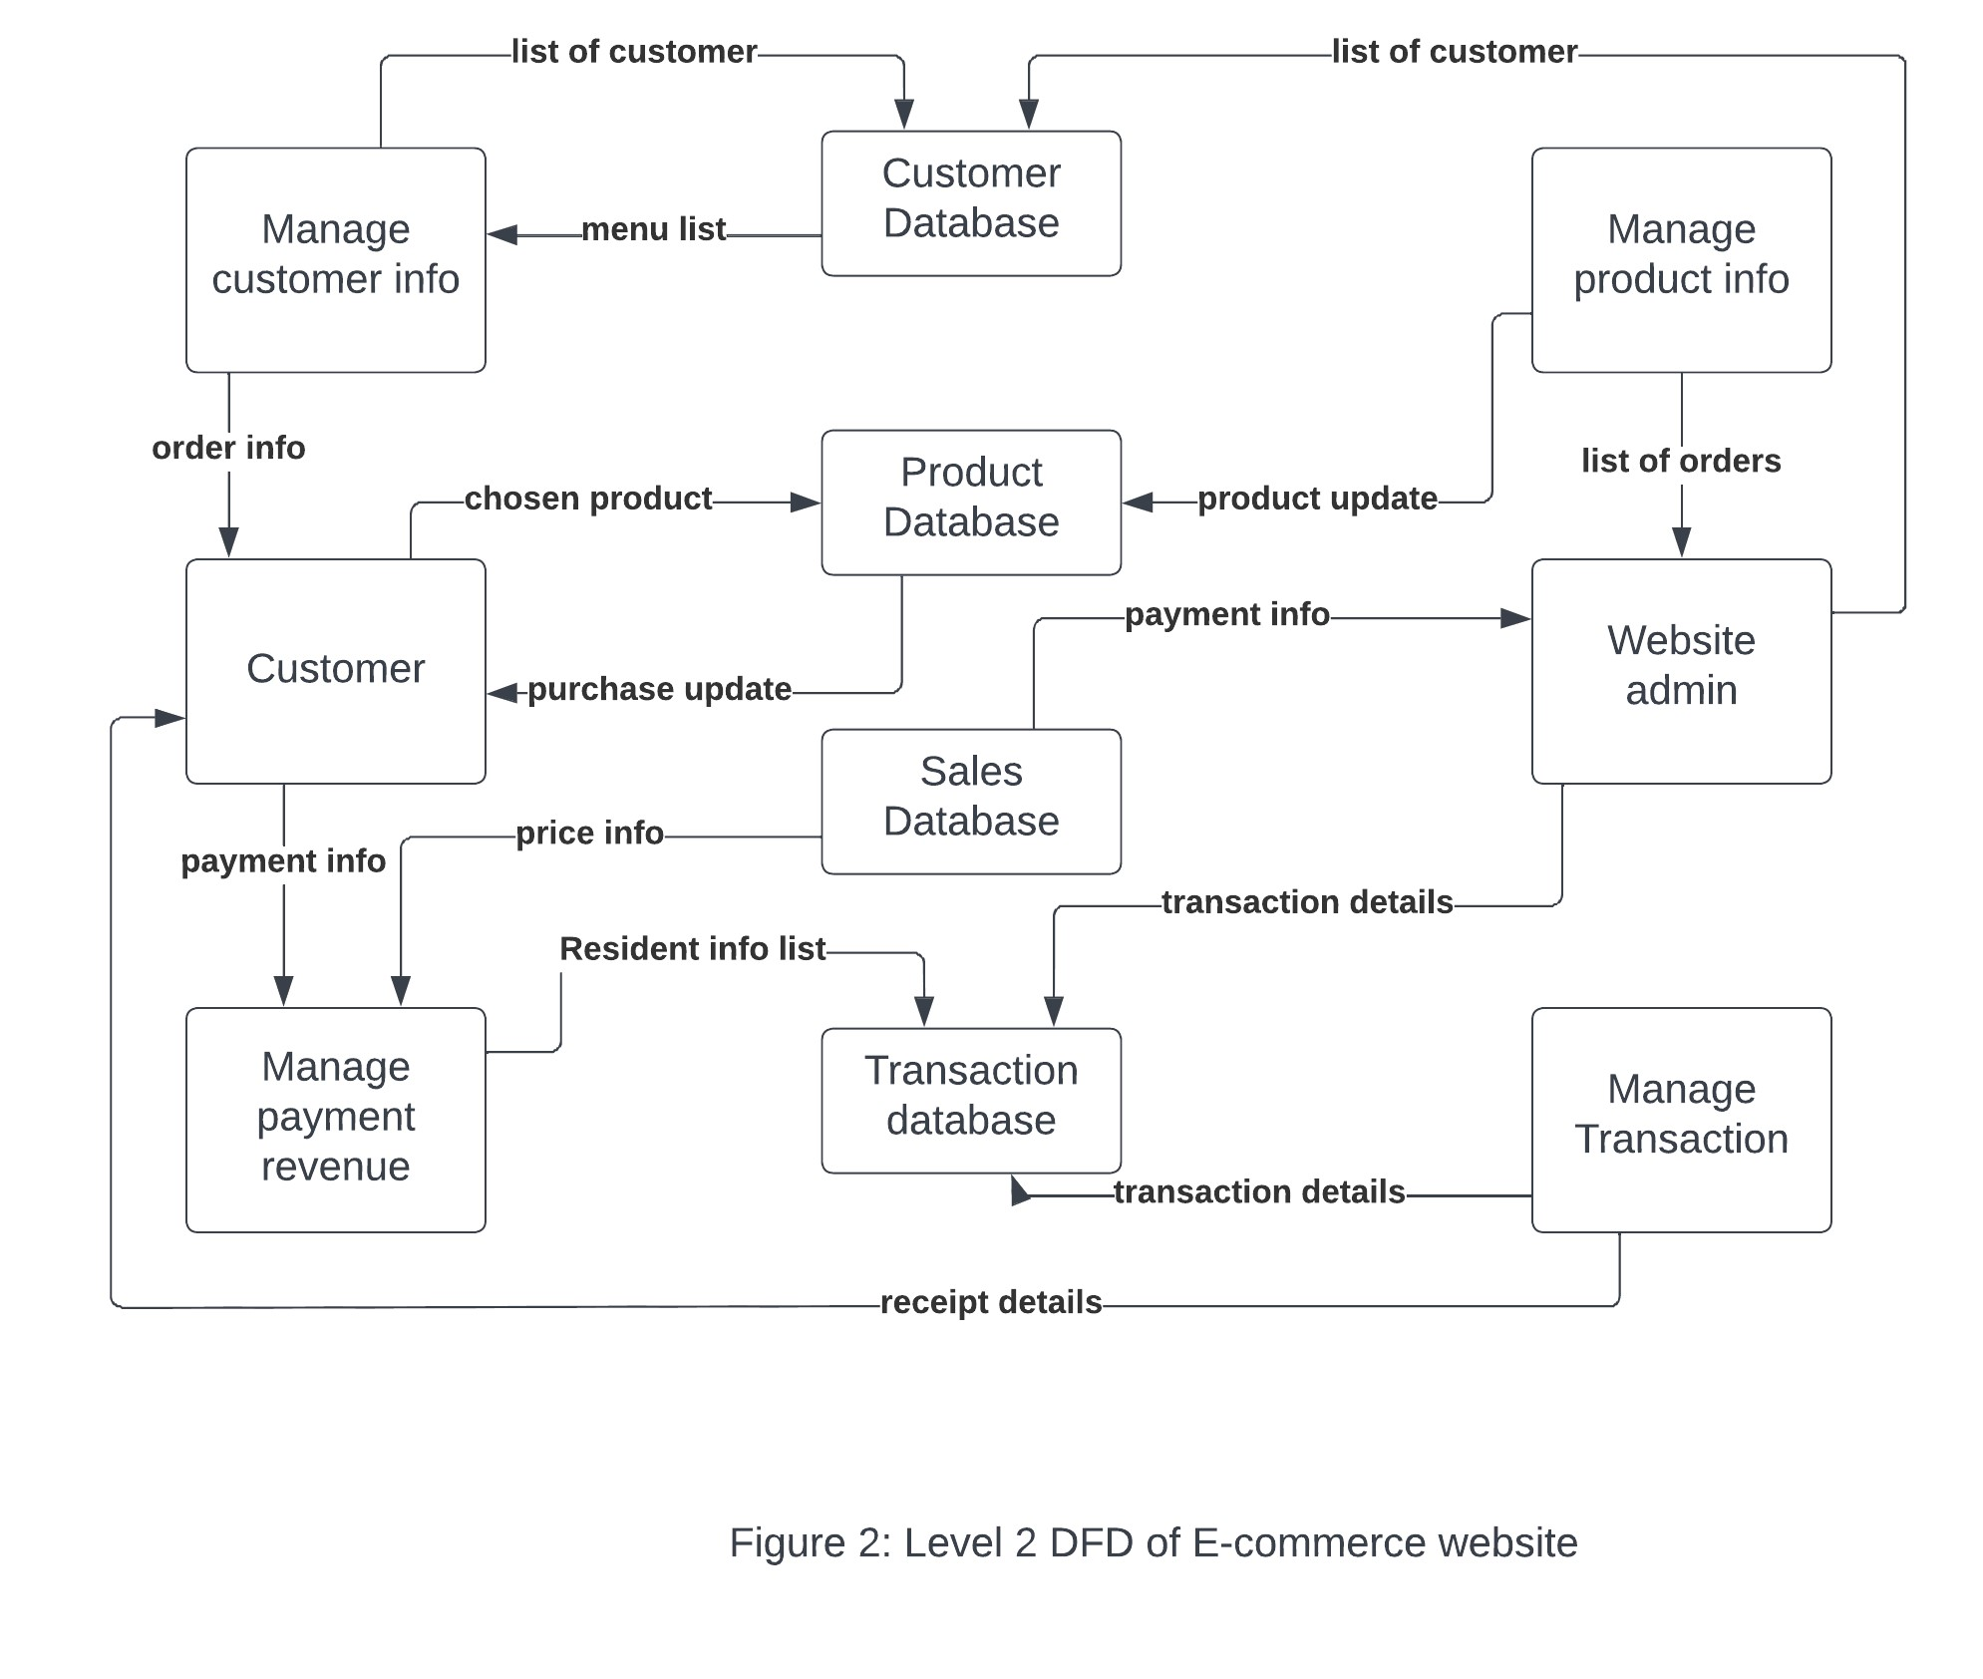
DFD of the project

Slide 13
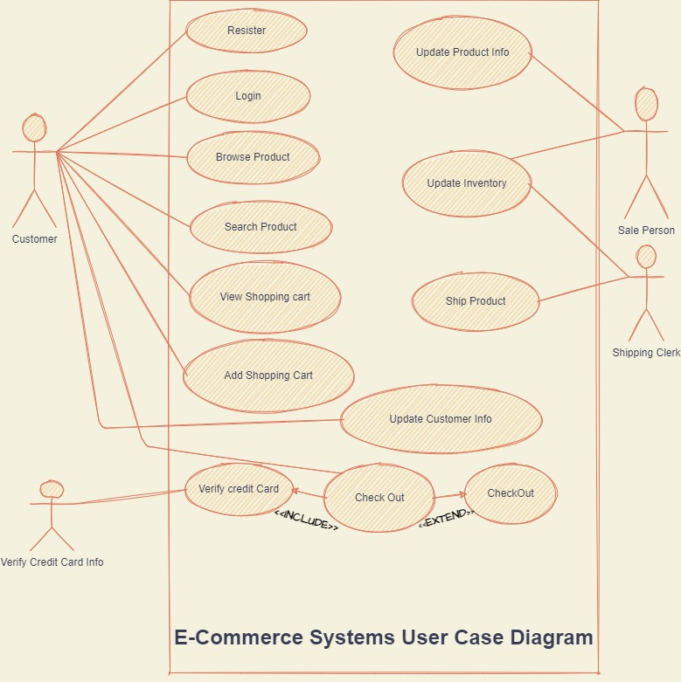
User Case Diagram

Slide 14
THANK YOU!

