Slide 1


Course Code: CSE -105 Course Title:Data Structure
Presented by: Md Sayem Alam ID:201002007

Slide 2
TOPICS
FUSE(Future Smart Energy System)

Slide 3
Content
Introduction
Methodology
Implementation
Conclusions

Slide 4
Introduction
Cost Effective
Renewable energy
Bi-litral R&D Project

Slide 5
FUSE Architecture
There are 3 level of Fuse Architecture:
Level-1
Level-2
Level-3
5G Network

Slide 6
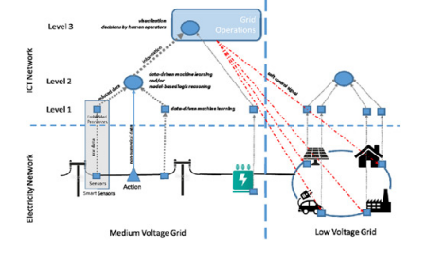
FUSE Architecture Design

Slide 7
Implemenetation of Fuse
There are some steps of implementing Fuse Architecture:
CM/PM application
D-dsm application

Slide 8
Conclusion
It investigates use of AI in MV and LV grids
Objective to implement hierarchical data processing infrastructure

Slide 9
THANK YOU!

