Slide 1
US Naval Officer Uniforms
And Their Occasions of Wear
by
OC Joshua Goulet

Slide 2
Working Uniforms
The following uniforms are considered “working” uniforms for both Officer and Enlisted Sailors:
Navy Physical Training Uniform (PTU)
Navy Working Uniform (NWU)
Coveralls

Slide 3
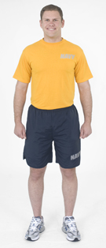
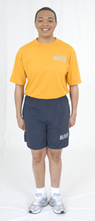
Navy PT Uniform
The PTU is designed primarily for group/unit physical training activities and the semi-annual Physical Fitness Assessment (PFA)
It can be worn both on and off base for fitness and/or leisure unless determined otherwise by regional coordinators or commanding officers.

Slide 4
Navy PT Uniform (Cont’d)
The PTU cannot be worn while in a duty status or when conducting official business on base. I.E. visiting medical treatment, galleys or Personnel Support Detachments.
The PTU shirt will be tucked into the shorts during any Command event (PT, Weigh-ins, BCA etc). It may be worn untucked during individual PT.

Slide 5
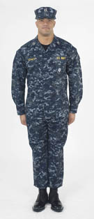
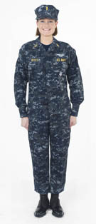
Navy Working Uniform (NWU)
The NWU is intended for year-round wear and shall be the standard working uniform ashore.
The NWU is designed to accommodate male and female sailors and to fulfill multi-functional/geographical uniform requirements at sea and ashore.

Slide 6
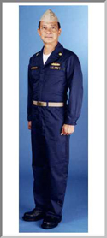
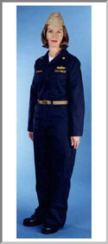
Coveralls
Designed to be the principal underway uniform of the day.
May also be worn when other uniforms would be unsafe or become unduly soiled.
Generally, coveralls are authorized to be worn only aboard Naval vessels or around the immediate vicinity of the ship.
Ashore (i.e. Squadrons, and industrial working environments) coveralls may be worn in the immediate workspaces only.

Slide 7
Coveralls (Cont’d)
Commands may additionally authorize
wear of the Coverall Uniform while
transiting to and from and using base
galleys or any other eating facility
within the fenceline of the installation
and at personnel support detachments
while in a duty status.
Coveralls are not authorized for wear other than described above.
Under no circumstances may it be worn in either an official or unoffical capacity outside the confines of a military installation.

Slide 8
Service Uniforms
The following uniforms are considered “service” uniforms for Naval Officers:
Service Khakis
Summer Whites

Slide 9
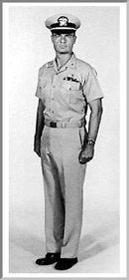
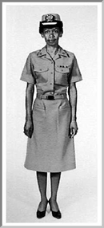
Service Khakis
Worn in Summer/Winter for office work, watch standing, liberty, or business ashore when prescribed as uniform of the day

Slide 10
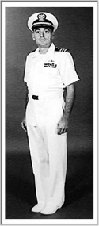
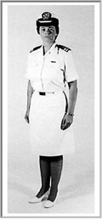
Summer Whites
Worn in Summer for office work, watch-standing, liberty, or business ashore when prescribed as the uniform of the day
May also be authorized during the winter in certain geographical locations (I.E. Hawaii, Guam, etc.)

Slide 11
Service Dress Uniforms
The following uniforms are considered “service dress” uniforms for Naval Officers.
Service Dress Blues
Service Dress Whites

Slide 12
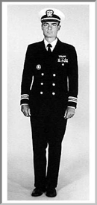
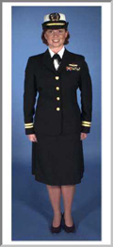
Service Dress Blues
May be prescribed for wear year-round to all official functions when Formal Dress, Dinner Dress or Full Dress Uniforms are not prescribed and civilian equivalent dress is coat and tie.
Always considered an appropriate uniform to check-in to a new command, regardless of season.

Slide 13
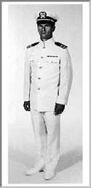
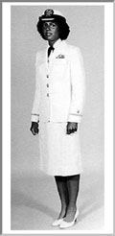
Service Dress Whites
May be prescribed for Summer Wear when Formal Dress, Dinner Dress, or Full Dress Uniforms are not prescribed and civilian equivalent is coat and tie.
Remember, white shoes, white pants, white socks!

Slide 14
Ceremonial Uniforms
The following uniforms are considered appropriate for ceremonial attire:
Full dress Blues
Full Dress Whies

Slide 15
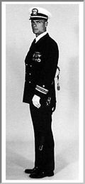
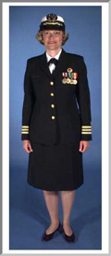
Full Dress Blues/Whites
To be worn when assuming or relinquishing command, or are participating in the ceremony.
Official visits with honors as prescribed in U.S. Navy Regulations.
Visits to ceremony of Foreign Men-of-War and Foreign Officials.
Occacions of State, Ceremonies, and Solemnities.
If you are going to serve onboard a Submarine, you will be wearing this uniform and participating in Changes of Command.

Slide 16
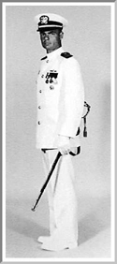
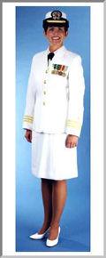
Full Dress Blues/Whites Cont’d
Sword is a perscribable item for LCDR (O-4) and above.
Full-sized medals are to be worn with this uniform.
Don’t forget, white pants, white shoes white socks!

Slide 17
Dinner Dress Uniforms
Dinner Dress Blue Jacket
Dinner Dress White Jacket
Dinner Dress White
Dinner Dress Blue
Formal Dress

Slide 18
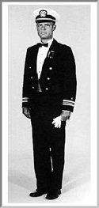
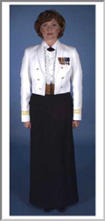
Dinner Dress Blue/White Jacket
Prescribable uniform for LCDR and above, optional for Lieutenant and below.
Worn to official functions and/or dinners where equivalent civilian attire is black tie.
Miniature medals and warfare insignia are to be worn in lieu of full-sized.

Slide 19
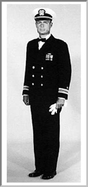
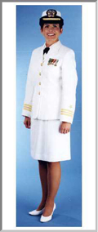
Dinner Dress Blue/Whites
Worn to official functions where equivalent civilian attire is black tie.
Miniature medals and warfare insignia replace full-sized insignia/medals from the full-dress uniform.
Black bow tie replaces neck tie for male full-dress blues.
Typical uniform worn to balls and formal command functions.

Slide 20
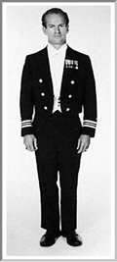
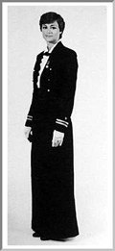
Formal Dress
Worn to official evening functions where equivalent civilian attire is evening clothes (white tie).
This uniform is prescribable for Captains (O-6) and above, and other officers assigned to duty where required by protocol.
This uniform is strictly optional for all other officers.

Slide 21
Questions?

Slide 22
Uniform Links and Useful Information
Official U.S. Navy Uniform Regulations:
http://www.npc.navy.mil/CommandSupport/USNavyUniforms/UniformRegulations/

