Slide 1
Project-Build2

Slide 2
Concordia University
Department of Computer Science and Software Engineering
Advanced Programming Practices
SOEN 6441 --- Winter 2024
Professor: Joey Paquet
Students: Team 14
Mahdieh Shekarian-40279366
Parsa MohammadRezaei-40277489
AmirMohammad RezaeiPour-40279239
Farid Farahmand-40241630
Mohammad Aminan-40277902
Omer Sayem-40226505

Slide 3
Agenda
Code Architecture
Code Explanation
Project Structure
Code
Model
  Player
  Continent
  Country
  Game State
  Orders
  Card
  LogEntryBuffer
  Observable
Controller
  Command
  Country Controller
  Map Controller
  Order Controller
  Player Controller
Services
  CustomPrint
  GameGraphUtils
  GameMapReader
Phases
  Phase
  EditMapPhase
  ExecuteOrderPhase
  FinishPhase
  IssueOrderPhase
  StartUpPhase
  Game Engine
View
  FileLogObserver
  Observer
App
Game Menu
Test
GitHub Pictures
JavaDoc Pictures

Slide 4
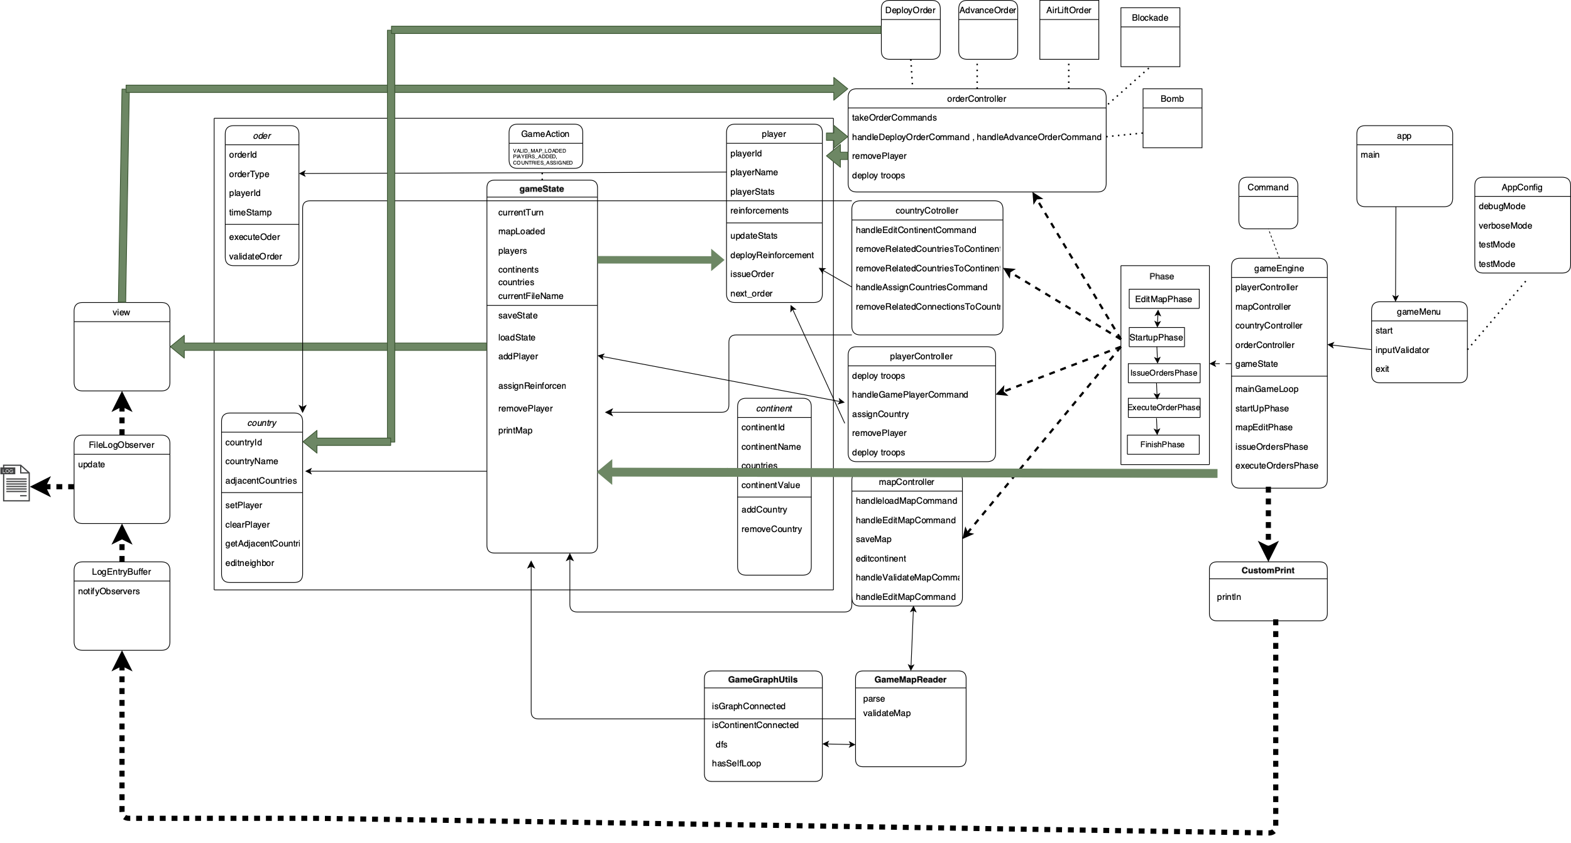

Slide 5
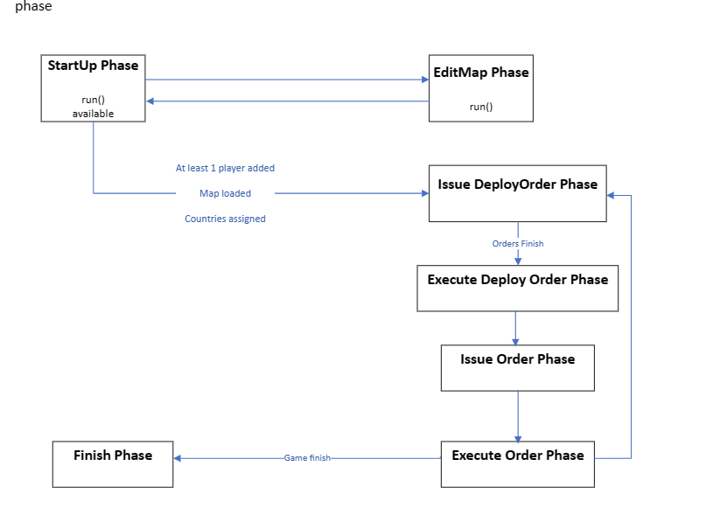

Slide 6
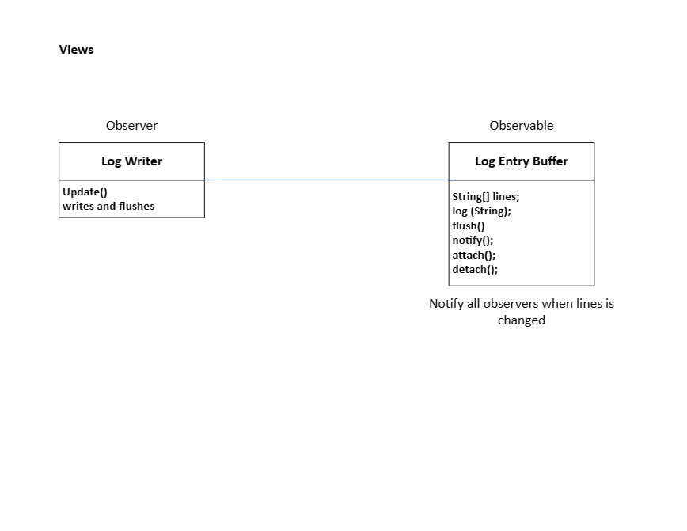

Slide 7
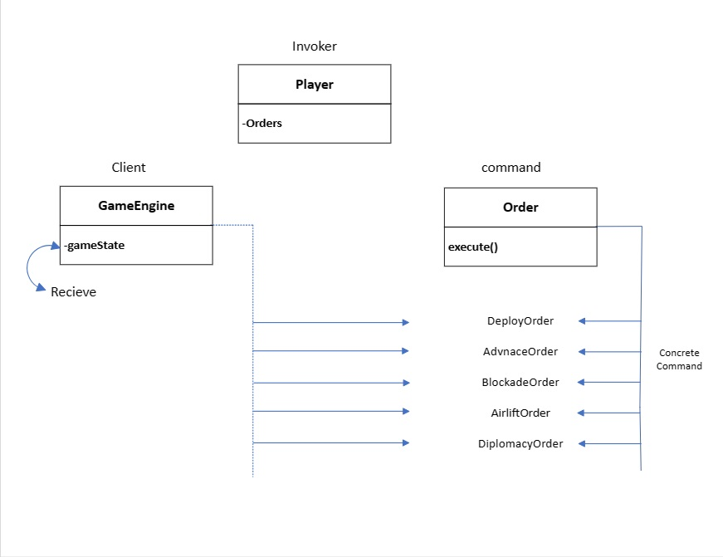

Slide 8
Code Explanation

Slide 9
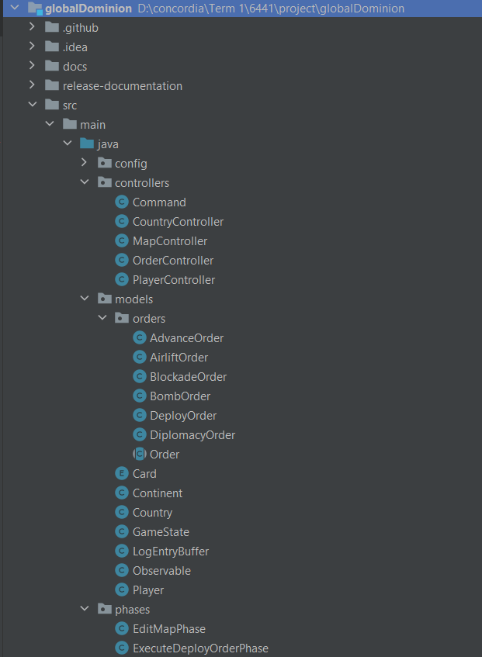
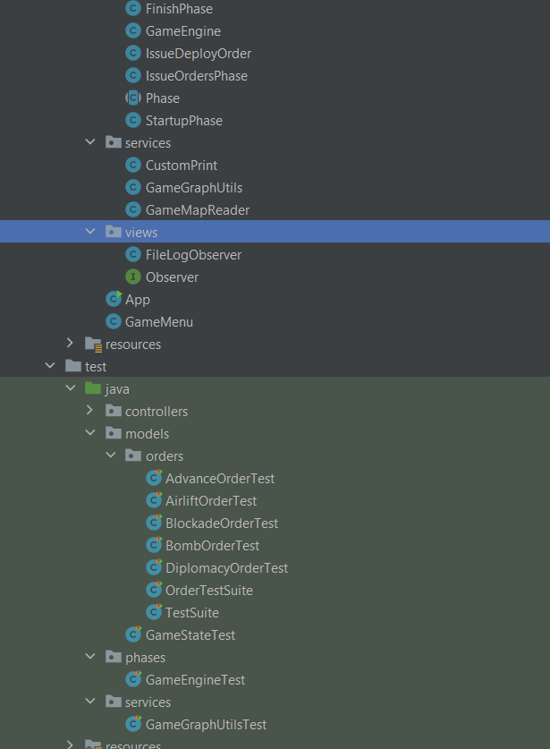
Project Structure

Slide 10
Code

Slide 11
Model
There are eight classes in the Model:
1- Player
2- Continent
3- Country
4- Game State
8- Observable
5- Orders: deployOrder, AdvanceOrder, AirliftOrder, BombOrder, BlockadeOrder, DiplomacyOrder
6- Card
7- LogEntryBuffer

Slide 12
Player
The Player class represents a player in a game, with their name, statistics,
reinforcements, orders, and the countries they control.
The class provides methods for issuing and executing orders, managing
reinforcements, and accessing player information.
All the details are explained in the bulid1 document.

Slide 13
Player changes compare to previous build
The import statement for the DeployOrder class is removed in the new code.
The ArrayList<Card> variable d_cards is initialized directly in the new code, whereas it was initialized
using the new ArrayList<>() syntax in the previous code.
The method setOrder in the new code takes an Order object as a parameter, whereas it had a
DeployOrder parameter in the previous code.
The nextOrder method in the new code returns an Order object, whereas it returned a DeployOrde
object in the previous code.
The getcards method in the new code returns a String, whereas it returned an ArrayList<Card> in the
previous code.
The removeCard method in the new code takes a String parameter, whereas it took a Card parameter
in the previous code.
The reinforcementPoll variable is accessed directly using the d_reinforcementPoll identifier in the new
code, whereas it was accessed using the getter method getReinforcementPoll() in the previous code.

Slide 14
Continent
The Continent class is a simple representation of a continent in a game.
It stores information such as the continent's ID, name, value, and color.
The class provides constructors to initialize the continent object with different combinations of values and getter/setter methods to access and modify the
instance variables.
There are no changes with this class.

Slide 15
Country
The Country class is used to represent countries in a game.
It stores information such as the country's ID, name, adjacent countries, continent ID, and the number of reinforcements.
The class provides constructors to initialize the country object with different combinations of values, getter/setter methods to access and modify the instance
variables, and methods to add and remove adjacent countries.
All the details are explained in the bulid1 document.

Slide 16
Country changes compare to previous build
The getArmies() method returns the number of reinforcements in the country.

Slide 17
Game State
The GameState class is responsible for managing the state of the game.
It keeps track of the current turn, whether a map has been loaded, the players, continents, and countries in the game.
It provides methods to perform actions such as adding players, setting the map loaded status,
advancing the turn, and printing the map details. It also includes methods for calculating and assigning
reinforcements to players based on continent ownership.

Slide 18
Order
The Order class serves as a base class for different order types in a game.
It provides common functionality and requires subclasses to implement order-specific execution and
validation.
The class has two instance variables:
d_gameState of type GameState, which represents the game state associated with the order.
d_owner of type Player, which represents the player who owns the order.
The constructor Order is a parameterized constructor that initializes the Order object. It takes a GameState object and a Player object as parameters. It assigns the values of the parameters to the corresponding instance variables. The constructor is marked as protected,
indicating that it can only be called by subclasses.
The private no-argument constructor Order is used to prevent the creation of an Order object without a game state or owner. It sets the
game state and owner variables to null.
The execute() method is an abstract method that must be overridden by subclasses. It represents the execution of the order and does
not have an implementation in the Order class itself.
The validate() method is an abstract method that must be overridden by subclasses. It represents the validation of the order and does not have an implementation in the Order class itself.

Slide 19
Deploy Order
The DeployOrder class represents a specific type of order where reinforcements are deployed to a country owned by a player.
It extends the base Order class and provides its own implementation of the execute() and toString()
methods.
All the details are explained in the bulid1 document.

Slide 20
Advance Order
The `AdvanceOrder` class represents an order to advance reinforcements from one country to another in a game.
- The class has several instance variables:
`d_countryAttackerId`: An integer representing the ID of the attacking country.
`d_countryDefenderId`: An integer representing the ID of the defending country.
`d_numReinforcements`: An integer representing the number of reinforcements to be advanced.
- The class defines two constants:
`ATTACKER_BEING_KILLED`: A constant representing the probability of an attacker being killed during a battle.
`DEFENDER_BEING_KILLED`: A constant representing the probability of a defender being killed during a battle.

Slide 21
Advance Order(Cont.)
The constructor AdvanceOrder initializes the AdvanceOrder object. It takes a GameState object, a Player object (the owner of the order), the IDs of the attacking and defending countries, and the number of reinforcements as parameters. The constructor calls the superclass constructor (Order) and assigns values to the instance variables. It then calls the validate() method to check the validity of the order.
The execute() method is overridden from the superclass. It performs the execution of the advance order. It retrieves the Country objects corresponding to the attacker and defender countries from the GameState. If the defender country is owned by the attacker, the method
increases the number of reinforcements in the defender country and decreases the number of reinforcements in the attacker country.
Otherwise, a battle occurs between the attacker and defender. The number of defending and attacking reinforcements are determined
based on the available reinforcements. Random numbers are generated to determine the number of casualties for both the attacker and defender. The number of reinforcements in the defender country is updated based on the casualties. If the defender country has no
reinforcements left and the attacker has remaining reinforcements, the defender country is captured by the attacker, and some additional actions are performed. Otherwise, the number of reinforcements in the attacker country is updated based on the remaining
reinforcements.
The validate() method is overridden from the superclass. It validates the advance order to ensure that it is valid. It checks various
conditions, such as whether the attacking country is owned by the player, whether the countries are adjacent, whether the number of
reinforcements is non-negative, whether the countries exist, and whether the player is negotiated with the defender's owner.
The toString() method is overridden from the superclass. It returns a string representation of the advance order, including the owner, the number of reinforcements, and the IDs of the attacker and defender countries.

Slide 22
Airlift Order
The `Airlift` class represents an order to airlift reinforcements from one country to another in a game.
- The class has several instance variables:
- `d_countryFromId`: An integer representing the ID of the country from which the airlift is initiated.
- `d_countryToId`: An integer representing the ID of the country to which the airlift is directed.
- `d_numReinforcements`: An integer representing the number of reinforcements to be airlifted.
The constructor Airlift initializes the Airlift object. It takes a GameState object, a Player object (the owner of the order), the IDs of the "from" and "to" countries, and the number of reinforcements as parameters. The constructor calls the superclass constructor (Order) and assigns values to the instance variables. It then calls the validate() method to check the validity of the order.
The execute() method is overridden from the superclass. It performs the execution of the airlift order. It prints a message indicating the player's name, the number of reinforcements being airlifted, and the names of the "from" and "to" countries. The method then updates the number of reinforcements in both the "from" and "to" countries accordingly. Finally, it removes the "AIRLIFT" card from the player.
The validate() method is overridden from the superclass. It validates the airlift order to ensure that it is valid. It checks various conditions, such as whether the player has the "AIRLIFT" card, whether the player owns both the "from" and "to" countries, and whether the "from" country has enough reinforcements to airlift.

Slide 23
Blockade Order
The BlockadeOrder class represents a blockade order in a game. A blockade order triples the number of armies on one of the player’s
own territories and converts it into a neutral territory.
The class has an instance variable l_countryId which represents the ID of the country on which the blockade order is to be executed.
The constructor BlockadeOrder initializes the BlockadeOrder object. It takes a GameState object, a Player object (the owner of the
order), and the ID of the country as parameters. The constructor calls the superclass constructor (Order) and assigns values to the instance variables. It then calls the validate() method to check the validity of the order.
The execute() method is overridden from the superclass. It performs the execution of the blockade order. It prints a message indicating
the player's name and the name of the country being blockaded. The method then triples the number of armies on the country by setting its number of reinforcements to three times its current value. It creates a new neutral player in the game and assigns the blockaded
country to the neutral player. Finally, it removes the country from the current player and removes the "BLOCKADE" card from the player.
The validate() method is overridden from the superclass. It validates the blockade order to ensure that it is valid. It checks whether the
player has the "BLOCKADE" card and whether the country is owned by the player. If any of these conditions are not met, an
IllegalArgumentException is thrown.
Overall, the BlockadeOrder class represents a blockade order in a game. It provides methods to execute the order, validate its validity,
and perform the necessary actions such as tripling the number of armies on a player's territory, converting it into a neutral territory, and
updating the game state accordingly.

Slide 24
Bomb Order
The BombOrder class represents a bomb order in a game. A bomb order destroys half of the armies located on an opponent's territory.
The class has an instance variable l_countryId which represents the ID of the country on which the bomb order is to be executed.
The constructor BombOrder initializes the BombOrder object. It takes a GameState object, a Player object (the owner of the order), and
the ID of the country as parameters. The constructor calls the superclass constructor (Order) and assigns values to the instance
variables. It then calls the validate() method to check the validity of the order.
The execute() method is overridden from the superclass. It performs the execution of the bomb order. It prints a message indicating the player's name, the name of the country being bombed, and the owner of the country. The method then destroys half of the armies on the country by setting its number of reinforcements to half of its current value (rounded down). Finally, it removes the "BOMB" card from the player.
The validate() method is overridden from the superclass. It validates the bomb order to ensure that it is valid. It checks whether the
player owns the country and whether the player has the "BOMB" card. If any of these conditions are not met, an
IllegalArgumentException is thrown.
Overall, the BombOrder class represents a bomb order in a game. It provides methods to execute the order, validate its validity, and
perform the necessary actions such as destroying half of the armies on an opponent's territory and updating the game state accordingly.

Slide 25
Diplomacy Order
The DiplomacyOrder class represents a diplomacy order in a game. A diplomacy order allows a player to negotiate with another player.
The class has an instance variable d_playerToNegotiateWith which represents the name of the player to negotiate with.
The constructor DiplomacyOrder initializes the DiplomacyOrder object. It takes a GameState object, a Player object (the owner of the
order), and the name of the player to negotiate with as parameters. The constructor calls the superclass constructor (Order) and assigns values to the instance variables. It then calls the validate() method to check the validity of the order.
The execute() method is overridden from the superclass. It performs the execution of the diplomacy order. It prints a message indicating the player's name and the name of the player being negotiated with. The method then removes the "NEGOTIATE" card from the player and adds the player to negotiate with to the negotiated players list of the owner player. It also adds the owner player to the negotiated
players list of the player to negotiate with. Finally, it removes the "NEGOTIATE" card from the player to negotiate with.
The validate() method is overridden from the superclass. It validates the diplomacy order to ensure that it is valid. It checks whether the player has the "NEGOTIATE" card, whether the player to negotiate with exists in the game, and whether the player to negotiate with is
not the owner player. If any of these conditions are not met, an IllegalArgumentException is thrown.
Overall, the DiplomacyOrder class represents a diplomacy order in a game. It provides methods to execute the order, validate its validity, and perform the necessary actions such as removing the "NEGOTIATE" card from the player, adding players to the negotiated players list, and updating the game state accordingly.

Slide 26
Card
The code implements an enumeration (enum) called Card, which represents different types of cards in a game.
Here's an explanation of the code:
The Card enum defines four card types: BOMB, BLOCKADE, AIRLIFT, and NEGOTIATE. These types represent different
abilities or actions that can be associated with game cards.
The getRandomCard() method is used to retrieve a random card type from the available card types. It uses the values()
method of the enum to get an array of all possible card types and selects a random element from that array.
The getCardType() method is used to retrieve the name of a specific card type as a String. It uses the name() method of the enum to get the name of the card type.
Each card type (BOMB, BLOCKADE, AIRLIFT, and NEGOTIATE) is automatically assigned an ordinal value based on its
position in the enum declaration. The first card type, BOMB, has an ordinal value of 0, BLOCKADE has an ordinal value of 1, and so on.
The enum provides a convenient way to represent a fixed set of related constants (in this case, different card types) in a type-safe manner. It ensures that only valid card types can be used in the code.

Slide 27
LogEntryBuffer
The `LogEntryBuffer` class extends the `Observable` class, which suggests that it is intended to be used in the Observer
design pattern.
The class has a private instance variable called `lines`, which is a `StringBuilder` used to store log entries.
The `getLines()` method returns the log entries stored in the `lines` variable as a `String`.
The `log(String action)` method is used to add a new log entry to the buffer. It appends the `action` parameter to the `lines`
variable, followed by a newline character (`\n`). After adding the entry, it notifies the observers (if any) by calling
`notifyObservers(this)`. Finally, it calls the `flush()` method.
The `flush()` method is used to clear the log entries by creating a new `StringBuilder` instance and assigning it to the `lines` variable. This effectively clears the stored log entries.
Overall, the `LogEntryBuffer` class provides a simple mechanism for storing log entries in a buffer. It allows adding new log
entries, retrieving the stored entries, and clearing the buffer. By extending the `Observable` class, it also allows other classes to observe changes in the log entries and be notified when new entries are added.

Slide 28
Observable
The `Observable` class is a custom implementation of the observer pattern.
The class has a private instance variable called `observers`, which is a list of `Observer` objects. This list is used to keep
track of the views that are observing (or subscribed to) the `Observable`.
The `attach(Observer p_o)` method is used to attach a view (`Observer`) to the `Observable`. It adds the specified
`Observer` object to the list of observers by calling `observers.add(p_o)`.
The `detach(Observer p_o)` method is used to detach a view (`Observer`) from the `Observable`. It removes the specified
`Observer` object from the list of observers by calling `observers.remove(p_o)`.
The `notifyObservers(Observable p_o)` method is used to notify all the attached observers (views) that a change has
occurred in the `Observable`. It calls the `update()` method on each observer, passing the `Observable` object as a
parameter.
The `update(Observable p_o)` method is not shown in the provided code. It is assumed to be part of the `Observer` interface or superclass, and it is expected to be implemented by the views (observers) to handle the updates from the `Observable`.
Overall, the `Observable` class provides a basic implementation of the observer pattern. It allows views (observers) to attach to and detach from the `Observable`, and it provides a mechanism to notify the attached observers of changes in the `Observable`.

Slide 29
Controller
There are five classes in the Controller:
1- Command
2- Country Controller
3- Map Controller
4- Order Controller
5- Play Controller

Slide 30
Command
The Command class provides a centralized place to define and access the commands and
their corresponding syntax in the game.
It can be used by other classes or components to validate and parse user input, execute specific actions based on the commands, and provide feedback or error messages to the user.
In this build just the needed commands are added to this class.

Slide 31
Country Controller
This class is responsible for handling commands related to countries, such as assigning countries to players and editing country details.
This code provides functionality for assigning countries to players and editing the game map by adding or removing countries, continents, and connections between countries.
The only thing that is change is the multiple option for adding or removing countries or
continents.

Slide 32
Map Controller
The MapController class is responsible for handling the map parsing, validation, and display
of continents and countries from a game map file. It utilizes the GameMapReader service to
read and validate the map file.

Slide 33
Order Controller
the OrderController class acts as an intermediary between the user input and the creation of specific order objects. It parses the user
input, validates the arguments, and creates the corresponding order objects based on the input commands.
The OrderController class has three static variables:
d_gameState of type GameState, which represents the game state.
d_scanner of type Scanner, which is used for reading input from the user.
The constructor OrderController initializes the d_gameState and d_scanner variables with the provided game state and scanner objects.
The takeOrderCommands method is used to capture order commands from the user. It takes a Player object as a parameter,
representing the player who is issuing the order. The method uses a while loop to continuously prompt the user for input until a valid
order is received. It checks the input command and calls the corresponding handler methods to create the specific order object. If the
command is "exit," the game is exited. If the command is "show_map," the game state's printMap method is called.
The handleDeployOrderCommand method is responsible for creating a DeployOrder object based on the input arguments. It validates
the arguments, creates the order object, and returns it. If there are any errors, such as an invalid number of arguments or invalid IDs,
error messages are printed, and null is returned.
The handleAdvanceOrderCommand method is similar to handleDeployOrderCommand, but it handles the creation of AdvanceOrder
objects.
The handleBombOrderCommand, handleBlockadeOrderCommand, handleAirliftOrderCommand, and handleNegotiateOrderCommand methods follow the same pattern as the previous methods. They handle the creation of BombOrder, BlockadeOrder, AirliftOrder, and
DiplomacyOrder objects, respectively.

Slide 34
Player Controller
The PlayerController class is responsible for handling player-related commands in a game,
such as adding and removing players from the game.
All the details are explained in the bulid1 document.

Slide 35
Services
There are three classes in the Service:
1- CustomPrint
2- GameGraphUtils
3- GameMapReader

Slide 36
App
The App class represents the entry point of the application.
It sets up the application configuration, logs debug information, and starts the game menu.
Setting up application configuration:
It calls the setDebugMode and setVerboseMode methods of the AppConfig class to enable debug mode and verbose mode
for the application.
Logging debug information:
It uses the Debug.log method to log debug messages. It logs that the game has started and displays the status of the
verbose mode and debug mode based on the values set in the AppConfig class.
Starting the game menu:
It creates an instance of the GameMenu class and calls its start method to begin the game.
The App class assumes the existence of the AppConfig and Debug classes, which provide configurations and logging
capabilities, respectively.

Slide 37
Game Engine
The GameEngine class is responsible for handling the game loop and game phases.
It utilizes various controllers (PlayerController, MapController, CountryController, and
OrderController) to handle different aspects of the game.
The code assumes the existence of various classes such as Command, GameState, Player, Order, PlayerController, MapController, CountryController, and OrderController.
It also assumes the availability of logging capabilities through the Debug class.

Slide 38
Game Engine(cont.)
Constructor: Initializes the GameEngine object with a GameState object and a Scanner object.
mainGameLoop(): Represents the main game loop. It continues until the user has loaded a valid map, added players, and assigned countries. It calls the startUpPhase(), issueOrdersPhase(), and executeOrdersPhase() methods.
startUpPhase(): Represents the startup phase of the game. It displays the available commands and prompts the user for input. It handles commands such as adding players, loading and editing the map, and assigning countries. It continues until the user enters the "proceed" command or exits the game.
mapEditPhase(): Represents the map edit phase of the game. It displays the available commands and prompts the user for input. It handles commands related to editing the map, such as editing continents, countries, and neighbors, validating the map, saving the map, and showing the map. It continues until the user enters the "proceed" command or exits the game.
issueOrdersPhase(): Represents the issue orders phase of the game. It handles the issuing of orders by players. It prompts each player to issue orders until all players have finished issuing orders. It uses a map playerFinishedOrders to keep track of players who have finished issuing orders.
executeOrdersPhase(): Represents the execute orders phase of the game. It executes the orders issued by players in the previous phase. It iterates over each player and executes their next order until all orders have been executed. It also prints the players, their countries, and the number of reinforcements in each country.

Slide 39
Game Menu
It handles the game menu and starts the game.
The GameMenu class provides a simple game menu interface for starting the game or exiting the program based on user input.
The class has a private Scanner object called l_scanner, which is used to read user input.
The start() method is the entry point of the game. It displays the game menu and waits for user input.
Inside the while loop, the user's input is read and stored in the l_inputString variable. It is trimmed and converted to lowercase for case-insensitive comparison.
If the input is "start", the game is started. It creates a new instance of the GameEngine class, passing a new GameState object and the scanner object. Then it calls the mainGameLoop() method of the GameEngine to start the game.
If the input is "exit", the program exits the loop and terminates.
If the input is neither "start" nor "exit", an error message is displayed, and the loop continues to prompt for input.

Slide 40
Phases
There are three classes in the Service:
2- EditMapPhase
5- IssueOrderPhase
6- StartUpPhase
3- ExecuteOrderPhase
4- FinishPhase
1- Phase
7- GameEngine

Slide 41
Phase
The Phase class has one instance variable:
d_gameEngine of type GameEngine, which represents the game engine associated with the phase.
The constructor Phase initializes the d_gameEngine variable with the provided game engine object.
The Phase class declares two abstract methods:
printAvailableCommands(): This method is responsible for printing the available commands for the phase. The
implementation of this method is expected to vary based on the specific phase.
run(): This method represents the main logic of the phase. It is responsible for running the phase, which may involve getting user input, executing commands, and performing other phase-specific operations. The implementation of this method is
expected to vary based on the specific phase.
The Phase class is designed to be extended by concrete phase classes. Concrete phase classes would provide the
implementations for the abstract methods defined in the Phase class. By defining a common interface through the abstract
Phase class, different phases in the game can have their own specific behaviors while still adhering to a common structure.
Overall, the Phase class serves as a blueprint for defining different phases in the game. It provides a common structure and
interface that concrete phase classes can implement to define their unique behavior.

Slide 42
EditMapPhase
The EditMapPhase class has a constructor that calls the constructor of the superclass (Phase) and passes the GameEngine object to it.
The printAvailableCommands method is overridden from the Phase class. It prints the available commands for the map editor phase,
including commands related to editing continents, countries, neighbors, validating the map, saving the map, and showing the map. It
also displays the option to exit the game.
The run method is overridden from the Phase class. It represents the main logic of the map edit phase. It starts by calling the
printAvailableCommands method to display the available commands. Then, it enters a loop that prompts the user for input and processes the input accordingly. The user input is split into command and arguments, and a switch statement is used to determine the
appropriate action based on the command. For example, if the command is "proceed," the method calls the goToStartUpPhase method
to transition to the startup phase. If the command is "exit," the game is exited. Other commands are handled by calling the respective
methods in the controllers (CountryController and MapController) of the GameEngine. If the command is invalid, an error message is
displayed.
The goToStartUpPhase method is used to transition to the startup phase by setting the game phase of the GameEngine to a new
instance of the StartupPhase class.
Overall, the EditMapPhase class represents the phase of the game where the map is being edited. It provides methods to print available commands, handle user input, and transition to the startup phase when necessary. It interacts with the GameEngine and its associated
controllers to perform map-related operations.

Slide 43
ExecuteOrder Phase
The ExecuteOrdersPhase class has a constructor that calls the constructor of the superclass (Phase) and passes the GameEngine
object to it.
The printAvailableCommands method is overridden from the Phase class, but in this case, it is left empty, indicating that no commands are available in this phase.
The run method is overridden from the Phase class. It represents the main logic of the execute orders phase. It starts by printing a
message indicating that orders are being executed. Then, it enters a loop that continues until no orders are left to execute. Inside the
loop, it iterates over each player in the game state and checks if the player has any orders. If the player has orders, the next order is
retrieved and executed using the execute method of the Order class. If an order is executed, the anOrderExecuted flag is set to true.
Once the loop finishes, the method prints information about each player's countries and their number of reinforcements.
The resumeOrThrow method is used to check if any player has won the game. It iterates over each player in the game state and checks if the number of country IDs they own is equal to the total number of countries in the game. If it is, an exception is thrown, indicating that the player has won.
The goToFinishPhase method is used to transition to the finish phase by setting the game phase of the GameEngine to a new instance of the FinishPhase class.
The goToIssueOrdersPhase method is used to transition to the issue orders phase. It first checks if any player has won the game by calling the resumeOrThrow method. If no player has won, the game phase is set to a new instance of the IssueOrdersPhase class. If a player has won, an exception is caught, and the error message is printed. Then, the game phase is transitioned to the finish phase.
Overall, the ExecuteOrdersPhase class represents the phase of the game where orders are executed. It executes orders for each player in the game state until no orders are left. It also checks if any player has won the game and transitions to the appropriate phase
accordingly.

Slide 44
Finish Phase
The FinishPhase class has a constructor that calls the constructor of the superclass (Phase) and passes the GameEngine
object to it.
The printAvailableCommands method is overridden from the Phase class, but in this case, it is left empty, indicating that no
commands are available in this phase.
The run method is overridden from the Phase class. It represents the main logic of the finish phase. It prints a message
indicating that the game is finished and then exits the program by calling System.exit(0). The argument 0 passed to
System.exit() indicates a successful termination of the program.
Overall, the FinishPhase class represents the phase of the game where the game is finished. It provides an empty implementation for the printAvailableCommands method, as there are no commands available in this phase. The run method simply
prints a message and terminates the program, indicating that the game is finished.

Slide 45
IssueOrder Phase
The IssueOrdersPhase class has a constructor that calls the constructor of the superclass (Phase) and passes the GameEngine object
to it.
The printAvailableCommands method is overridden from the Phase class. It prints the available commands for the issue orders phase,
including the DEPLOY command syntax. It also displays the option to exit the game.
The run method is overridden from the Phase class. It represents the main logic of the issue orders phase. It initializes a Map called
playerFinishedOrders to keep track of whether each player has finished issuing orders. Initially, all players are marked as not finished.
The method then enters a loop that continues until all players have finished ordering. Inside the loop, it iterates over each player in the game state and checks if the player has finished ordering. If the player has finished, the loop moves to the next player. If the player has
not finished, the loop sets aPlayerOrdered flag to true, indicating that a player has ordered. The player is then prompted to issue an order using the issueOrder method. After issuing an order, the player is asked if they want to continue ordering. Based on their input, the
appropriate action is taken. If the player wants to continue ordering, their playerFinishedOrders status is set to false. If the player does
not want to continue ordering, it is checked if they have any remaining reinforcements. If they do, a message is displayed indicating that they need to deploy their remaining reinforcements. If they don't have any remaining reinforcements, their playerFinishedOrders status
is set to true. If the player inputs an invalid option, an error message is displayed. Once all players have finished ordering, the method
transitions to the execute orders phase by calling the goToExecuteOrdersPhase method.
The goToExecuteOrdersPhase method is used to transition to the execute orders phase by setting the game phase of the GameEngine to a new instance of the ExecuteOrdersPhase class.
Overall, the IssueOrdersPhase class represents the phase of the game where players issue orders. It provides methods to print available
commands, handle player input for issuing orders, and transition to the execute orders phase when all players have finished ordering.
It interacts with the GameEngine and its associated models (Player) to perform order-related operations.

Slide 46
StartUp Phase
The StartupPhase class represents the startup phase of the game. It provides methods to print available commands, handle user input for various commands related to game setup, and transition to the edit map phase and issue orders phase based on the game state and conditions. It interacts with the GameEngine and its associated controllers (e.g., PlayerController,
MapController, CountryController) to perform game setup operations.
The StartupPhase class has a constructor that calls the constructor of the superclass (Phase) and passes the GameEngine
object to it.
The printAvailableCommands method is overridden from the Phase class. It prints the available commands for the startup phase, including commands such as GAME_PLAYER, LOAD_MAP, EDIT_MAP, and ASSIGN_COUNTRIES. It also displays
the option to proceed to the next phase or exit the game.
The run method is overridden from the Phase class. It represents the main logic of the startup phase. It starts by printing the available commands by calling the printAvailableCommands method. Then, it enters a labeled while loop, which continues indefinitely until a break statement is encountered. Inside the loop, it prompts the user for input and parses the command and
arguments. It uses a switch statement to determine the action to be taken based on the command.
The goToEditMapPhase method is used to transition to the edit map phase by setting the game phase of the GameEngine to a new instance of the EditMapPhase class.
The goToIssueOrdersPhase method is used to transition to the issue orders phase. It performs some checks to ensure that the necessary conditions are met before transitioning. It checks if a valid map is loaded, players are added, and countries are assigned. If all conditions are met, it sets the game phase of the GameEngine to a new instance of the IssueOrdersPhase class and returns true. If any condition is not met, it prints an error message and returns false.

Slide 47
Game Engine
The GameEngine class has several instance variables:
scanner: A Scanner object used for user input.
playerController: An instance of the PlayerController class.
mapController: An instance of the MapController class.
countryController: An instance of the CountryController class.
orderController: An instance of the OrderController class.
gameState: An instance of the GameState class, representing the current state of the game.
d_gamePhase: An instance of the Phase class, representing the current game phase.
The GameEngine class has two constructors:
The first constructor takes a GameState object and a Scanner object as parameters. It initializes the gameState, scanner, playerController, mapController, countryController, and orderController variables. It also creates an instance of the StartupPhase class and assigns it to the d_gamePhase variable. Additionally, it logs the number of reinforcements for each player using the Debug.log method.
The second constructor takes a GameState object, a PlayerController object, a MapController object, a CountryController object, and an OrderController object as parameters. It initializes the gameState, playerController, mapController, countryController, orderController, and d_gamePhase variables.
The mainGameLoop method is the main game loop. It continuously calls the run method of the current game phase (d_gamePhase) in an infinite loop.
The getGameState method returns the gameState object.
The setGamePhase method sets the current game phase to the specified Phase object.
The getGamePhase method returns the current game phase.
The getScanner, getPlayerController, getMapController, getCountryController, and getOrderController methods return the respective controller objects.
Overall, the GameEngine class serves as the central component for managing the game loop and coordinating the various controllers and game phases. It handles user input, game state management, and the execution of game phases.

Slide 48
View
There are two classes in the Service:
1- FileLogObserver
2- Observer

Slide 49
FileLogObserver
This class is designed to observe changes in the state of a LogEntryBuffer object and write the log entries to a file.
The FileLogObserver class has a private member variable printWriter of type PrintWriter. PrintWriter is a class in Java that provides convenient
methods for writing text to a file.
The constructor of FileLogObserver takes a String parameter called path, which represents the path to the file where the log entries will be written.
Inside the constructor, a PrintWriter object is created by passing a FileOutputStream object to it. The FileOutputStream is created with the specified file path and the true parameter, which indicates that the file should be opened in append mode.
The update method is implemented as required by the Observer interface. It takes an Observable parameter p_observable_state, which represents the observable object whose state has changed. In this case, it expects an instance of LogEntryBuffer.
Inside the update method, the log entries are retrieved from the LogEntryBuffer object by calling the getLines method. The getLines method returns a String containing the log entries.
The retrieved log entries are then written to the file using the printWriter object's println method. The println method writes the specified string followed by a newline character to the file.
After writing the log entries, the printWriter object is flushed using the flush method. Flushing ensures that any buffered data is written to the underlying file.
Overall, the FileLogObserver class provides a way to observe a LogEntryBuffer object and persist the log entries to a file in real-time. This can be
useful for logging purposes or any other scenario where you want to store log data for later analysis.

Slide 50
Observer
The class is an interface called Observer. In the context of the Observer design pattern, this interface defines the contract that must be
implemented by any class that wants to act as an observer of an observable object.
The Observer interface declares a single method called update. This method takes a single parameter of type Observable named
p_observable_state. The Observable type represents the observable object whose state has changed.
The update method is a public method without any implementation. It serves as a callback method that will be called by the observable
object when its state changes. The actual implementation of the update method will vary depending on the specific requirements of the
observer.
By defining the Observer interface, we establish a contract that any class wanting to observe an observable object must adhere to. This allows for
loose coupling between the observer and the observable, enabling flexibility and extensibility in the design. Multiple observers can be
registered with
an observable object, and when the observable's state changes, it will notify all registered observers by calling their update method.
Each observer can then perform its own logic based on the updated state of the observable.

Slide 51
App
The code snippet you provided represents a Java class called App with a main method. This class serves as the entry point of the
application and demonstrates the usage of other classes and configurations.
The import statements at the beginning of the code are used to import necessary classes and configurations from other packages.
The App class has a main method, which is the starting point of the application. It takes an array of String arguments (args) as input.
The AppConfig.setDebugMode(true) line sets the debug mode of the application to true using a method provided by the AppConfig class. The AppConfig class likely contains configuration settings for the application.
The AppConfig.setVerboseMode(false) line sets the verbose mode of the application to false using another method provided by the AppConfig class.
The Debug.log lines demonstrate the usage of the Debug class, which likely provides logging functionality. The Debug.log method is
called with a string parameter to log messages. The logged messages include information about the game starting, the verbose mode
status, and the debug mode status. The AppConfig.isVerboseMode() and AppConfig.isDebugMode() methods are used to retrieve the
current states of the verbose mode and debug mode, respectively.
The code then creates an instance of the GameMenu class and assigns it to a variable called gameMenu.
Finally, the start method of the gameMenu object is called, presumably to begin the execution of the game menu.
Overall, this code snippet demonstrates the setup and initialization of the application's configuration settings, logging of initial messages using the Debug class, and starting the execution of the game menu.

Slide 52
Game Menu
This class is responsible for handling the game menu and starting the game.
The import statements at the beginning of the code are used to import necessary classes from other packages.
The GameMenu class has a private member variable l_scanner of type Scanner. Scanner is a class in Java that allows for user input to be read from
the console.
The start method is a public method that starts the game. It displays a menu to the user and waits for their input.
Inside the start method, the initial menu messages are printed using System.out.println. The user is prompted to type "start" to begin the game or "exit" to exit the application.
The while (true) loop ensures that the menu keeps prompting for input until a valid option is selected or the user chooses to exit.
User input is read using the l_scanner.nextLine() method, which reads a line of text entered by the user.
The input string is trimmed and converted to lowercase using trim().toLowerCase() for case-insensitive comparison.
If the input is "start", the game is started. An instance of the GameEngine class is created, passing a new GameState object and the l_scanner as parameters. The GameEngine is responsible for managing the game's logic and main game loop.
If the input is "exit", the program prints a message and breaks out of the loop, terminating the application.
If the input is neither "start" nor "exit", an error message is displayed, and the loop continues to prompt for input.
Overall, the GameMenu class provides a simple game menu interface that allows the user to start the game by typing "start" or exit the application by
typing "exit". It uses a Scanner to read user input and initiates the game by creating an instance of the GameEngine class.

Slide 53
Test
In order to make sure our code is correct and there is no bug in it, we wrote several tests.

Slide 54
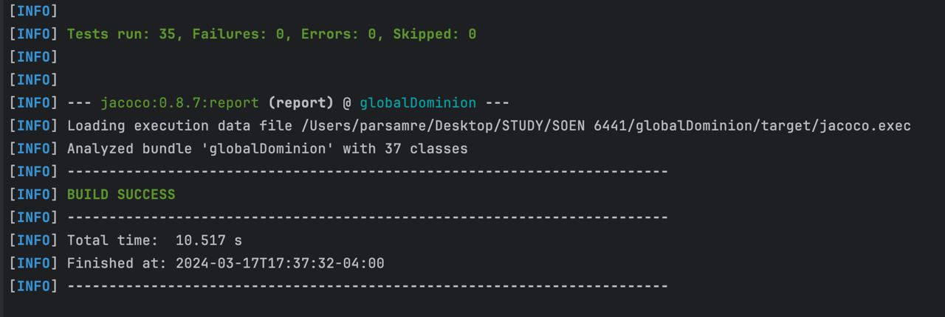

Slide 55
Git Hub Pictures

Slide 56
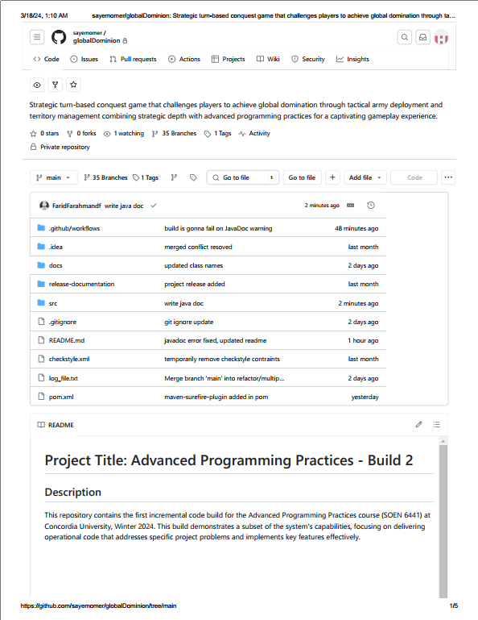
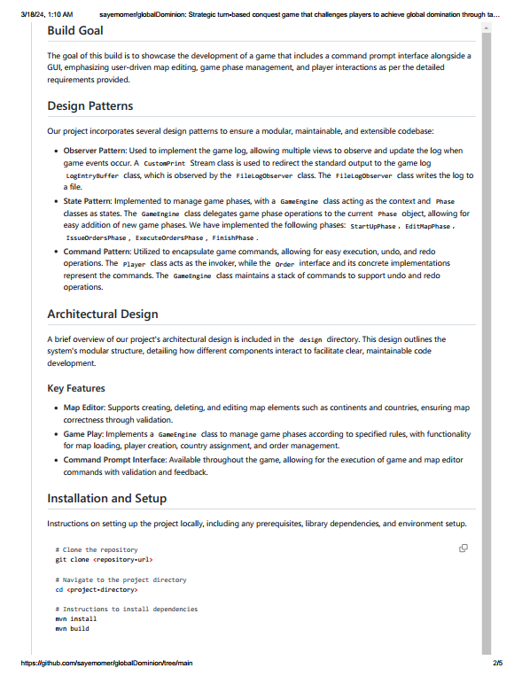

Slide 57
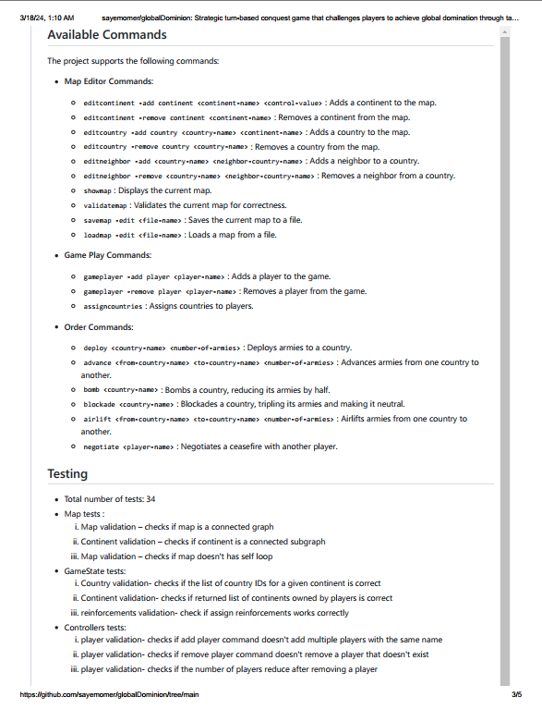
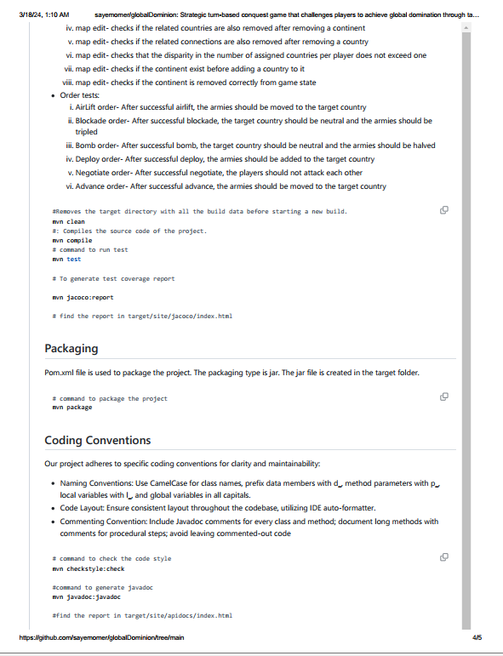

Slide 58
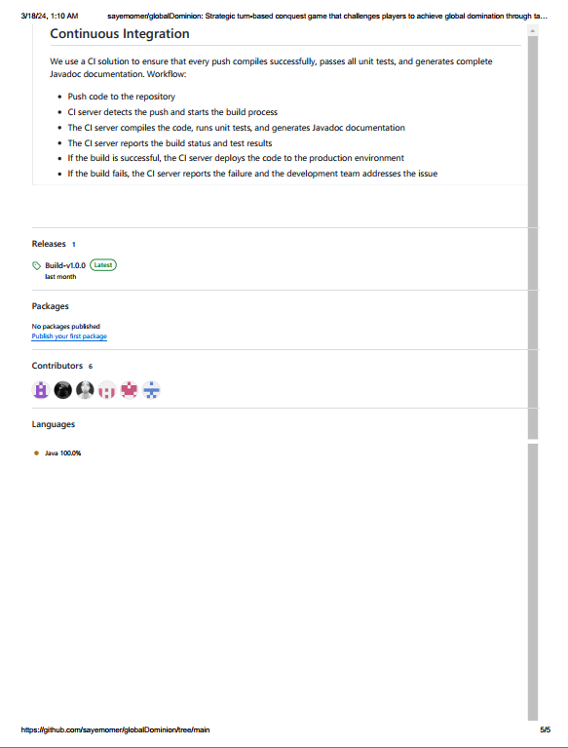

Slide 59
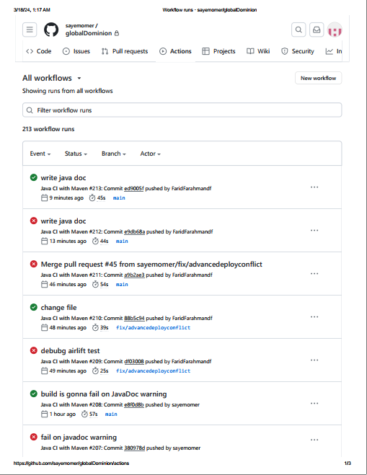
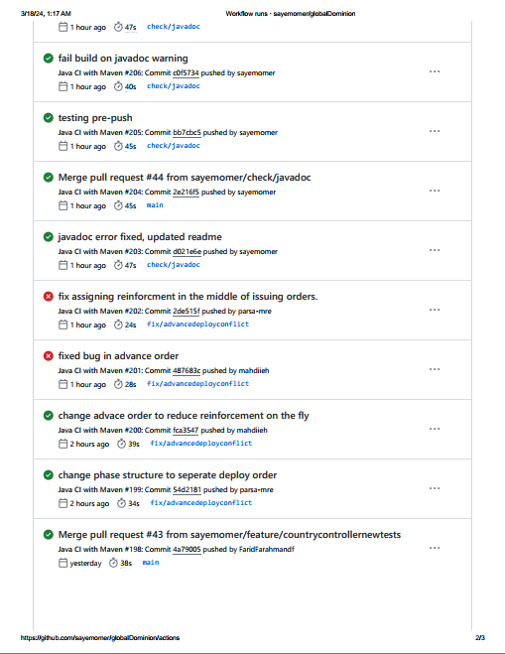

Slide 60
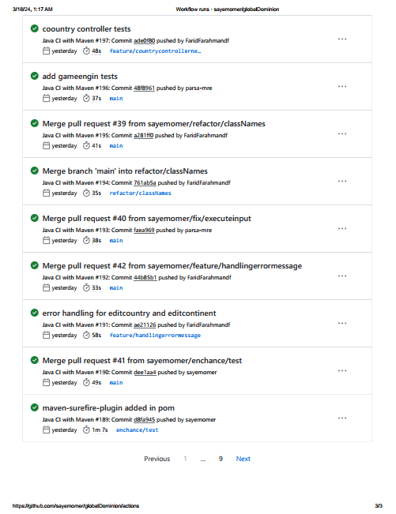

Slide 61
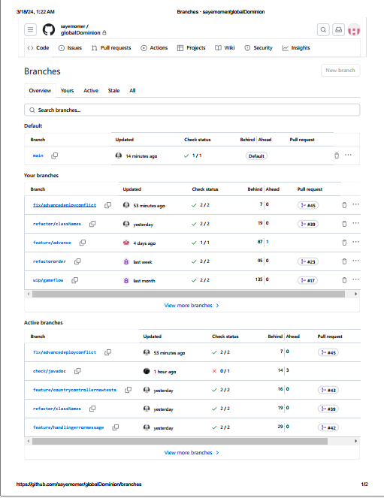

Slide 62
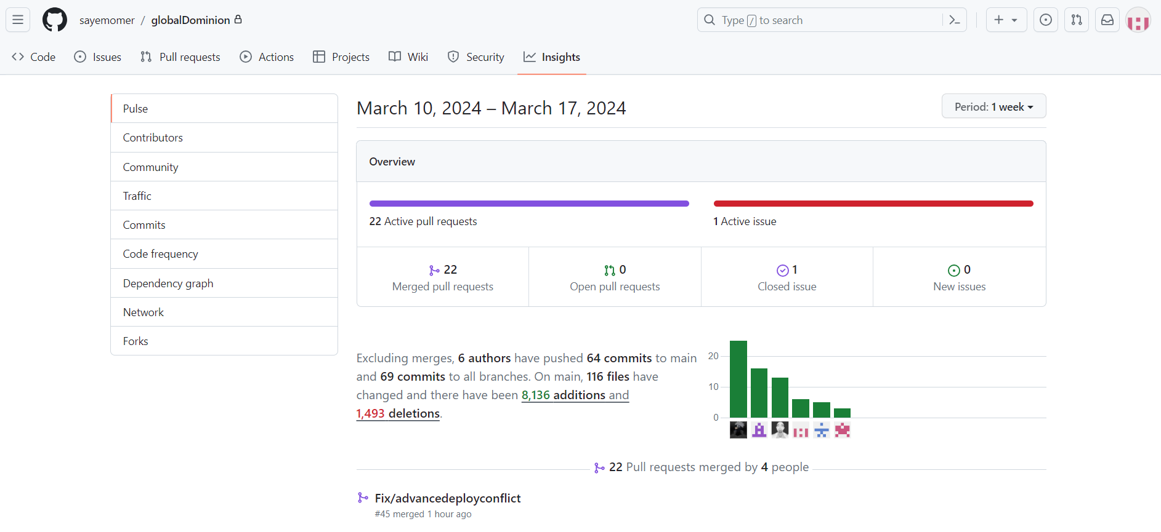

Slide 63
JavaDoc Pictures

Slide 64
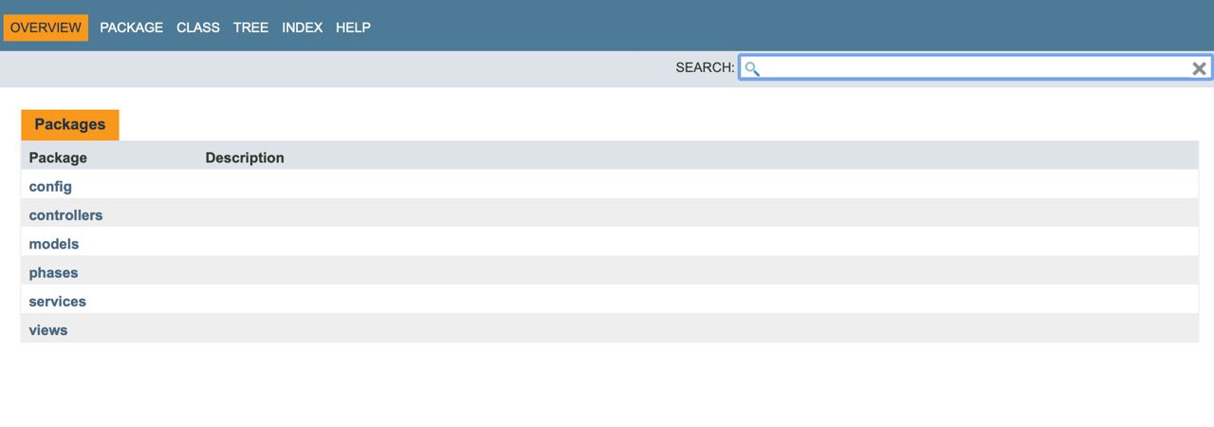

Slide 65
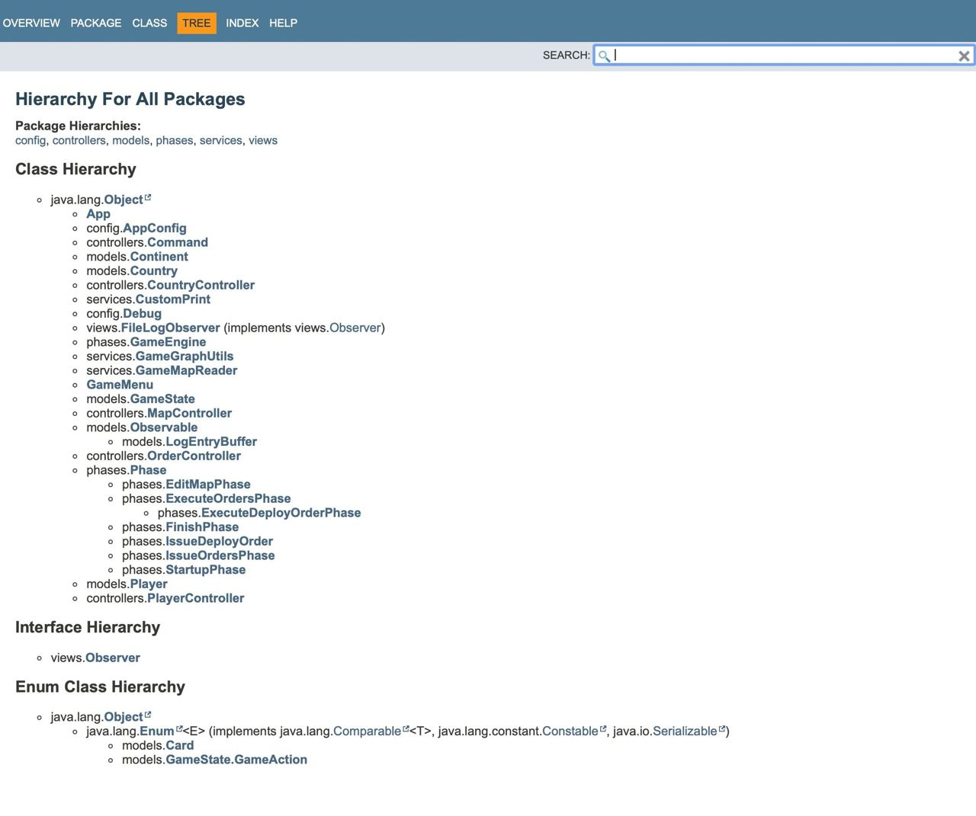

Slide 66
Thank you

