Slide 1
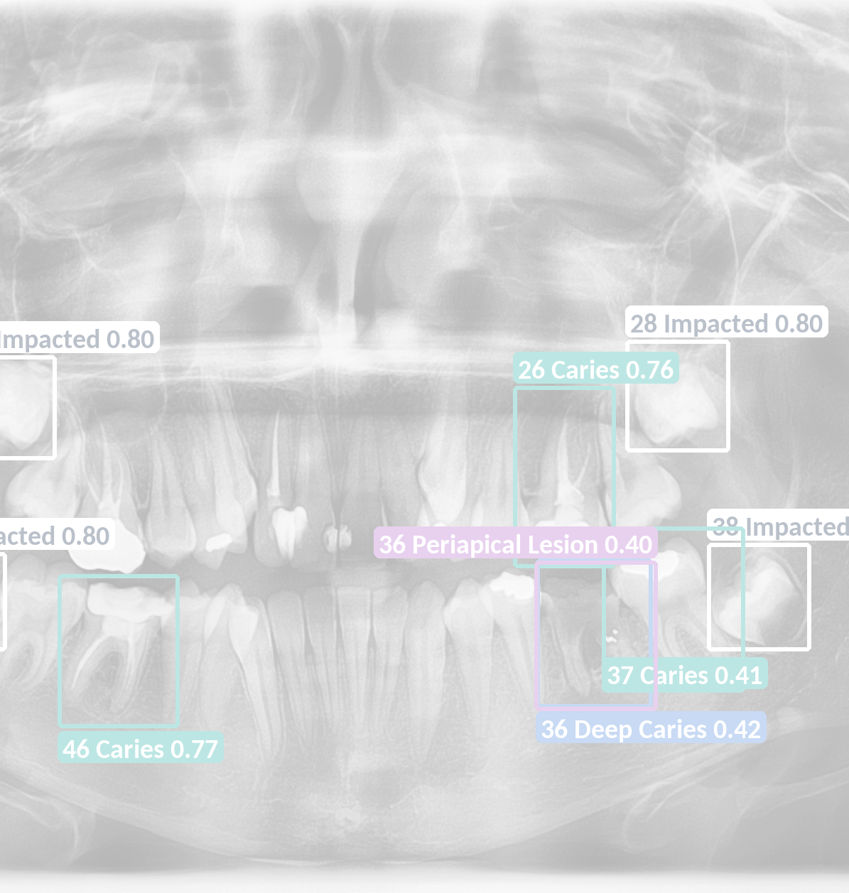
DentalAI
A second opinion on every
panoramic X-ray — the dentist
stays in charge
Team: Seif Ahmed · Abdullah Tarek Habashy · 3 team names: UNVERIFIED
Alexandria University (CDS) · Advisor: Ashraf Eshta
IEEE IC-FTAI 2026 · Student Project Track
Background: shipped model on a public DENTEX image (CC BY-NC-SA)
Notes:
[0:00–0:15] Good morning. We are the DentalAI team from Alexandria University. Dentists read panoramic X-rays every day, often under time pressure. DentalAI gives them a second opinion on every scan, while the dentist stays in charge of every decision.

Slide 2
The problem
Findings get missed
History is scattered
Easy to overlook on a busy day.
Paper files, separate software.
Drug safety from memory
AI ignores the dentist
Allergies checked by recall.
Corrections are simply lost.
IC-FTAI 2026 · Alexandria University (CDS)
2
Notes:
[0:15–0:45] Here is the problem. Subtle lesions, like early caries or a periapical lesion, are easy to miss on a busy day. A patient's history is scattered across paper files and different software. Before prescribing, the dentist checks allergies and drug interactions from memory. And most AI tools stop at detection: when the dentist disagrees, that correction is simply lost. Each of these slows the dentist down or puts the patient at risk.

Slide 3
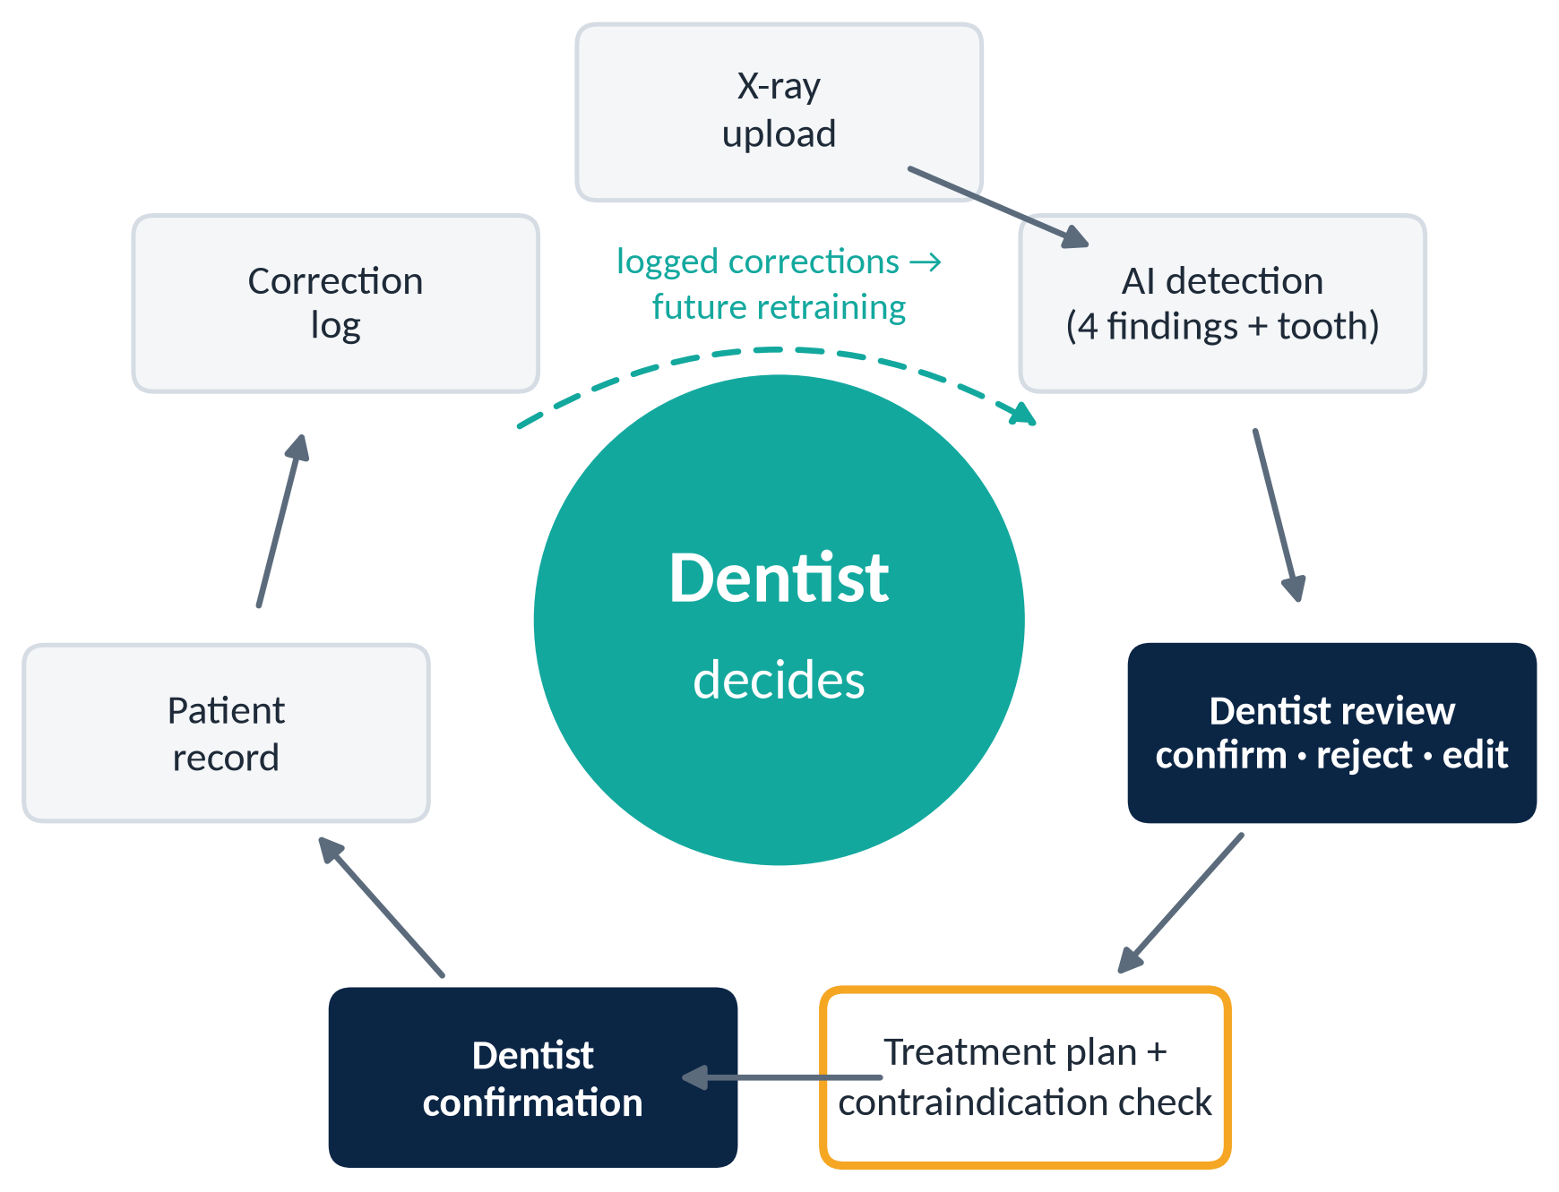
Our solution: the closed loop
Others detect.
DentalAI connects detection, decision, treatment and record.
Every correction is logged as future training data.
IC-FTAI 2026 · Alexandria University (CDS)
3
Notes:
[0:45–1:15] Our answer is a closed loop, with the dentist at its centre. The X-ray goes in, the AI marks findings tooth by tooth, and the dentist confirms, rejects or edits each one. Only confirmed findings drive a treatment plan, which is checked for drug safety, confirmed again by the dentist, and saved to the patient's record. Every correction is logged, so it can become training data later.

Slide 4
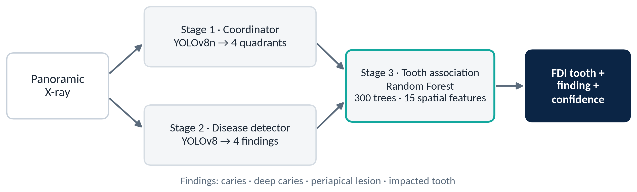
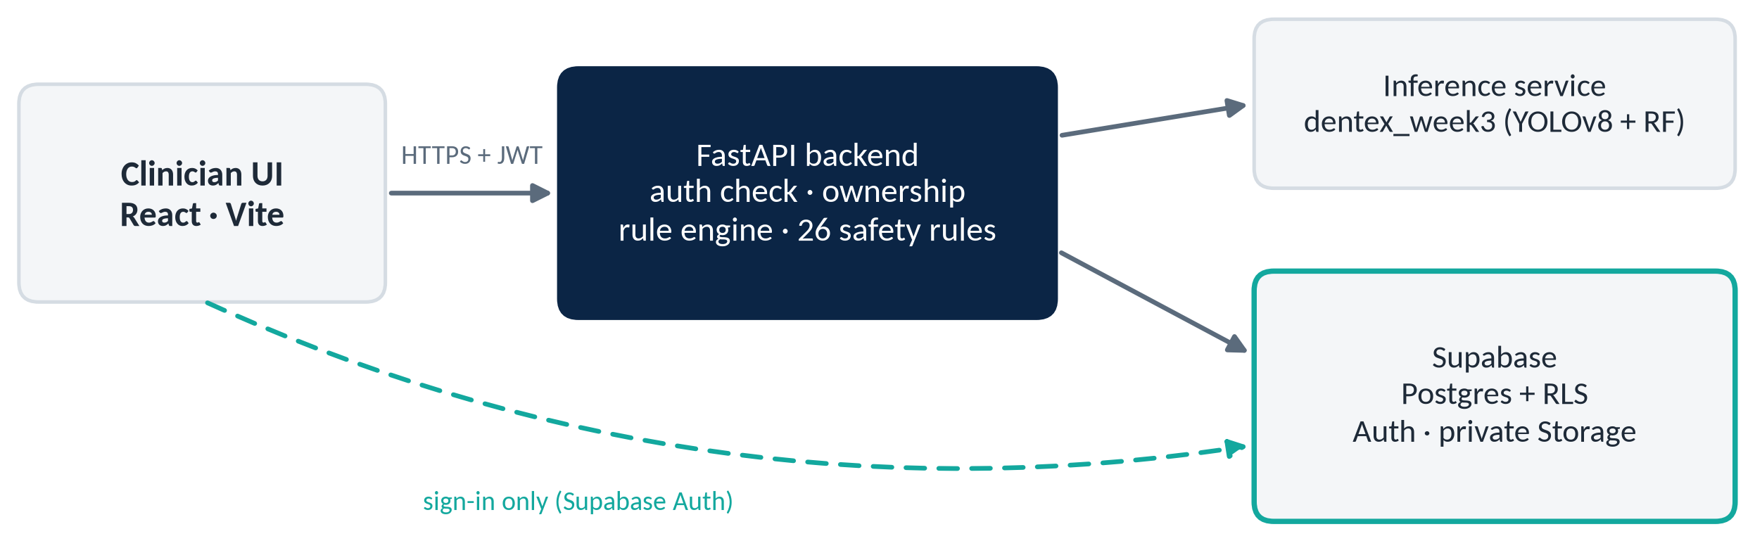
How it works
Model pipeline
System
IC-FTAI 2026 · Alexandria University (CDS)
4
Notes:
[1:15–1:45] Under the hood, three models work in sequence. A YOLOv8 nano model finds the four quadrants, a YOLOv8 detector finds four kinds of findings, and a Random Forest assigns each finding to its tooth number. Around it, a React interface talks to a FastAPI backend that holds our safety rules, the inference service, and Supabase for the database, sign-in and private image storage. Every request is authenticated, and each dentist sees only their own patients.

Slide 5
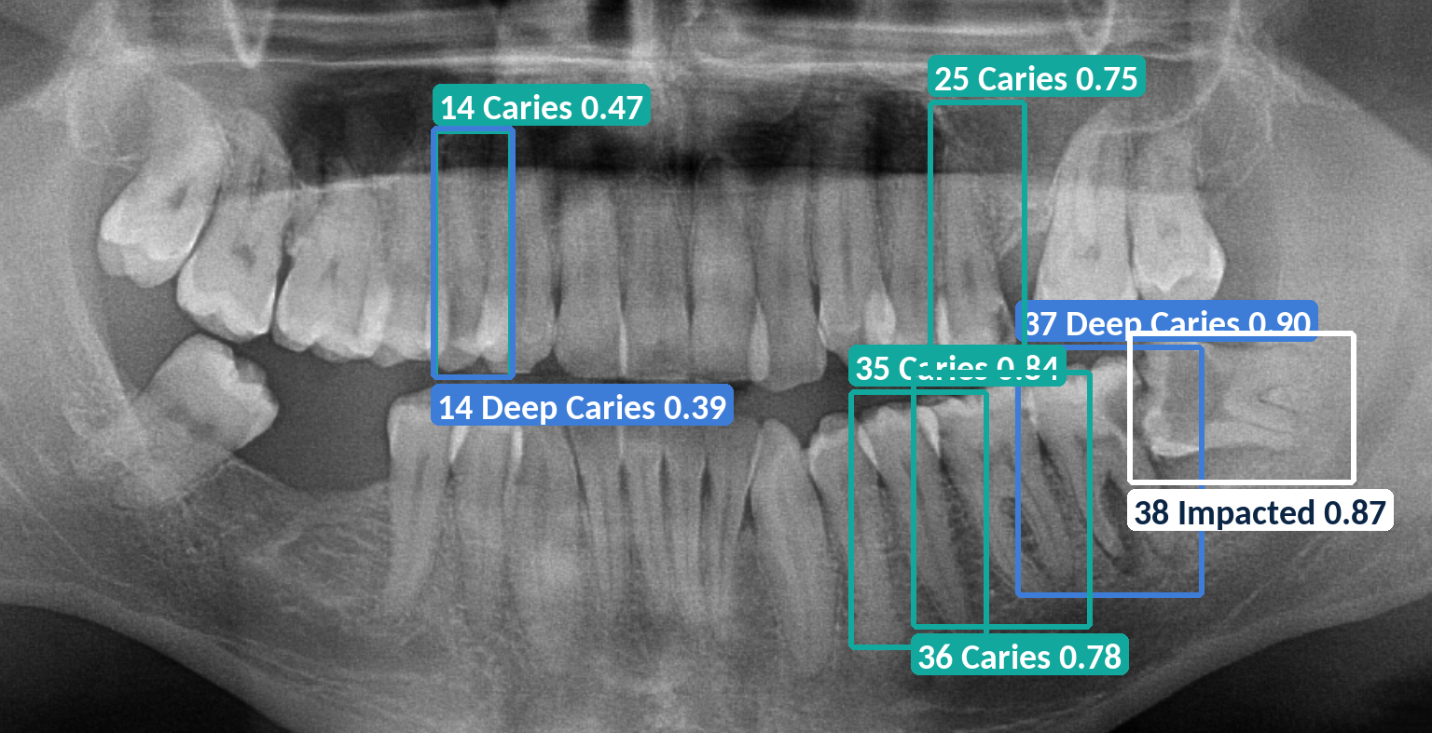
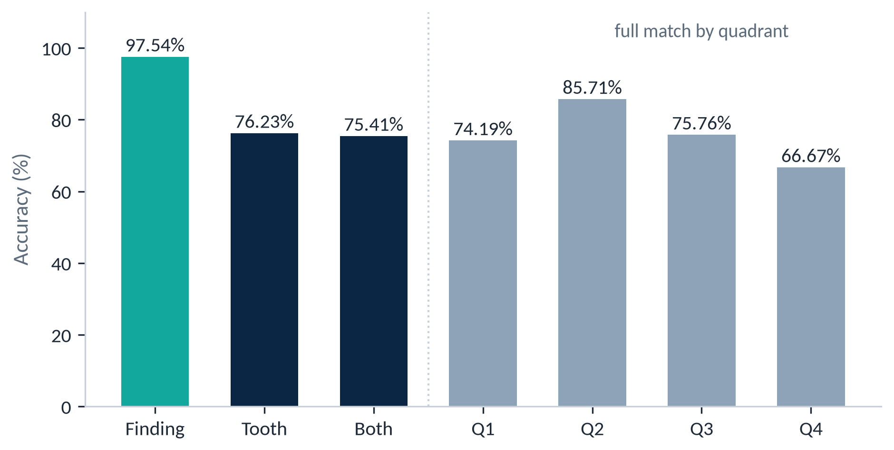
Results
Shipped pipeline · held-out benchmark · 23 images, 122 detections
97.54%
76.23%
75.41%
finding label correct
tooth number correct
finding + tooth correct
Public DENTEX image · detections ≥ 0.35 shown
IC-FTAI 2026 · Alexandria University (CDS)
5
Notes:
[1:45–2:15] On a held-out benchmark of twenty-three panoramic images with one hundred and twenty-two detections, the pipeline gave the right finding label ninety-seven point five percent of the time, the right tooth seventy-six percent, and both seventy-five percent. Tooth numbering is clearly our weakest point, and twenty-three images is a small test, so we treat these as early results, not clinical performance. Every finding shows its confidence, and nothing is final until the dentist confirms it.

Slide 6
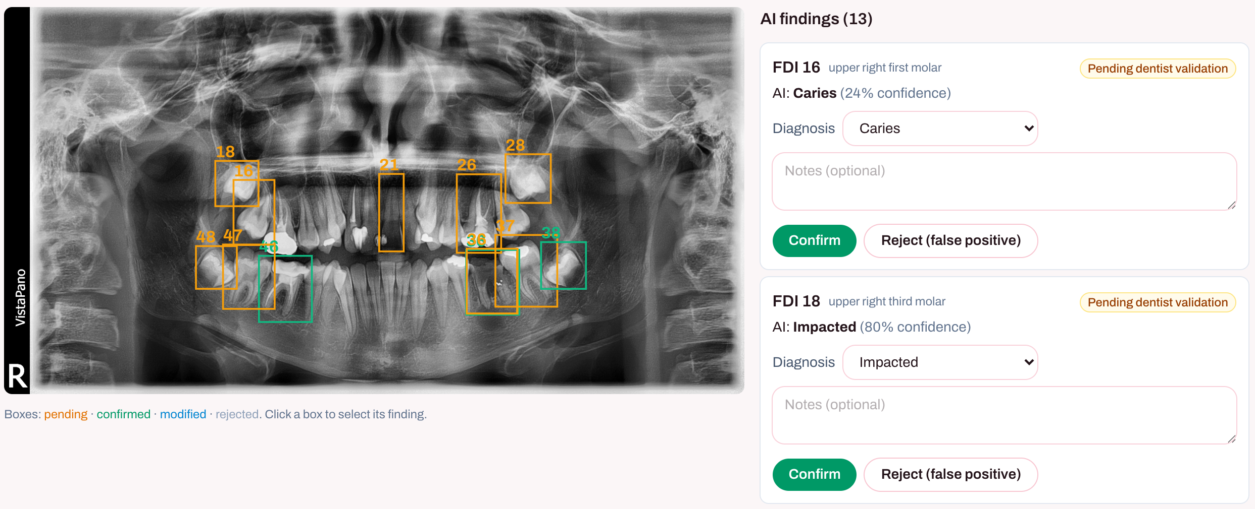
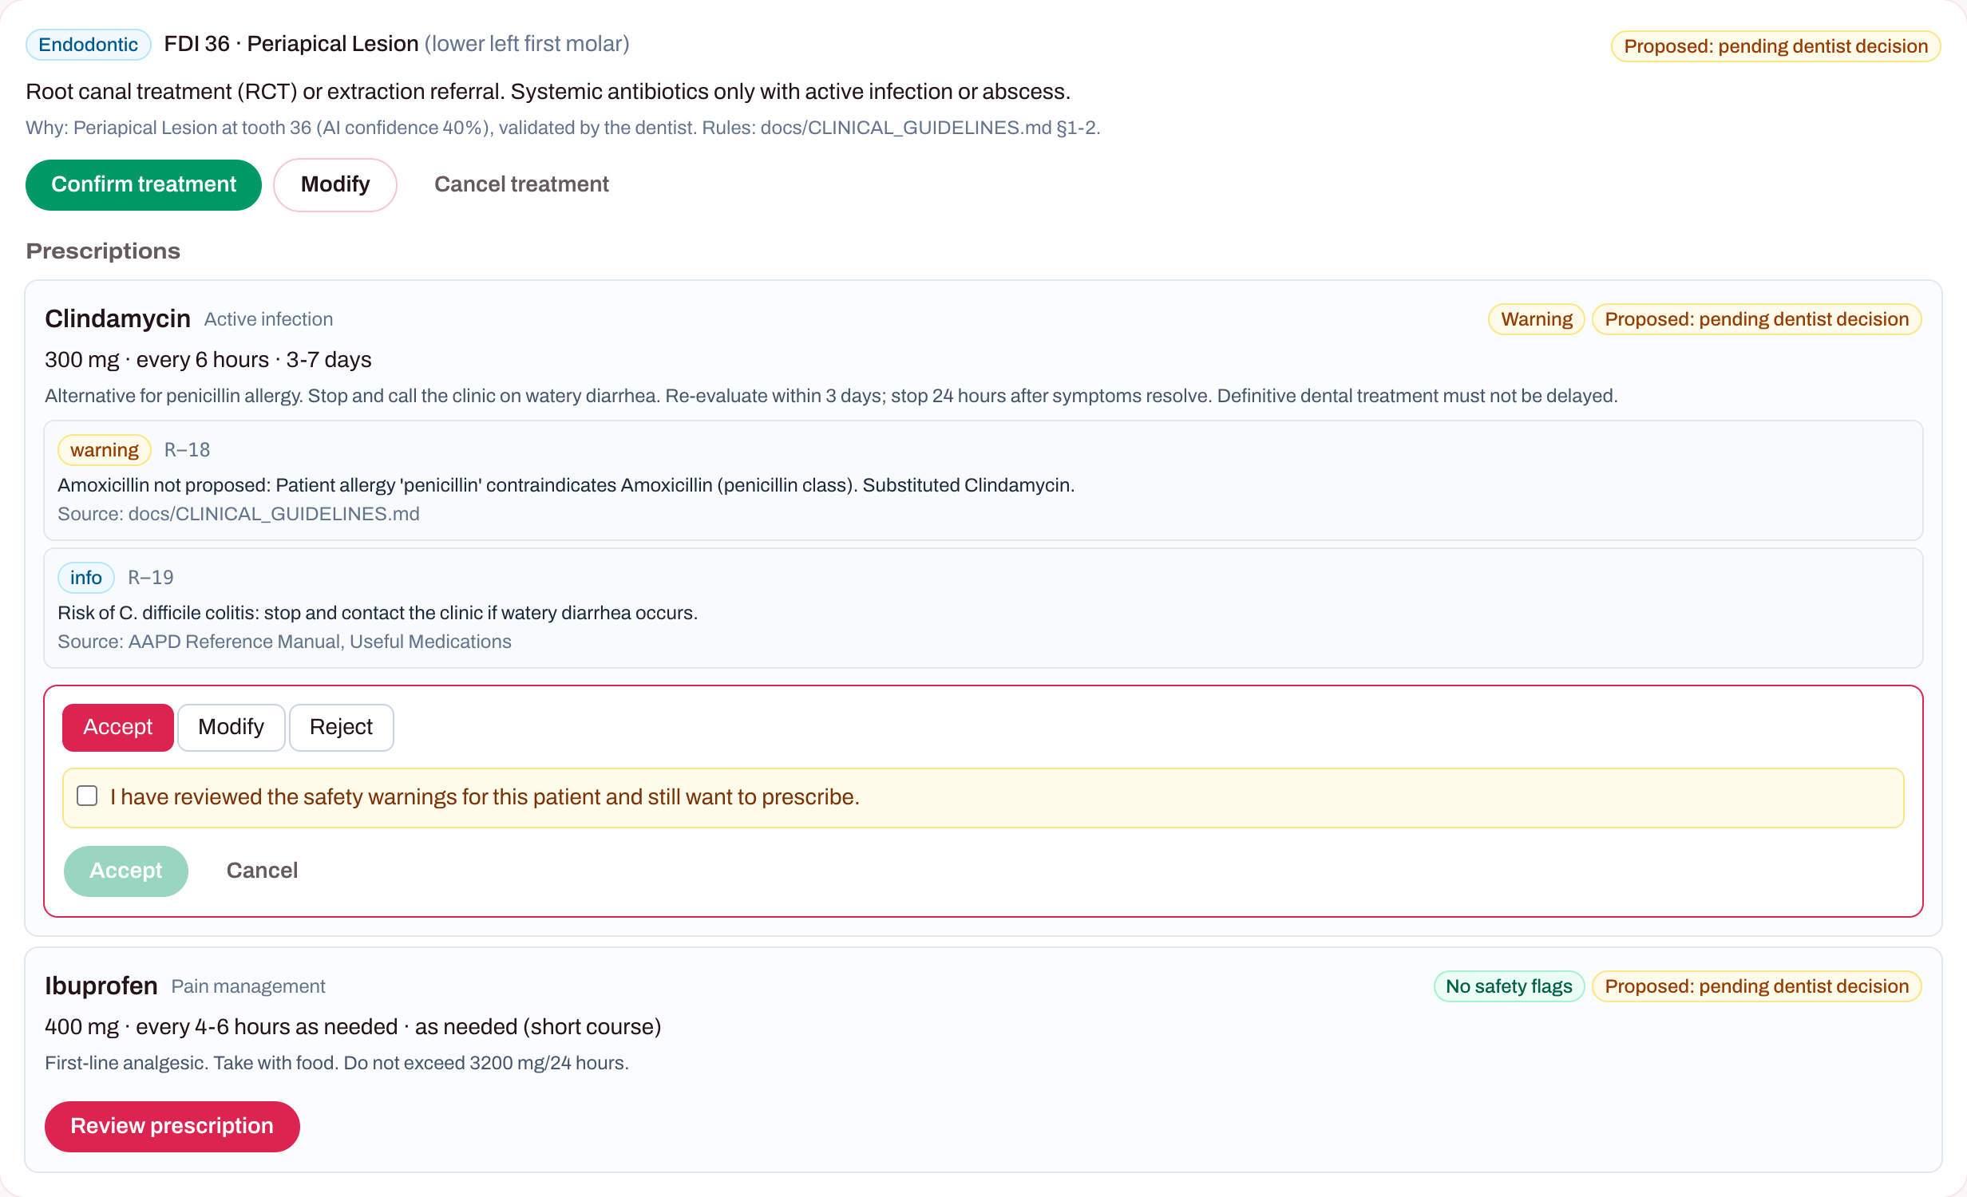
In the clinic: safety by design
Findings stay pending until the dentist acts.
Caries
Infection
Allergy
No drug
Drug, no conflict
Drug with conflict
Penicillin allergy: warning must be acknowledged.
AI proposes. Dentist decides.
IC-FTAI 2026 · Alexandria University (CDS)
6
Notes:
[2:15–2:40] Safety is built into the workflow. Every AI finding stays pending until the dentist acts. Here the patient is allergic to penicillin, so amoxicillin is excluded, clindamycin is suggested, and the dentist cannot accept it without acknowledging the warning. A contraindicated drug needs a written reason. The AI proposes; the dentist decides.

Slide 7

Impact & next steps
Done
Next
Full loop, end to end
Login + per-dentist access
196 automated tests in CI
Clinic pilot
Clinician rule review
Retraining from corrections
PDPL 151/2020 compliance
Code & docs on GitHub
Thank you — questions welcome.
IC-FTAI 2026 · Alexandria University (CDS)
7
Notes:
[2:40–3:00] Today the full loop works end to end and is covered by about two hundred automated tests. Next comes a clinic pilot, clinician validation of our rules, retraining from the logged corrections, and compliance with Egypt's data protection law. Thank you.

Slide 8
Backup — Q&A
Competition · Data · Limitations · Privacy · Testing · Clinical rules
Notes:
Backup slides for judge questions. Not part of the 3-minute talk.

Slide 9
Backup · Competitive landscape
Product | Detects findings on X-rays | Dentist confirms each finding | Treatment + drug-safety check | Longitudinal record | Corrections logged
Diagnocat | Yes | verify | verify | verify | verify
Pearl | Yes | verify | verify | verify | verify
Overjet | Yes | verify | verify | verify | verify
dentalXrai | Yes | verify | verify | verify | verify
DentalRx | verify | verify | verify | verify | verify
DentalAI | Yes (4 findings + tooth) | Yes, required | Yes, 26 rules, gated | Yes | Yes (retraining planned)
Competitor cells are UNVERIFIED: check each vendor's current public product pages before presenting.
Our claim is narrow: DentalAI links detection to the dentist's decision, treatment safety and the patient record in one loop.
IC-FTAI 2026 · Alexandria University (CDS)
9
Notes:
Competitors detect findings well. Our difference is the loop: dentist confirmation, treatment and drug-safety checks, the record, and logged corrections, in one workflow.

Slide 10
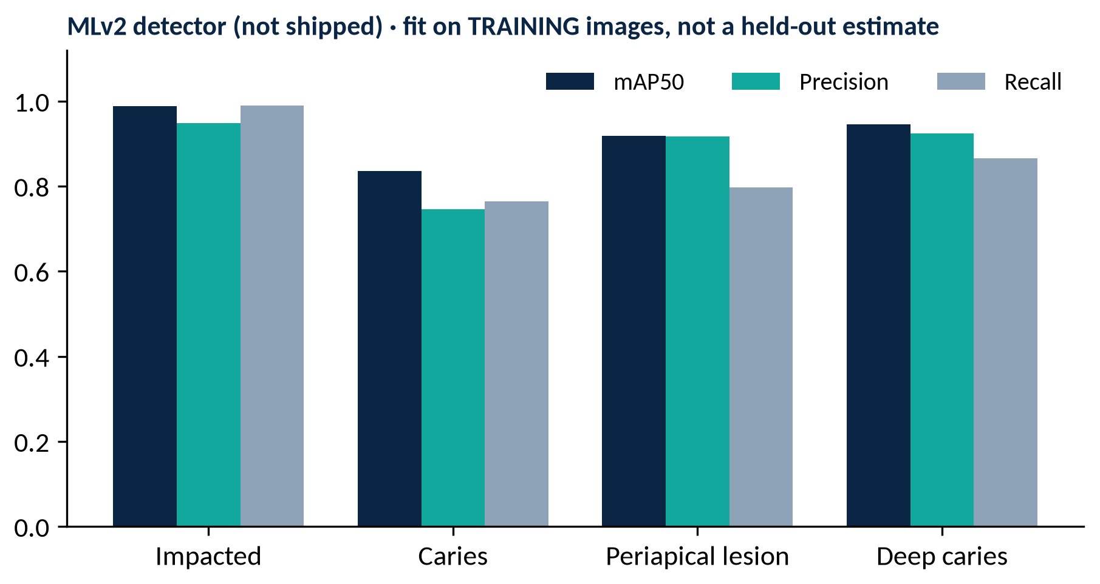
Backup · Data & training
Data: DENTEX 2023 panoramic X-rays (public, CC BY-NC-SA). Tufts + Loki model set aside; Roboflow never used.
Classes: caries, deep caries, periapical lesion, impacted; FDI tooth numbers.
Training (Kaggle, 2× T4): YOLOv8n coordinator, 50 epochs, 640 px; YOLOv8s detector (MLv2), 50 epochs, 640 px; Ultralytics default augmentation.
Tooth association: Random Forest, 300 trees, 15 spatial features, balanced classes.
Held-out test: 23 images, 122 detections (results slide).
Shipped detector checkpoint differs from the MLv2 run: its training split is UNVERIFIED.
MLv2 validated on its own training folder (val = train), so these numbers show fit, not generalization. We report only the held-out benchmark as performance.
IC-FTAI 2026 · Alexandria University (CDS)
10
Notes:
Be explicit: the high mAP numbers in the MLv2 notebook were measured on training images. The held-out benchmark is the only generalization result.

Slide 11
Backup · Limitations & honest risks
Small test set: 23 held-out images, 122 detections; no held-out mAP or recall for the shipped detector yet.
Tooth numbering: weakest output (76.23%). Older enumerators shifted numbers when a tooth was missing; the Random Forest was added to fix this.
Uncalibrated confidence: scores are model probabilities, not clinical probabilities.
Domain gap: trained and tested on public DENTEX images; real clinic X-rays may differ.
Feedback loop: corrections are logged; no retraining has been run yet.
Clinical rules: source-backed (ADA, AHA, AAPD) but not yet clinician-validated; no clinic pilot yet.
IC-FTAI 2026 · Alexandria University (CDS)
11
Notes:
Name the limits before judges do. Each one has a next step: a larger test set, calibration, a pilot, retraining, clinician review.

Slide 12
Backup · Privacy & compliance
Synthetic data only: demo patients are synthetic QA profiles; X-rays are public DENTEX images.
Access: every API call needs a signed-in dentist; each dentist sees only their own patients (others answer 404).
Database: Supabase row-level security with no client access; only the backend reads and writes.
Images: private storage bucket; time-limited signed links (1 hour).
Audit: every correction and override is recorded with the dentist's id.
Egypt PDPL 151/2020: compliance review planned before any clinic pilot (consent, data residency, retention).
IC-FTAI 2026 · Alexandria University (CDS)
12
Notes:
We have not processed real patient data. PDPL compliance is a planned step, not a claim.

Slide 13
Backup · Testing & QA evidence
171
25
3
6
backend tests
frontend tests
CI jobs
synthetic profiles
CI: repo guard (no weights, secrets or keys committed), backend (compile + tests), frontend (typecheck + tests + build).
Three demo branches tested: caries → no drug; periapical lesion + infection → amoxicillin; penicillin allergy → clindamycin with warning.
HTTP tests: sign-in required (401), cross-dentist access blocked (404), decision gates enforced (422).
Live runs: full loop on a real Supabase project with throwaway accounts, deleted afterwards.
IC-FTAI 2026 · Alexandria University (CDS)
13
Notes:
All numbers come from the repository test runs on 21 Oct 2026.

Slide 14
Backup · Clinical rules
Pending clinician validation
Finding | Proposed treatment | Drugs
Caries | Restorative referral | Never antibiotics
Deep caries | Pulp capping / endodontic evaluation | Only if infection reported
Periapical lesion | Root canal or extraction referral | Only if infection reported
Impacted tooth | Oral surgery evaluation | Prophylaxis only for cardiac risk
26 safety rules, for example:
R-01 penicillin allergy → no amoxicillin
R-02 ibuprofen + anticoagulant
R-14 no clindamycin for prophylaxis (AHA 2021)
R-23 daily-dose limits
R-18 substitute shown with reason
Warning → acknowledge · Contraindicated → written reason
Sources: ADA 2019, AHA 2021, AAPD Reference Manual, AGS Beers 2023. Antibiotics are proposed only when the dentist reports infection (antibiotic stewardship).
IC-FTAI 2026 · Alexandria University (CDS)
14
Notes:
Liability stays with the dentist: the system never finalises a drug; flagged drugs need acknowledgement or a written reason, stored for audit.

