Slide 1
Molecular characterization and clinical relevance of m6A regulators in digestive system tumors

Slide 2
消化道肿瘤m6A分析思路
TCGA、GEO等数据库下载mRNA、lncRNA、circRNA表达
数据库搜集
体系突变、SNP等
Go、KEGG分析
差异表达
m6A调节因子分析
与临床病理、预后的关系
共表达网络
Lasso分析筛选预后密切分子
m6A建模分型
Go、KEGG分析
m6A水平高低亚组
与临床病理、预后的关系
食管癌、胃癌、结肠癌、肝癌、胰腺癌
筛选潜在功能、靶点
根据m6A亚型功能聚类分析结果
功能筛选
聚焦热点方向：菌群、代谢、免疫等

Slide 3
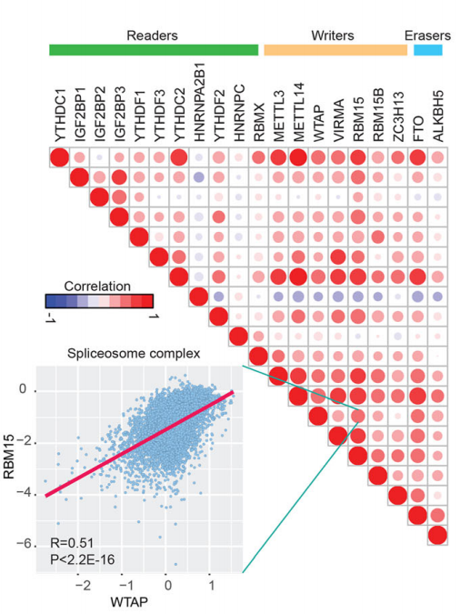
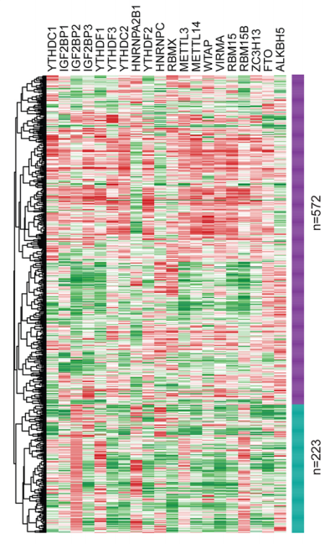
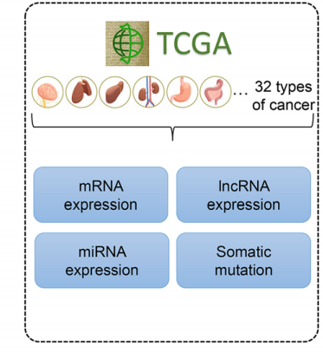
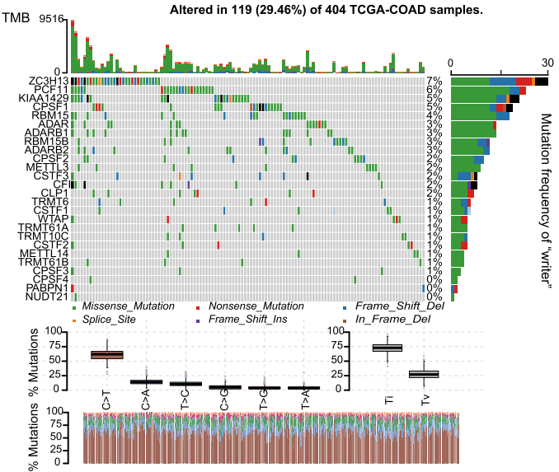
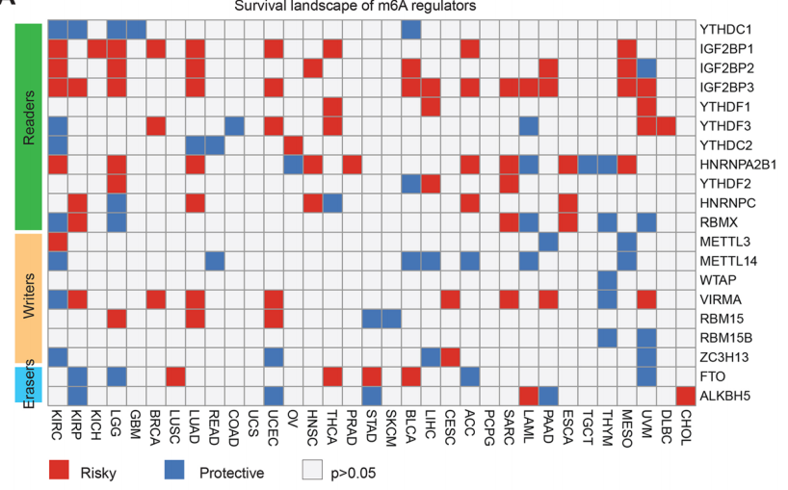
Fig1 Genetic and transcriptional alterations of m6A in digestive system tumors
A
B
D
C
E

Slide 4
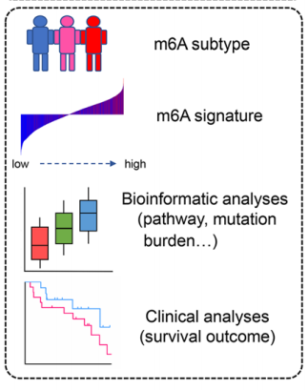
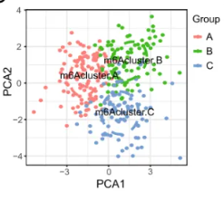
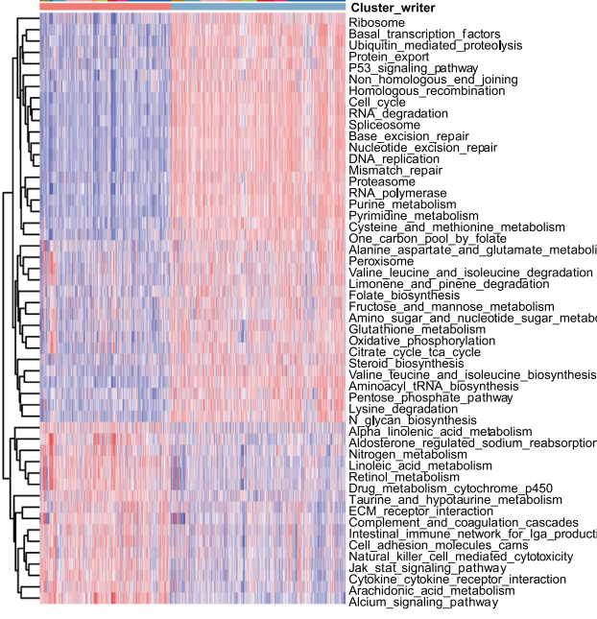
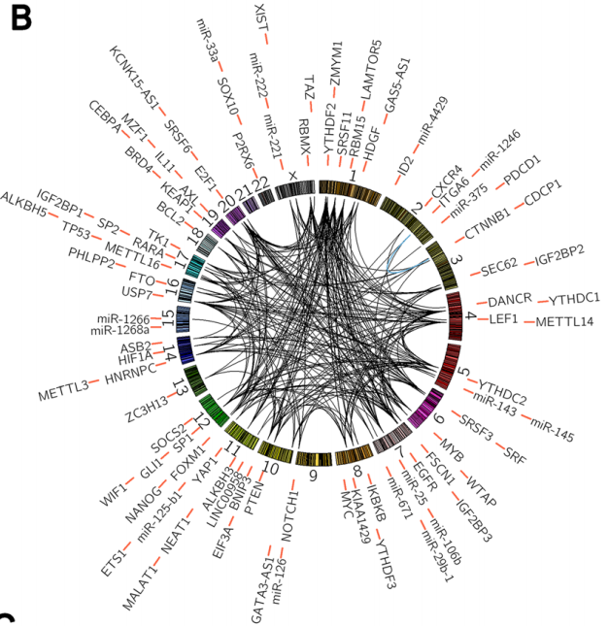
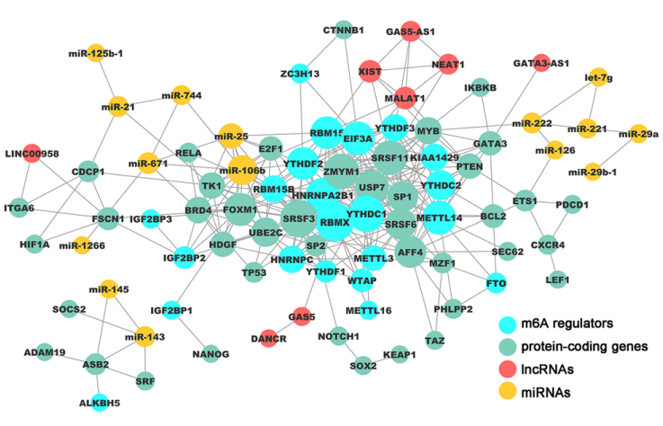
Fig2 Construction of RNA modification patterns mediated by m6A regulators and differential function enrichment analysis among clusters
A
C
E
B
D

Slide 5
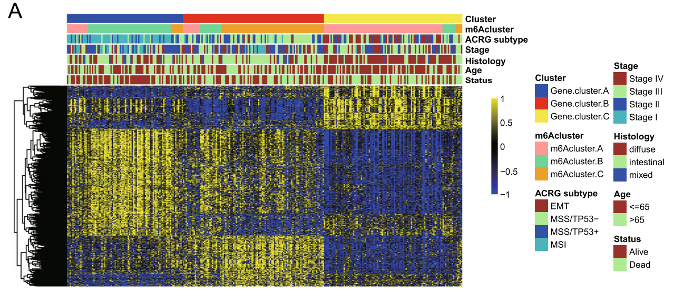
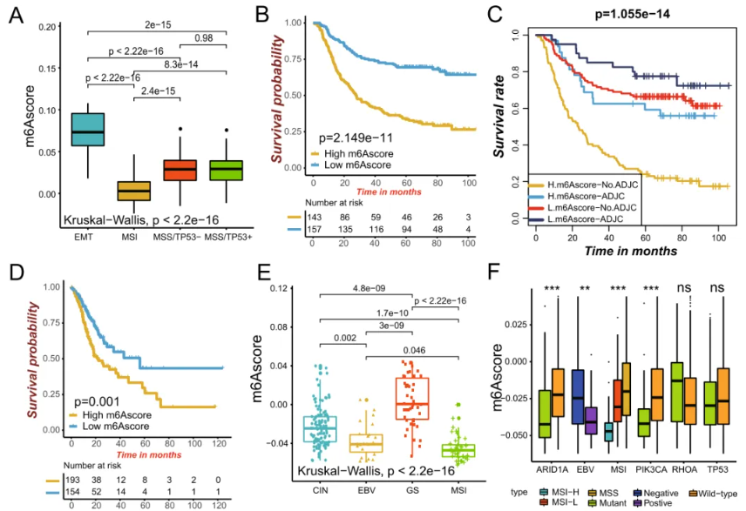
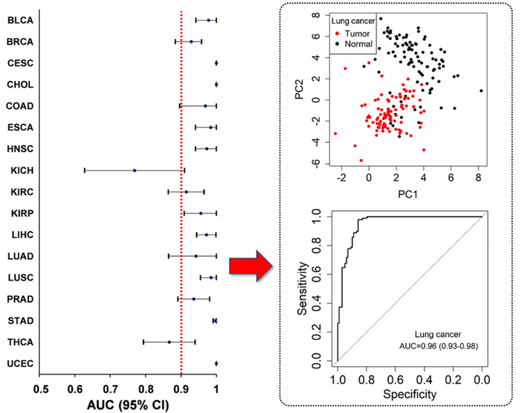
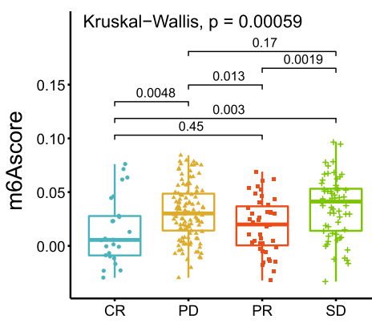
Fig3 Characteristics of m6A modification in clinical characteristics
C
m6Ascore 与HP感染的关系
D
E

Slide 6
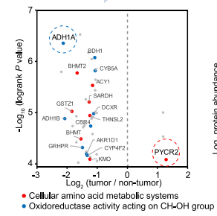
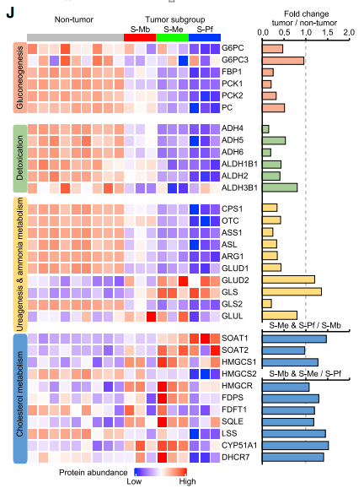
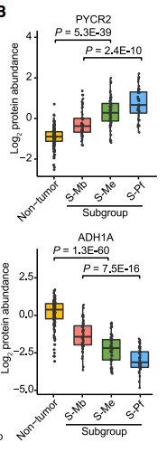
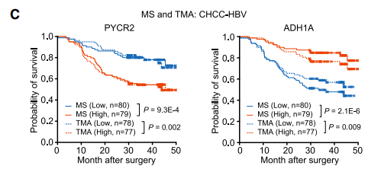
Fig4 m6A modification patterns in cellular metabolic and signaling pathways

Slide 7
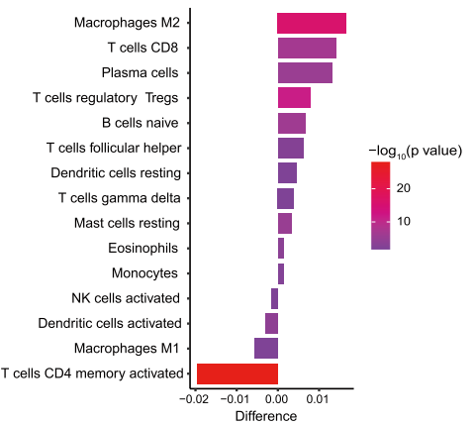
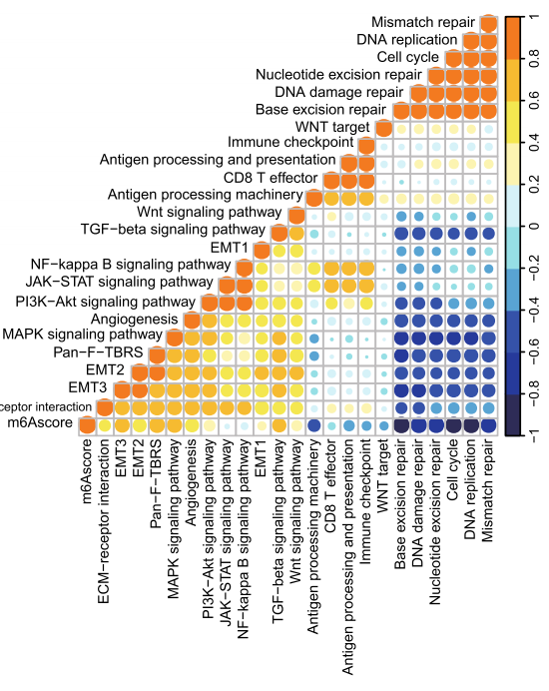
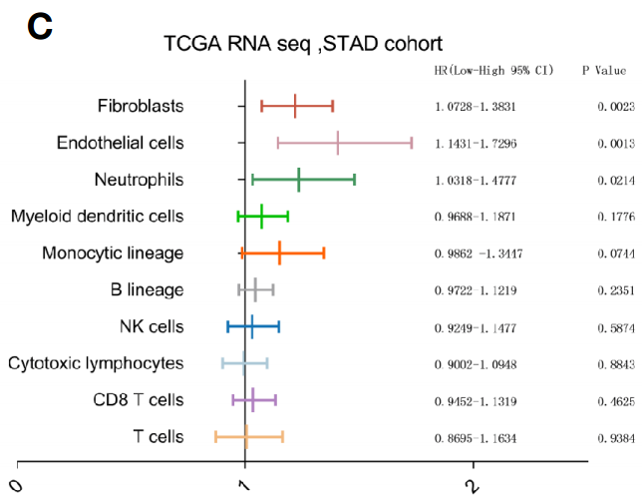
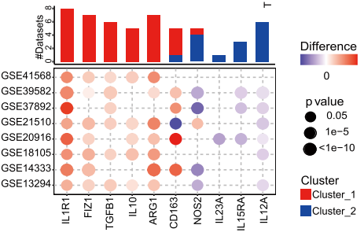
Fig5 TME cell infiltration characteristics in distinct m6A modification patterns

Slide 8
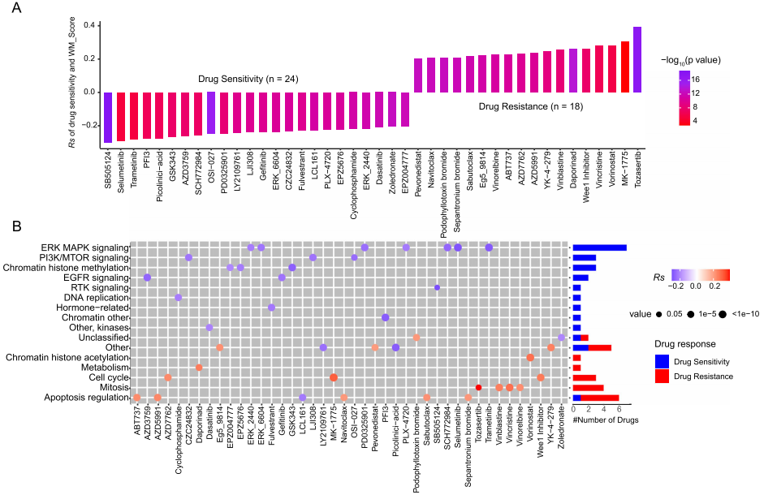
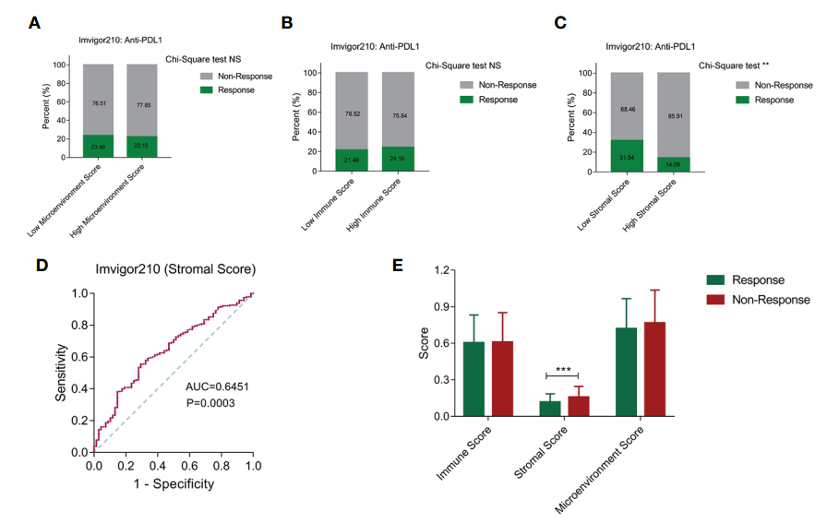
Fig6 m6A modification patterns in the role of anti-PD-1/ L1 immunotherapy
C
D

