Slide 1
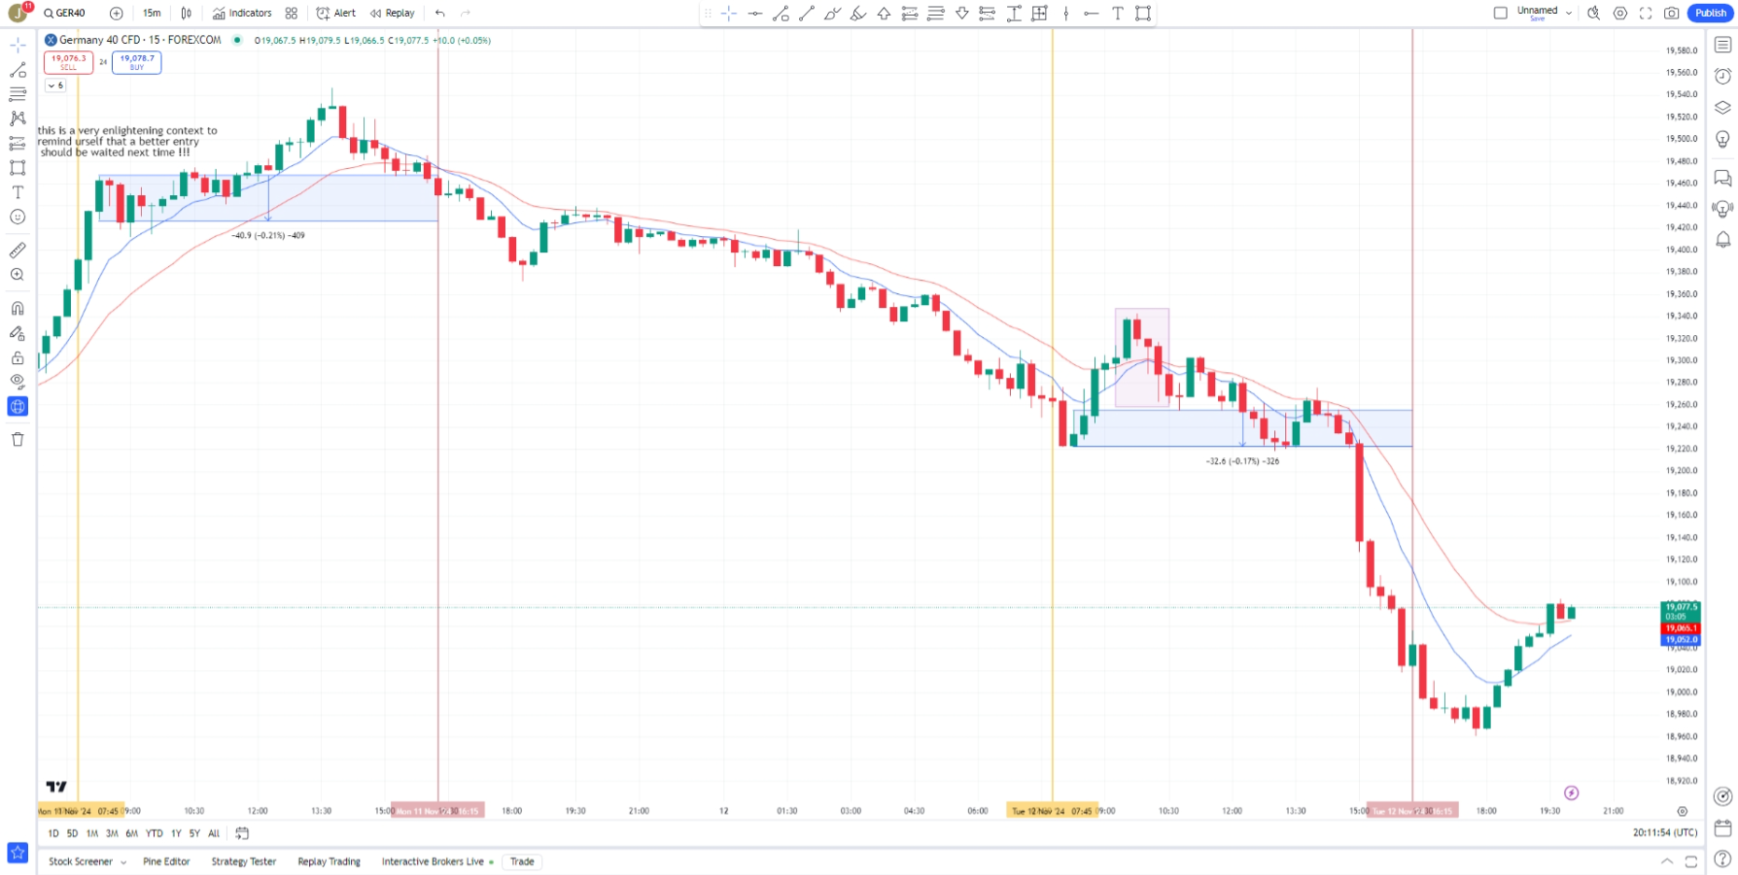
12/Nov/2024

Slide 2
12/Nov/2024

Slide 11
Thank you for your attention

