Slide 1
OPERATING SYSTEM TERM PROJECT
A Distributed Resource Manager
and Job Scheduler
Submit Job
CPU: 8 RAM: 32 GB
GPU: 1
for Heterogeneous Lab Computing
Scheduler
Chooses when and where
the job runs
Treat multiple lab machines as one shared pool of CPU, memory, and GPU resources.
Worker Pool
Node A Node B Node C
614410111 張宸維 | 614410038 陳弘翔
Notes:
Hello everyone
I am 誰誰誰
Today I'm presenting our project proposal
Our project is a distributed resource manager and job scheduler for lab computing. The idea is to treat several lab machines as one shared resource pool. Users submit jobs, and our scheduler decides when and where each job should run.

Slide 2
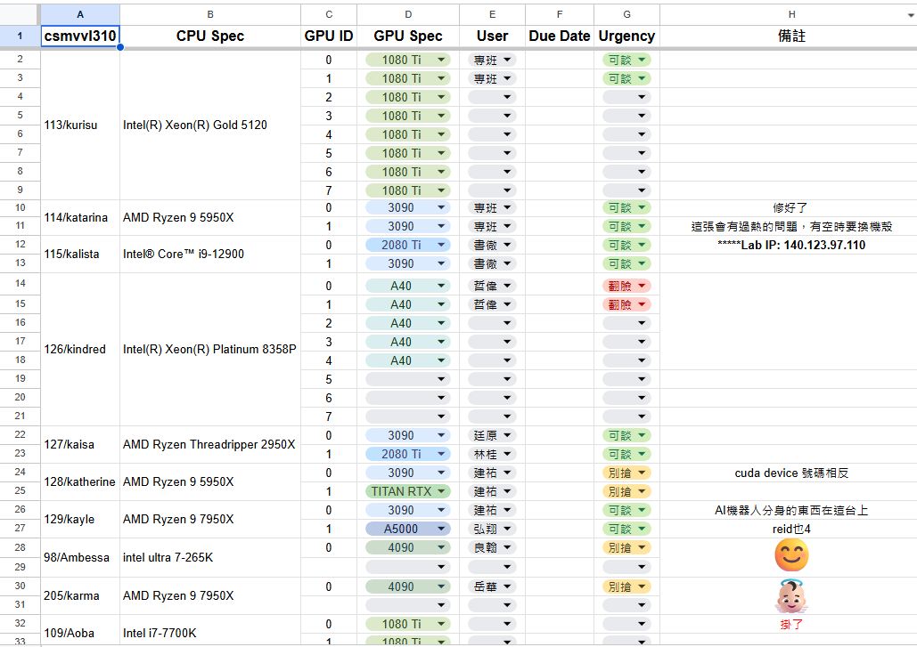
Notes:
So this is our current method in our lab to allocate our Computing resources
We register in a unify excel sheet
And everyone orchestrate base on their urgency
There is a lot of resource waste because everyone wants to reserve machines, resulting in high communication costs when someone has an urgent job

Slide 3
Why Do We Need a Lab Scheduler?
Small labs often own useful hardware, but resource use is still manual and fragmented.
Today: Manual Resource Hunting
1. Wasted capacity
2. Manual search
3. No global policy
One machine can be overloaded while another sits idle.
Users spend time checking machines instead of running jobs.
No shared queue, priority, or fairness mechanism.
Machine A
GPU busy
Machine B
mostly idle
Project Goal
Hide the physical location of resources and let users interact with the lab as one shared computing pool.
Machine C
RAM available
Users manually SSH into machines
and search for free resources.
Submit work once. Let the scheduler decide where and how it runs.
Notes:
So in our lab user needs to manually search for an available GPU while another machine stays idle.
This wastes resources and provides no common rule for priority or fairness.
Our goal is to manage these machines through one central scheduler.
But when we looked closer, we found that not all of our work fits the idea of submitting a job.

Slide 4
Not Every Job Is a Batch Job
Our lab runs three kinds of work, and a traditional queue only fits one.
Training runs
WHAT IT LOOKS LIKE
Runs for hours or days and holds a whole GPU.
HOW WE HANDLE IT
Queue with priority, fairness, and backfilling.
Quick tests
WHAT IT LOOKS LIKE
AI coding tools run code every few seconds.
HOW WE HANDLE IT
Fast lane: ready-to-go workers with a strict time limit.
Agent development
WHAT IT LOOKS LIKE
Needs a model to call, not a GPU to hold.
HOW WE HANDLE IT
Shared model service, started when someone needs it.
One scheduler, one GPU pool. Idle model services give their GPU back to training.
Notes:
So we are designing a slurm-like system
But we are facing some different problem
Go back to our excell sheet

Slide 5
Notes:
Why do people reserve whole machines on that Excel sheet? Because much of our work isn't a batch job.

Slide 6
Not Every Job Is a Batch Job
Our lab runs three kinds of work, and a traditional queue only fits one.
Training runs
WHAT IT LOOKS LIKE
Runs for hours or days and holds a whole GPU.
HOW WE HANDLE IT
Queue with priority, fairness, and backfilling.
Quick tests
WHAT IT LOOKS LIKE
AI coding tools run code every few seconds.
HOW WE HANDLE IT
Fast lane: ready-to-go workers with a strict time limit.
Agent development
WHAT IT LOOKS LIKE
Needs a model to call, not a GPU to hold.
HOW WE HANDLE IT
Shared model service, started when someone needs it.
One scheduler, one GPU pool. Idle model services give their GPU back to training.
Notes:
We have 3 types of typical job
Model training/small test from AI coding tools/Agent’s large langue model call
Training runs hold a GPU for hours or days, so they can fit in a normal priority queue.
Quick tests from AI coding tools re-run every few seconds, so they will need a fast lane with a strict time limit.
Agent development just needs to call a model, not hold a GPU — so we spin up a shared model service on demand, and it hands the GPU back to training when idle.
So there is One scheduler, one pool, three kinds of work.

Slide 7
System Overview
Three access paths share one scheduler and a dynamically allocated worker pool.
Batch Jobs / CLI
Quick Tests / API
Agent / Inference Gateway
Training and experiments
Submit to batch queue
Short dev-session leases
Warm worker, streamed output
OpenAI-compatible API, model routing
Ready model: send requests directly
Queued jobs
Lease request
Model startup request
Shared Scheduler & Lifecycle Manager
Dashboard
CPU / RAM / VRAM admission
Batch priority, fairness and backfilling
Test leases and timeout cleanup
Model startup and idle reclamation
Queue, node and
service status
Dispatch / stop workers; receive heartbeats and resource reports
Ready-model traffic
Shared Heterogeneous Worker Pool
Batch jobs, leased test workers and model servers run on suitable nodes.
Node A: smaller GPU Node B / C: larger-memory GPUs Roles change with demand
Notes:
Here's how that actually runs, in three parts.
batch jobs come through the CLI into a queue;
quick tests request a short-lived warm worker through an API and stream output back on that same worker;
agents talk to an inference gateway, which routes straight to a ready model if one's already up.
All these three lead into one shared brain — the scheduler and lifecycle manager.
It handles resource admission, batch priority and backfilling, test-lease timeouts, and reclaiming idle model servers.
Underneath is one shared pool of worker nodes

Slide 8
Scheduling Policies
The project is about scheduling decisions, not just remote execution.
Resource-aware Placement
Priority
Fairness
Backfilling
Match CPU, RAM, GPU type, and availability.
Important jobs can receive earlier service.
Waiting time and recent resource use affect scheduling score.
Use idle resources without unnecessarily delaying larger jobs.
Backfilling Example
Job A
Available
Job B
Decision
Needs a large-memory GPU
Queue position: 1
Only a smaller GPU is free
Fits on the smaller GPU
Short estimated duration
Run Job B first if it can finish before Job A is ready.
Notes:
For training runs, the main question is scheduling. We will support resource-aware placement, priority, fairness, and backfilling.
For example, if a large job cannot run yet, a smaller job may use the available resources first, as long as it does not delay the larger job.
In our lab, that means a big job waiting for a large-memory GPU while a small job runs on the smaller GPU.

Slide 9
What We Will Build
A working prototype that runs on our own lab machines.
Core System
One Pool, Three Kinds of Work
Central scheduler
Worker daemon on each node
Job submission interface
Monitoring dashboard
Training runs: priority queue + backfilling
Quick tests: fast lane with a time limit
Agent development: shared model service
Everyone submits work to one scheduler instead of reserving machines on a spreadsheet.
Outcome
Final demo: live jobs, a fast-lane test, an on-demand model service, and a worker failure.
Notes:
To wrap up, here is what we will build.
The core is a central scheduler, a worker daemon on each machine, a way to submit jobs, and a dashboard.
On top of that, the same GPU pool serves all three kinds of work: training runs in a queue, quick tests go through a fast lane, and agent developers get a shared model service.
Each job is isolated with cgroups, and heartbeats let us notice when a machine goes down.
In the final demo, we will show jobs arriving live, a fast-lane test, a model service starting on demand, and a worker failure. Thank you.

