Slide 1
Project Title
Smart Agriculture using LoRaWAN
Presented By
SAYLEE KELKAR
PRACHI JADHAV
PRANJAL KAMDAR
VIDHI BUDHE
Under the Guidance of
Prof. R.P. DESHMUKH
Area of specialization
Communication Systems
Notes:
1

Slide 2
Contents
Introduction
Problem Statement
Literature Survey
Block Diagram
Methodology
Work Done
References

Slide 3
Introduction
In the contemporary era, agriculture stands at the intersection of tradition and technology, facing the challenges of feeding a growing global population while navigating the complexities of climate change. In response to these challenges, this project introduces a Smart Agriculture System designed to revolutionize traditional farming practices by leveraging the power of the Internet of Things (IoT) and Long Range Wide Area Network (LoRaWAN) technology.
The essence of this project lies in the fusion of hardware and software components, including the ESP8266 microcontroller, LoRa module, DHT sensor, and antenna, to create a comprehensive and efficient solution for precision farming. Through the implementation of this system, farmers gain the ability to monitor and manage crucial environmental factors such as temperature and humidity in real-time, facilitating informed decision-making and resource optimization.

Slide 4
Problem Statement
“Current agricultural practices do not use real-time monitoring, as it limits farmers’ ability to respond properly to environmental changes crucial for crop health. Additionally, remote areas face communication challenges, hindering the adoption of smart farming technologies. This project addresses these issues by developing a Smart Agriculture System utilizing ESP8266, LoRaWAN, and DHT sensor technologies. The goal is to empower farmers with real-time data, optimize resource usage, and enable sustainable cultivation practices, particularly in areas with limited connectivity.”

Slide 5
Literature Survey
The paper primarily focuses on the application of LoRa technology in smart agriculture, potentially limiting the scope of the discussion to this specific domain[1].
While it discusses various scenarios within smart agriculture where LoRa can be beneficial, it may not delve deeply into the technical challenges or limitations faced in implementing these solutions[1].
The paper focuses on modernizing traditional agricultural methods through smart agriculture using automation and IoT technologies [2].
It highlights the importance of IoT in applications such as crop growth monitoring, irrigation decision support, and overall crop productivity improvement [2].
The system aims to reduce the complexity of traditional irrigation methods by using sensors to gather data on soil humidity, temperature, and daily sunshine duration to calculate the required water quantity for irrigation [2].
By analyzing weather conditions and optimizing water and fertilizer usage, the system aims to improve crop productivity while reducing water wastage and manual labour in the fields [2].

Slide 6
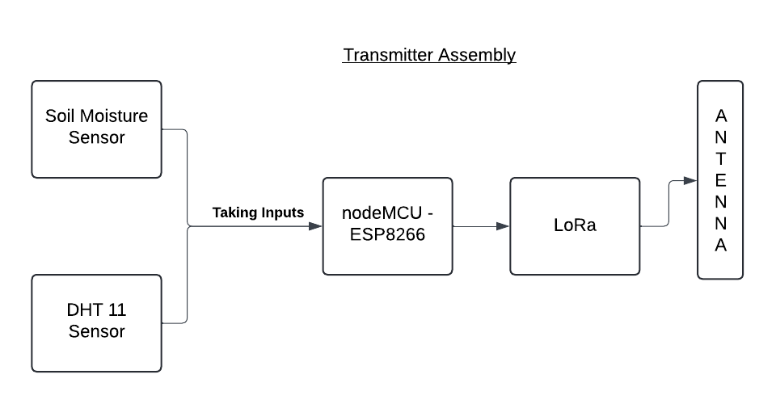
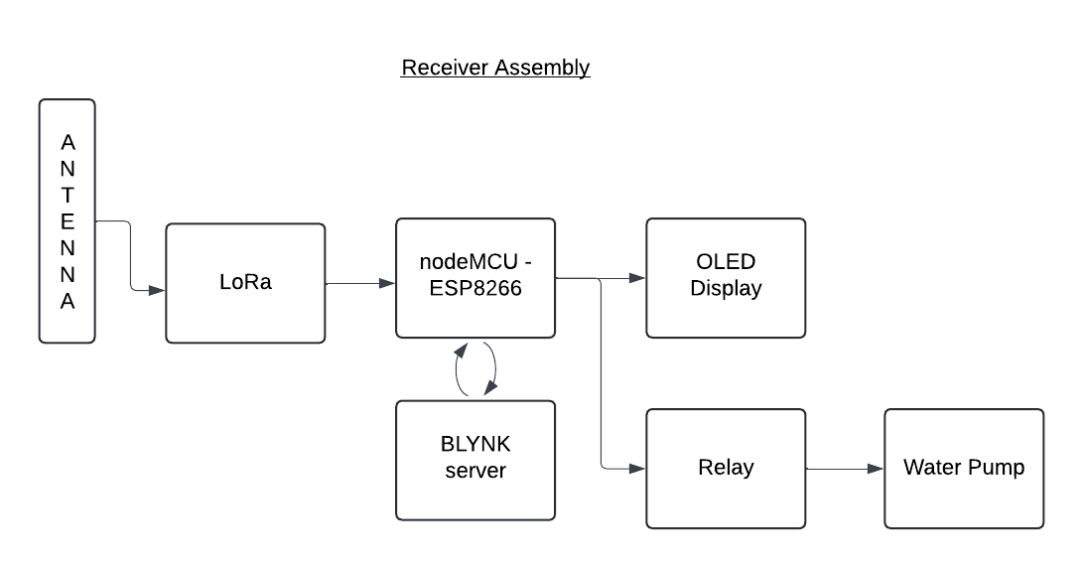
Block Diagram

Slide 7
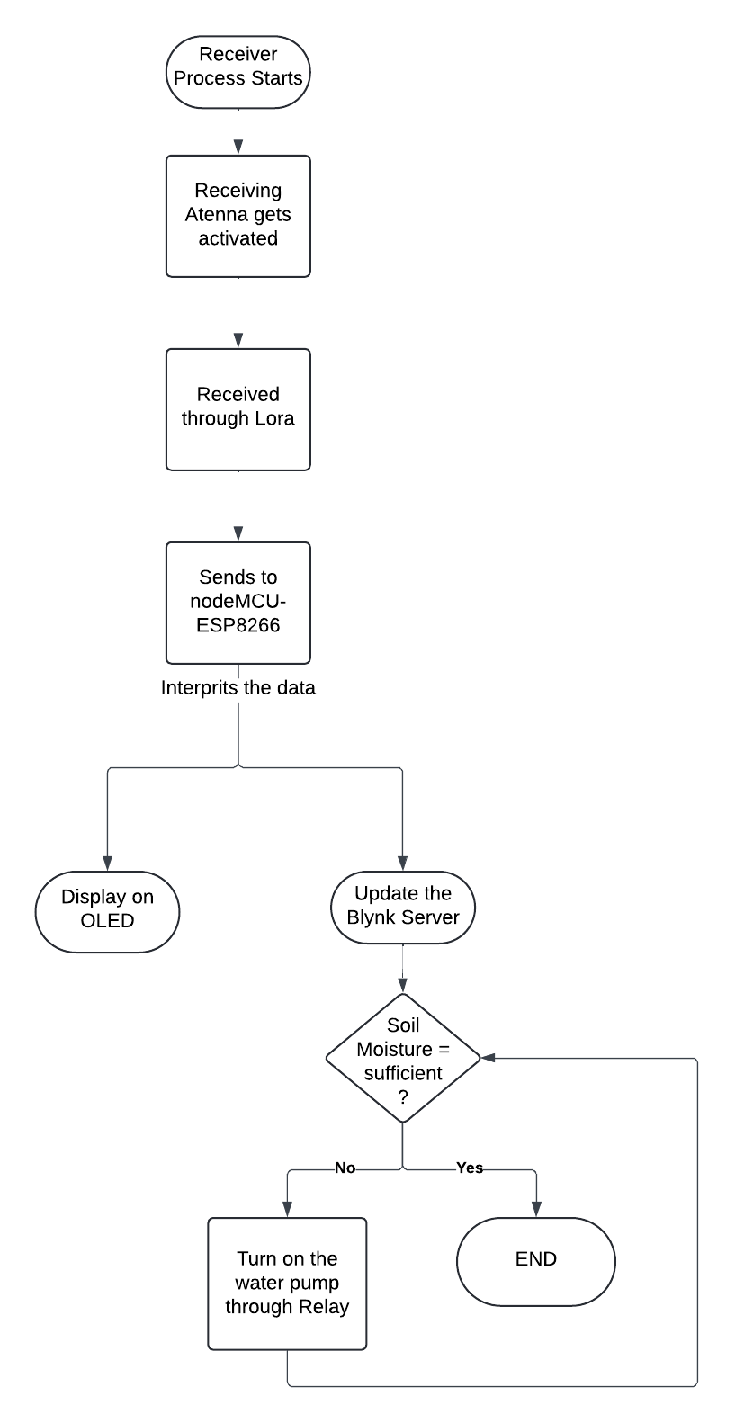
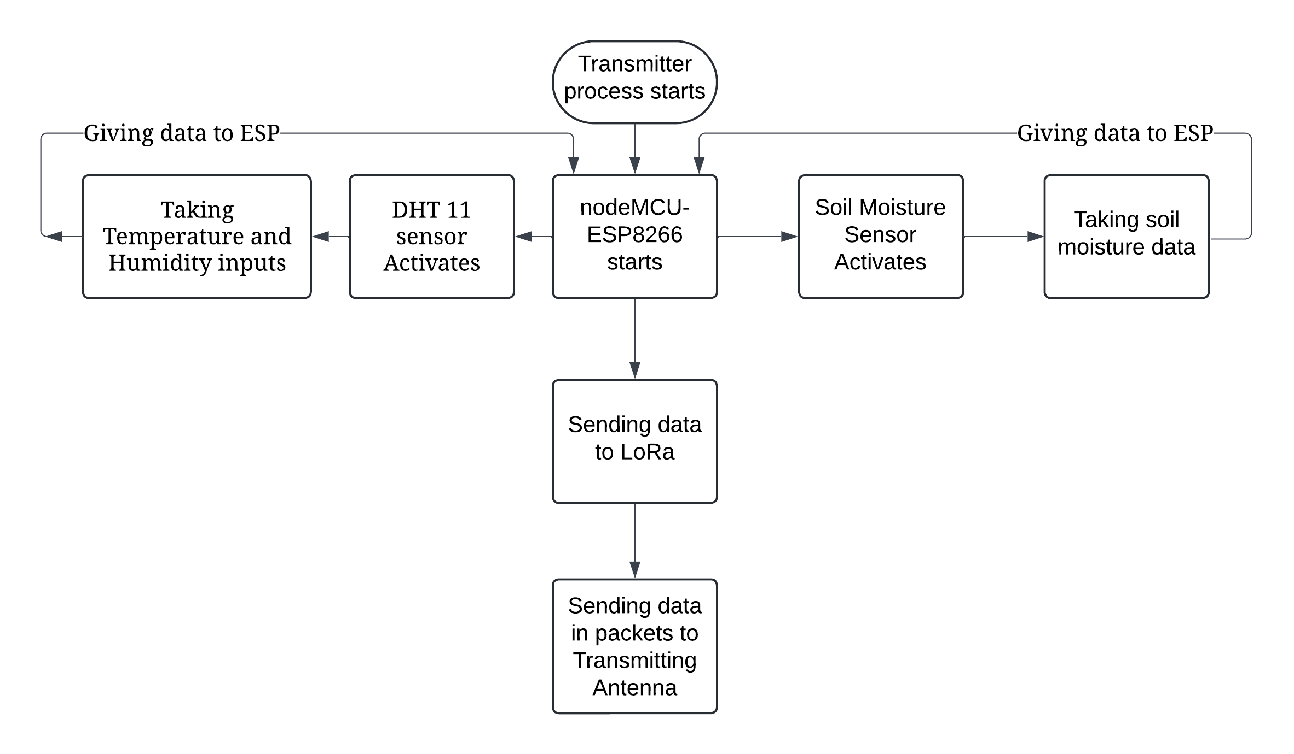
Methodology

Slide 8
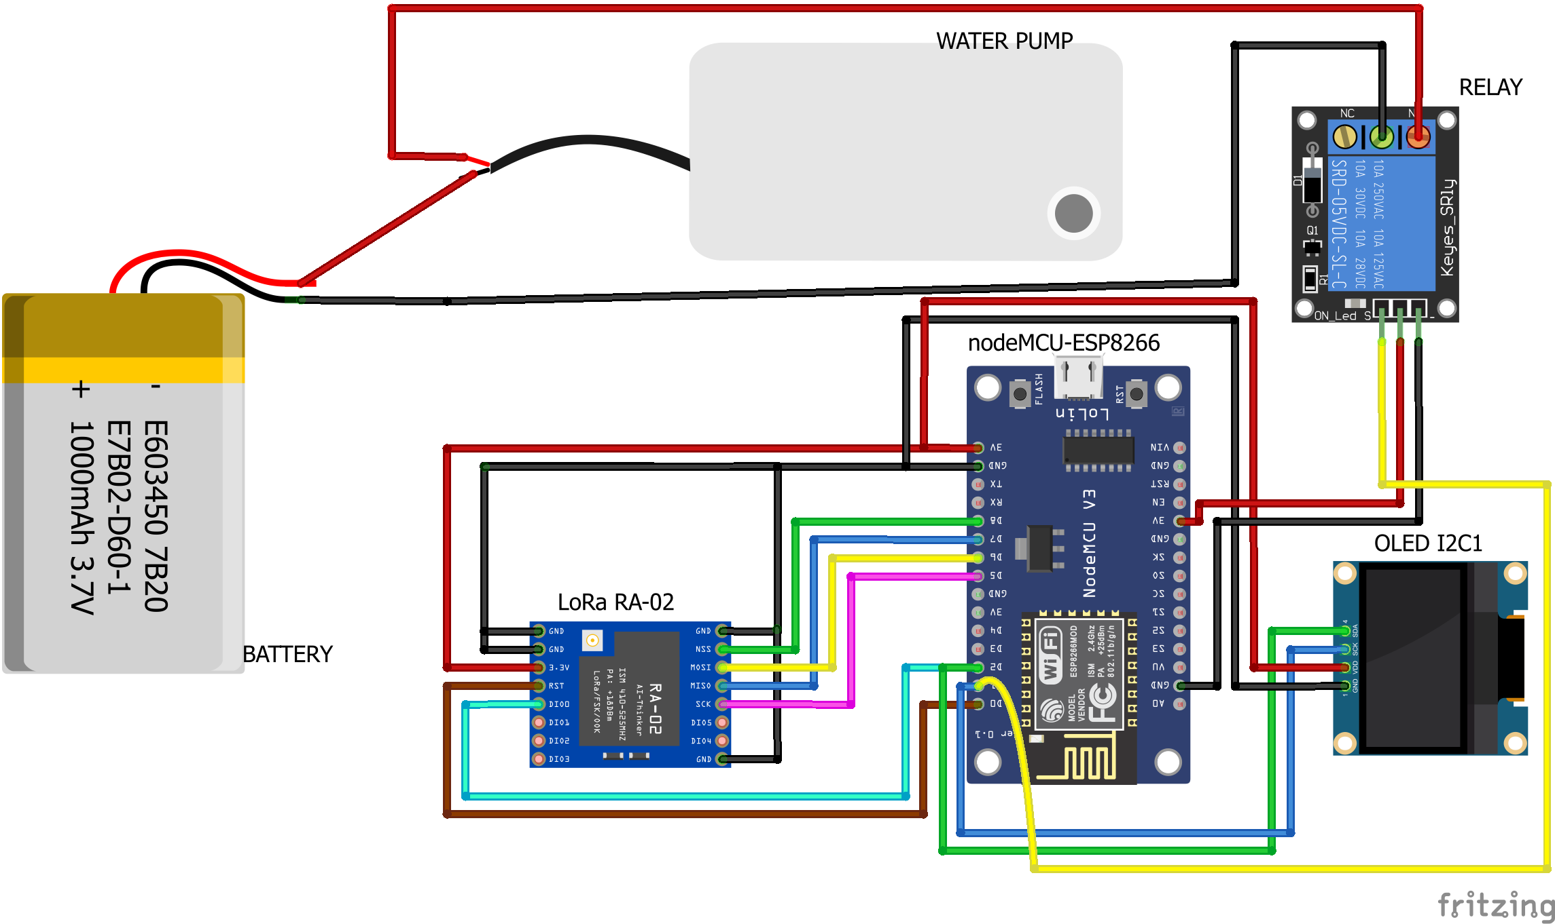
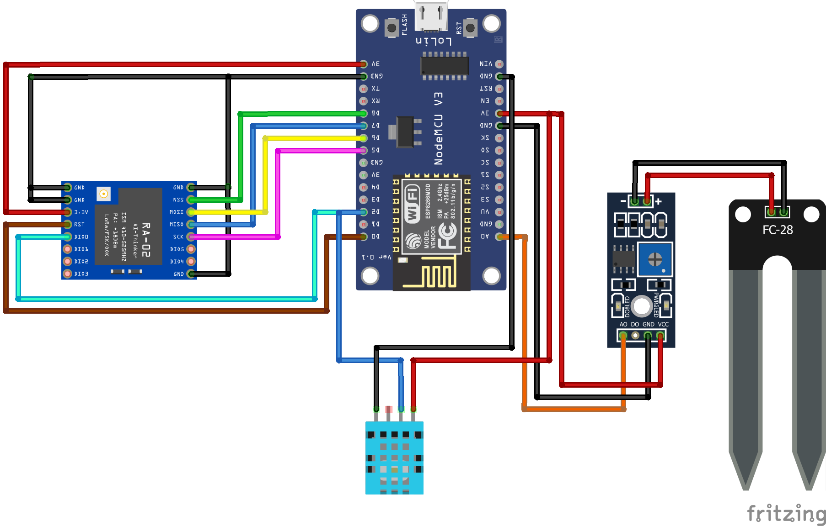
Circuit Diagram

Slide 9
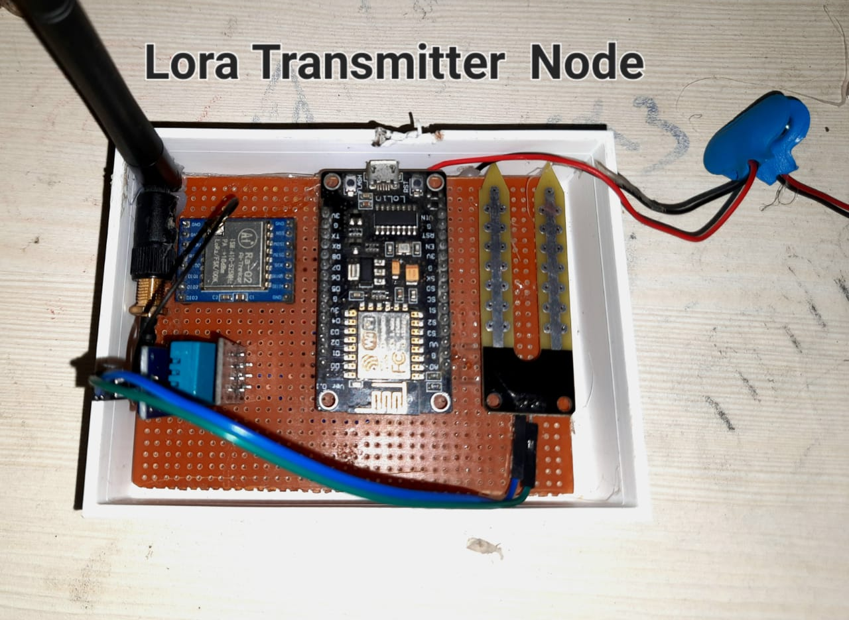
WORK DONE

Slide 10
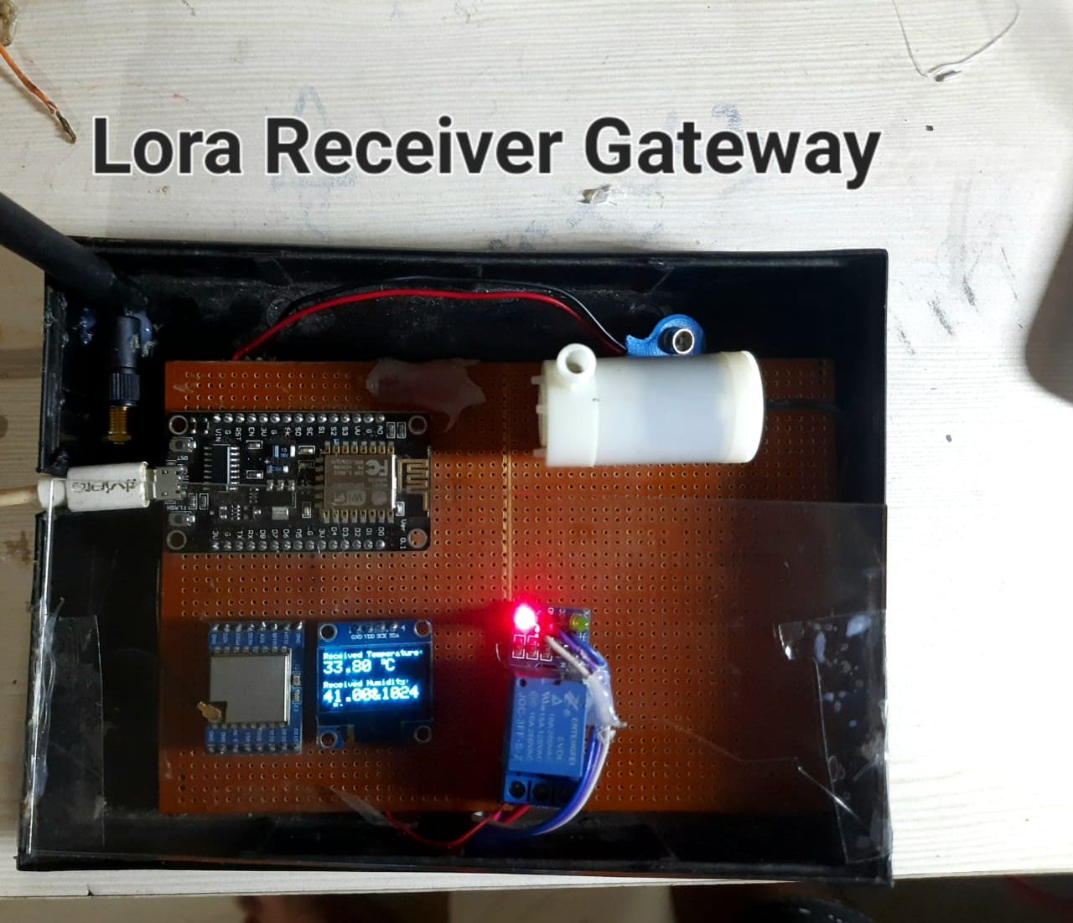
WORK DONE

Slide 11
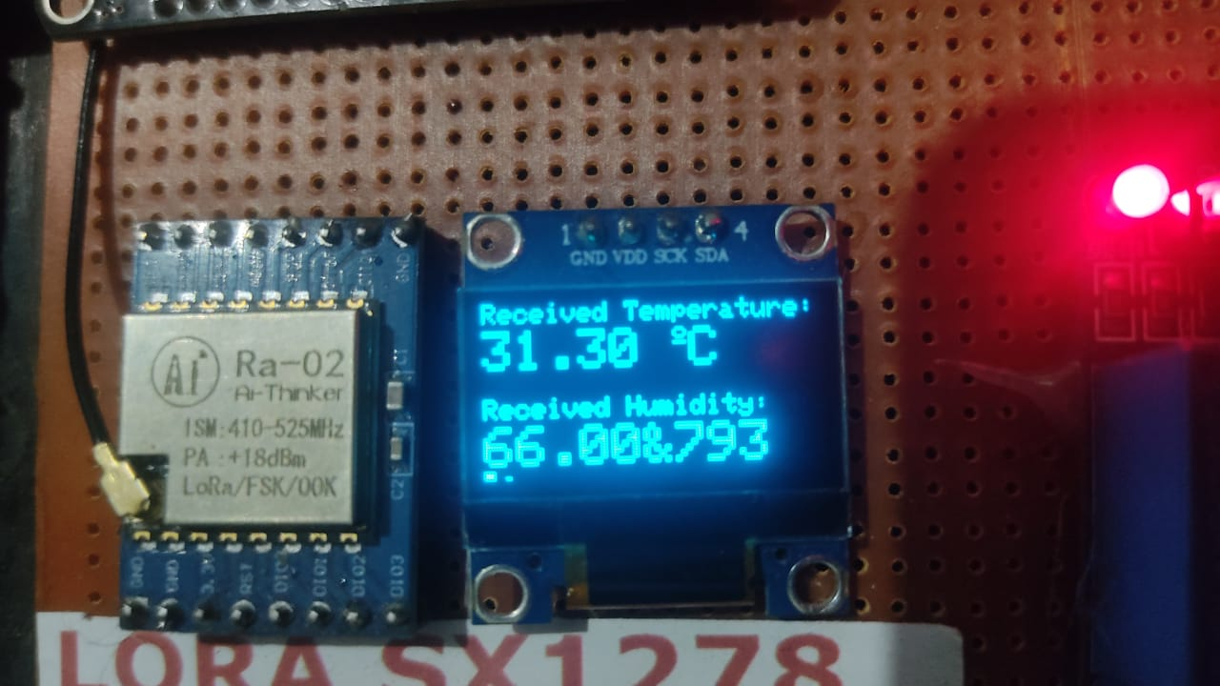
RESULTS
Figure: OLED Display RESULT

Slide 12
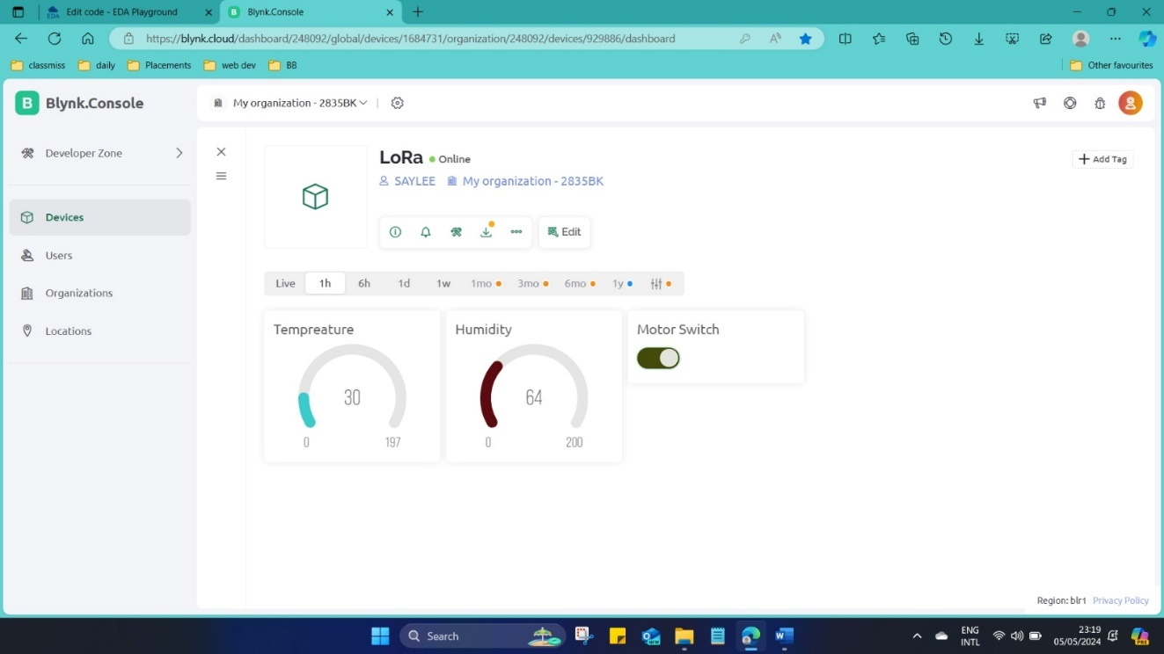
RESULTS
Figure : OUTPUT OF THE BLYNK

Slide 13
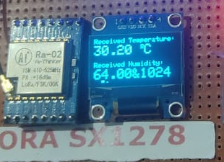
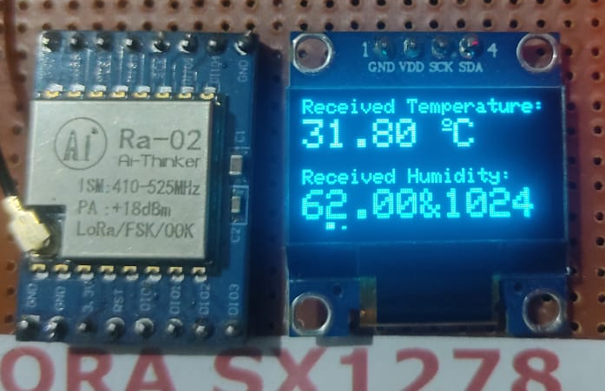
RESULTS
Figure : Idle output when Moisture sensor is not inserted to ground

Slide 14
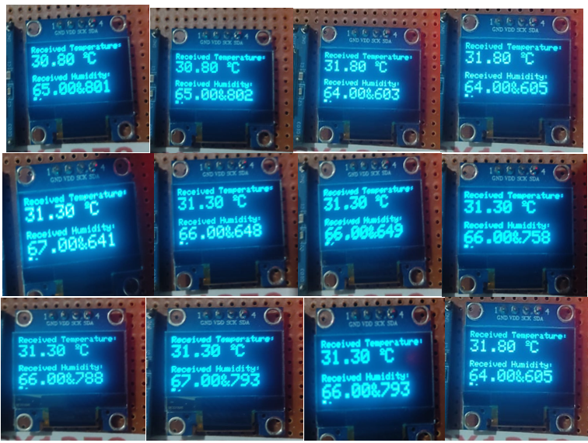
RESULTS
Figure : Outputs at OLED

Slide 15
RESULTS
Figure : Output of Blynk Application

Slide 16
Reference
Antonino Pagano , Daniele Croce , Ilenia Tinnirello , Gianpaolo Vitale, “A Survey on LoRa for Smart Agriculture: Current Trends and Future Perspectives ” IEEE INTERNET OF THINGS JOURNAL, VOL. 10, NO. 4, 15 FEBRUARY 2023
R. N. Rao and B. Sridhar, “IoT based smart crop-field monitoring and automation irrigation system,” in 2018 2nd International Conference on Inventive Systems and Control (ICISC), Jan. 2018, pp. 478–483, doi: 10.1109/ICISC.2018.8399118.
G. Sushanth and S. Sujatha, “IOT Based Smart Agriculture System,” in 2018 International Conference on Wireless Communications, Signal Processing and Networking (WiSPNET), Mar. 2018, pp. 1–4, doi: 10.1109/WiSPNET.2018.8538702.
M. AshifuddinMondal and Z. Rehena, “IoT Based Intelligent Agriculture Field Monitoring System,” in 2018 8th International Conference on Cloud Computing, Data Science Engineering (Confluence), Jan. 2018, pp. 625–629, doi: 10.1109/CONFLUENCE.2018.8442535.

Slide 17
THANK YOU

