Slide 1

Department of Information Technology
A.P. Shah Institute of Technology
G.B.Road,Kasarvadavli, Thane(W), Mumbai-400615
UNIVERSITY OF MUMBAI
Academic Year 2019-2020

Slide 2
A Project Report on
DRIVER DROWSINESS AND ALERT SYSTEM
Submitted in partial fulfillment of the degree of
Bachelor of Engineering(Sem-7)
in
INFORMATION TECHNOLOGY
By
Saylee Patne(16104021)
Riya Sangal(16104014)
Yashashree Gore(17204009)
Under the Guidance of
Prof.Anagha Aher

Slide 3
1.Project Conception and Initiation

Slide 4
1.1 Abstract
Drowsy driving is one of the major cause for road accidents. Hence, detection of drivers fatigue and its indication is an active research area. Therefore, in this study, a low cost ,real time drivers drowsiness detection system is developed with acceptable accuracy. In the developed system, a front camera of drivers cell phone records the video and drivers face is detected. For this, eyes, nose and mouth are detected to improve the area of interest using Google Vision API. For creating an app android studio alternative b4a is used. When the drowsiness is detected, then the driver is alerted by audio.

Slide 5
1.2 Objectives
It can be used for the safety of driver while driving which reduces accidents and detects drowsiness of the driver.
To generate alerts to the driver by playing loud music.
To enhance the safety of the driver.
To monitor driver fatigue and alert him\her when drowsiness situation is detected.
To capture the frames from video and detect drowsiness.

Slide 6
1.3 Literature Review
Paper Title: Eye Gaze Tracking Based Driver Monitoring System
Authors: Annu George Mavely, J.E Judith, Sahal P A, SteffyAnn Kuruvilla
Publication Details: 2017 IEEE
Findings: Face And Eye Detection is done.
Advantages: Along with audio, steering vibration warning is also given to the driver.
Disadvantages: This project uses Raspberry Pie which needs more power supply and uses sensors which increases the cost of the product.

Slide 7
1.3 Literature Review
Paper Title: Driver Drowsiness Monitoring System using Visual Behaviour and Machine Learning
Authors: Ashish Kumar, Rusha Patra
Publication Details: 2018 IEEE
Findings: Using facial points, drowsiness is detected. It uses HOG algorithm.
Advantages: Machine Learning is used which gives more accuracy.
Disadvantages: Uses webcam which requires high level image processing to focus the visuals.

Slide 8
1.4 Problem Definition
The main purpose of this project is to develop an application for drowsiness of the driver.
Nowadays more accident occurs in vehicles due to drowsiness. That’s why this system is proposed for reducing accidents.
We are implementing a system where the app will capture the video of driver’s face on basis of image processing techniques. After drowsiness detection alerts will be send to the driver.
Instead of using hardware components like webcam, we will be implementing on mobile app.

Slide 9
1.6 Technology stack
Google Vision API
It allows developers to easily integrate vision detection features within applications, including image labelling, face and landmark detection.
B4A
Alternative of Android Studio. It describes as Rapid development tool. Used for application development.

Slide 10
1.7 Benefits for environment & Society
Helps to avoid crashes caused by fatigue by drivers to take a break in time.
Warns the driver of drowsiness and sends alert.
To ensure the safety of the driver.

Slide 11
2. Project Design

Slide 12
2.1 Proposed System
In this we have proposed a mobile application for detection of driver’s drowsiness. When the application starts, it asks for camera permissions.
Video recording starts, it is done in frames.
These frames are extracted using google vision api features.
The region of Interest(like-eye, mouth, nose) is extracted and calculation is done for determining the ratio of height and width of the region.
The probability of region of interest is calculated.
If the probability is less than 50% then alert is send.

Slide 13
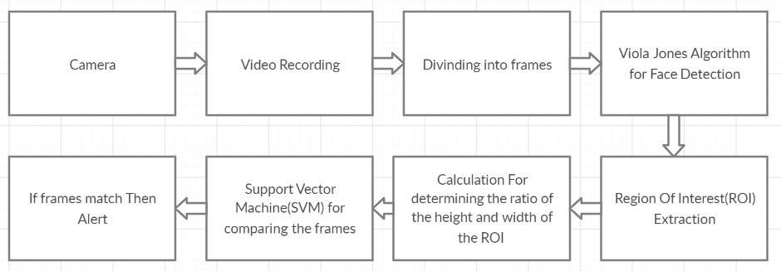
2.2 Design(Flow Of Modules)

Slide 14
2.3 Description Of Use Case
It shows the user’s interaction with the systems. The purpose of a use case diagram in Unified Modeling Language (UML) is to demonstrate the different ways that a user might interact with a system. Use case diagrams are valuable for visualizing the functional requirements of a system that will translate into design choices and development priorities. They also help identify any internal or external factors that may influence the system and should be taken into consideration.

Slide 15
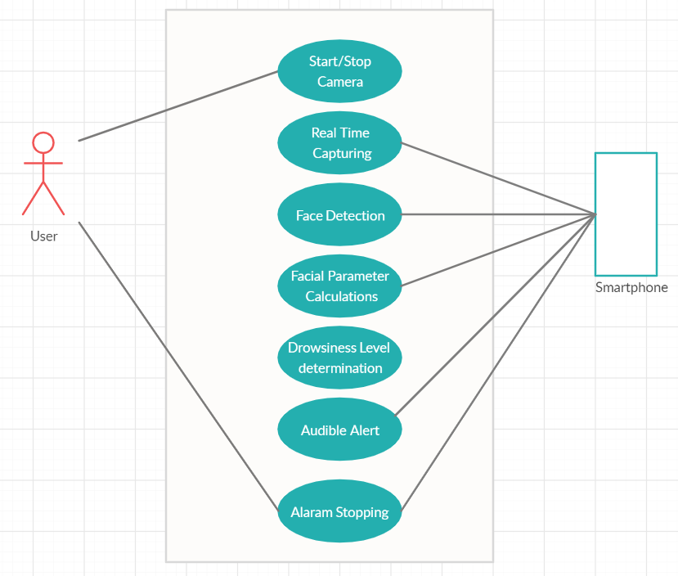

Slide 16
2.4 Activity diagram
Activity diagram is a flowchart to represent the flow from one activity to another activity. The basic purposes of activity diagrams is similar to other four diagrams. Activity diagrams are not exactly flowcharts as they have some additional capabilities. It captures the dynamic behavior of the system.

Slide 17
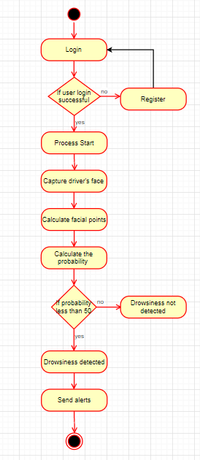

Slide 18
2.6 Module-1: Registration of User
The first thing after opening the app is, user must login to its account. If user is new then he/she should register first.
When user forgets the password, the user is able to change the password via OTP.
After the user logs into the app, the process starts.

Slide 19
Module-2: Google Vision API
It has libraries to easily integrate vision detection features within applications, including image labelling, face and landmark detection.
When the process starts, the frames are captured every 5 seconds.
Then using Google Vision API facial landmarks are pointed.

Slide 20
Module-3: Drowsiness detection
Alert send when drowsiness is detected or else not.
When the probability of the calculation of facial landmarks is less than 50% then the drowsiness is detected.

Slide 21
2.7 References
Ashish Kumar and Rusha Patra, “Driver Drowsiness Monitoring System using Visual Behaviour and Machine Learning”, IEEE, 2018
Annu George Mavely, J.E Judith, Sahal P A, Steffy Ann Kuruvilla, “Eye Gaze Tracking Based Driver Monitoring System”, IEEE, 2017
Kwok Tai Chui, Kim Fung Tsang, Hao Ran Chi,Bingo Wing Kuen Ling, and Chung Kit Wu, “An Accurate ECG Based Transportation Safety Drowsiness Detection Scheme”, IEEE, 2016
Navneet Dalal and Bill Triggs, “Histograms of Oriented Gradients for Human Detection”, IEEE, 2005

Slide 22
3.Future Scope

Slide 23
Future Scope
Using Pressure sensor on the steering alarm, Automatic braking System can be set in case of drowsiness.
By using wireless Technology if the driver gets drowsy an alert message can be sent to a selected person’s mobile by using GSM module along with the alarm in vehicle.

Slide 24
Thank You

