Slide 1

Healthcare System Database
SE-2001
Aliya Aitkozha
Educational Practice

Slide 2

*PROJECT*

Slide 3
STRUCTURE
Introduction :
- Purpose
Body :
- What was done
- Which data was used
- Importance
Conclusion

Slide 4
Daily progress
01
05
02
06
03
07
11.11.20
17.11.20
Drawing tables in ‘paint’
Adding attributes to the tables
12.11.20
18.11.20
Creating tables in PostgreSQL
Adding attributes to the tables
13.11.20
19.11.20
Searching data from the Internet
Adding attributes to the tables
04
16.11.20
08
20.11.20
Adding attributes to the tables
Preparing the presentation

Slide 5
Daily progress

Slide 6
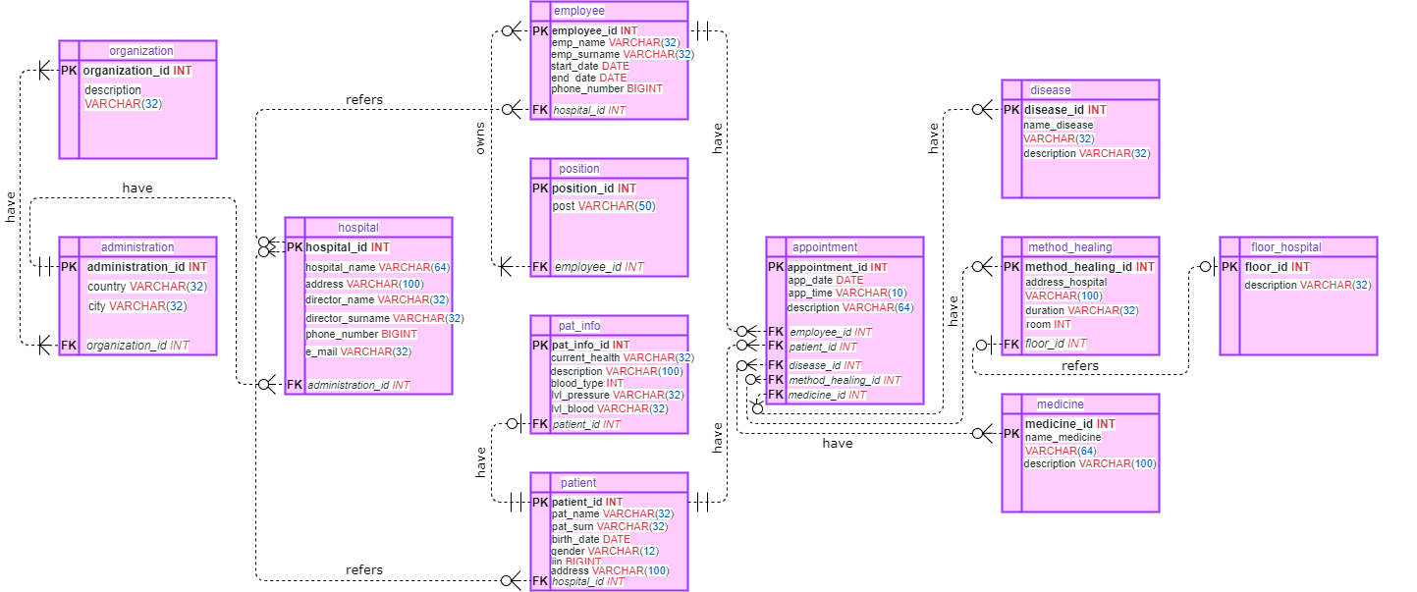

OMG, Aliya made a Database !!
IS IT REALITY ?

Slide 7
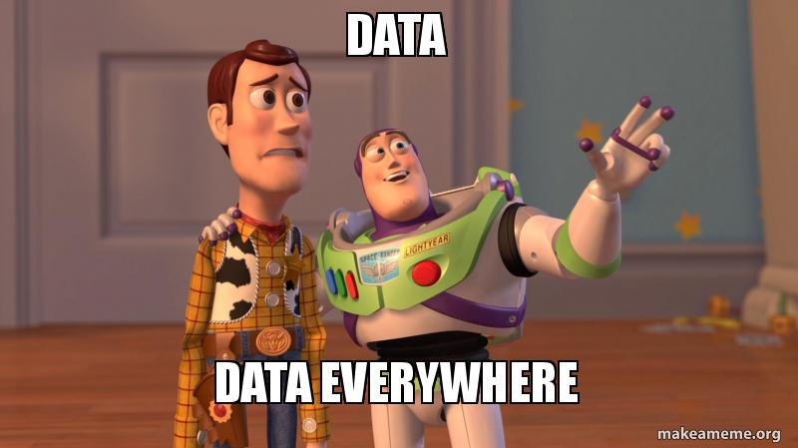

Which data was used

Slide 8
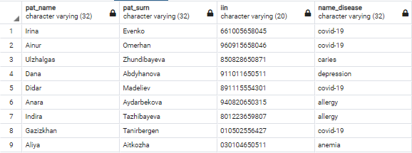
I M P O R T A N C E

Slide 9
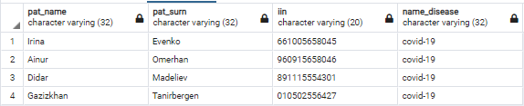
I M P O R T A N C E

Slide 10
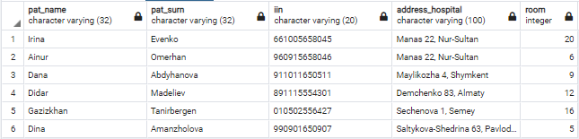
I M P O R T A N C E

Slide 11
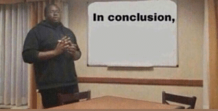
C O N C L U S I O N
Easy to:
use
find information
modify data

Slide 12
Reference List
1. DOQ.kz - cервис поиска врача и онлайн записи на прием. (2020).
https://doq.kz/clinic/almaty/emirmed
2. Администрация — ГКП на ПХВ "Городская поликлиника №2". (2020).
https://www.2-emhana.kz/
3. Врачи - Областная клиническая больница г. Шымкент, Казахстан, Шымкент, ул. Майлыкожа, д. 4. (2020).
http://okb-trk.kz/%D1%8E%D0%B6%D0%BD%D0%BE-%D0%BA%D0%B0%D0%B7%D0%B0%D1%85%D1%81%D1%82%D0%B0%D0%BD%D1%81%D0%BA%D0%B0%D1%8F-%D0%BE%D0%B1%D0%BB%D0%B0%D1%81%D1%82%D0%BD%D0%B0%D1%8F-%D0%BA%D0%BB%D0%B8%D0%BD%D0%B8%D1%87%D0%B5%D1%81%D0%BA%D0%B0%D1%8F-%D0%B1%D0%BE%D0%BB%D1%8C%D0%BD%D0%B8%D1%86%D0%B0-%D1%88%D1%8B%D0%BC%D0%BA%D0%B5%D0%BD%D1%82/%D0%B2%D1%80%D0%B0%D1%87%D0%B8
4. ГКП на ПХВ "Городская поликлиника №10" г. Астаны – Официальный сайт Поликлиники №10. (2020).
http://emhana10.kz/
5. Поликлиника № 4 - 84 врача - Павлодар - 36n6.kz. (2020).
http://36n6.kz/poliklinika-n-4-30648/vrachi/pavlodar/

