Slide 1
Emerging Technology within Prosthesis
Intelligence vs. Artificial Intelligence
By: Saylor Dickey

Slide 2
Overview
Table of Contents
Slide 2 | overview
Slide 3 | history
Slide 4 | history
Slide 5 | Plan and Implementation
Slide 6 | Plan and Implementation
Slide 7 | Upsides/Pros to the Advancement
Slide 8 | Downsides/Cons to the Advancement
Slide 9 | Summary
Slide 10 | References
Notes:
-Table of Contents

Slide 3
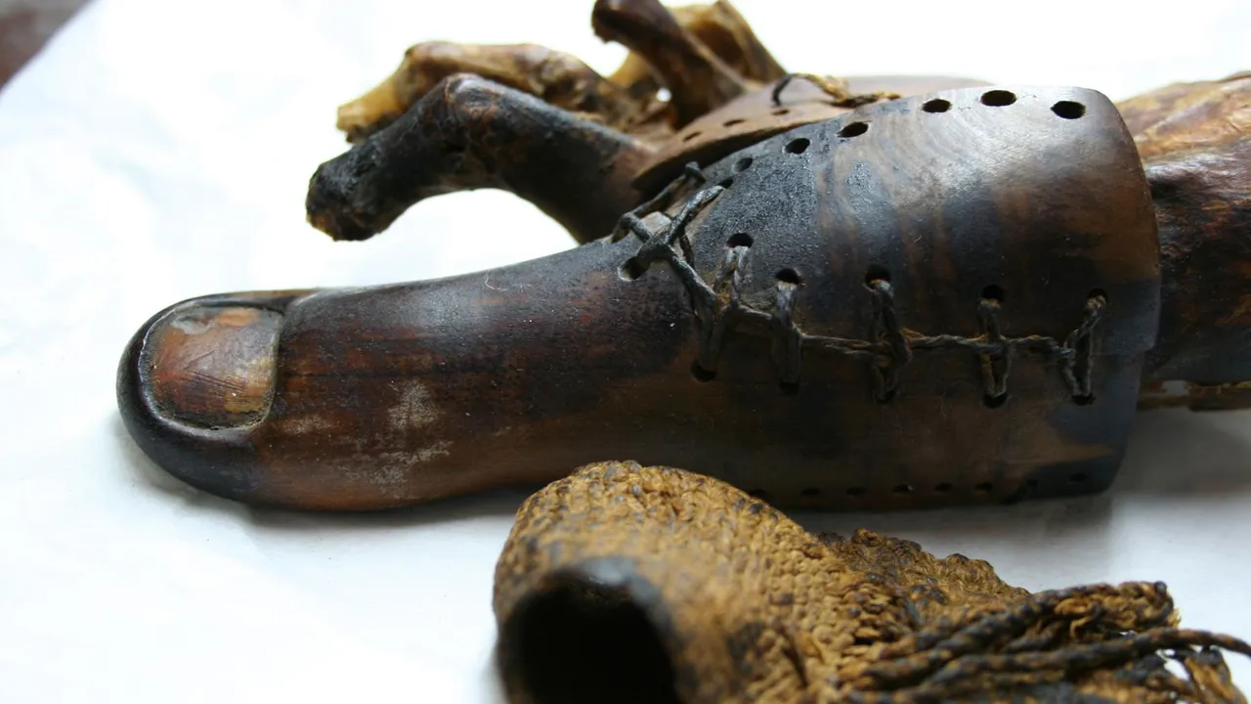
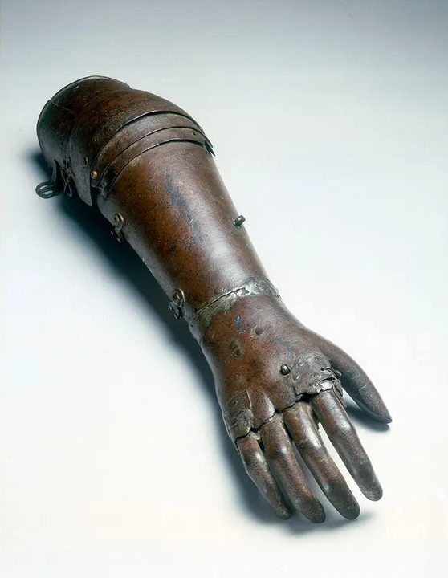
History
Prosthetics originated in the ancient Near East circa 3000 BCE, with the earliest evidence of prosthetics appearing in ancient Egypt and Iran. The earliest recorded mention of eye prosthetics is in the Egyptian story of the Eye of Horus dated circa 3000 BC. This involves the left eye of Horus being plucked out and then restored by Thoth.
The Egyptians were also early pioneers of foot prosthetics, as shown by the wooden toe found on a body from the New Kingdom circa 1000 BC. Another early textual mention is found in South Asia circa 1200 BC, involving the warrior queen Vishpala in the Rigveda.
Notes:
The earliest evidence of prosthetics comes from ancient Egypt and Iran circa 3000 BCE. Around 3000 BC, the Egyptian story of the Eye of Horus mentions eye prosthetics. Thor restores Horus' left eye after plucked out and restored.
In the New Kingdom, circa 1000 BC, a wooden toe was found on a body showing the early use of foot prosthetics. Another early textual mention is found in South Asia circa 1200 BC, involving the warrior queen Vishpala in the Rigveda.

Slide 4
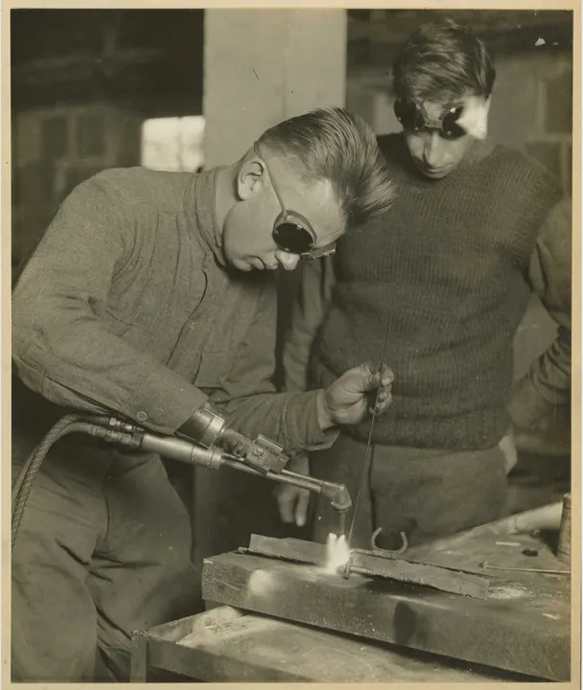
History
Technology progression before the 20th century:
An Italian surgeon recorded the existence of an amputee who had an arm that allowed him to remove his hat, open his purse, and sign his name. Improvement in amputation surgery and prosthetic design came at the hands of Ambroise Paré. Among his inventions was an above-knee device that was a kneeling peg leg and foot prosthesis with a fixed position, adjustable harness, and knee lock control. The functionality of his advancements showed how future prosthetics could develop.
Modern Times:
For the first time, artificial limbs were being mass-produced in response to the enormous number of casualties in World War One. In the US, the Walter Reed Army Hospital produced a large number of artificial limbs for the returning veterans. This example is of a welding attachment and other tools integrated into the limbs for amputees to return to work after the war.
Notes:
-An Italian surgeon wanted to keep record of an amputee who had an arm that could complete multiple tasks for him.
-The improvement in amputation surgery & design came from Ambroise Pare.
-The new functionality of his devices opened up the minds for all of how the future of prosthetics could look.
-The large amount of casualties during ww1 influenced artificial limbs in the U.S.
-Thanks to Walter Reed Army Hospital

Slide 5
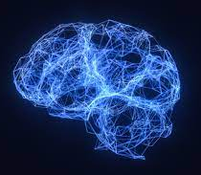
Plan and Implementation
Samanth Subramanian states “Well, the future of the prosthetic is really neural, I think. It's a way in which we can hook up our brains and nerves with our prosthetics to be able to control them with our thoughts, with our minds, the way we control our own limbs.” The technology used for prosthetic limbs now includes 3D printing, device implants, digital design tools, and more. As scientists learn more about how the human body functions, prosthetic limbs will start to feel and behave like the real thing.
Notes:
-Samantha Subramanian believes that the future of prosthetics will lead to mind control allowing artificial limbs move just like any other body part.
-The new advancements of 3D printing, device implants and more allow people to find their own systems for prosthetic limbs.

Slide 6
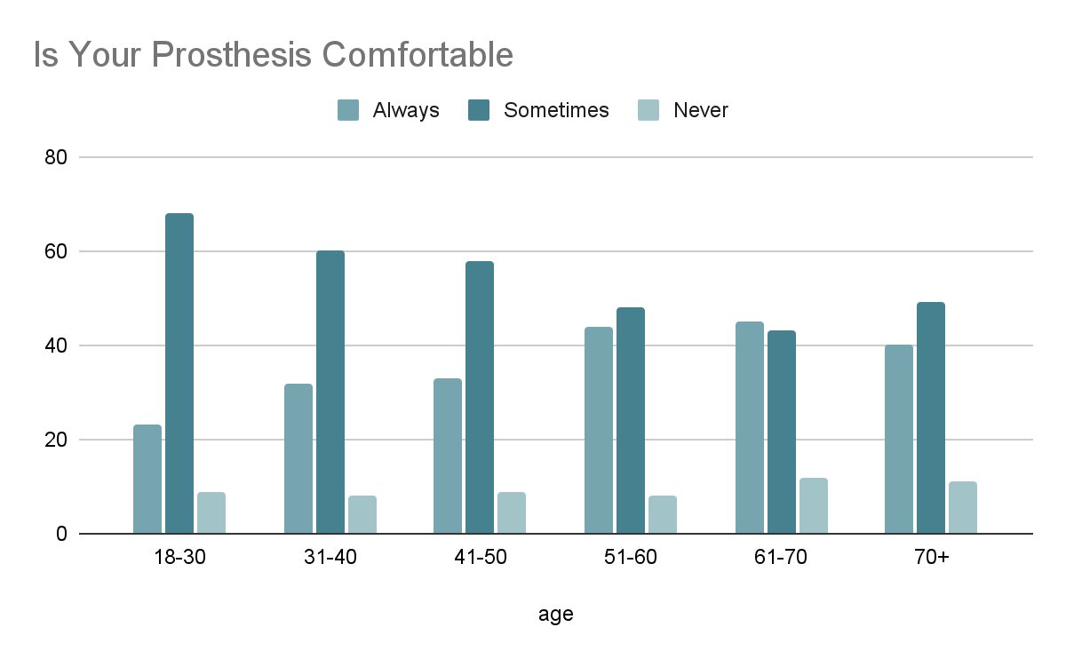
Plan and Implementation
Current prosthetics are often uncomfortable and difficult to control and provide limited functional restoration. Moreover, the inability to normalize anthropomorphic biomechanics with a prosthesis increases one's risk of developing long-term health risks such as arthritis, skin breakdown, and pain.
Notes:
-There is a common issue influencing discomfort for amputees causing future long-term health risks.
- The graph on the right of the screen labels a survey through all age groups and their comfort level within their prosthetics.

Slide 7

Upsides - Pros
When an arm or other extremity is amputated or lost, a prosthetic device, or prosthesis, can play an important role in rehabilitation. For many people, an artificial limb can improve mobility and the ability to manage daily activities, as well as provide the means to stay independent. Not only does it help mobility but with the modern day advancing technology prosthetic limbs will become more mobile and usable for all, making it easier for one to live their life feeling like nothing was ever gone!
Notes:
-This slide goes over many of the positive advancements prosthetic devices have to come in our future and how it will change the daily lives of amputees around the world!

Slide 8
Downsides - Cons
Sadly many prosthetics cause discomfort, instability and fatigue. Most prosthetic users are using more energy than needed to be able to be mobile, though there are solutions many of them are overpriced and still in the testing stages.
Intact Limb Pain. ...
Back Pain. ...
Current Prosthetic Not Meeting Your Needs. ...
Poor Balance, Instability, or a Fear of Falling. ...
General Fatigue and Reduced Mobility. ...
Irritation and Skin Issues. ...
Socket Issues or Discomfort.
Notes:
-This slide goes over many issues that have been stated through past slides and how some prosthetics are causing extreme health issues for amputees but the new day solutions are extremely overpriced!

Slide 9

Summary
Though prosthetics may make others embarrassed, uncomfortable, or even in pain, I believe with the new and advancing technology of our times, we'll come up with more innovative solutions for our world to accept, embrace, and care for those who need prosthetics. We have already made great strides in the field, and with more research and development, we can make even greater advancements. We need to work together to create a more inclusive and accepting world.
Notes:
-On this slide I wanted to tie up my belief in our new and upcoming generation and how greatly we are coming along to help change the daily lives of all around the world and allowing everyone to feel equal and happy within their own body in a healthy, inexpensive and modern way!!

Slide 10
Resources
Amputee Community Survey 2022: The Aging Curve | Amplitude
Updates to Clinical Coverage Policy 5B Orthotics and Prosthetics | NC Medicaid
Modern prosthetics go beyond artificial limbs—and into the human brain.
https://redshift.autodesk.com/articles/prosthetic-technology
Recent advances in bioelectric prostheses - PMC.
Prosthetic Issues – Tips for Amputees
Using Prosthetic Limbs: Safety, Care, and Concerns.
Notes:
-all used cites and resources that made this presentation possible

