Slide 1
Meet SOLA
The Saylor Online Learning Assistant
Faculty Town Hall, 10 June 2026
Notes:
Slide up while people settle. No talking points; the script begins on slide 2.

Slide 2
Every Saylor learner studies alone. Until now.
Saylor courses are self paced and open to everyone
We have no traditional teaching faculty. There is no one to raise a hand to.
When a learner gets stuck at 2 AM, the choice has been: push through, or give up
SOLA gives every learner a personal tutor inside every course page
It teaches with questions, in the learner's own language, grounded in the course you built
Notes:
The core story: our model has no instructors, so the tutor gap is structural. SOLA fills it.

Slide 3
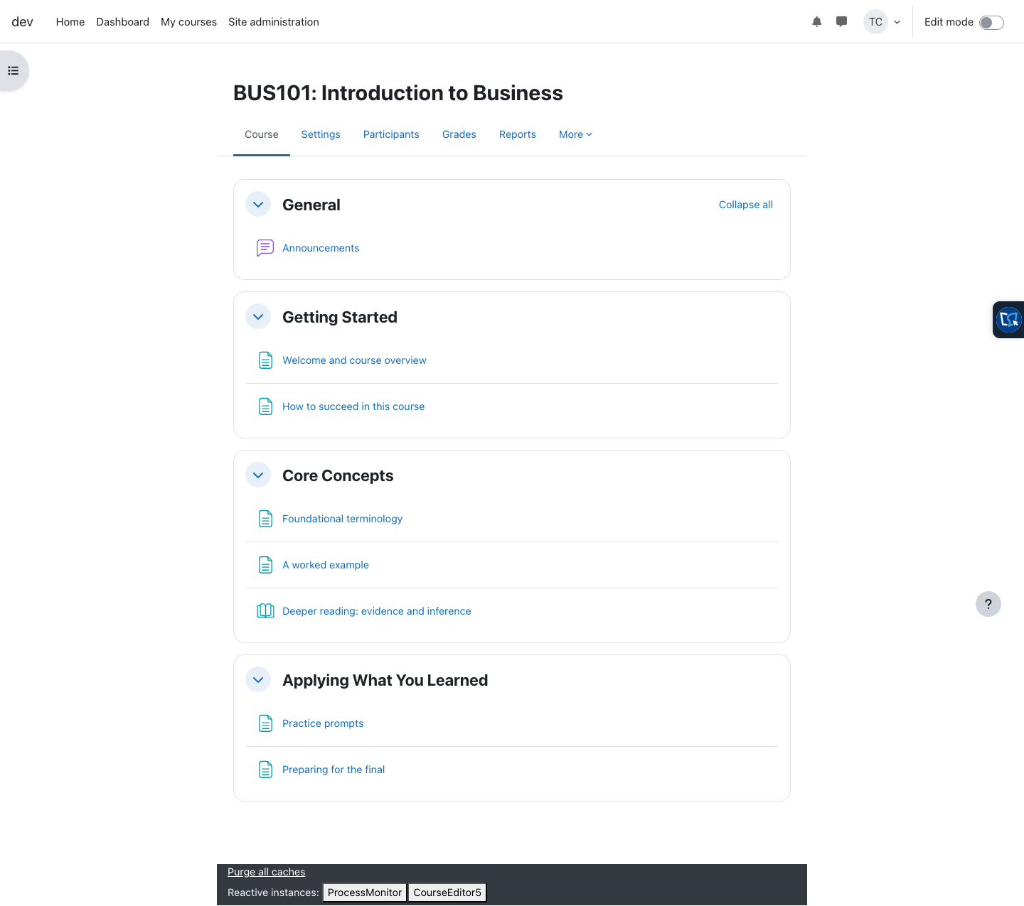
A tab on the edge of every course page
No new logins, no new apps
Lives inside Moodle on learn.saylor.org
One click opens the chat drawer
Knows which course and which page the learner is on
Screenshot: demo course on our development environment
Notes:
Point at the right edge of the screenshot where the SOLA tab sits.

Slide 4
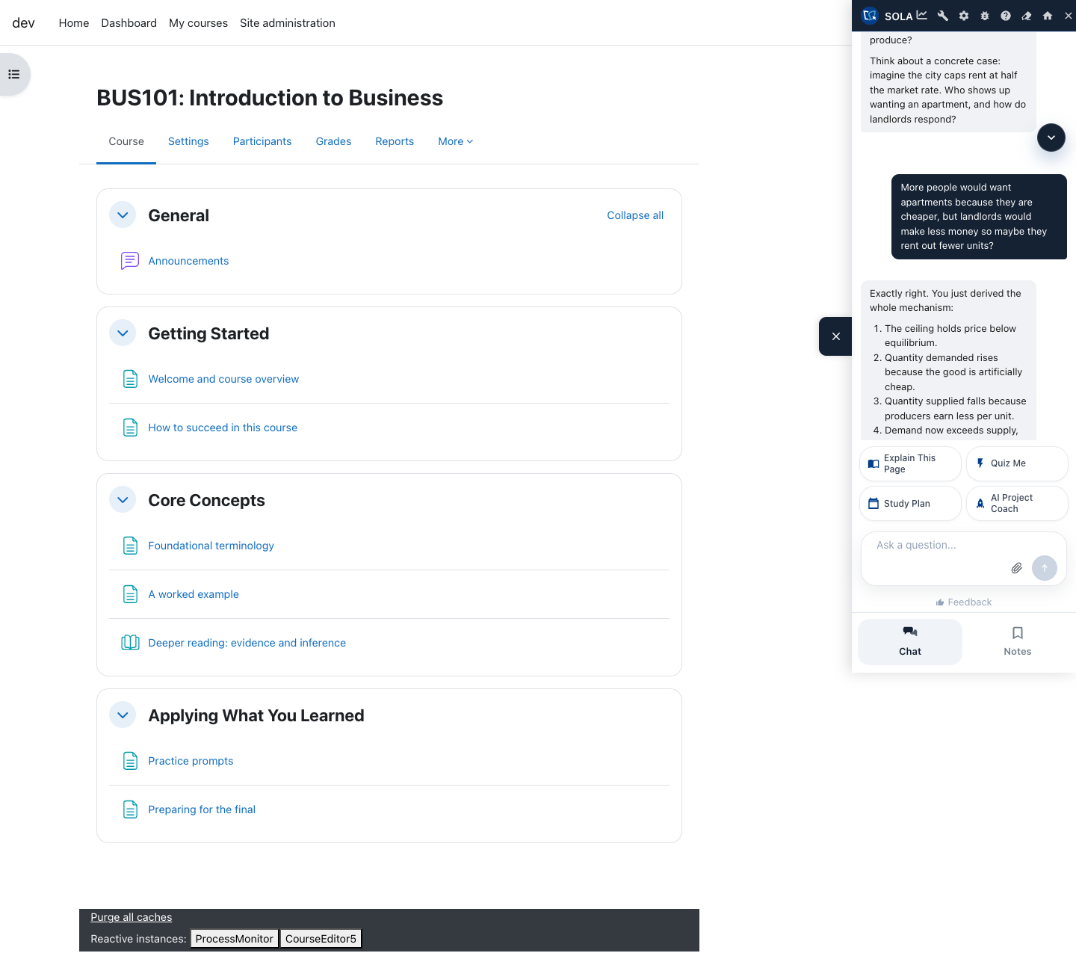
First open: a coach that suggests where to start
Conversation starters, not a blank box
Explain this page
Quiz me
Build a study plan
Learners who do not know what to ask still get moving
Backup slide for the live demo
Notes:
If the live demo works, skip this slide. It exists as backup.

Slide 5
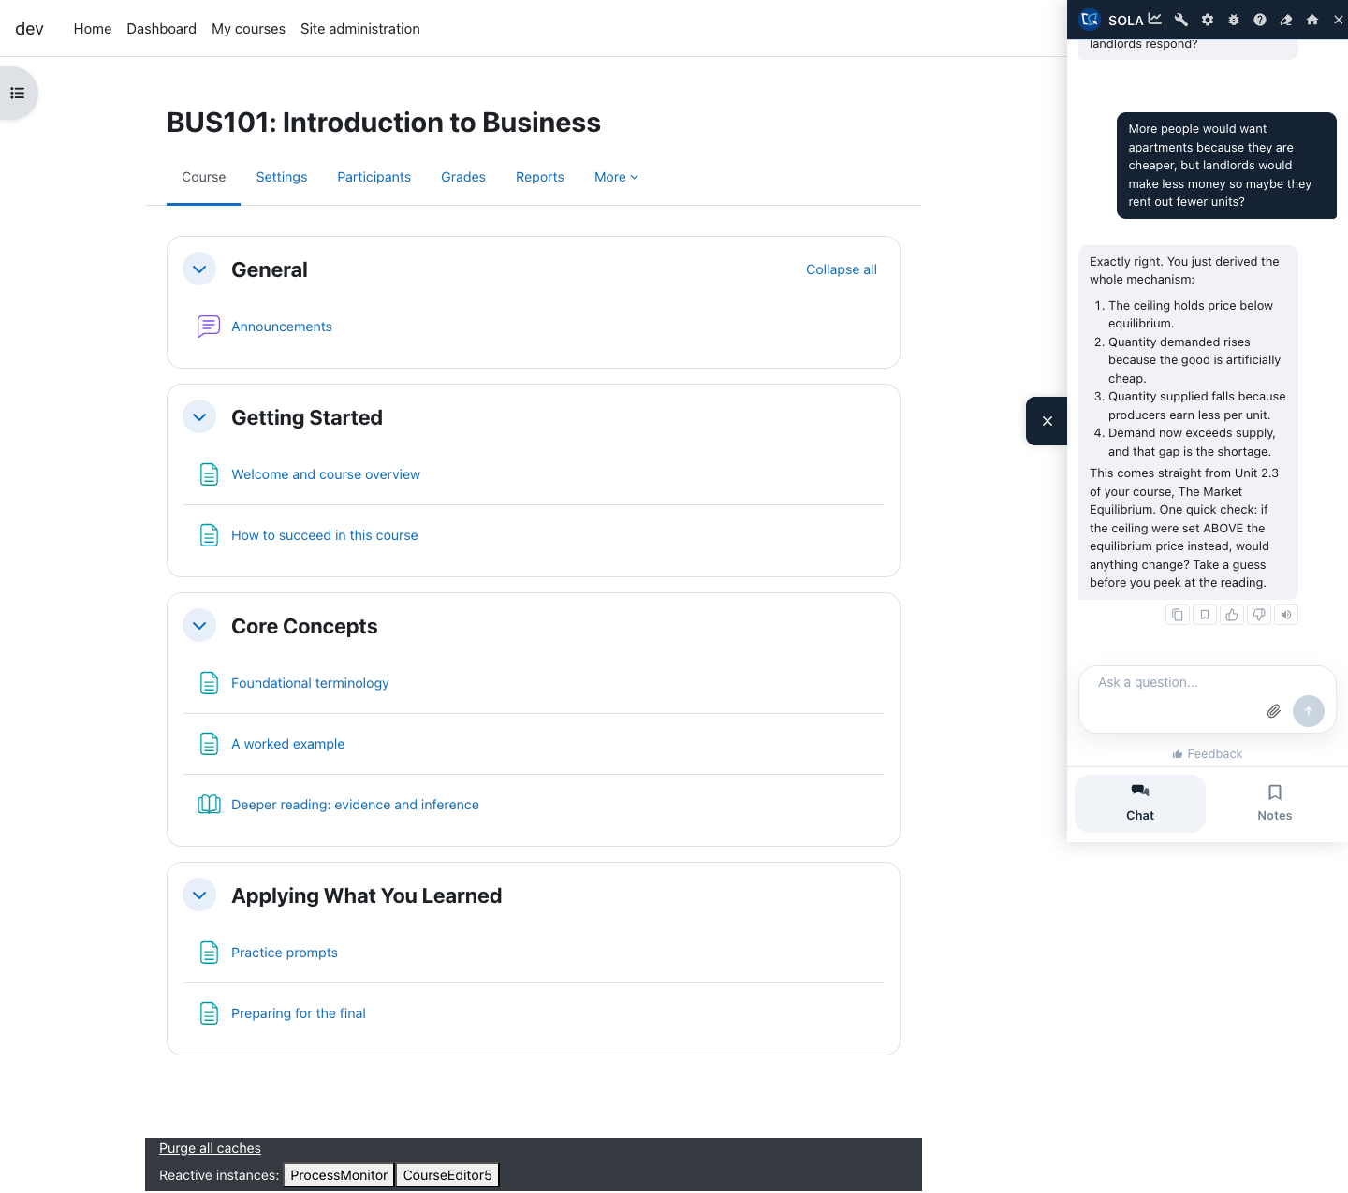
It coaches. It does not hand over answers.
Socratic by design: it asks the learner to reason first
Grounded in your course: it retrieves the actual unit text and cites it
This exchange references Unit 2.3 of the course by name
Declines to answer graded quiz and exam questions
Backup slide for the live demo
Notes:
Read the exchange aloud if the room cannot see detail: learner asks about price ceilings, SOLA asks a guiding question, learner reasons it out, SOLA confirms and points to Unit 2.3.

Slide 6
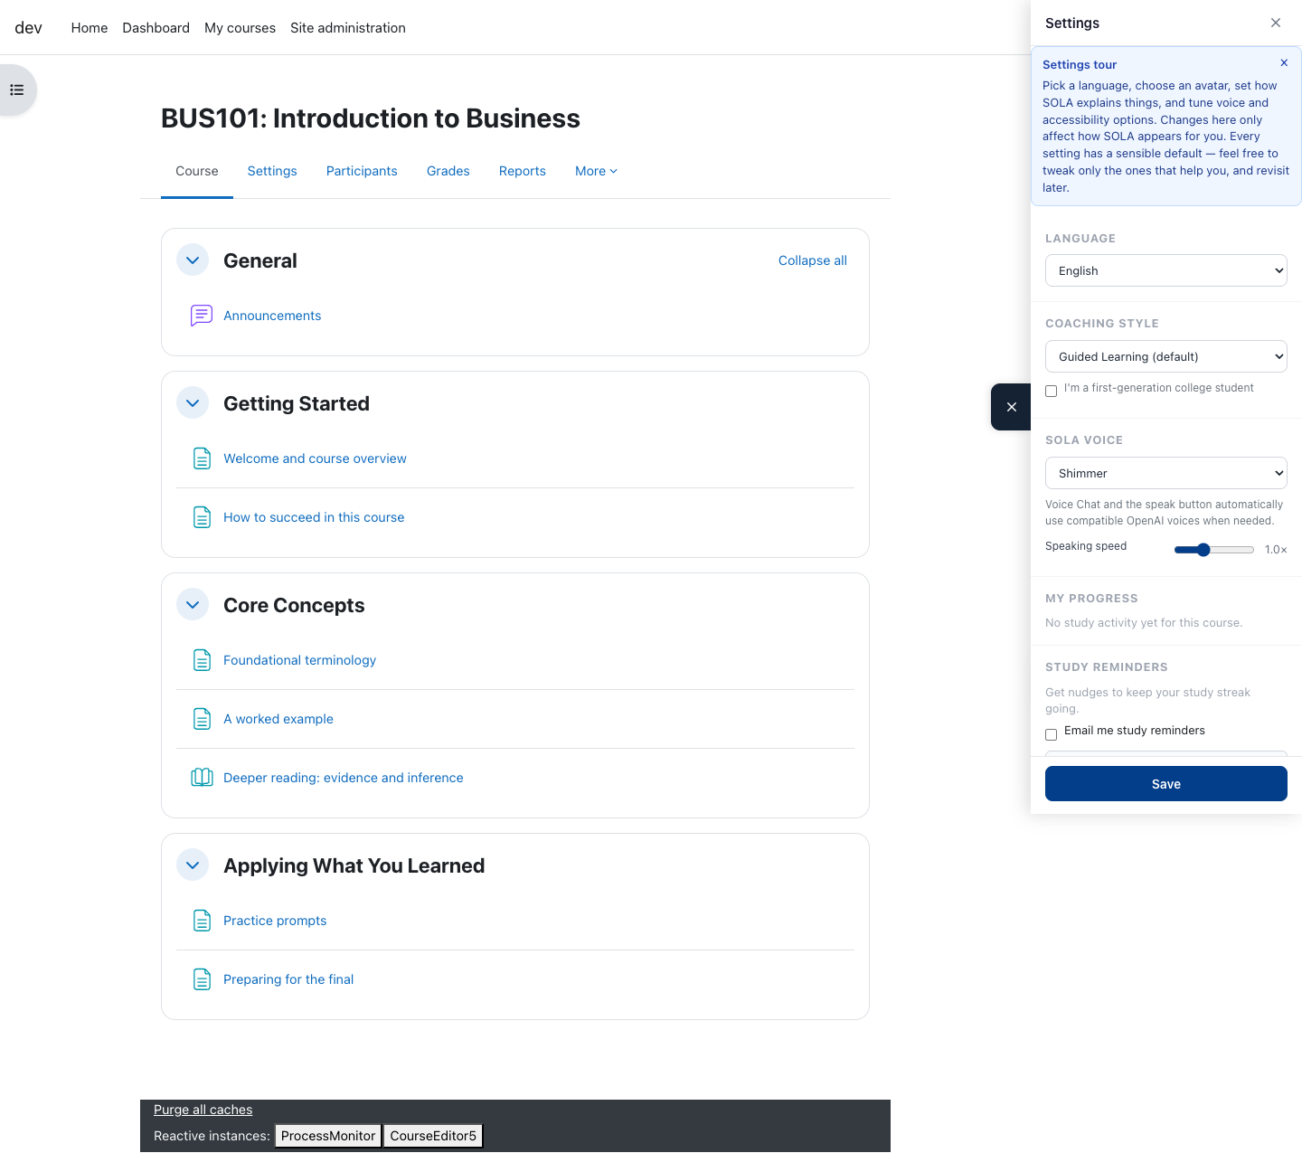
46 languages, detected automatically
Most Saylor learners are outside the United States
A learner can ask in Swahili, Hindi, Vietnamese, or 43 other languages
SOLA answers in their language while teaching your course content
Learners can also pin a preferred language in settings
Notes:
Language support is the equity story: same tutor quality regardless of first language.

Slide 7
Built with guardrails
Academic integrity: refuses to supply graded answers, redirects to learning
Privacy: a consent notice before first use, plain language, GDPR aligned
Cost control: spend caps per course and site wide, alerts to administrators
Off topic limits: it stays on the course
Every release passes an automated 32 scenario jailbreak test before shipping
Notes:
Preempt the two questions every faculty audience asks: cheating and privacy.

Slide 8
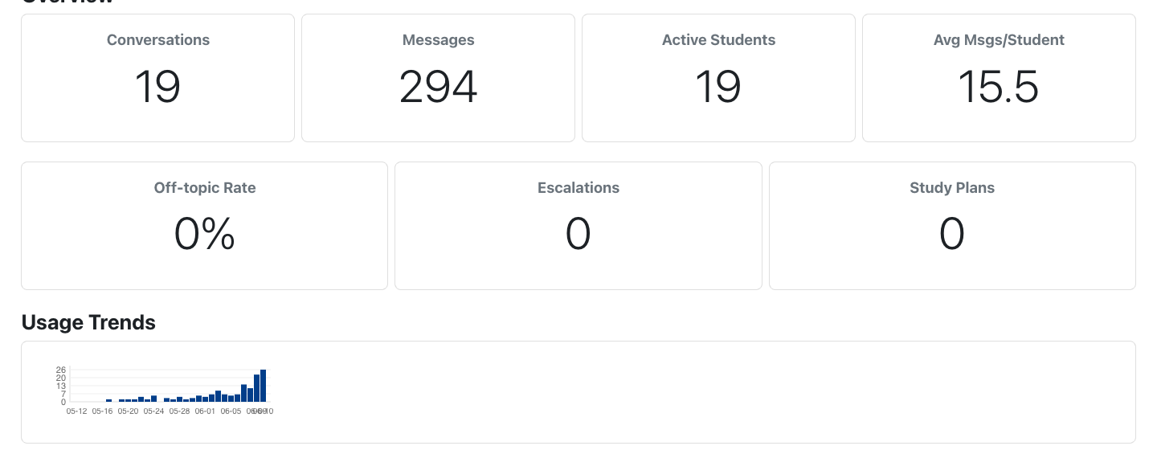
Your course, measured
Per course dashboard: conversations, active learners, usage trends
No grading burden, no inbox, nothing to moderate
You see how learners actually use the course you built
Demo data shown
Notes:
Numbers shown are seeded demo data, not real learner data.

Slide 9
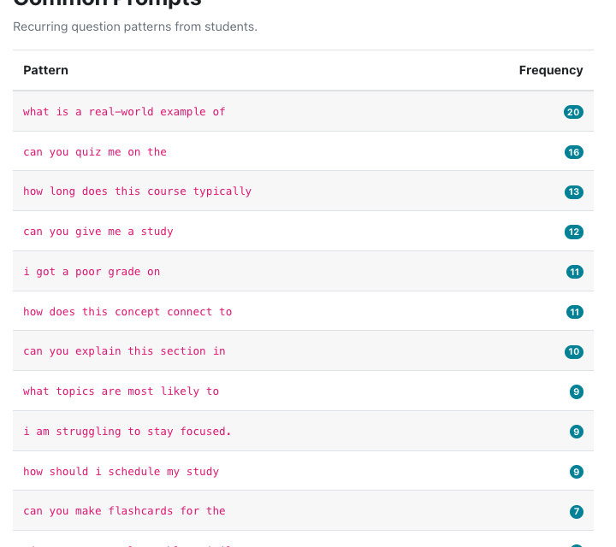
The questions learners are really asking
Recurring question patterns, ranked by frequency
What is a real world example of... appears 20 times
I got a poor grade on... appears 11 times
I am struggling to stay focused appears 9 times
This is course revision gold: it tells you which unit needs a better example, a clearer explanation, or a checkpoint quiz
Demo data shown
Notes:
This is the slide that lands with course developers. Pause on it.

Slide 10
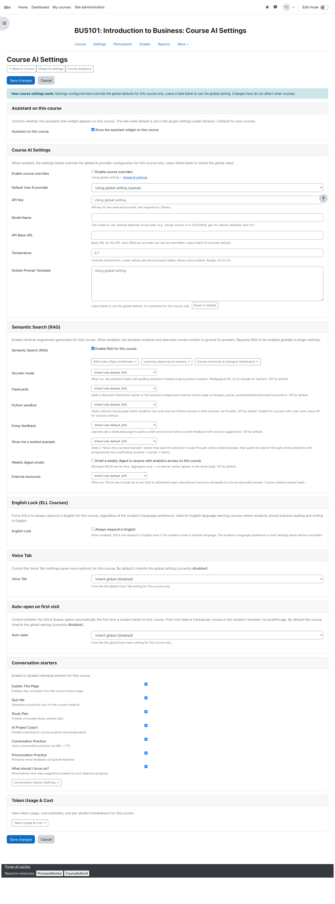
You are in control of your course
Per course settings: enable or disable SOLA, tune the welcome, adjust behavior
Hide SOLA on graded quizzes automatically
Learning objectives you define become the spine SOLA coaches toward
Nothing changes in your course unless you choose it
Notes:
Reassurance slide: SOLA is additive and opt out friendly per course.

Slide 11
Live demo
learn.saylor.org, BUS101
Notes:
Demo plan (3 min, on production v5.4.5): 1. Open BUS101, point at the tab. 2. Open the drawer, show starters. 3. Ask: Why does a price ceiling cause shortages? Let it stream. 4. Ask the same in Spanish. If anything fails, say: let me show you exactly what that looks like, and use slides 4 and 5.

Slide 12
Where we are, and how to get involved
Live today on Learn and Degrees in a pilot of about 30 courses
Nearly 3,000 learners used SOLA in the pilot window
Cost at full pilot scale is a few hundred dollars per month, with caps
Next: expanding toward all courses, smarter routing for hard STEM questions
What we need from you:
Tell us which of your courses should join the rollout next
Send us the confusing spots you already know about, SOLA data will confirm them
Fifteen minutes with the analytics dashboard for your course, we will set it up
Notes:
Close with the ask. Offer office hours after the meeting.

