Slide 1
Fruit Ripeness Detection system
CSE 4128: Image Processing & Computer Vision LaboRatory
PRESENTED BY
Sayma Mushsharat
2007036
Department of Computer Science and Engineering Khulna University of Engineering & Technology (KUET)

Slide 2
Contents of Presentation
Introduction
Objectives
Tools Used
Methodology
Result Analysis
Limitation and challenges
Conclusion
03
04
05
07
14
15
16

Slide 3
INTRODUCTION
Fruit Ripeness Detection automates the detection of fruit ripeness using classical image processing techniques focusing on color and texture analysis to classify fruits as Unripe, Ripe or Overripe.
Used in agriculture, food quality control, supply chain management, and fruit sorting to improve accuracy and streamline processes.
Combines color segmentation (HSV), edge detection, morphological operations, and texture analysis to classify fruit ripeness.

Slide 4
OBJECTIVE
Classify fruit into three categories: Unripe, Ripe, and Overripe, based on visual cues (color, texture).
Provide an interactive platform for users to upload fruit images and view results.
Ensure the system works across different fruit types, sizes, and orientations.
Display intermediate processing steps in real-time including color space conversion, segmentation, and texture analysis.

Slide 5
TOOLS USED
Python: The programming language used for development.
OpenCV: For core image processing tasks such as segmentation and color-based classification.
NumPy: For numerical operations and efficient handling of image data.
Tkinter: For the graphical user interface (GUI).
PIL / Pillow: For handling and processing images.
Matplotlib: For displaying intermediate steps and final outputs.

Slide 6
SYSTEM OVERVIEW
Image Preprocessing: Convert to HSV color space and apply Gaussian blur
Fruit Segmentation: Isolate fruit from background using edge detection and contours.
Color-Based Segmentation: Classify pixels as unripe, ripe, or overripe based on HSV ranges.
Texture Analysis: Calculate local variance to detect spots and wrinkles.
Final Classification: Combine both results and then classify the fruits.

Slide 7
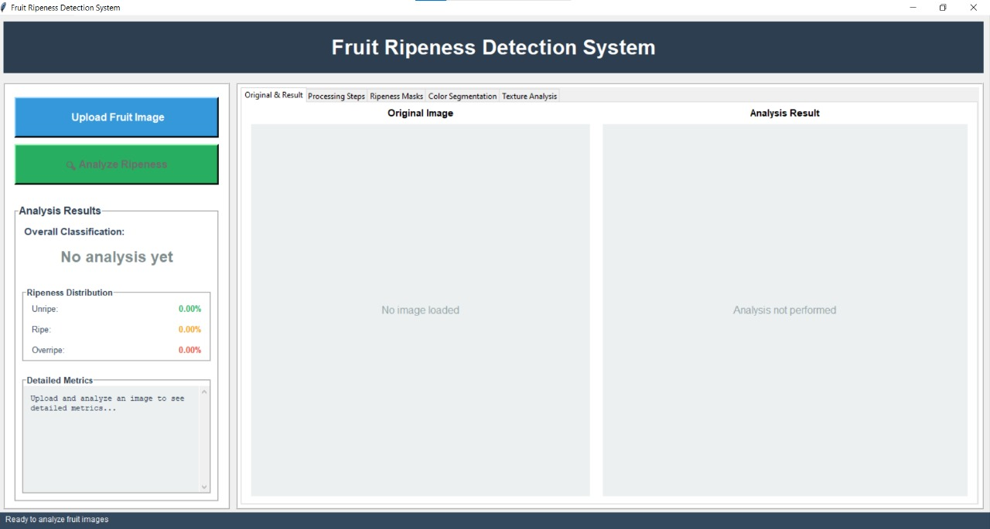
METHODOLOGY
User Interface:
The UI is designed to be simple and intuitive with the help of tkinter framework, providing the user with the following functionalities:
• Image Upload
• Ripeness Analysis
• Real-Time Visualization
• Classification Results
Fig 1 : User Interface

Slide 8
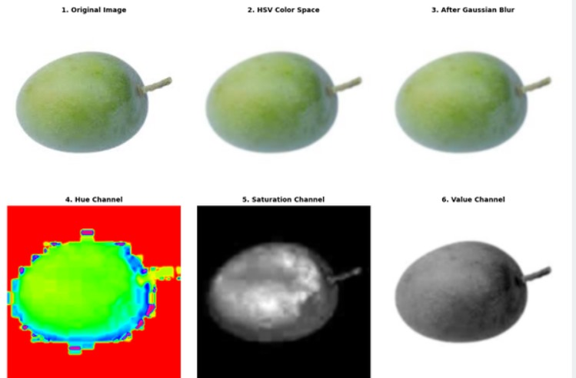
METHODOLOGY
Image Preprocessing:
Color Space Conversion: Convert image from BGR to HSV for better color segmentation.
Gaussian Blur: Apply Gaussian blur to reduce noise and enhance edge detection.
Fig 2 : Image Preprocessing

Slide 9
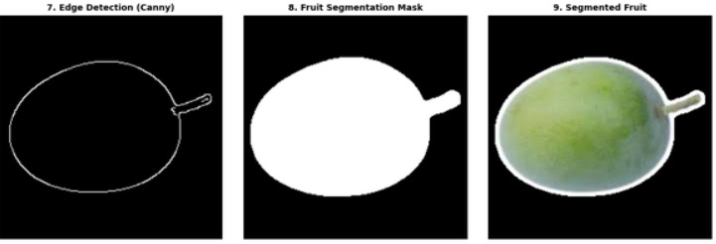
METHODOLOGY
Fruit Segmentation:
Canny Edge Detection: Detects edges by identifying areas with high intensity changes.
Contour Detection: Detects and isolates the fruit from the background.
Dilation: Helps fill in gaps and solidify contours.
Fig 3 : Fruit Segmentation

Slide 10
METHODOLOGY
Ripeness Mask Generation:
Unripe Mask: Detects green hues (40°–85°) with low saturation and high brightness to represent unripe fruits.
Ripe Mask: Identifies red (0°–10°) and yellow (15°–50°) hues with high saturation and brightness for ripe fruits.
Overripe Mask: Detects dark hues (5°–35°) and low brightness (value < 100) to identify overripe fruits.

Slide 11
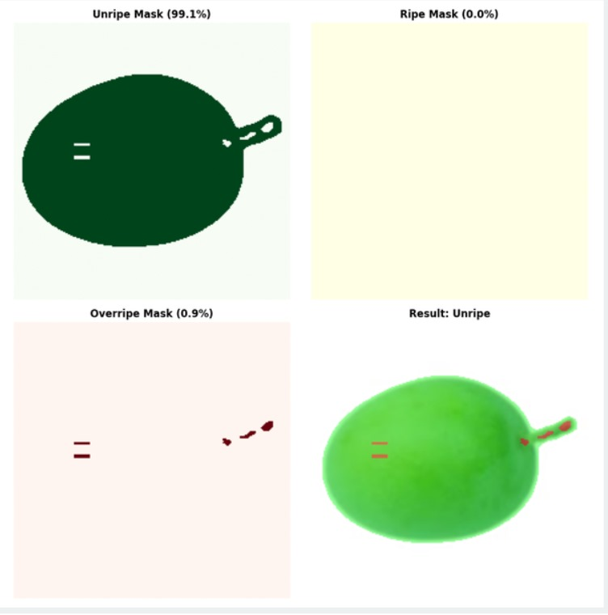
METHODOLOGY
HSV Thresholding:Applied to Hue, Saturation, and Value channels to generate the unripe, ripe, and overripe masks using cv2.range().
Morphological Operations: Dilation fills gaps and erosion removes noise to refine the masks.
Fig 4 : Ripeness Mask

Slide 12
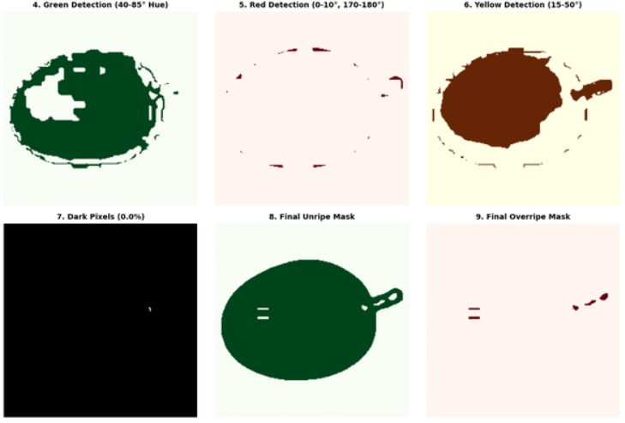
METHODOLOGY
Color Segmentation :
Unripe: Green, low saturation, high brightness.
Ripe: Red or yellow, high saturation and brightness.
Overripe: Brown or dark, low brightness.
Fig 4 : Color Segmentation

Slide 13
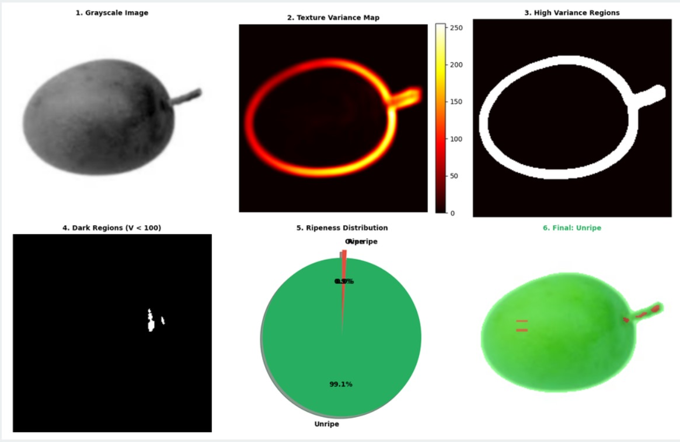
Texture Analysis:
Local Variance Calculation: Computes pixel intensity variance within a 15×15 window. High variance indicates rough, overripe surfaces.
Texture Refinement: Identifies high-variance areas to classify as overripe and smooth areas as ripe/unripe.
Thresholding: A threshold is applied to the variance map, with values above a set threshold (e.g., 2000) classified as overripe.
METHODOLOGY
Fig 5 : Texture Analysis

Slide 14
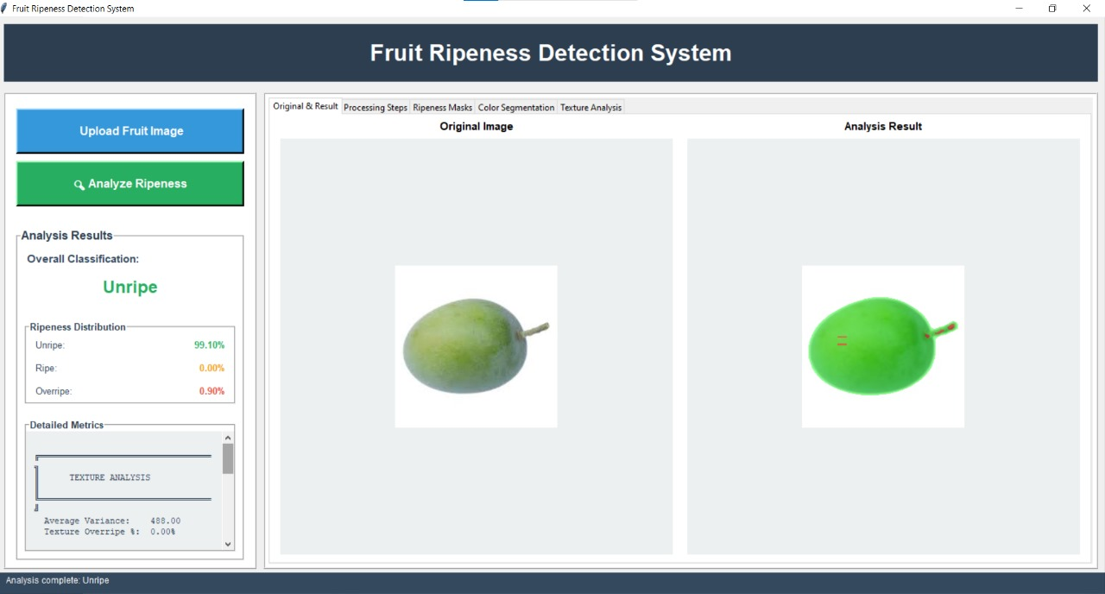
Results Analysis
The User Interface shows the original image and the corresponding ripeness analysis result. The system classifies fruits with the analysis displaying the ripeness distribution and detailed texture analysis metrics.
Fig 6 : Final Ressult

Slide 15
Limitation and Challenges
Lighting Sensitivity: System performance degrades under non-uniform or extreme lighting conditions.
Background Complexity: Complex backgrounds may interfere with fruit segmen tation despite fallback mechanisms.
Fruit Type Specificity: HSV ranges are calibrated primarily for bananas and may need adjustment for other fruits.
Multiple Fruits: Currently processes only one fruit per image .

Slide 16
Conclusion
The system successfully classifies fruit ripeness into Unripe, Ripe, and Overripe categories using color segmentation and texture analysis, without the need for machine learning
It effectively handles variations in fruit types, sizes, and orientations, providing consistent results across different conditions.
The system is valuable for agricultural automation, food quality control, and supply chain management, offering a reliable and efficient solution for ripeness assessment.

Slide 17
THANK YOU

