Slide 1

Salary Predictions of Data Professions

Slide 2
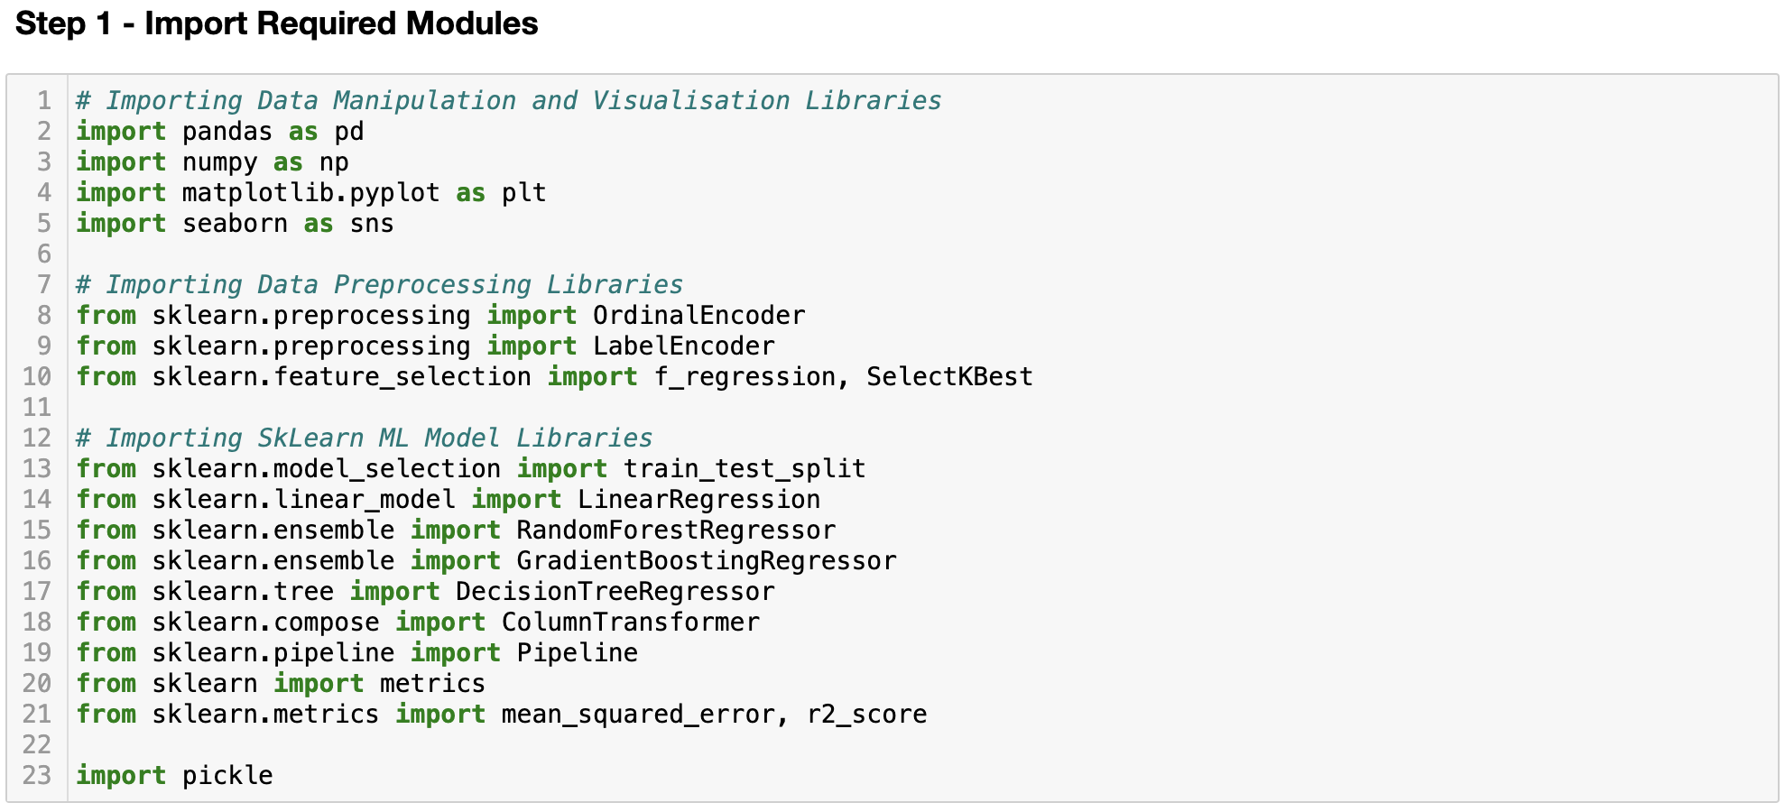
First import all the required modules

Slide 3
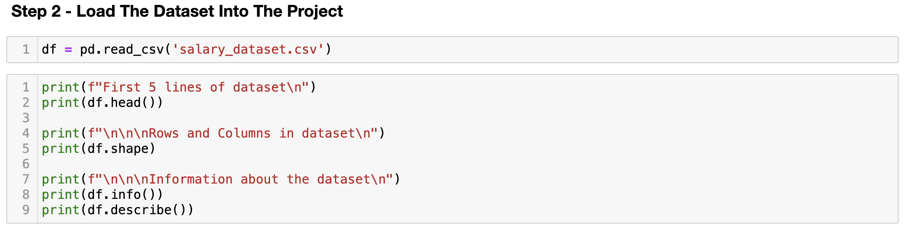
Load Dataset into Project

Slide 4
Remove duplicate and null rows

Slide 5
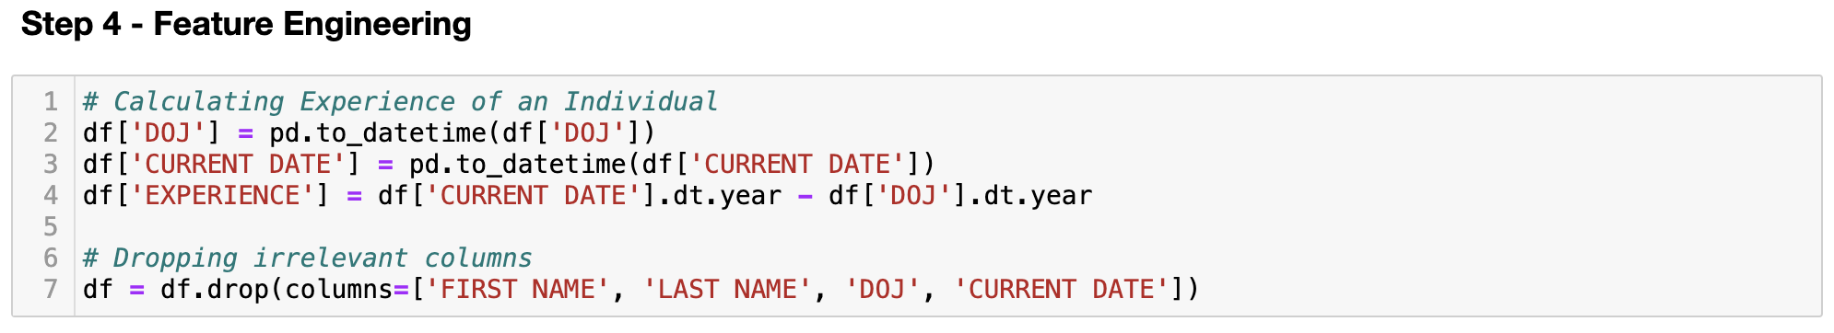
Creating a new feature called “Experience”

Slide 6
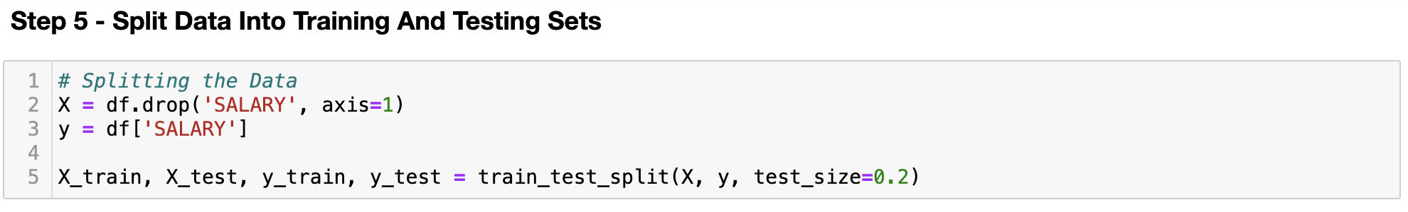
Splitting Data

Slide 7
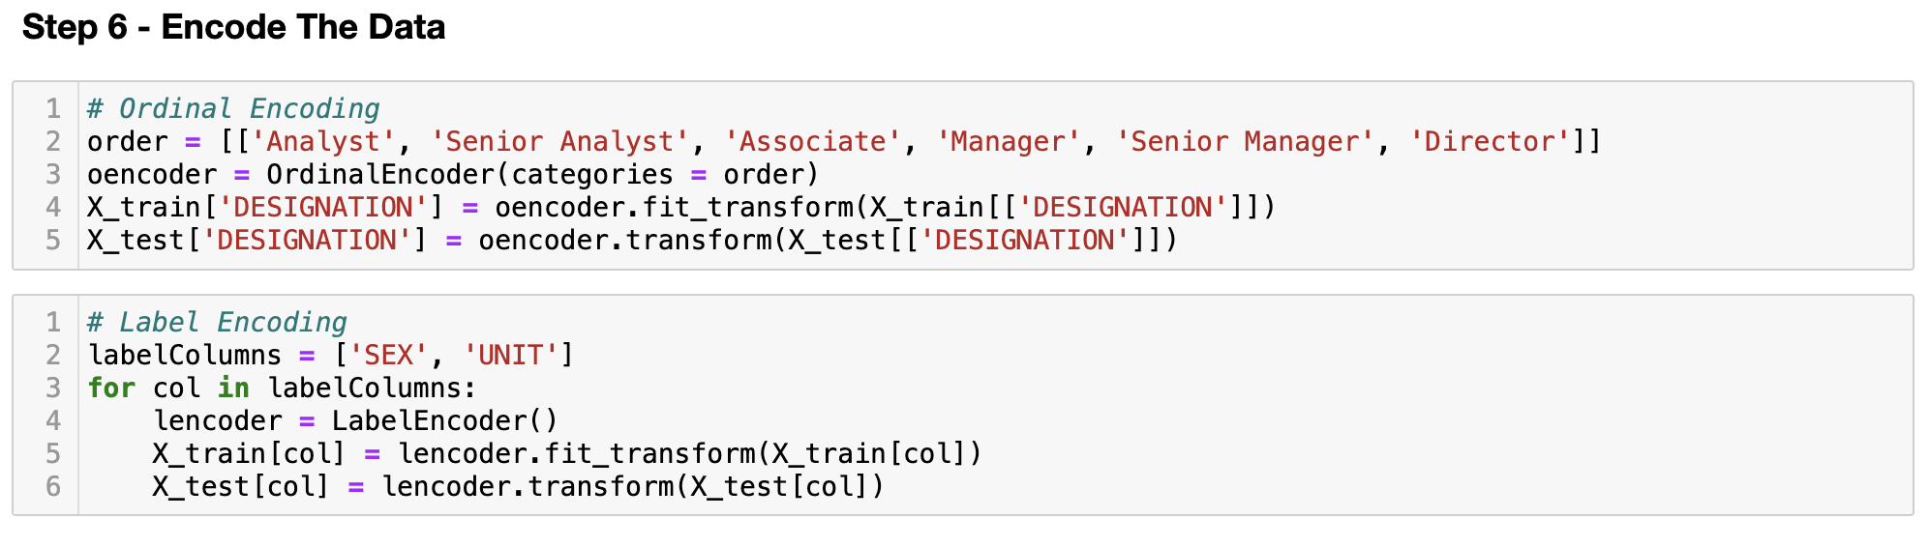
Encoding the Data

Slide 8
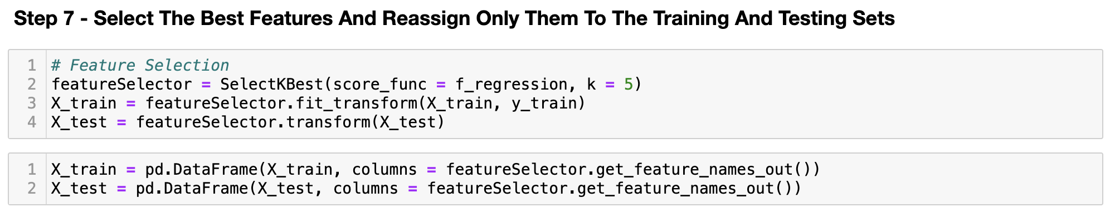
Selecting the Best Features

Slide 9
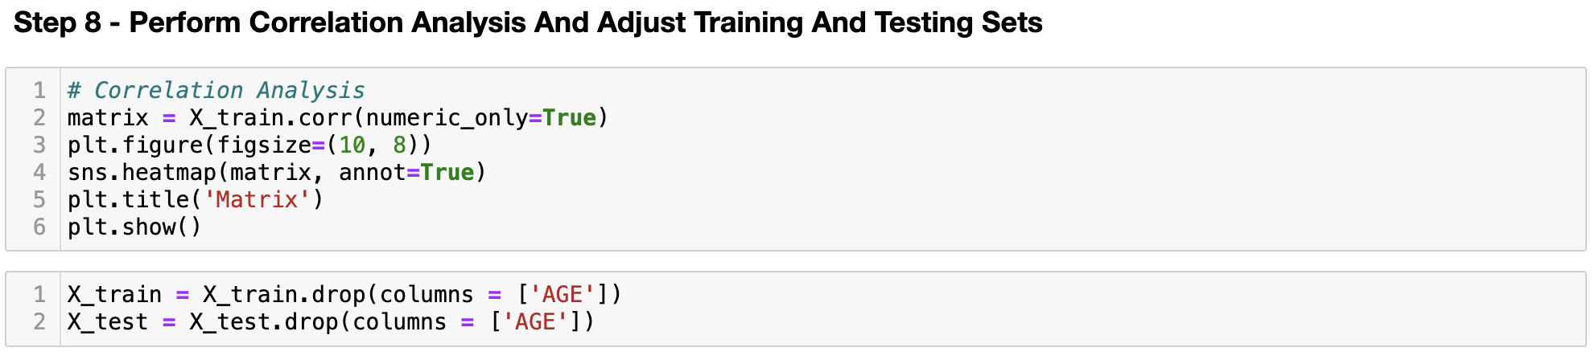
Using Correlation Analysis

Slide 10
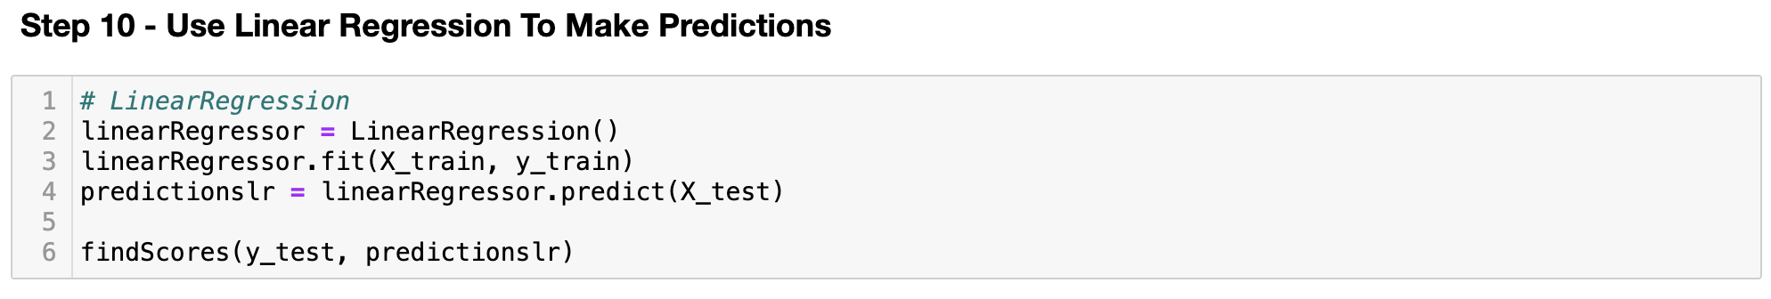
Using a Linear Regression Model

Slide 11
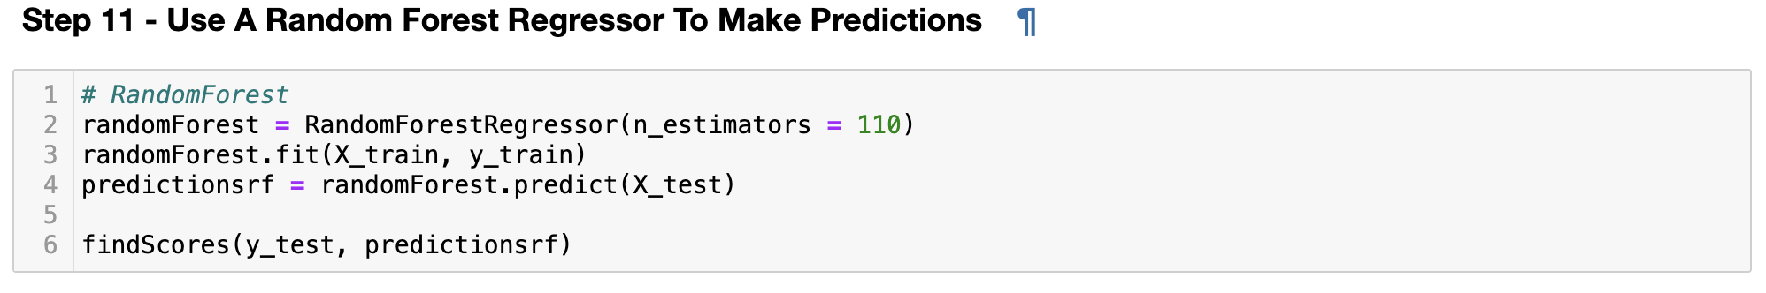
Using a Random Forest Regressor Model

Slide 12
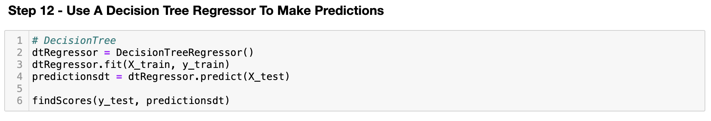
Using a Decision Tree Regressor Model

Slide 13
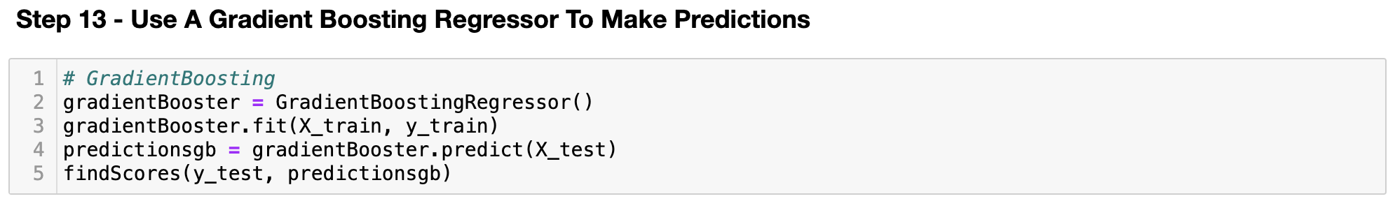
Using a Gradient Booster Regression Model

Slide 14
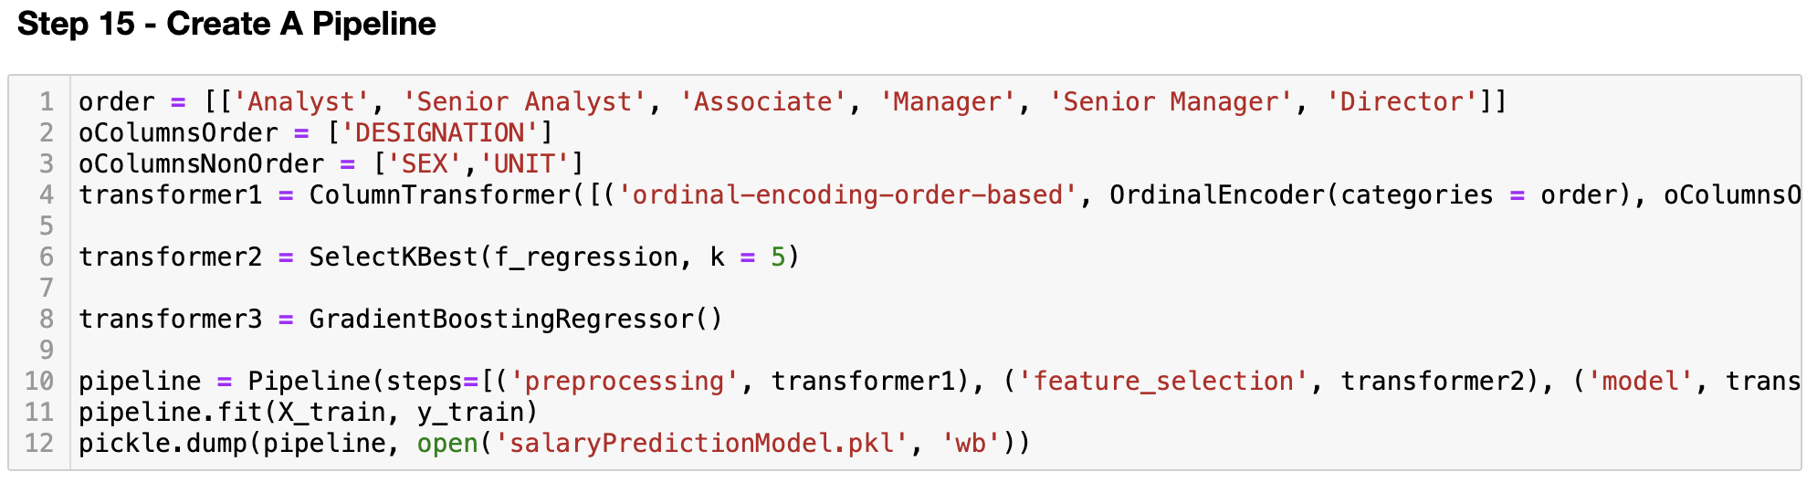
Pipeline to Create a Model

