Slide 1
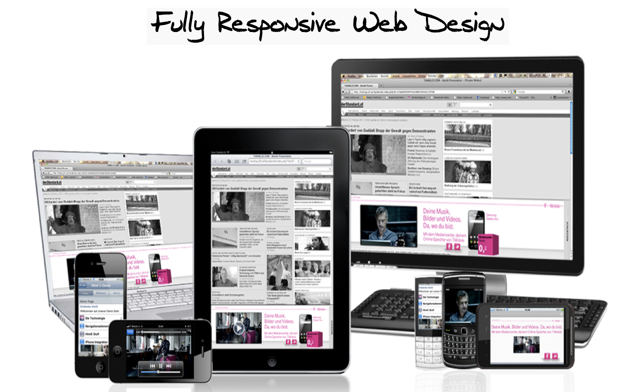
Presented By:
Ipsita Roy, Pabitra Patra, Sayon Adhikary

Slide 2
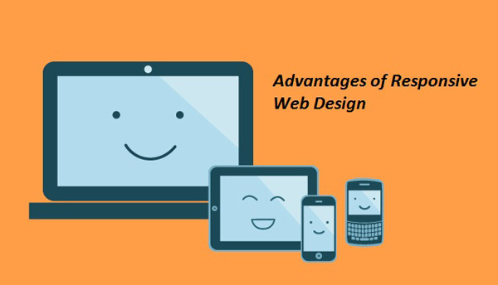
RWD is the concept of developing a website in a way that allows the layout to adjust according to the user’s screen resolution (view port) using media queries.
Responsive Web Design (RWD)

Slide 3

Do we really need to use RWD
1. Recommended by GOOGLE | 2. One website, many devices | 3. Easier to manage
Notes:
With 67 percent search market share, when Google
speaks, search marketers listen. Google states that
responsive web design is its recommended mobile
configuration, and even goes so far as to refer to
responsive web design as the industry best practice.

Slide 4
Responsive vs. Adaptive vs. Mobile
Responsive | Adaptive | Mobile
Reacts quickly and positively to any change Responsive design websites continually and fluidly change based on different factors, such as viewport width | Easily modified for a new purpose or situation, such as change Adaptive websites are built to a groups of preset factors | Builds a separate website commonly on a new domain solely for mobile users
Currently the most popular technique lies within responsive web design, favoring design that dynamically adapts to different browser and device viewports, changing layout and content along the way. This solution has the benefits of being all three, responsive, adaptive, and mobile.

Slide 5
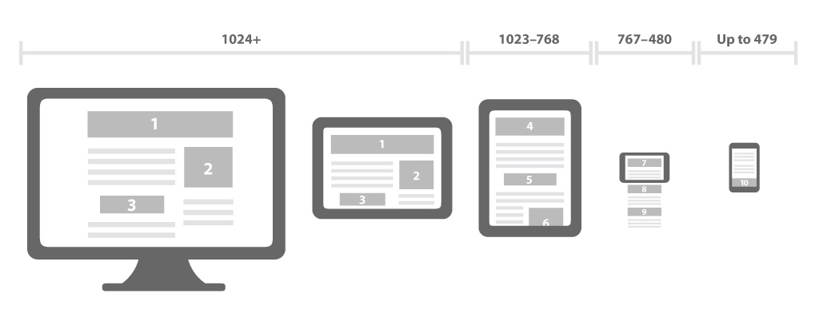
Layouts
Fluid Layout (using % unit)
Elastic Layout (using em unit)
Fixed Layout (using px unit)
Flexible Grid
Holy Grail

Slide 6
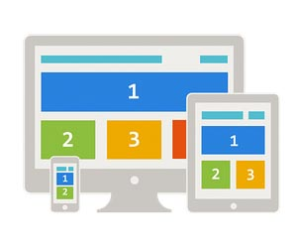
Flexible Grid
Using Float
Using display : table and display : table-cell
Using Bootstrap

Slide 7
Flexible Grid
Using Float
Using display : table and display : table-cell
Using Bootstrap

Slide 8
Media Queries
Height & Width Media Features
  @media all and (width: 320px) and (height: 780px) {...}
Using Minimum & Maximum Prefixes
  @media all and (min-width: 320px) and (max-width: 780px) {...}
Orientation Media Feature
  @media all and (orientation: landscape) {...}
Aspect Ratio Media Features
  @media all and (min-device-aspect-ratio: 16/9) {...}
Resolution Media Feature
  @media print and (min-resolution: 300dpi) {...}

Slide 9
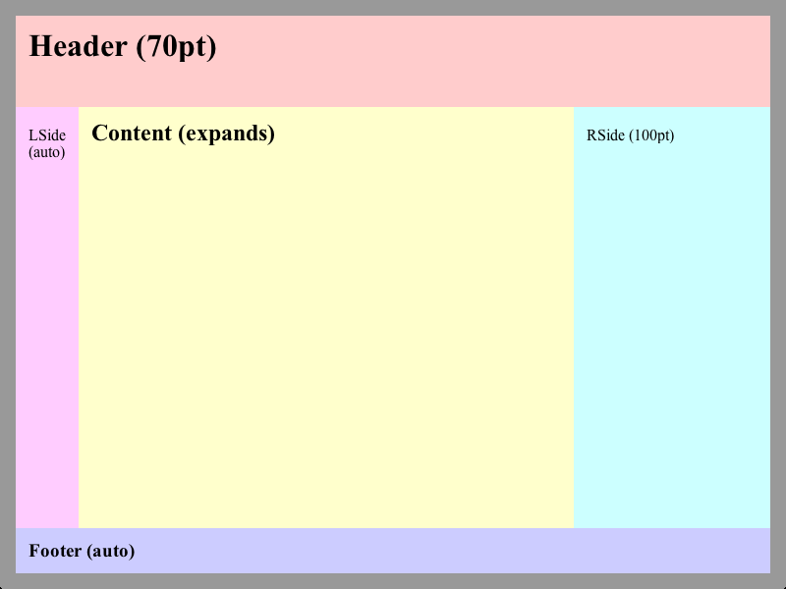
Holy Grail
Conventional approach
Holy Grail Layout
Using display : table approach

Slide 10
7 Habits of Highly Effective Media
Queries
1. Let content determine breakpoints
2. Treat layout as an enhancement
3. Use major and minor breakpoints
4. Use relative units
5. Go beyond width
6. Use media queries for conditional loading
7. Don’t go overboard

Slide 11
Flexible Media
1. Responsive Image
  img, video, canvas {
  max-width: 100%;
  }
2. Responsive Video
HTML : <figure> <iframe src="https://www.youtube.com/embed/4Fqg43ozz7A"></iframe> </figure> | CSS : figure { height: 0; padding-bottom: 56.25%; /* 16:9 */ position: relative; width: 100%; } iframe { height: 100%; left: 0; position: absolute; top: 0; Width: 100%; }

Slide 12
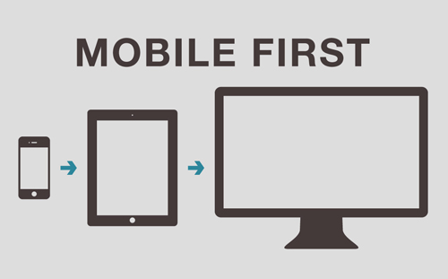
Mobile First
The mobile first approach includes using styles targeted at smaller viewports as the default styles for a website, then use media queries to add styles as the viewport grows.

Slide 13
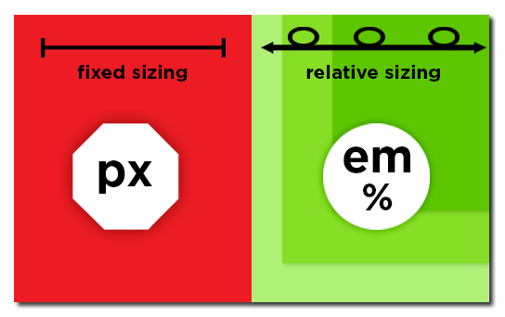
Relative unit
Using %
Using calc()
Using em
Using rem

Slide 14


