Slide 1
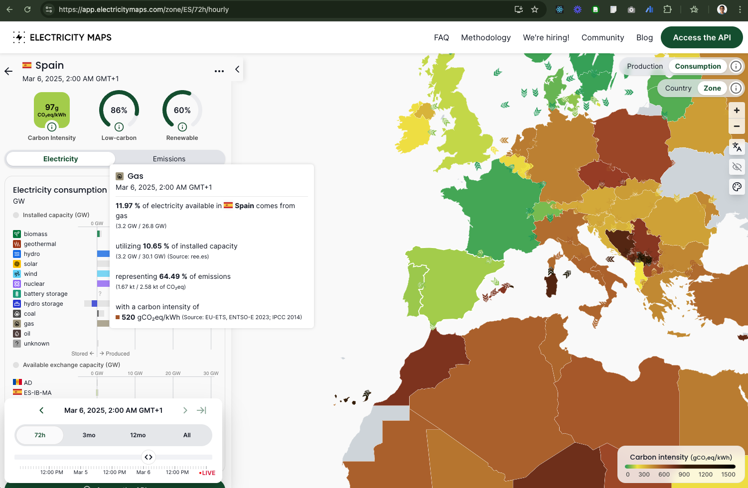

Slide 3
Carbon Aggregation Service + Forecasting
Two Separate products from Electricity Maps (150K x 2 = 300K Euros/year)
Gather real-time energy mix
“Estimate” missing data
Calculate real-time emission
Forecast Next 24 hours
100%
~20%
100%
PHASE 1: Deliver by
May (first week) 2025
PHASE 2 (TBD)

Slide 4
Forecast Service
M L Model
M L Model
M L Model
M L Model
M L Model
Coal
Hydropower
Wind
Solar
… 8 other sources
Natural Gas
46 of 138 done
46 of 138 done
2 of 138 done
2 of 138 done
46 of 138
Fine-tune for region
Fine-tune for region
Fine-tune for region
Fine-tune for region
Fine-tune for region
2 of 138
138 regions * 13 types of energy forecasting ML models = 1,794 fine-tuned, region-specific ML models

Slide 5
How each forecast model is developed?
Part of Phase 1
Historical Data (minimum 365 days, hourly)
Mixture of Experts: Ensemble Model (Prophet + ARIMA + LSTM)
Forecast Data (pre-weather corrected)
Weather Correction based on NOAA data
Final Forecast Data
Hyper-parameter Refinement
For every region
Under development in house at SRI-B
Using established methods

Slide 6
Status of Forecaster Development
Fuel Type | EIA Acronym | Core ML Model Development Status | RMSE | R2
Natural Gas | NG | Completed
Water | WAT | Completed
Nuclear | NUC | Completed
Coal | COL | Completed
Oil | OIL | Completed
Pumped Storage | PS | Completed
Wind | WND | In Progress
Geothermal | GEO | Completed
Sustainable Non-biomass | SNB | Completed
Battery | BAT | Completed
Solar | SUN | In Progress
Utility Energy Storage | UES | Not Started
Other Energy Source (including Biomass) | OES | Not Started

Slide 7
Differences from ElectricityMaps Forecasts
ElectricityMaps
SRI-B
Weather Source not known
Pricing information considered
Results available for both “Production” and “Consumption”
No insight into their ML model
NOAA weather – Free 120 hour ahead forecast available.
Pricing information not considered
Results available for “Production” of energy in a region only.
Full Model visibility.

Slide 8
Validation
SRI-B’s ElectricityMaps ForecastAPI subscription is discontinued.
So we can’t compare with them.
Instead we compare with actual data
SRI-B DEFINED FORECAST QUALITY CRITERIA
Metric | Target
RMSE | 5-10% of mean
R² | >0.8
MAPE | <5% (non-renewable, stable sources), <10% (variable sources)
MAE | Lower than RMSE, stretch goal: <10% of mean

Slide 9
Forecast Results
2 regions in the US
AVA – Avista
CISO – California ISO

Slide 10
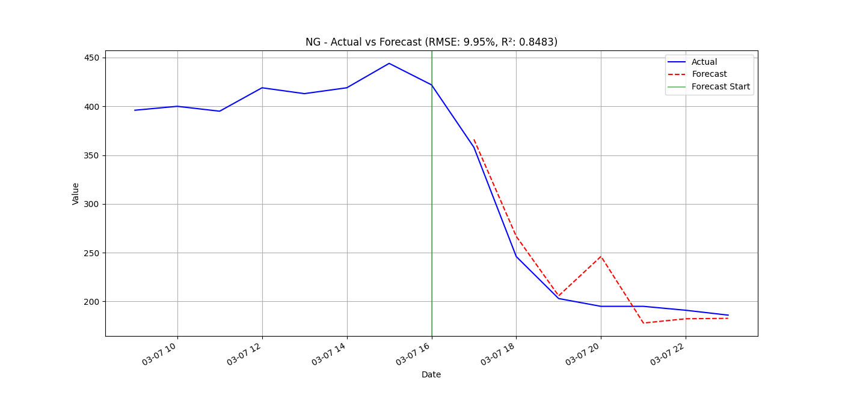
Avista Region: Natural Gas: Actual v/s Forecasts
TEST REGION 1

Slide 11
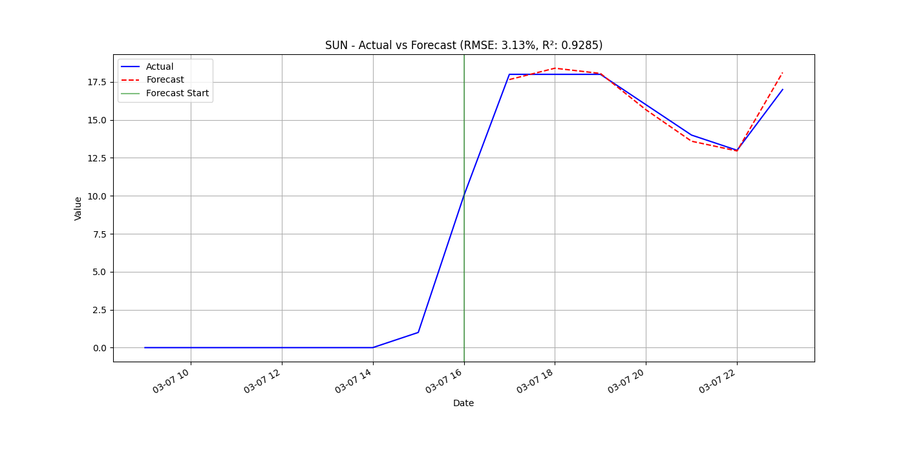
Avista Region: Solar: Actual v/s Forecasts

Slide 12
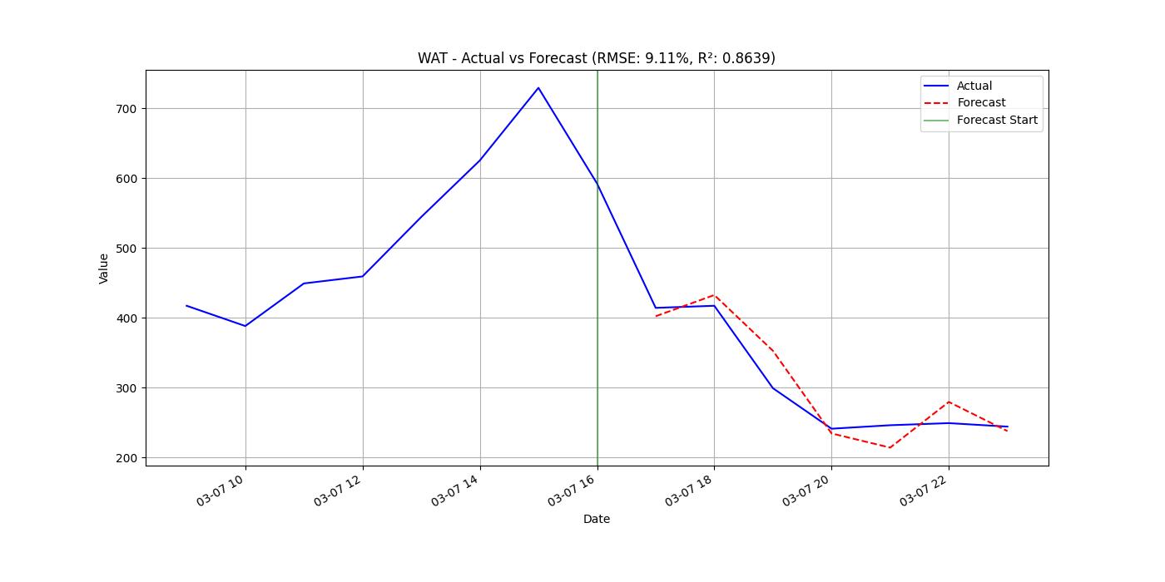
Avista Region: Hydropower: Actual v/s Forecasts

Slide 13
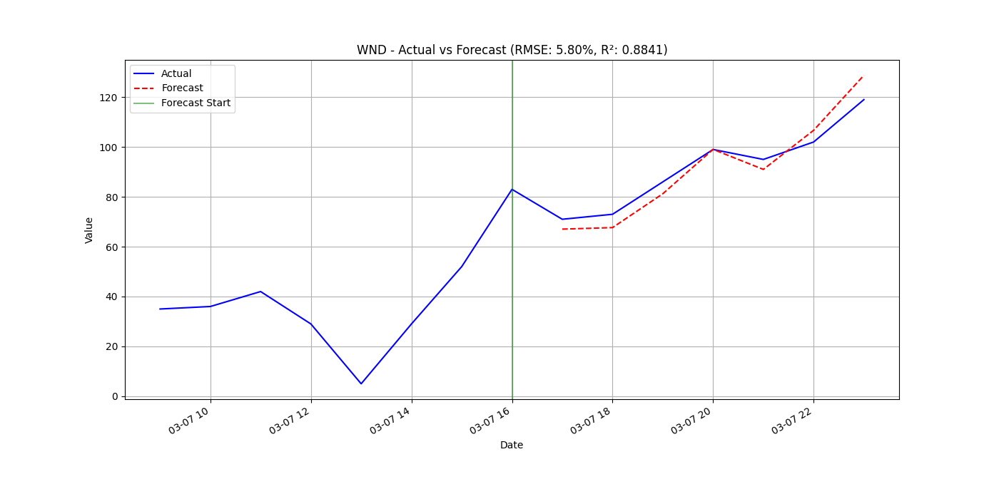
Avista Region: Wind: Actual v/s Forecasts

Slide 14
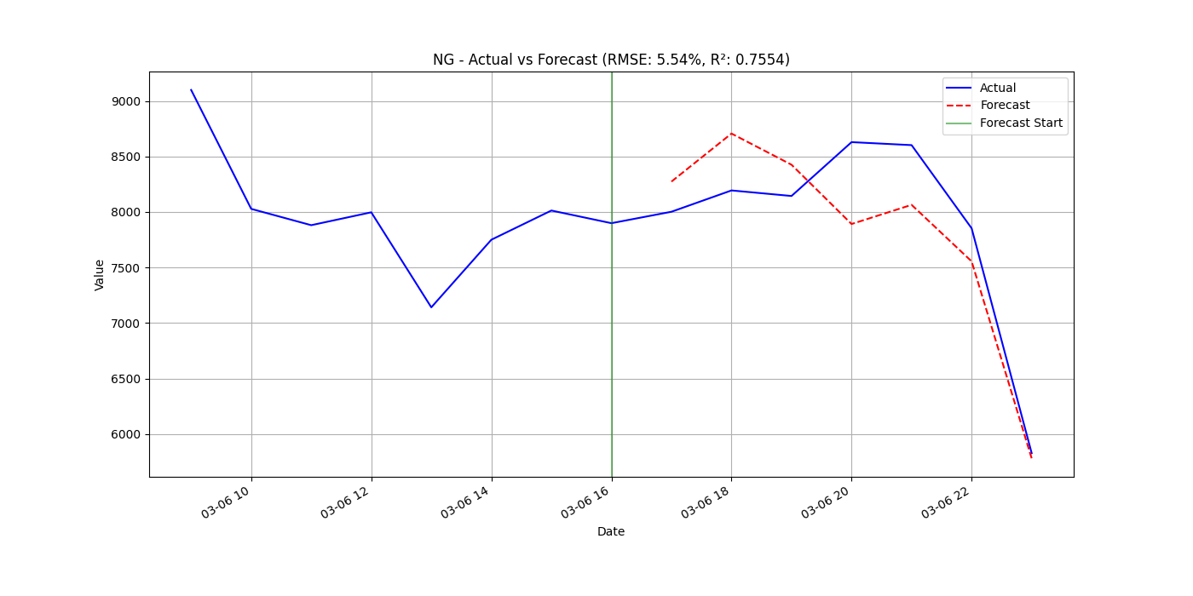
Natural Gas forecast vs actual in CISO Region
TEST REGION 2

Slide 15
Summary & Next Steps
Proof of Concept for Forecasting is done, alongside Estimation Service.
Accuracy of forecast results meet industry standards in experiment area.
N E X T --
Plan for architecture and management of 1,700+ region specific and fuel specific Forecasting ML models.

