Slide 1


SRI-B New Solar Forecasting Service using Physics-informed Machine Learning
Data Collection - NOAA's Global Forecast System
Global Horizontal Irradiance (GHI) - solar radiation received on a horizontal surface
Panel Calibration using Machine Learning
Analyses historical production data from panels
Forecast Generation
Calculate theoretical maximum production based on panel dimensions and efficiency (Physics Based), GHI, GNI data
Global Normal Irradiance (GNI) - solar radiation received perpendicular to the sun's rays
Temperature - affects solar panel efficiency
Cloud cover - impacts solar radiation reaching panels
Compares actual production with expected production based on historical weather data
Calculates a calibration factor for each panel to account for local conditions
Adjusts for panel-specific efficiency, orientation, shading, and degradation
Adjust for panel tilt and orientation
Apply temperature coefficient to account for efficiency changes
Generate hourly production forecasts for the next 72 hours
Accuracy Measurement
Mean Absolute Error (MAE) - average absolute difference between forecasted and actual production
Mean Absolute Percentage Error (MAPE) - average percentage difference
Apply the panel-specific calibration factor
GFS API
Feedback on model quality

Slide 2
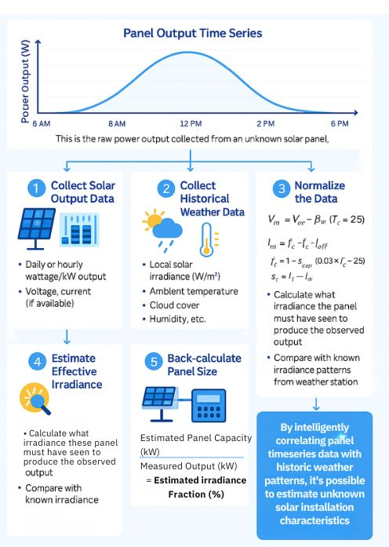
For Solar Panels with unknown specifications, we can identify its characteristics regressively, and then apply it forward in the new algorithm.
Proposed Physics-informed Solar Forecasting ML model
Panel Characteristics Identified
Historical Output Data from Different Panels
More accurate solar forecast going forward.

