Slide 1
MDITF Reducing Energy Burden for Indian households through Self-Demand Response

Slide 2
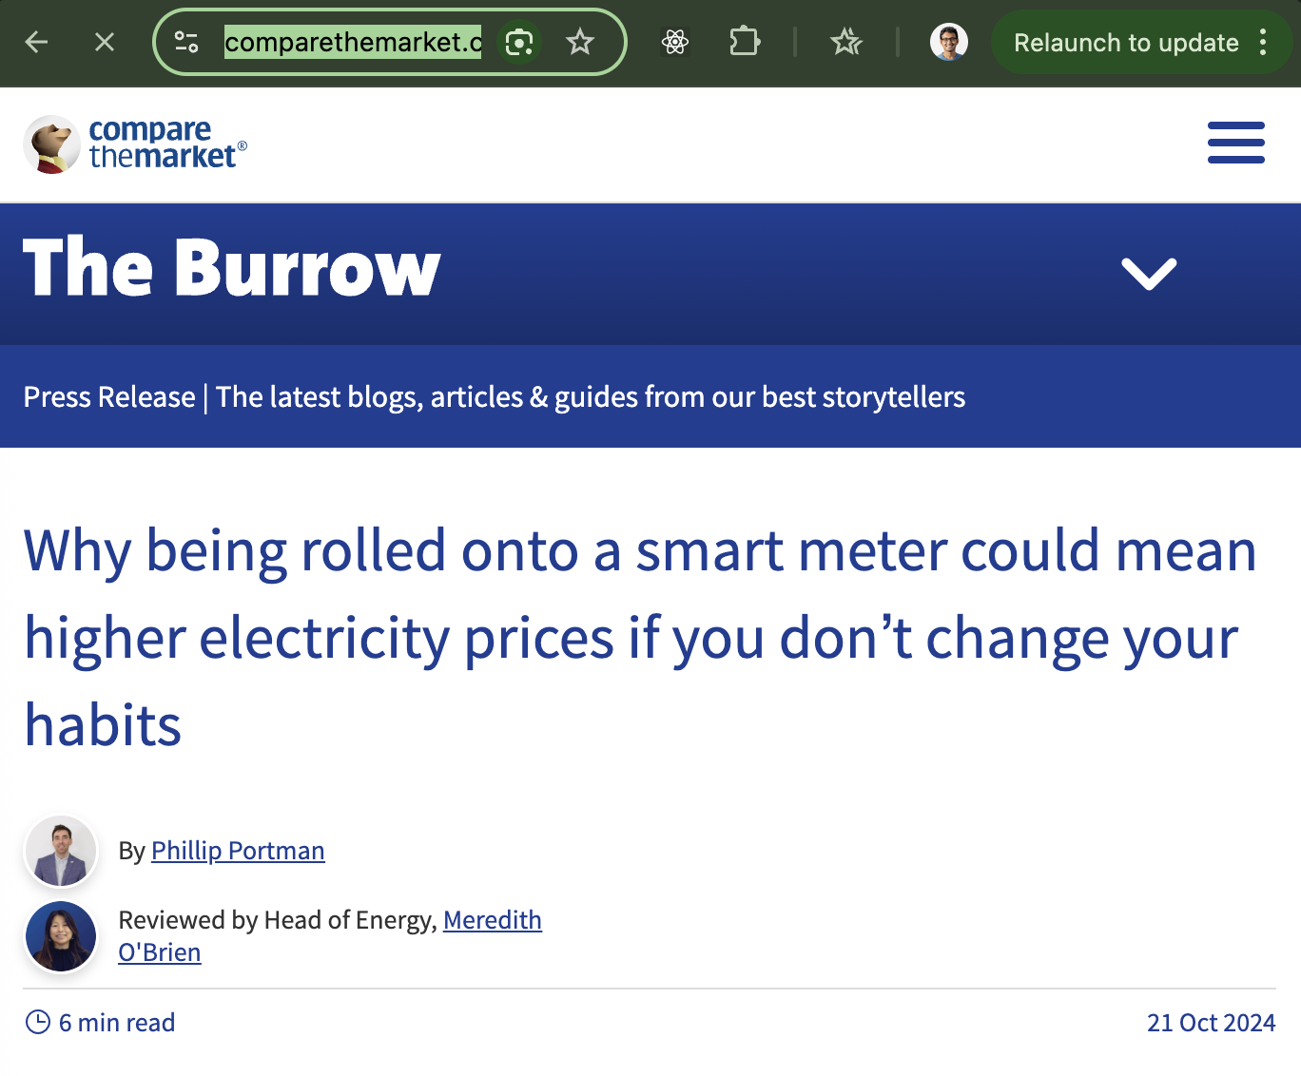

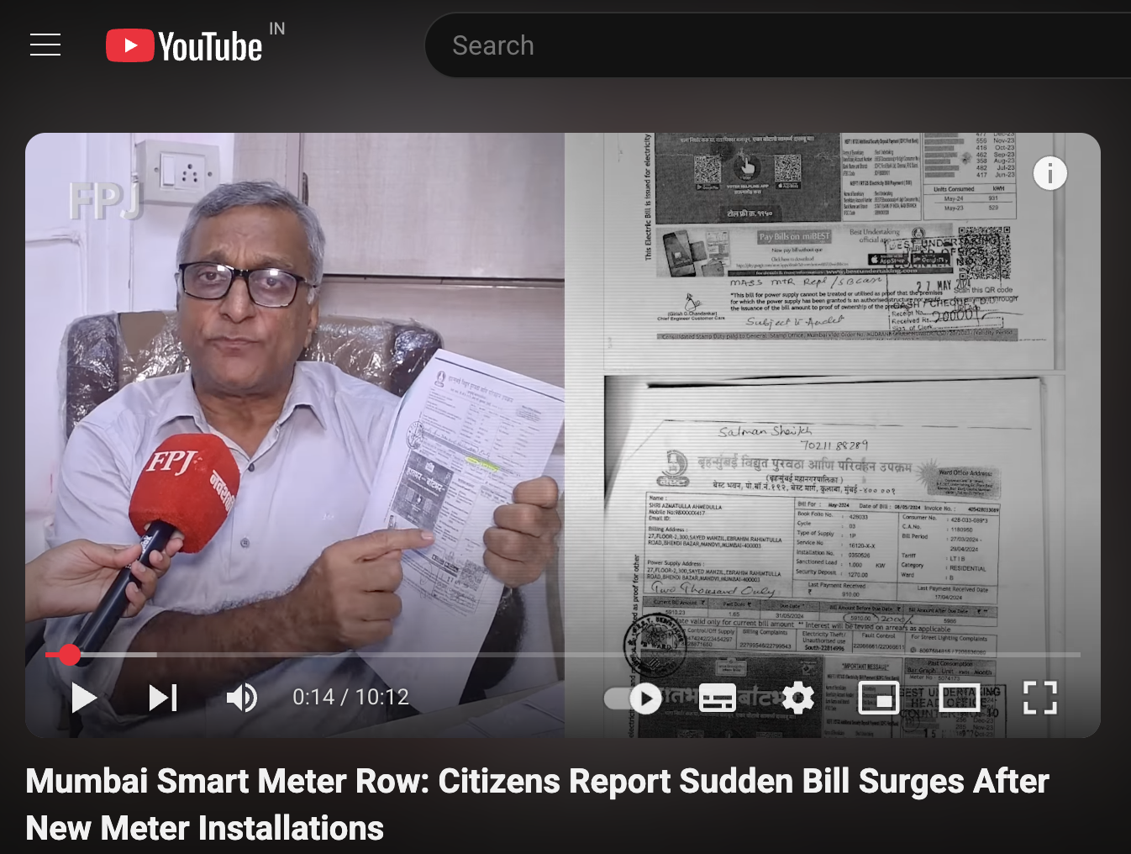
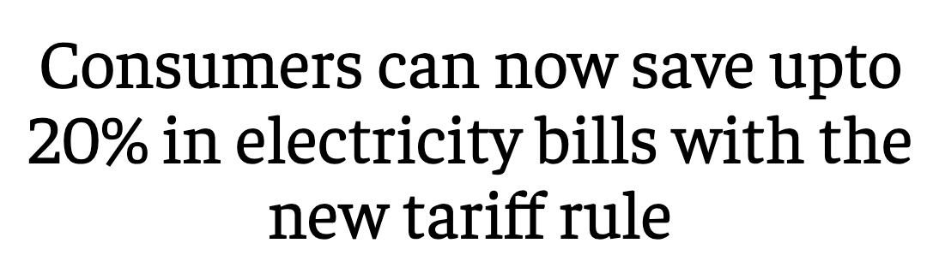
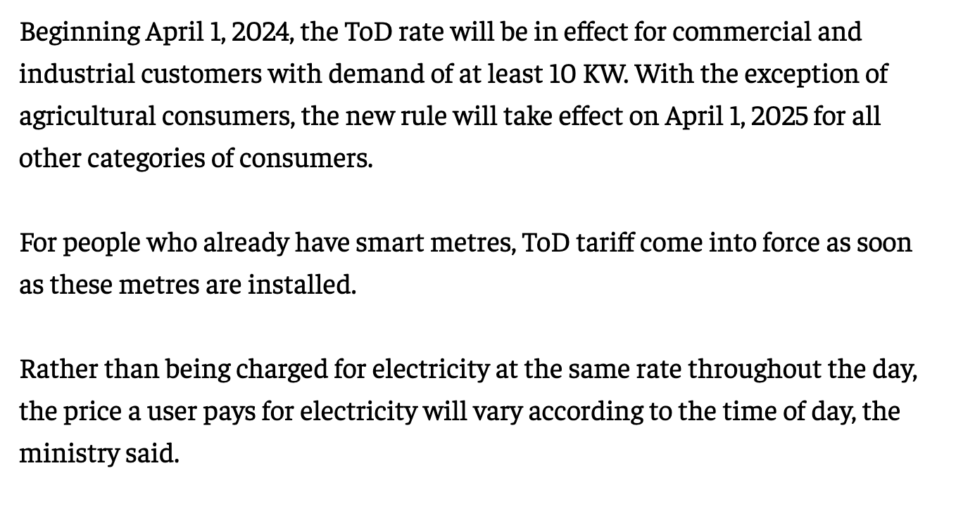
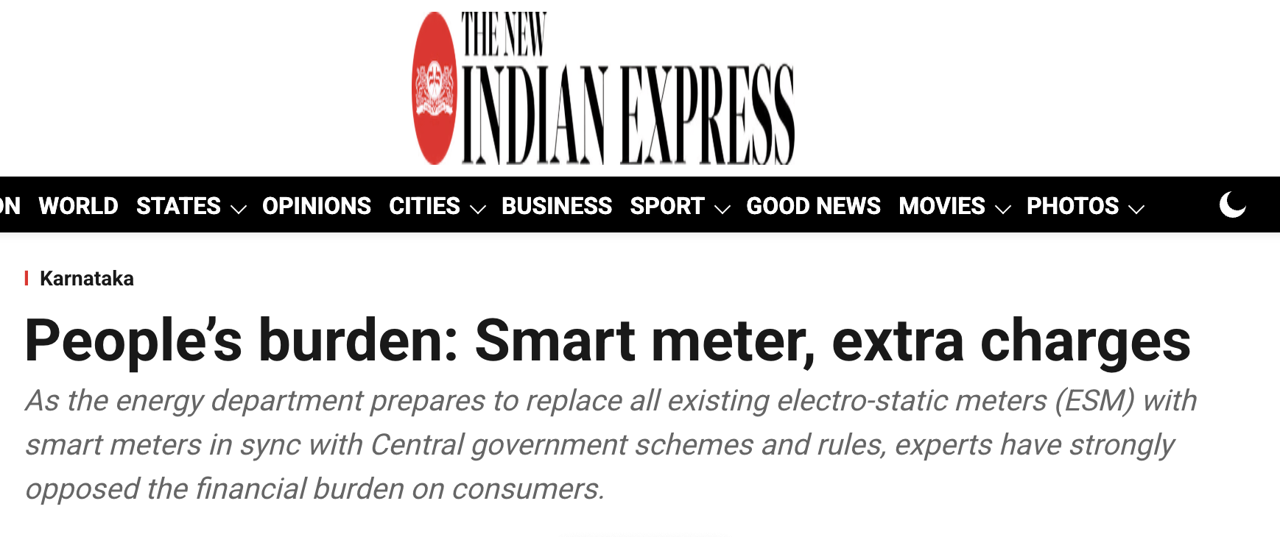
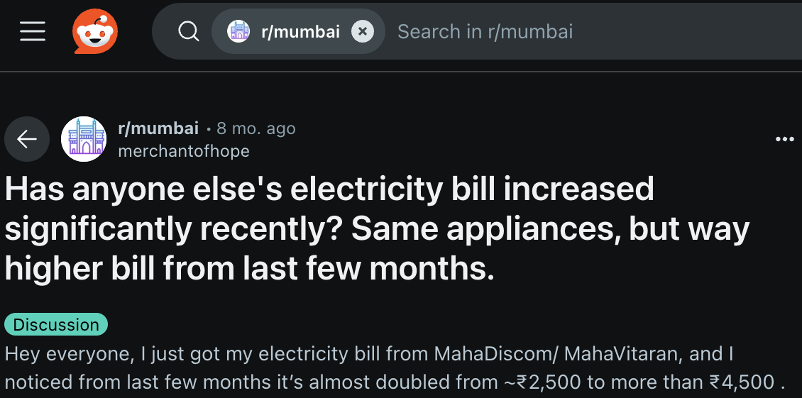
THE SITUATION
From April 2025, any Indian consumer with Smart Meter (including residential, except Agricultural) will be subject to Time of Day pricing.
PROMISE VERSUS REALITY
Ministry of Power Press Release: https://www.pib.gov.in/PressReleaseIframePage.aspx?PRID=1934673

Slide 3
Why are people getting higher bills?
THE WHY?
Most people use more energy during convenient hours → Leading to Peak Hours. Examples:
Running the AC at full blast after coming back from the office (peak hour)
Letting the geyser stay on all morning (peak hour)
Doing laundry when at home in the morning and evening (peak hours)
All these activities can be automated to be rescheduled for off-peak hours (10-20% cheaper than the base rate)

Slide 4
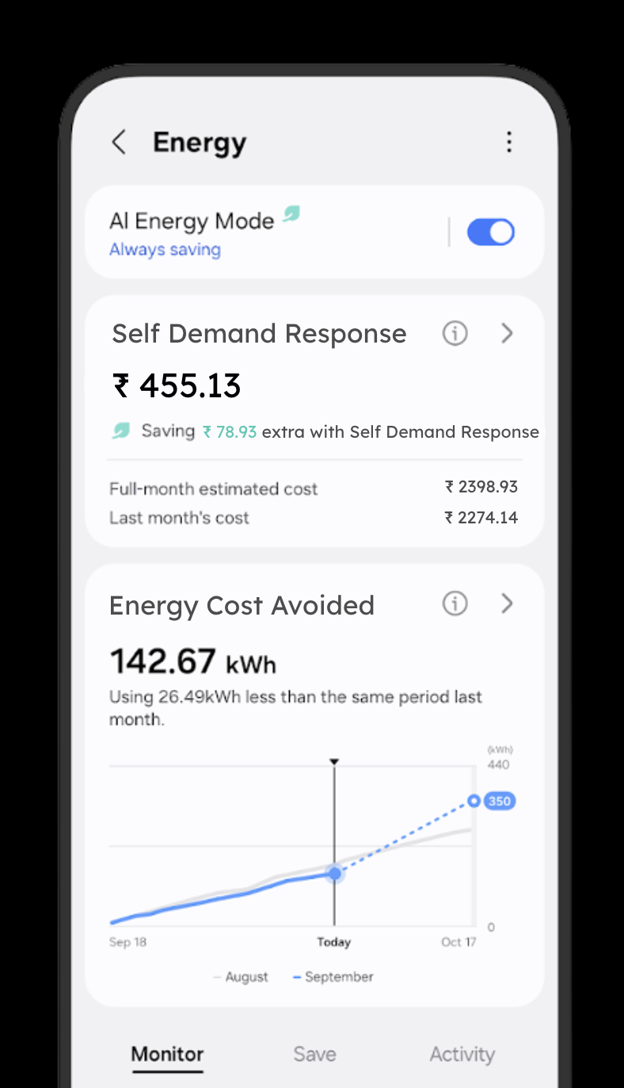
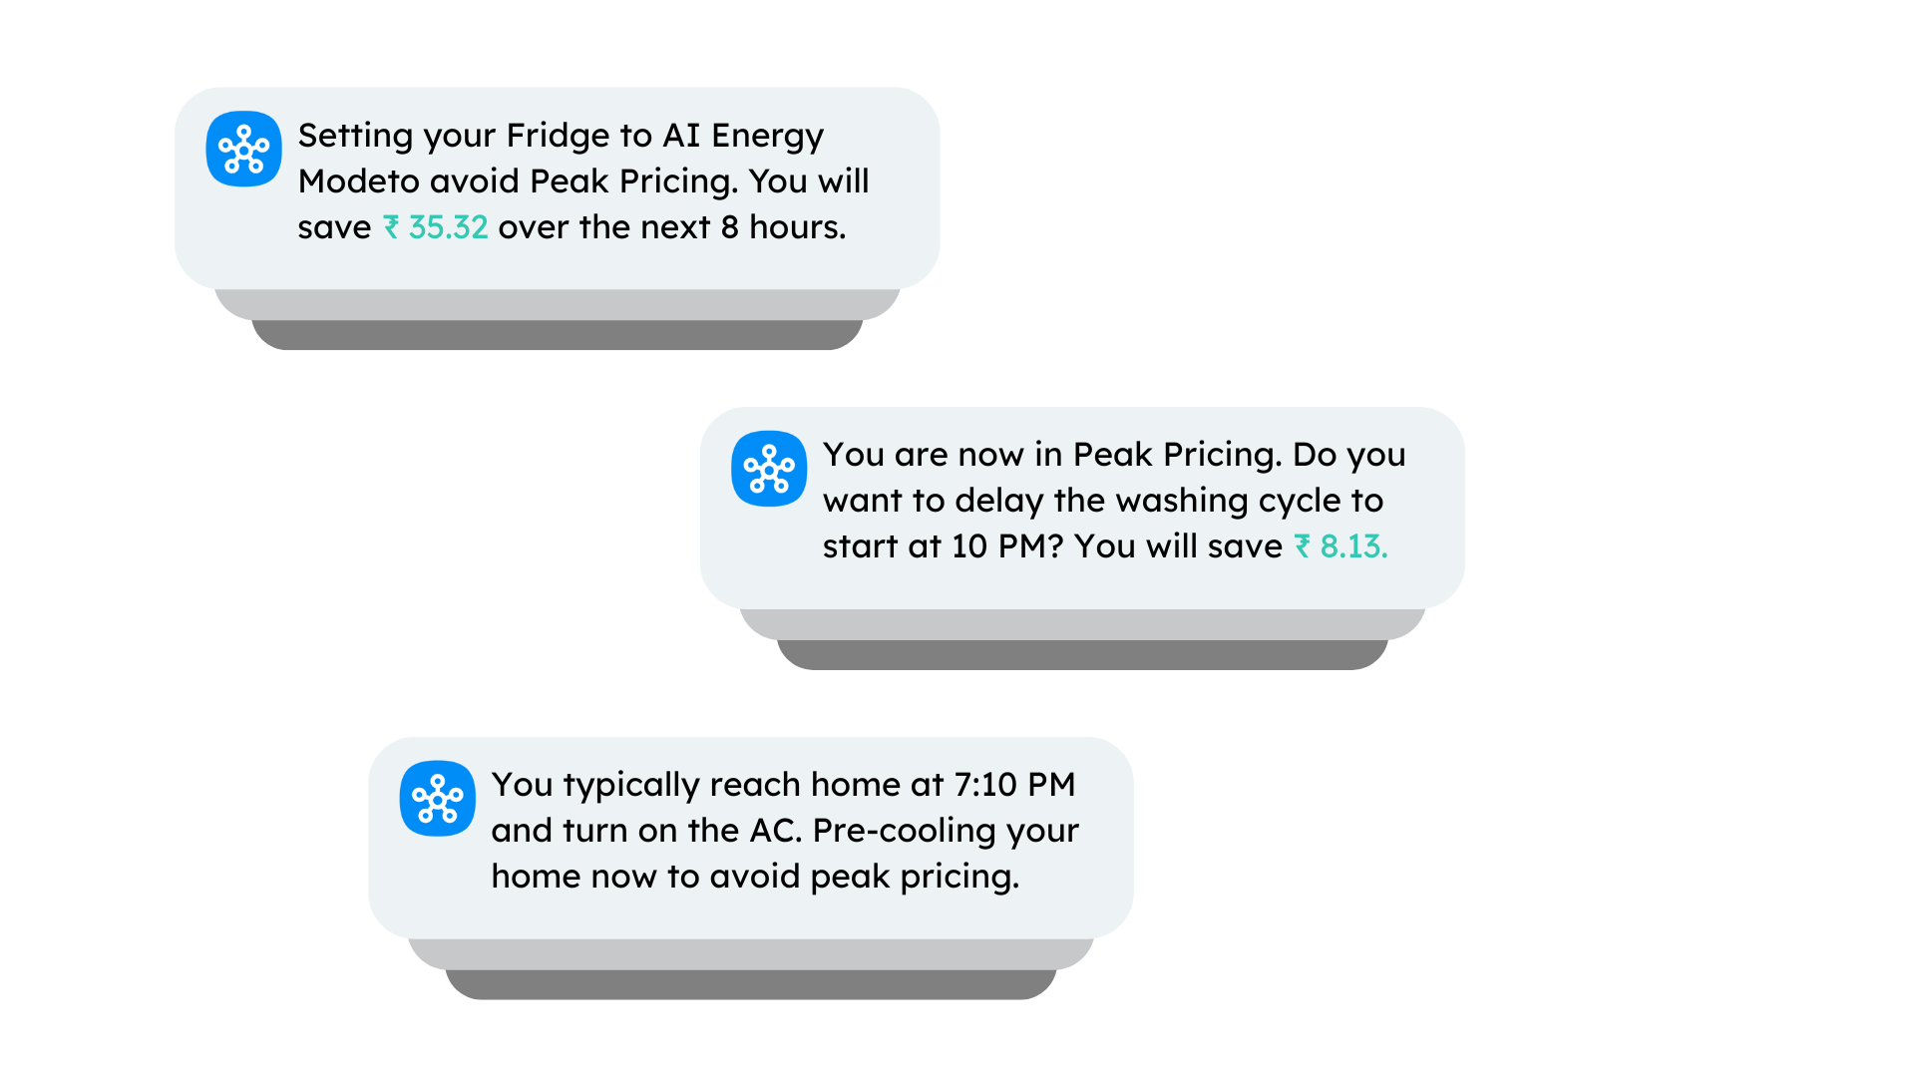
Self-Demand Response
SOLUTION
Automatically, at 6PM
Enabling customers to moderate their energy use through automations, AI Energy Mode, and reminders about pricing.
Customized for every customer’s appliance usage habits.
Leveraging local electricity rates data and season/weather-appropriate suggestions
When user is trying to use Washing Machine at 7 PM
Automatically, at 4 PM, when user is at office

