Slide 1
Physics-Informed Machine Learning for Solar Power Forecasting
Adaptive Calibration Framework for Unknown Panel Characteristics
C O R E I N N O V A T I O N
A hybrid physics-ML approach that combines first-principles solar modelling with adaptive machine learning calibration to accurately forecast solar power output, even for panels with unknown specifications.
K E Y C O M P O N E N T S
PHYSICS ENGINE
Implements solar irradiance models (GHI, DNI, DHI decomposition)
WEATHER INTEGRATION
NOAA GFS data for South Korea (0.25° resolution)
ML CALIBRATION
Neural network for panel-specific adjustments
INVERSE (OR REVERSE) MODELING
Characteristic estimation for unknown panels

Slide 2


SRI-B New Solar Forecasting Service using Physics-informed Machine Learning (PIML Solar Forecasting)
Data Collection - NOAA's Global Forecast System
Global Horizontal Irradiance (GHI) - solar radiation received on a horizontal surface
Panel Calibration using Machine Learning
Analyses historical production data from panels
Forecast Generation
Calculate theoretical maximum production based on panel dimensions and efficiency (Physics Based), GHI, GNI data
Global Normal Irradiance (GNI) - solar radiation received perpendicular to the sun's rays
Temperature - affects solar panel efficiency
Cloud cover - impacts solar radiation reaching panels
Compares actual production with expected production based on historical weather data
Calculates a calibration factor for each panel to account for local conditions
Adjusts for panel-specific efficiency, orientation, shading, and degradation
Adjust for panel tilt and orientation
Apply temperature coefficient to account for efficiency changes
Generate hourly production forecasts for the next 72 hours
Accuracy Measurement
Mean Absolute Error (MAE) - average absolute difference between forecasted and actual production
Mean Absolute Percentage Error (MAPE) - average percentage difference
Apply the panel-specific calibration factor
GFS API
Feedback on model quality

Slide 3
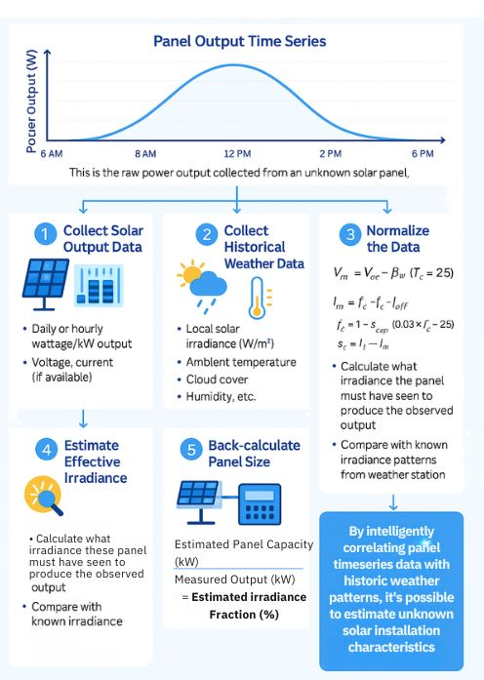
For Solar Panels with unknown specifications, we can identify its characteristics regressively, and then apply it forward in the new algorithm.
TECH STACK
Python FastAPI Backend
NOAA GFS API for solar irradiance data globally or POC regions
TensorFlow (or PyTorch) for ML calibration
Existing Cloud Infrastructure
Proposed Physics-informed Solar Forecasting ML model
Panel Characteristics Identified
Historical Output Data from Different Panels
More accurate solar forecast going forward.

Slide 4
Physics Foundation - Solar Power Generation Model
CORE EQUATIONS
Equation 1: Solar Power Output Model
P_out = η_total × A × G_POA × (1 - α(T_c - T_STC))
Where:
η_total = η_module × η_inverter × η_system (Total efficiency)
A = Panel area (m²)
G_POA = Plane of Array irradiance (W/m²)
α = Temperature coefficient (%/°C)
T_c = Cell temperature (°C)
Equation 2. Plane of Array (POA) Irradiance
G_POA = G_b × R_b + G_d × R_d + G_r × R_r
Where:
G_b = Beam (direct) irradiance from NOAA GFS
G_d = Diffuse irradiance (calculated via Perez model)
G_r = Reflected irradiance (albedo effect)
R_b, R_d, R_r = Transposition factors for panel tilt/azimuth
Equation 3. Cell Temperature Model
T_c = T_amb + (G_POA/800) × (NOCT - 20) × (1 - η_ref/0.9) Where:
NOCT = Nominal Operating Cell Temperature (typically 45°C)
T_amb = Ambient temperature from NOAA

Slide 5
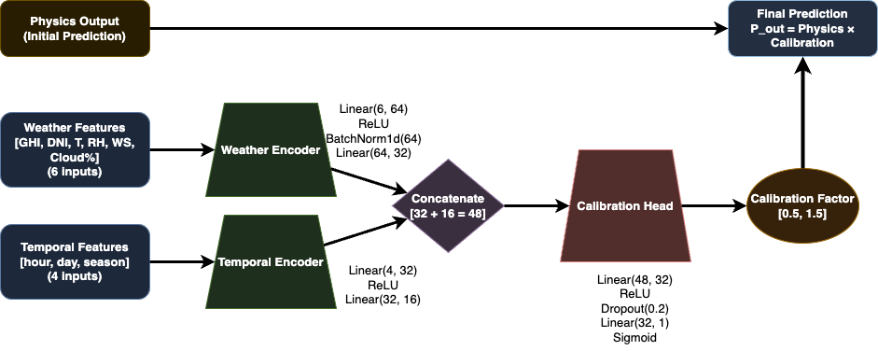
Physics-Informed ML Architecture
Hybrid Model Formulation
P̂_out = f_physics(X_weather, θ_panel) + f_ML(X_weather, X_temporal, θ_learned)
where:
_physics = Deterministic physics model f_ML = Neural network correction term X_weather = Weather features: [GHI, DNI, T, RH, WS, Cloud%] X_temporal = Time features: [hour, day, season encodings] θ_panel = Physical parameters (may be unknown) θ_learned = Learned calibration parameters
KEY INNOVATION
ML component learns multiplicative corrections to physics predictions, preserving physical relationships while adapting to panel-specific behaviors.

Slide 6
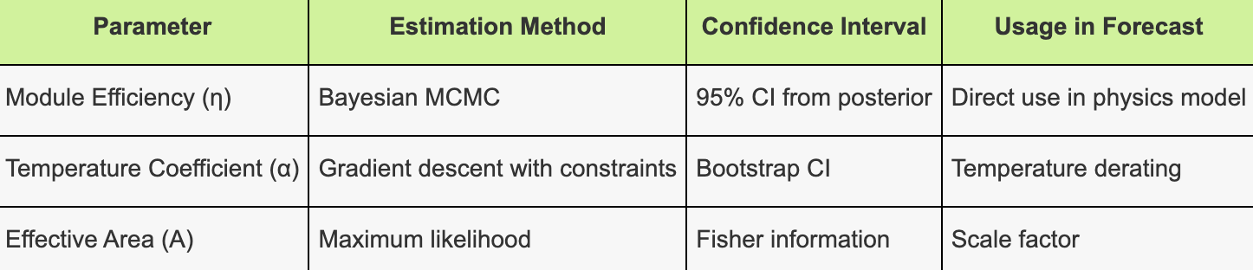
Inverse (or Reverse) Problem - Unknown Panel Characterization
Parameter Estimation Framework
Subject to:
0.001 ≤ α ≤ 0.006 (Temperature coefficient)
0.15 ≤ η_module ≤ 0.23 (Module efficiency bounds)
1.0 ≤ A ≤ 2.5 (Panel area in m²)
R(θ) = Regularization for physical plausibility
ESTIMATED PARAMETER USAGE

Slide 7
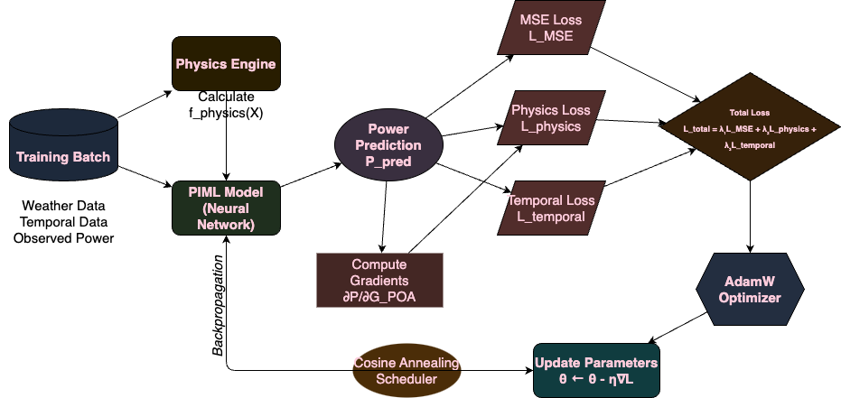
Physics informed ML Training Pipeline

Slide 8
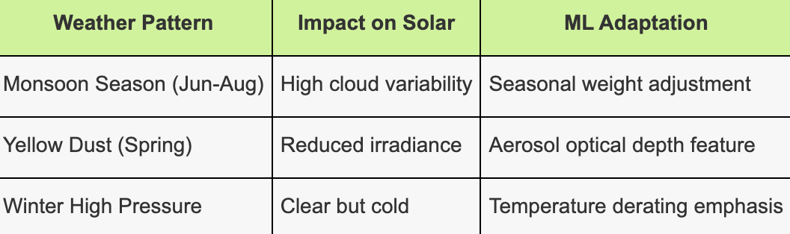
NOAA GFS Integration – Data Acquisition Pipeline
NOAA GFS Data
Forecast
Calibration based on actual data
Data Quality & Resolution
Spatial Resolution
GFS 0.25° (~28 km)
Covers entire Korean peninsula (and most of the world)
4x daily updates (00, 06, 12, 18 UTC)
Temporal Resolution
1-hour intervals: 0-120 hours
3-hour intervals: 120-384 hours
7-day forecast for ML training
Historical reanalysis available
Update frequently
REGION-SPECIFIC CONSIDERATION
Check it out below:
https://www.ncei.noaa.gov/products/weather-climate-models/global-forecast

Slide 9
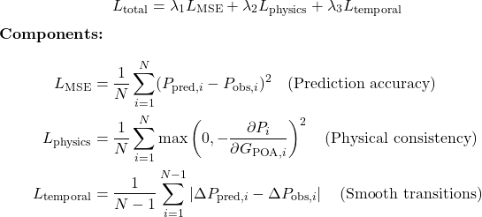
Model Training & Validation Strategy
VALIDATION METRICS
Physics-Informed Loss Function
Accuracy Metrics
nRMSE: < 8% for day-ahead
nMAE: < 6% for intraday
Forecast Skill: > 0.35
Ramp Detection: > 85% accuracy
Multi-Objective Loss
Physical Validity
Monotonicity w.r.t irradiance
Temperature response curves
Dawn/dusk transitions
Cloud edge enhancement
MSE Loss (Prediction Accuracy): This measures how close our predicted solar power output is to the actual measured output. The smaller the difference between our prediction and reality, the better our model is performing.
Physics Loss (Physical Consistency): This ensures our model respects the laws of physics - specifically that solar panels should always produce more power when they receive more sunlight.
Temporal Loss (Smooth Transitions): This makes sure our predictions change smoothly over time, just like real solar panels don't suddenly jump from producing no power to full power. It's similar to ensuring a weather forecast doesn't predict 30°C at 2pm and then -10°C at 2:15pm - the changes should be gradual and realistic.

Slide 10
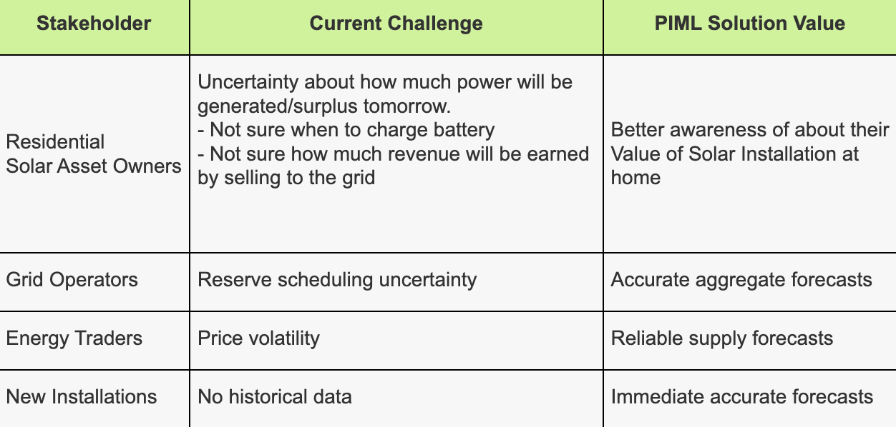
Expected Results & Business Impact
According to research papers and preliminary simulations, replacing time-series based solar forecasting with Physics-informed ML-based solar forecast will lead to:
Forecast Accuracy Improvements Day-ahead RMSE
Intra-hour MAE
Ramp event detection
Unknown panel accuracy
B2C
Computational Efficiency Reduced training time as seasonal features are handled externally
Reduced inference latency
Improved scaling
B2B

Slide 11
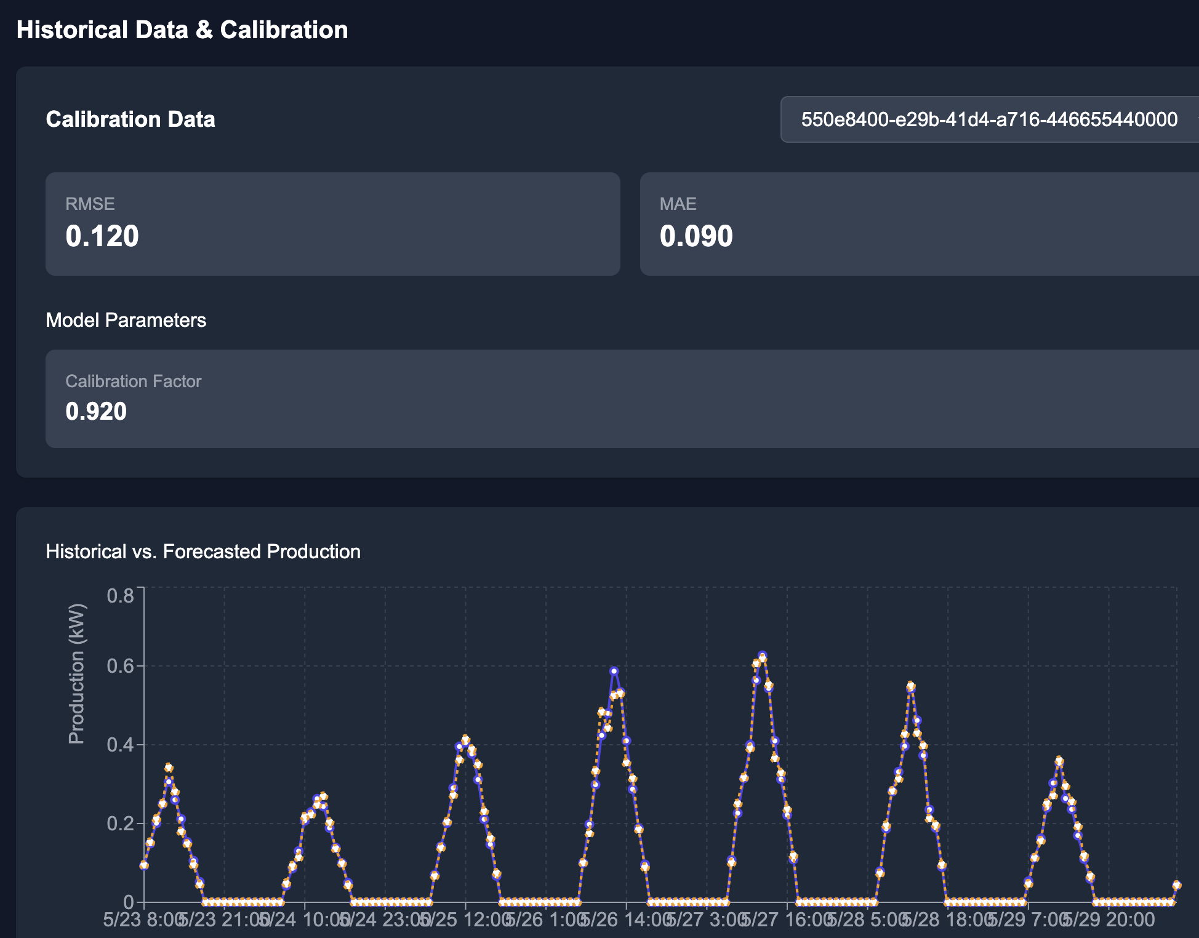
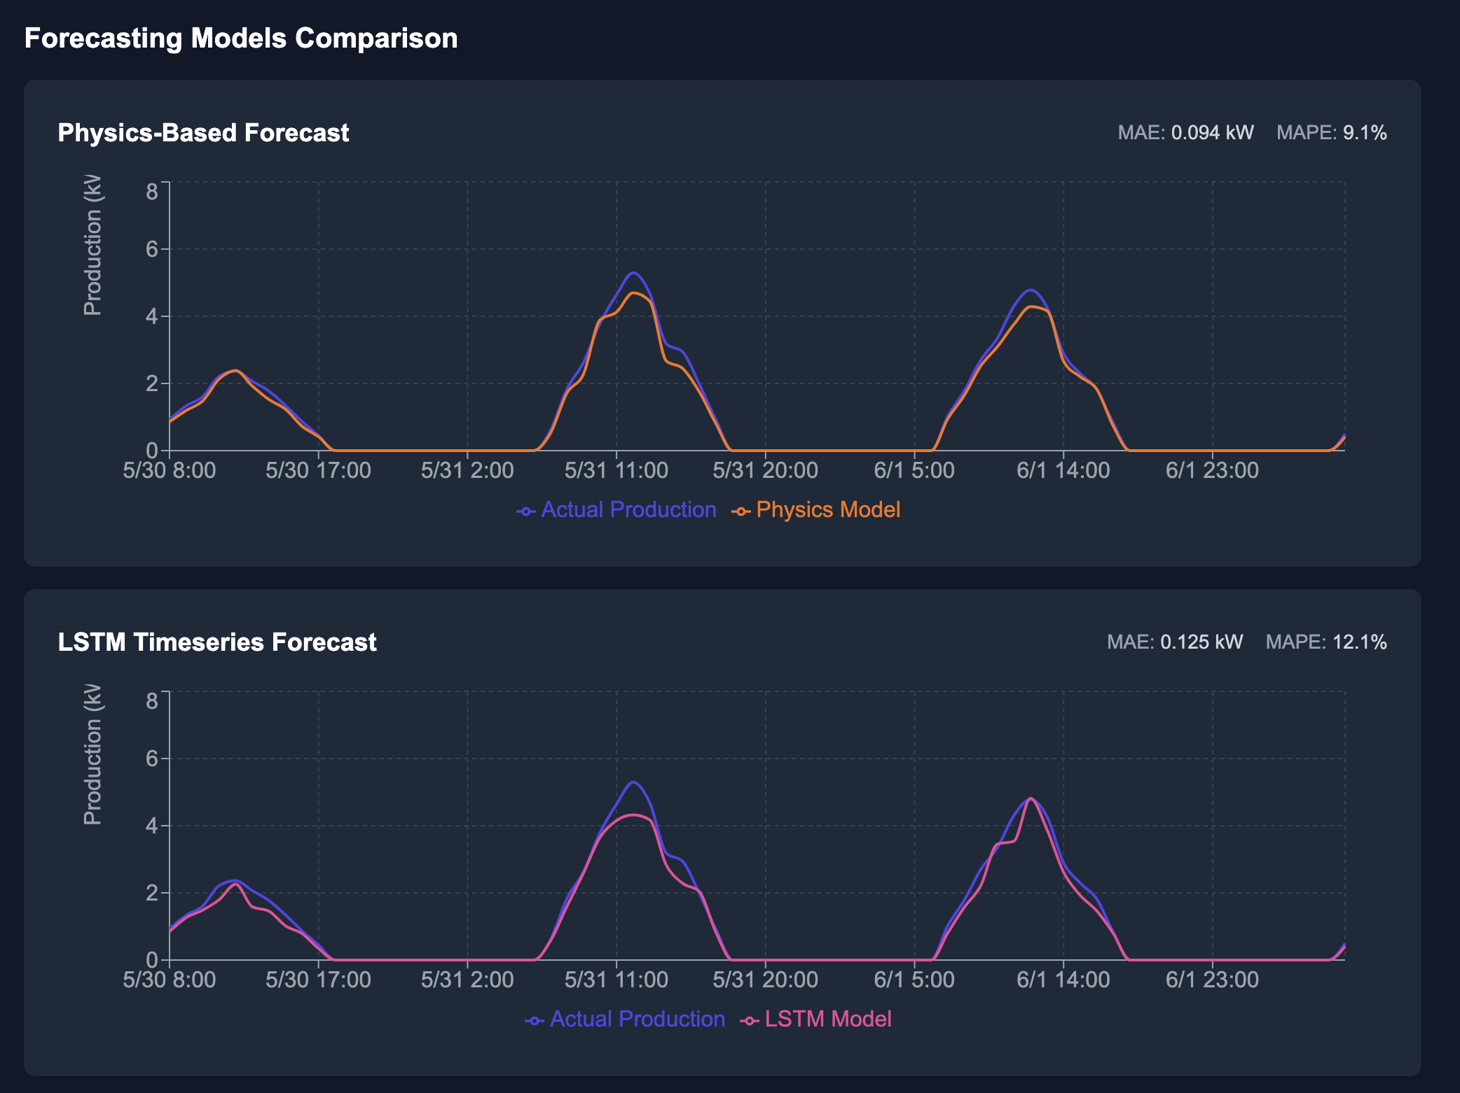
SRI-B has developed a small proof-of-concept tool for PIML

Slide 12
References we used:
[1] W. Liu, Y. Liu, X. Zhou, Y. Xie, Y. Han, S. Yoo, and M. Sengupta, “Use of physics to improve solar forecast: Physics-informed persistence models for simultaneously forecasting GHI, DNI, and DHI,” Solar Energy, vol. 215, pp. 252–265, 2021, Elsevier.
[2] Q. Paletta, Y. Nie, Y.-M. Saint-Drenan, and B. Le Saux, “Improving cross-site generalisability of vision-based solar forecasting models with physics-informed transfer learning,” Energy Conversion and Management, vol. 309, p. 118398, 2024, Elsevier.
[3] W. Liu, Y. Liu, T. Zhang, Y. Han, X. Zhou, Y. Xie, and S. Yoo, “Use of physics to improve solar forecast: Part II, machine learning and model interpretability,” Solar Energy, vol. 244, pp. 362–378, 2022, Elsevier.
[4] T. Han, R. Li, X. Wang, Y. Wang, K. Chen, H. Peng, Z. Gao, N. Wang, and Q. Peng, “Intra-hour solar irradiance forecasting using topology data analysis and physics-driven deep learning,” Renewable Energy, vol. 224, p. 120138, 2024, Elsevier.
[5] R. Johnson, S. F. Boubrahimi, O. Bahri, and S. M. Hamdi, “Physics-informed neural networks for solar wind prediction,” International Conference on Pattern Recognition, pp. 273–286, 2022, Springer.

