Slide 1
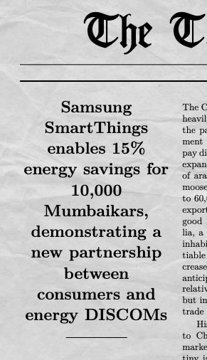
Y25 Focus 1: Bring a FlexConnect-like feature for Indian Markets
January Achievements
In depth understanding of FlexConnect in US
Partners identification - Tata Power (working on NDA)
Landis+Gyr (Smart Meter manufacturers) (still nurturing)
Prathmesh spoke with HS Cho to understand limitation of FLEXCONNECT in US. - Riktesh developed a tool to simulated automated demand response signals according to the actual protocol
Feb Goals:
Finalize POC scope with Tata Power
Get legal work out of the way
Feb RISKS:
Legal team & Business development (Ridhi/Arijit)
Consumer identification (work with Samsung Members)
01
Secure partnership
Strategic partnership with Tata Power secures access to real-time consumer usage data and control systems
02
Test
For 3 households, demonstrate remote—enabling of energy savings mode and AI-energy savings mode based on Utility request
Secure value proposition
03
Validate end-to-end value proposition for Samsung (i.e. energy savings for customers) & Tata Power (automated demand-side management)
Quantify Energy Savings
04
Expand the pilot to atleast 100 homes to statistically quantify benefits
Success
05
Customers report no discomfort AND at least 15% avg energy savings for last 3 months
*Timeline: 2 months for each milestones

Slide 2
Y25 Focus 2: There are 5 BIG steps to build our own carbon trading
01
Regulatory Clarity
Understand the Carbon Trading Scheme. Establish contacts with Grid controller of India (GCI) and BEE.
January work done.
Read through the BEE guidelines on platform creation (some familiarity is there now)
Feb Goals:
- Join (Volunteer) for National Steering Committee for Indian Carbon Market
Feb RISKS:
Need to discuss with a blockchain expert on how to maintain a carbon ledger eligible for trading according to BEE
02
Build the tech infrastructure architecture
Develop a block-chain based model for carbon credits,
Link with Global Standards
03
Standards are outlined by United Nations, to enable deals like “Microsoft buys XXX-million dollars carbon credits from Samsung SmartThings”
Market Quantification
04
We have to quantify atleast how many households need to save how much energy to be eligible for participation
Find POC project
05
Several companies in India (Bosch) is looking for participation in voluntary carbon market as a part of their CSR.

