Slide 1
Data Driven Testing

Slide 2
Data Driven Testing
Software testing method in which test data is stored in table or spreadsheet format.
Run a test case multiple times with different input and validation values.
Also called Table Driven Testing or Parameterized Testing

Slide 3
Data Driven Testing

Slide 4
Parameterization in Selenium
Parameterization in Selenium is a process to parameterize the test scripts in order to pass multiple data to the application at runtime.
It is a strategy of execution which automatically runs test cases multiple times using different values.

Slide 5
Type of Parameterization in TestNG
1. With the help of Parameters annotation and TestNG XML file.
2.With the help of DataProvider annotation.

Slide 6
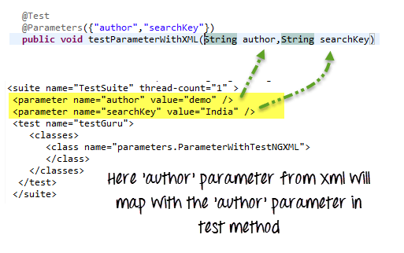
Parameters annotation with Testng.xml

Slide 7
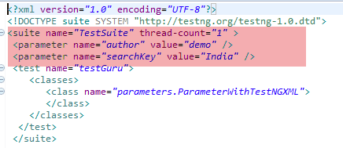
Suite Level Parameters

Slide 8
Test Level Parameters

Slide 9
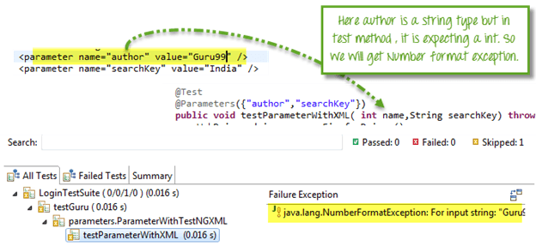
Issue1

Slide 10
Issue2
Your @Parameters do not have a corresponding value in testing.xml.
Solution: Use @optional
@Test
@Parameters(“username”,”password”)
public void loginTest(@optional(“admin”)String userName,String password){
}

Slide 11
Issue3
You want to test multiple values of the same parameter using Testng.xml
Cannot be done using xml
Solution : Dataprovider

Slide 12
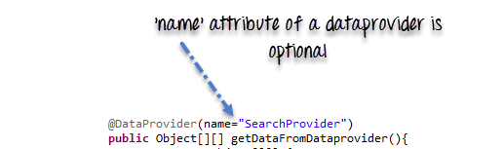
Data Provider in TestNG

Slide 13
Data Provider
Data provider returns a two-dimensional JAVA object to the test method and the test method, will invoke M times in a M*N type of object array.
For example, if the DataProvider returns an array of 2*3 objects, the corresponding testcase will be invoked 2 times with 3 parameters each time.

Slide 14
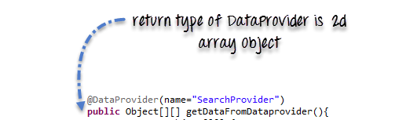
Return Type

Slide 15
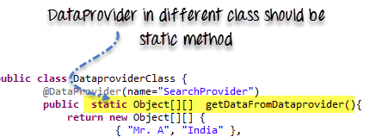

Slide 16
Types of Parameters in Dataprovider
Method- If the SAME DataProvider should behave differently with different test method , use Method parameter.
We check if method name is testMethodA.
If yes return one set of value
Else return another set of value

Slide 17
@DataProvider(name=”mydp”)
public Object[ ][ ] dp(Method m){
if(m.getName().equalsIgnoreCase(“testMethodA”)){
return new Object[ ][ ]{{“a”,”b”},{“c”,”d”}}
}
else{ return new Object[ ][ ]{{“a”},{“b”}
}

Slide 18
Types of Parameters in Dataprovider
ITestContext- It can use to create different parameters for test cases based on groups.
In real-life, you can use ITestContext to vary parameter values based on Test Methods, hosts, configurations of the test.

Slide 19
Summary
Parameterization is require to create Data Driven Testing.
TestNG support two kinds of parameterization, using @Parameter+TestNG.xml and using@DataProvider
In @Parameter+TestNG.xml parameters can be placed in suite level and test level. If
The Same parameter name is declared in both places; test level parameter will get preference over suit level parameter.

Slide 20
Summary
using @Parameter+TestNG.xml only one value can be set at a time, but @DataProvider return an 2d array of Object.
If DataProvider is present in the different class then the class where the test method resides,DataProvider should be static method.
There are two parameters supported by DataProvider are Method and ITestContext.

