Slide 1
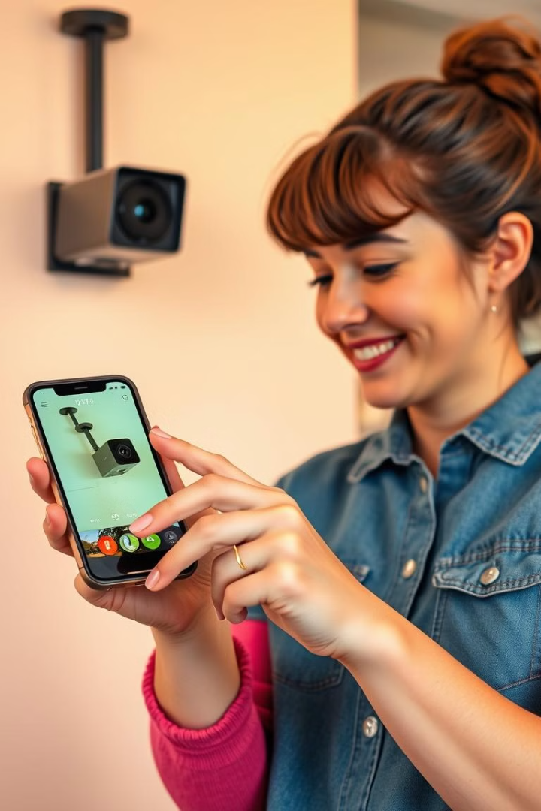
Real-Time Image Streaming from ESP32-CAM to Telegram

Slide 2
TEAM MEMBERS
2310040095 - Sayooj S
2310040076 – Venkat Prasad
2310040132 – Ravi Ratna
2310040089 – Sai Teja

Slide 3
Introduction to ESP32-CAM and IoT Surveillance
ESP32-CAM
IoT Surveillance
The ESP32-CAM is a low-cost microcontroller with built-in Wi-Fi and a camera module, making it ideal for IoT applications. It features a 2MP OV2640 camera sensor and supports deep sleep for low-power operation.
IoT-based surveillance offers flexibility and ease of deployment compared to traditional CCTV systems. It enables real-time access to images and videos from anywhere with internet connectivity.

Slide 4
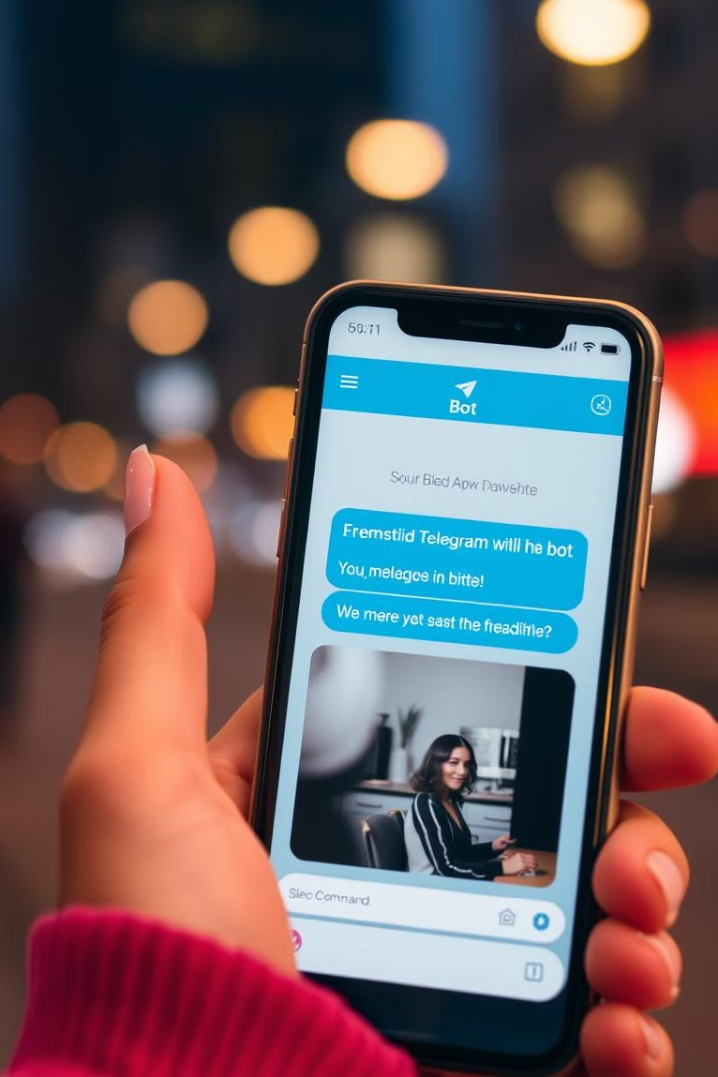
Telegram as an IoT Communication Platform
Telegram is a cloud-based messaging platform that supports bot automation, making it an excellent tool for IoT applications. Telegram bots can handle API-based interactions, enabling the ESP32-CAM to send captured images directly to users.
1
Advantages
Eliminates the need for third-party cloud services and reduces latency in data transmission.
2
Cost-Effective
Offers a cost-effective alternative to traditional surveillance systems.

Slide 5
Implementation of ESP32-CAM with Telegram
Setting Up the Telegram Bot
Users create a bot using BotFather and obtain an API token.
Programming the ESP32-CAM
The microcontroller is programmed to capture images upon receiving Telegram commands.
Image Processing and Transmission
The ESP32-CAM processes and compresses images before sending them via Telegram.
Security Features
The system includes authentication to prevent unauthorized access.

Slide 6
COMPONENTS
- ESP32CAM
- FTDI MODULE
- TELEGRAM ACCOUNT

Slide 7
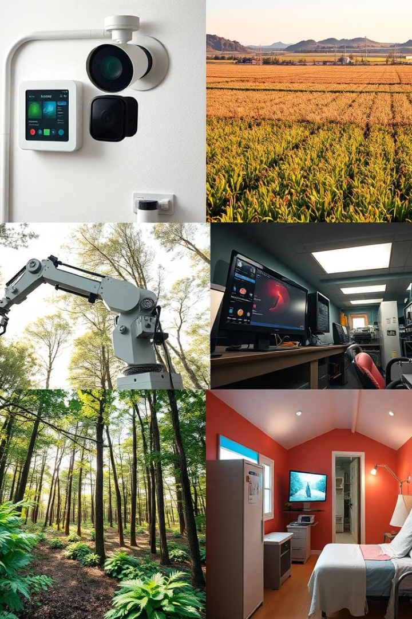
Applications of ESP32-CAM with Telegram
Home Security Monitoring
Users can install the ESP32-CAM at entrances and receive real-time images upon motion detection.
Agriculture and Livestock Monitoring
Farmers can place ESP32-CAM modules in remote fields or livestock areas to monitor crop health or animal activity.
Industrial Surveillance
Factories and warehouses can use the ESP32-CAM to monitor machinery, detect malfunctions, and ensure workplace safety.
Wildlife and Environmental Monitoring
Researchers studying wildlife or environmental changes can deploy ESP32-CAM modules in remote locations.

Slide 8
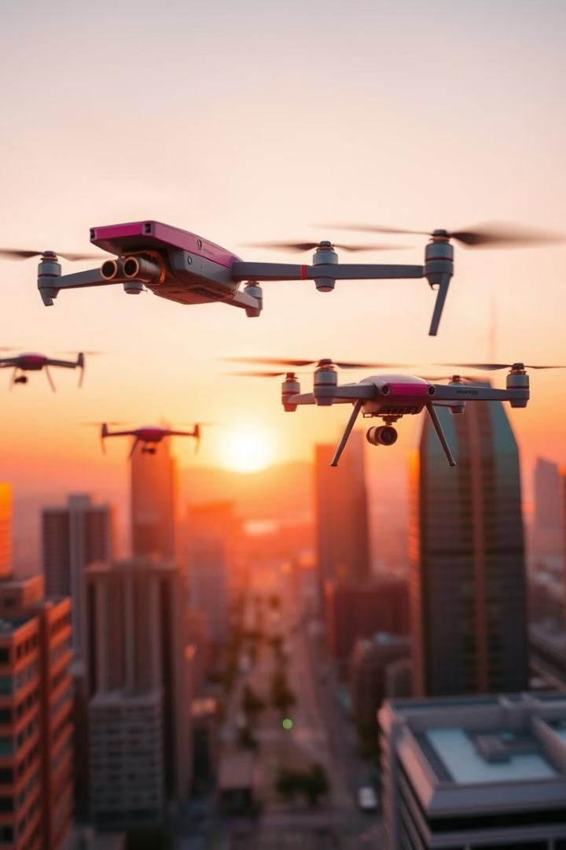




Future Enhancements and Scalability
AI-Based Object Detection
Using machine learning models to detect people, animals, or specific objects in the captured images.
Video Streaming Capabilities
Expanding the project to support live streaming instead of static image capture.
Integration with Cloud Storage
Saving images on cloud platforms for later retrieval.
Battery Optimization
Implementing deep sleep modes to enhance battery life in remote deployments.

Slide 9

Conclusion
This project successfully demonstrated the integration of an ESP32-CAM module with a Telegram chatbot for real-time image streaming. The system offers a cost-effective and flexible solution for remote surveillance and monitoring in various applications.
1
Key Features
2
Future Directions
Real-time image capture and transmission, remote control via Telegram commands, and potential for future enhancements.
Further development can include AI-based object detection, video streaming, cloud storage integration, and battery optimization.

Slide 10
References
The project report draws upon various resources, including academic papers, technical documentation, and online resources. These references provide valuable insights into the ESP32-CAM, Telegram API, and related technologies.
P. Monica, M. A. Kumar, and S. Vemulapalli, "ESP32 CAM-based Car Security System via Telegram Integration," 2023 3rd International Conference on Innovative Mechanisms for Industry Applications (ICIMIA), Bengaluru, India, Dec. 2023, pp. 1-6, doi: 10.1109/ICIMIA60377.2023.10425967.
Espressif Systems, “ESP32-CAM Datasheet,” 2021. \[Online\]. Available: https://www.espressif.com/en/products/socs/esp32
Telegram API Documentation, “Telegram Bot API,” 2024. \[Online\]. Available: https://core.telegram.org/bots/api
.

