Slide 1
Real-Time Image Streaming from ESP32-CAM Module to Telegram Chatbot
By: Sayooj
Venkat Prasad
Ravi Ratna
Sai Teja

Slide 2
Abstract
This project presents a system for real-time image streaming using the ESP32-CAM module to a Telegram chatbot, enabling remote surveillance and smart monitoring.

Slide 3
Introduction – Part 1
The Internet of Things (IoT) has revolutionized various domains, from smart homes to industrial automation. One of the significant applications of IoT is remote surveillance and monitoring. The ESP32-CAM, a low-cost microcontroller with built-in Wi-Fi and a camera module, provides an efficient solution for capturing images and transmitting them over the internet. By integrating the ESP32-CAM with Telegram, a widely used messaging platform, users can request and receive real-time images from any location.
This project focuses on building a system that allows users to interact with an ESP32-CAM module through a Telegram bot. Users can send predefined commands such as /photo to capture an image and receive it instantly via Telegram. Additionally, the system can incorporate motion detection and notification features to enhance security applications.
This project focuses on implementing real-time image streaming from the ESP32-CAM module directly to a Telegram chatbot. The goal is to create a smart, mobile-controlled surveillance system capable of responding to commands and sending live images to a user's chat window with minimal latency.

Slide 4
Literature Survey – Overview
The ESP32-CAM is an advanced microcontroller-based camera module developed by Espressif Systems. It features a 2MP OV2640 camera sensor, built-in Wi-Fi, and support for deep sleep, making it an ideal choice for low-power IoT applications. IoT-based surveillance has gained popularity due to its flexibility and ease of deployment. Unlike traditional CCTV systems, IoT-based surveillance enables real-time access to images and videos from anywhere with internet connectivity.

Slide 5
Existing System
Traditional surveillance methods use wired CCTV cameras and DVR/NVR systems for storage and retrieval. However, these systems have several limitations:
- High Cost: Traditional surveillance setups require expensive infrastructure, including storage and cabling.
- Limited Accessibility: Users must be physically present or use proprietary software to access footage.
- Power Consumption: Continuous video streaming leads to high power consumption.
- Storage Dependency: Local storage can run out, requiring additional management.
To overcome these limitations, wireless, low-power, and cloud-integrated systems like ESP32-CAM with Telegram offer an efficient alternative.

Slide 6
Proposed System
While the current implementation focuses on image capture and transmission, future enhancements can include:
- AI-Based Object Detection: Using machine learning models to detect people, animals, or specific objects in the captured images.
- Video Streaming Capabilities: Expanding the project to support live streaming instead of static image capture.
- Integration with Cloud Storage: Saving images on cloud platforms for later retrieval.
- Battery Optimization: Implementing deep sleep modes to enhance battery life in remote deployments.

Slide 7
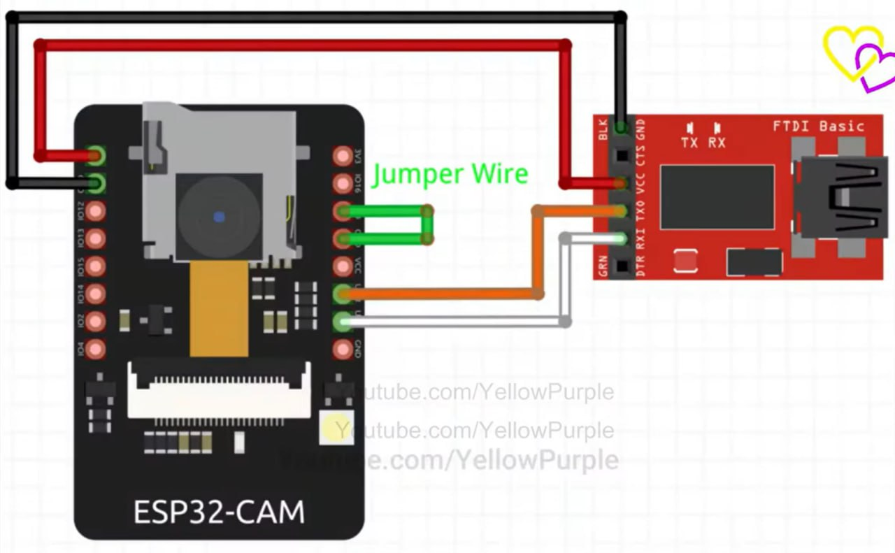
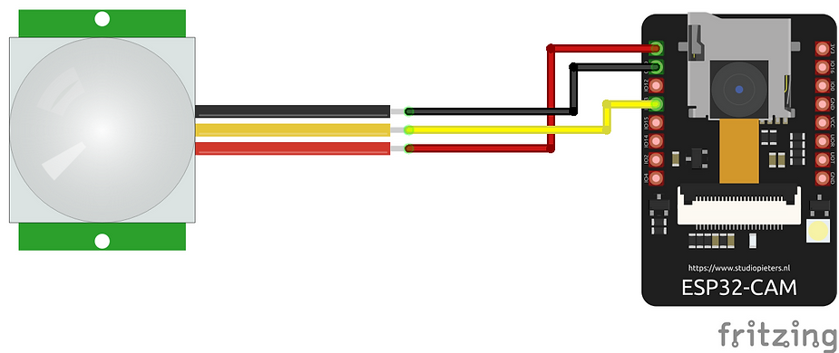
Block Diagram

Slide 8
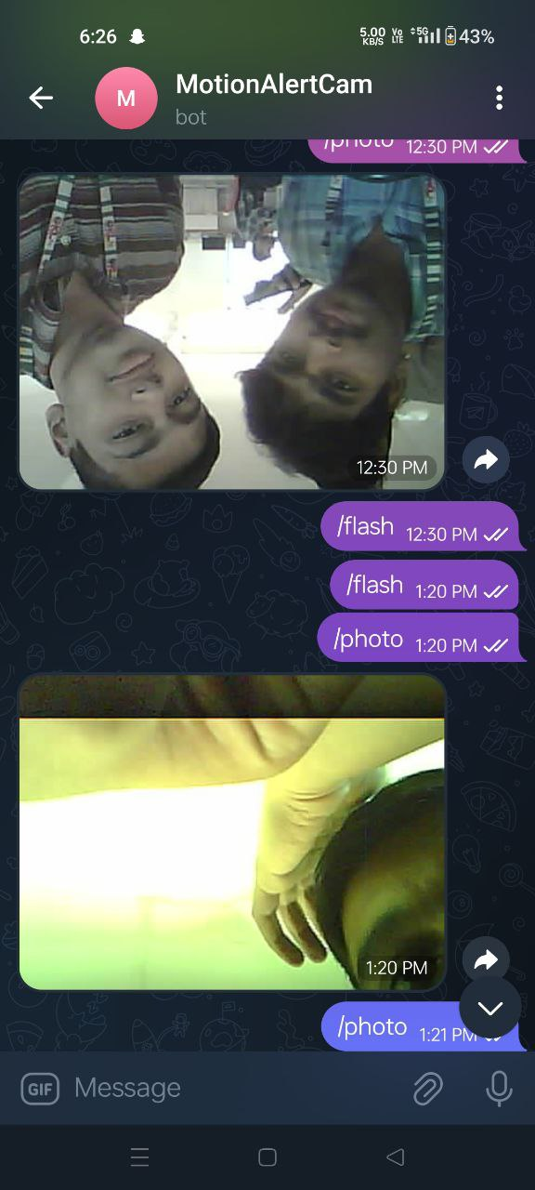
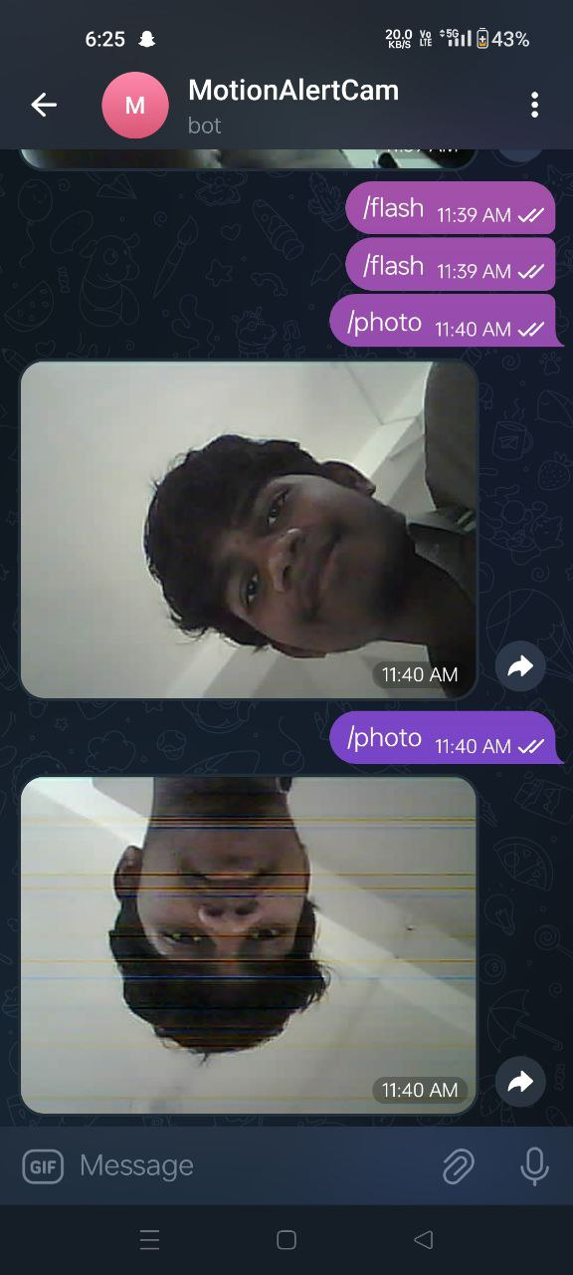
Working of the System

Slide 9
Hardware Requirements
1. ESP32-CAM Module
2. FTDI Programmer
3. Jumper Wires
4. Breadboard
5. Power Supply

Slide 10
Software Requirements
1. Arduino IDE
2. Telegram Bot API
3. ESP32 Board Package
4. Serial Monitor

Slide 11
Modules of the System
1. Image Capture Module
2. Telegram Bot Handler
3. Network Communication Module

Slide 12
Results
The ESP32-CAM module was successfully configured to capture real-time images and transmit them to a Telegram chatbot via the Telegram Bot API. The integration of a PIR motion sensor enabled the system to automatically detect movement and send captured images to the user without manual intervention.
The Telegram bot responded accurately to commands such as /photo, instantly triggering the ESP32-CAM to capture and deliver images to the user’s Telegram account. The system operated over Wi-Fi using HTTPS, ensuring a secure and reliable communication channel.
Observed Outputs:
Upon motion detection, an image was instantly sent to the Telegram chat.
Users could manually request a photo using /photo, receiving an image within seconds.
The system was responsive, stable, and provided high-quality images (in JPEG format).
Power consumption remained low, making it suitable for long-term deployment.
The ESP32-CAM handled multiple image requests without system crashes or memory issues.

Slide 13
Result Analysis
Latency of image delivery is <2 seconds. Accuracy and connectivity were consistent during trials.

Slide 14
Advantages & Applications
Advantages: Low cost, real-time access, no external storage.
Applications: Home Security, Wildlife Monitoring, Baby Monitoring.

Slide 15
Conclusion
The project successfully implemented real-time image transmission to Telegram using ESP32-CAM.

Slide 16
Future Work
Future enhancements could include video streaming, AI-based motion detection, and cloud storage.

