Slide 1

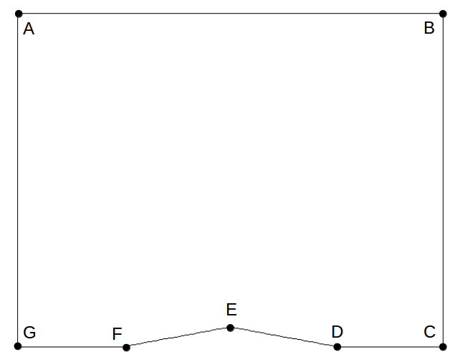
A
B
E
G
F
D
C

Slide 2
Read input data / Initialized arrays
Read grid points
Calculate grid metrics
Set initial conditions
Set boundary conditions
CALL AUSMPW+
Set time step (dt)
Set F’ at 1/2 points in i-direction
Set time integration (t = t + dt)
Set G’ at 1/2 points in j-direction
Check convergence with error limit
Integrate U vector w/ flux terms
Write result files out

Slide 3
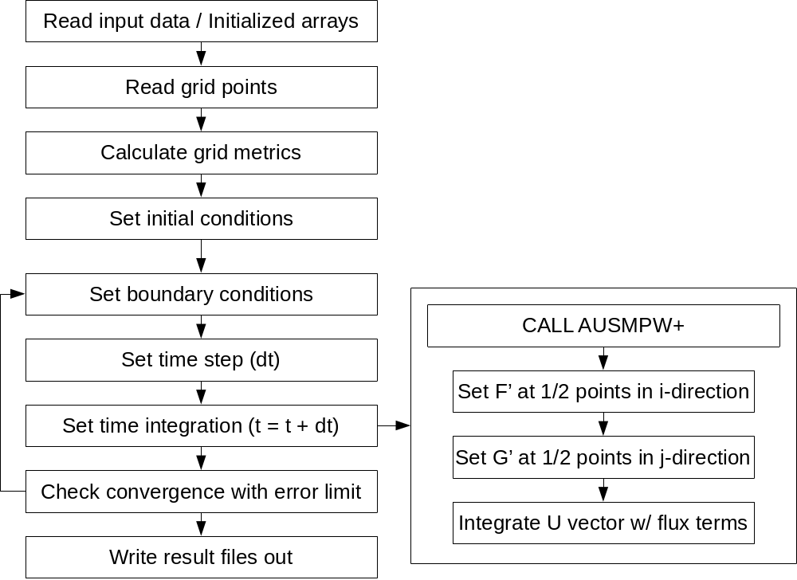
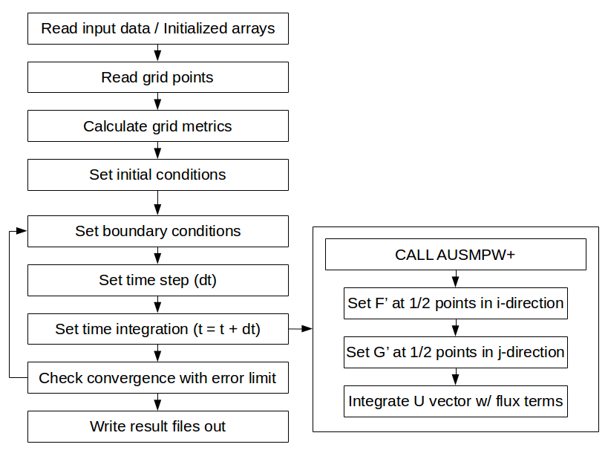

Slide 4
