Slide 1

Views and Layouts
GA Sample Lesson by Sathish kumar Somasundaram

Slide 2
Good to know…
Class
Object
Class hierarchy
Polymorphism

Slide 3
View
A view occupies a rectangular area on the screen and is responsible for drawing and event handling.
Why is it important?
With possible exception of streaming audio apps everything is done in UI.
Notes:
Believe it or not, you guys used views last using knowing it

Slide 4
Layout
Layout is a invisible container that hold other views (or other viewgroups).

Slide 5
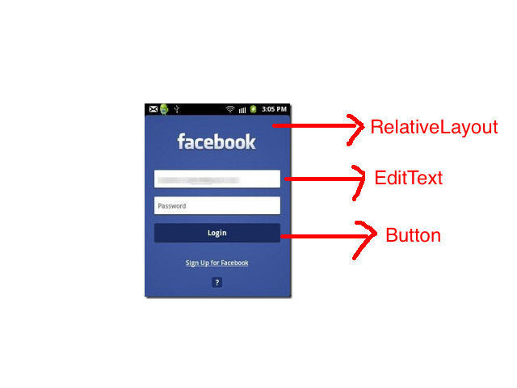
View and Viewgroup (Cont.)

Slide 6
View and Viewgroup (Cont.)

Slide 7
View is not
View is not a ViewGroup. But, a ViewGroup consists of views.
View is not an Activity. A View or ViewGroup is a part of Activity.

Slide 8
Relationship
Notes:
View is the base class for widgets, which are used to create interactive UI components (Buttons, text Fields etc.)
Viewgroup subclass is the base class for layouts which are invisible containers that hold other views (or other viewgroups).

Slide 9
Layout (cont.)
Each layout file must contain exactly one root element which must be a View or ViewGroup.
Notes:
Once you have defined the root element you can add additional layout objects or widgets as child elements to gradually build view hierarchy that defines your layout.

Slide 10
Layout (cont.)
LinearLayout
RelativeLayout
FrameLayout
AbsoluteLayout
TableLayout
Percent Layout (introduced in Android Marshmallow)

Slide 11
Layout (cont.)
LinearLayout
RelativeLayout
FrameLayout
AbsoluteLayout
TableLayout
Percent Layout (introduced in Android Marshmallow)

Slide 12
Layout (cont.)
Layout Designer
Layout XML Editor
Programmatically

Slide 13
Layout (cont.)
GUI Editor
Layout XML editor
Programmatically

Slide 14
LIVE DEMO

Slide 15
Learning Outcomes
View, ViewGroup and how its relates
Layout and root view.
LinearLayout and RelativeLayout.

Slide 16
Next class topics
Activity
More layouts

Slide 17

Questions?
Sathish kumar Somasundaram, 1/8/16

