Slide 1

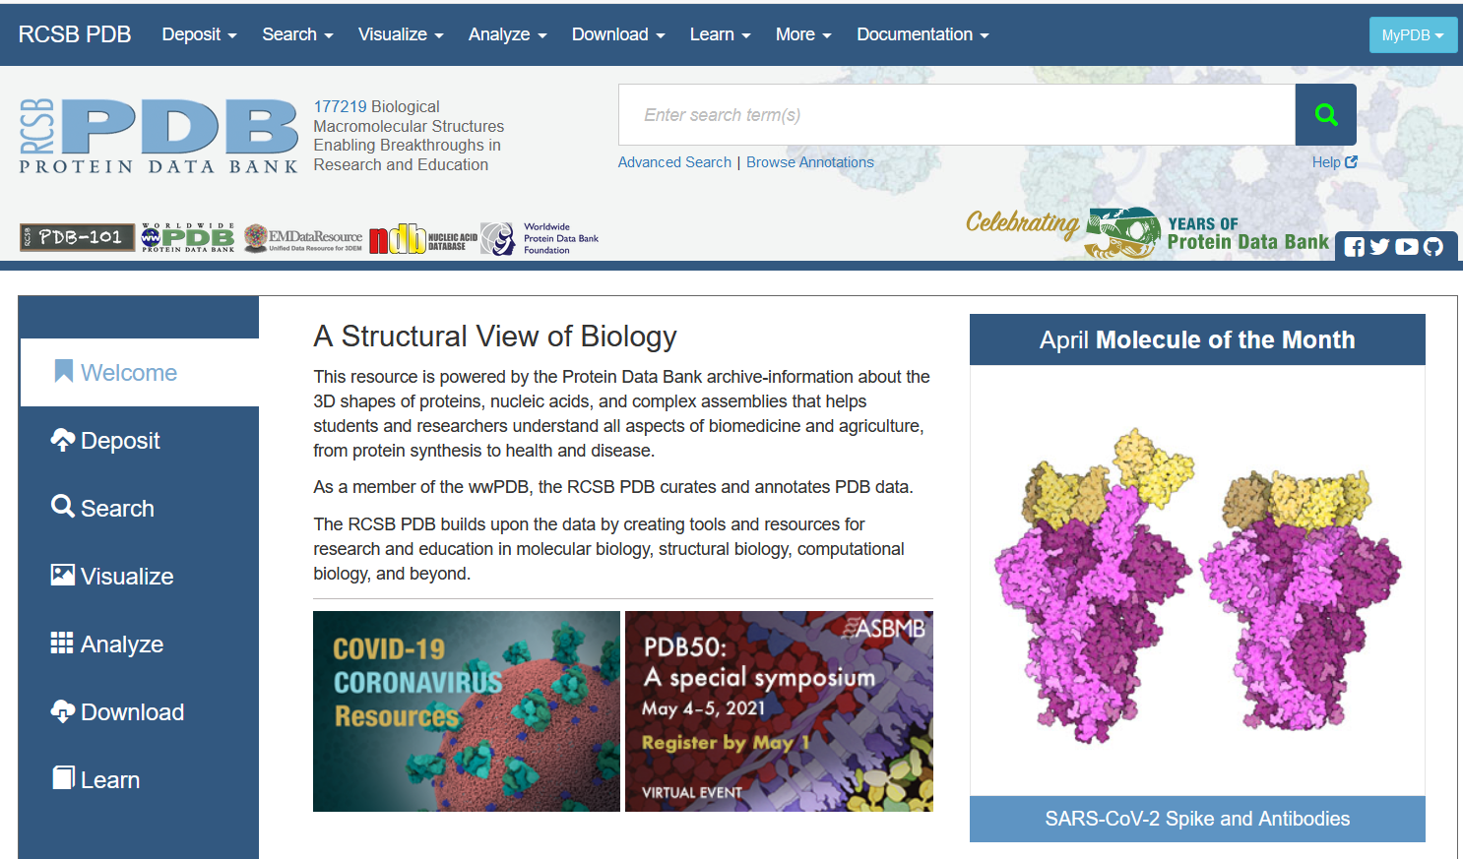
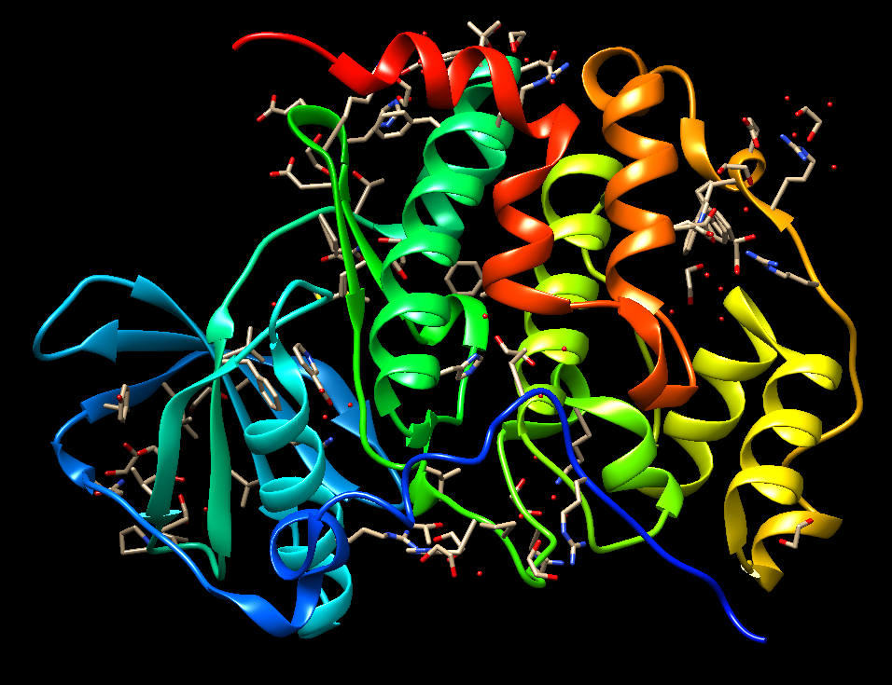
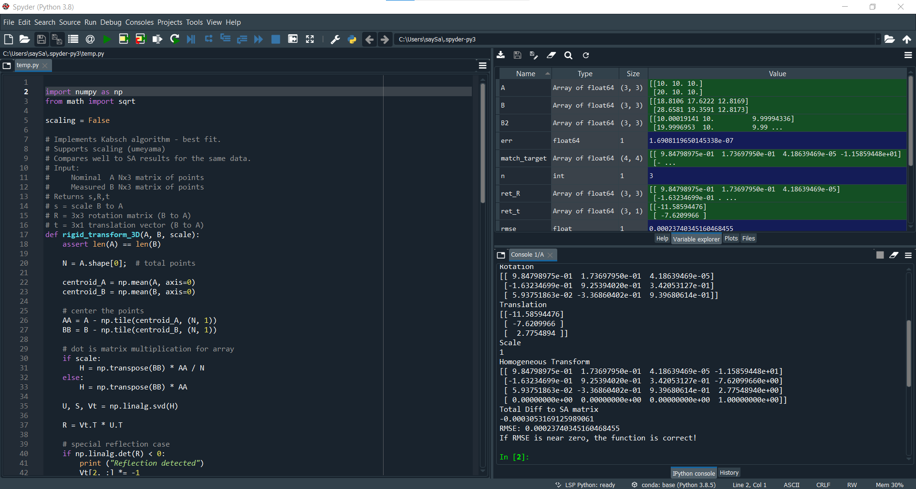
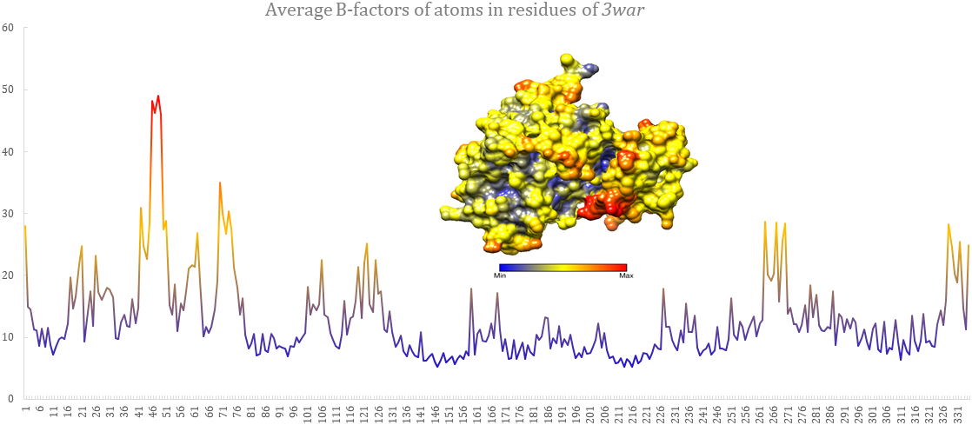
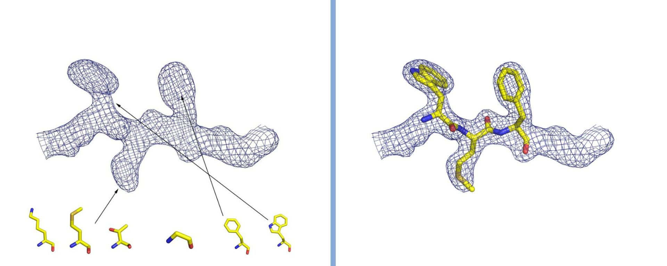
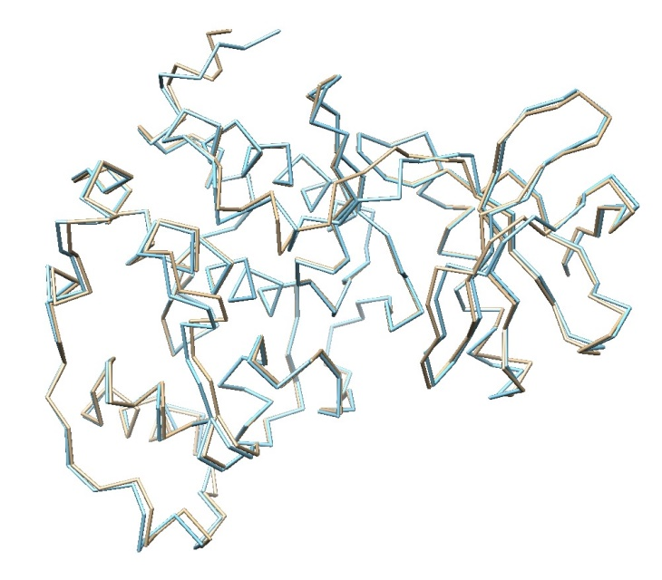

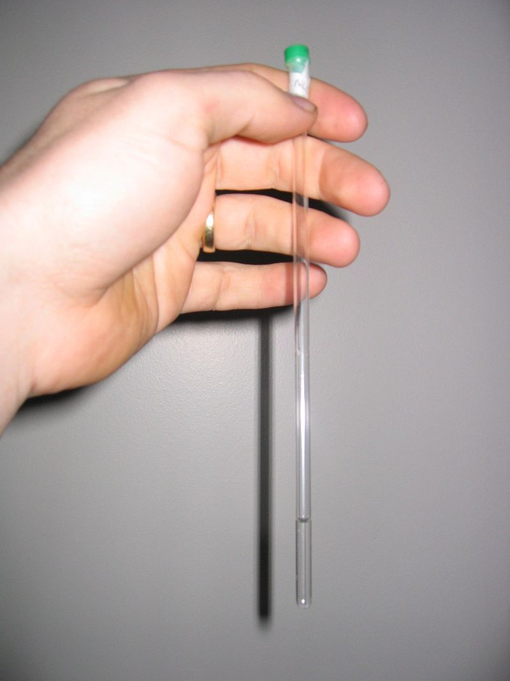
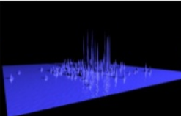
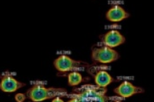
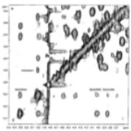
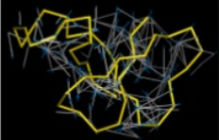
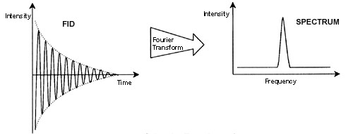



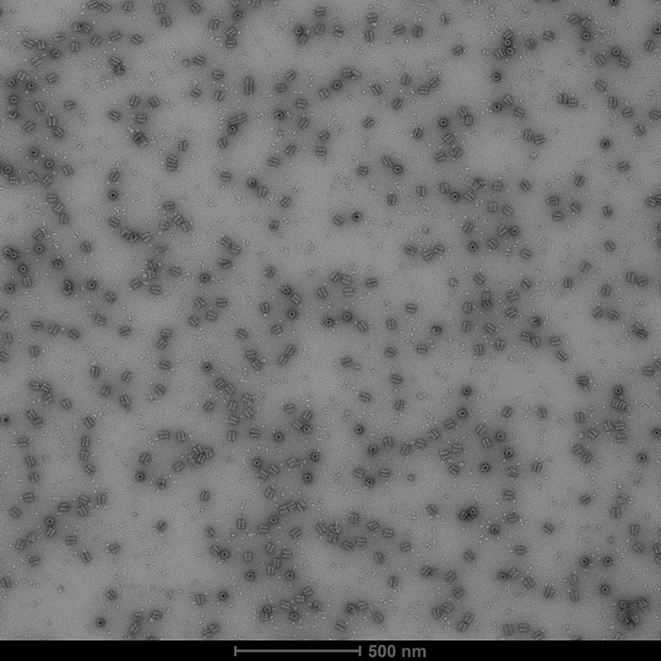
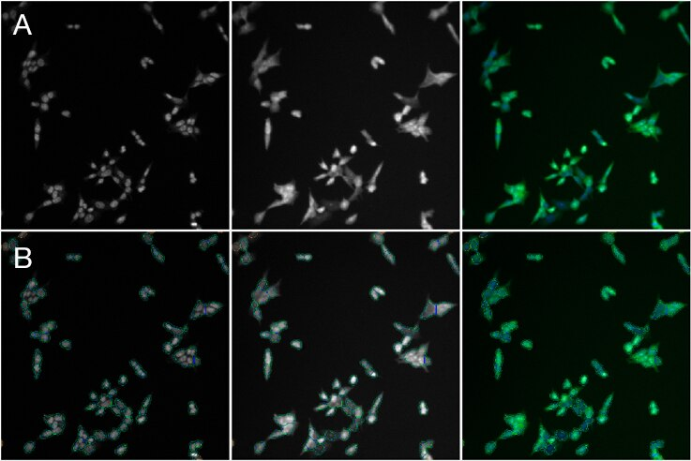
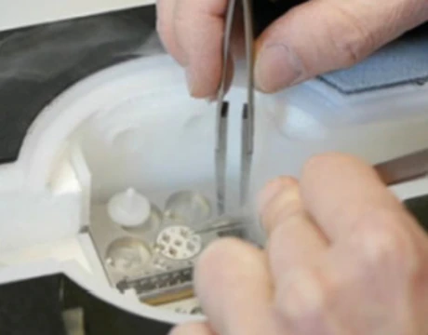
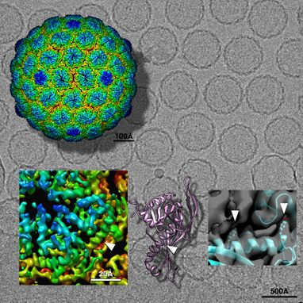
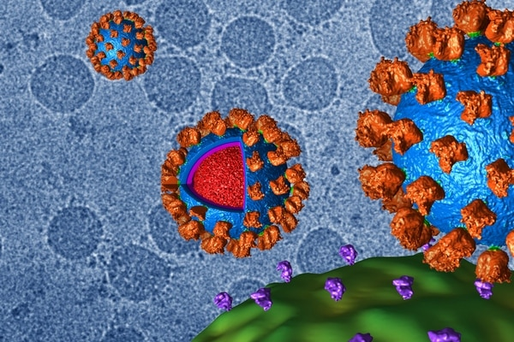

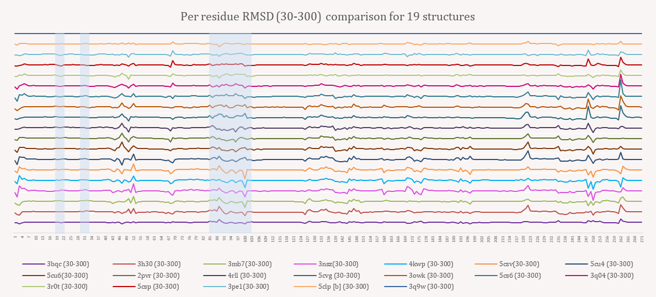
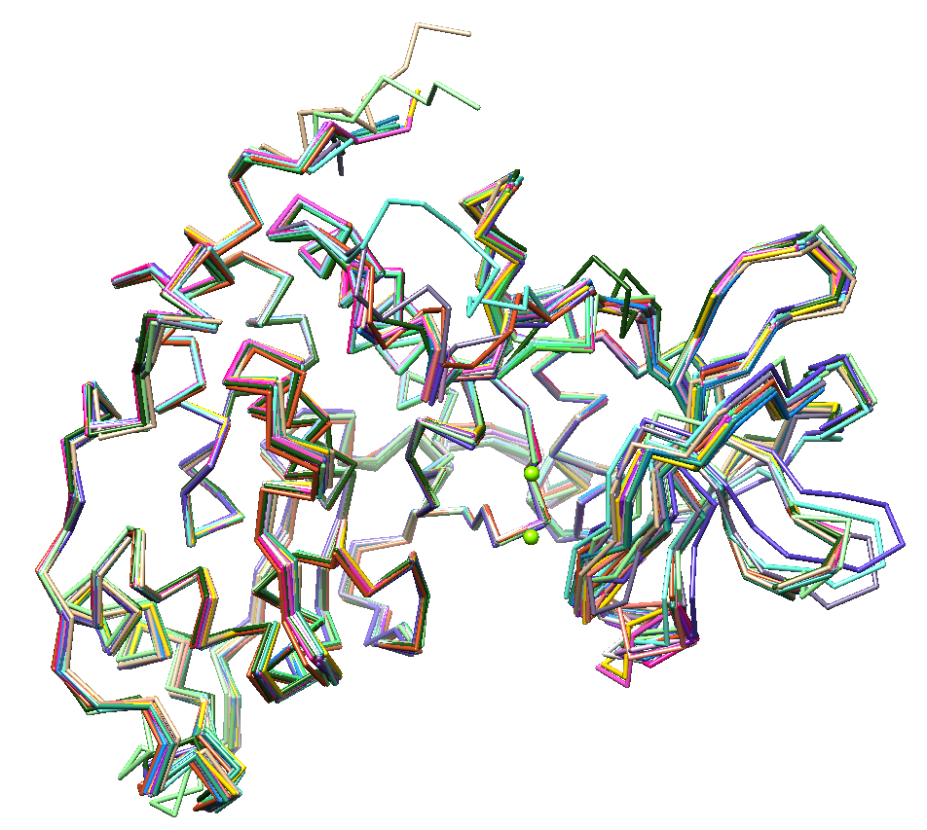
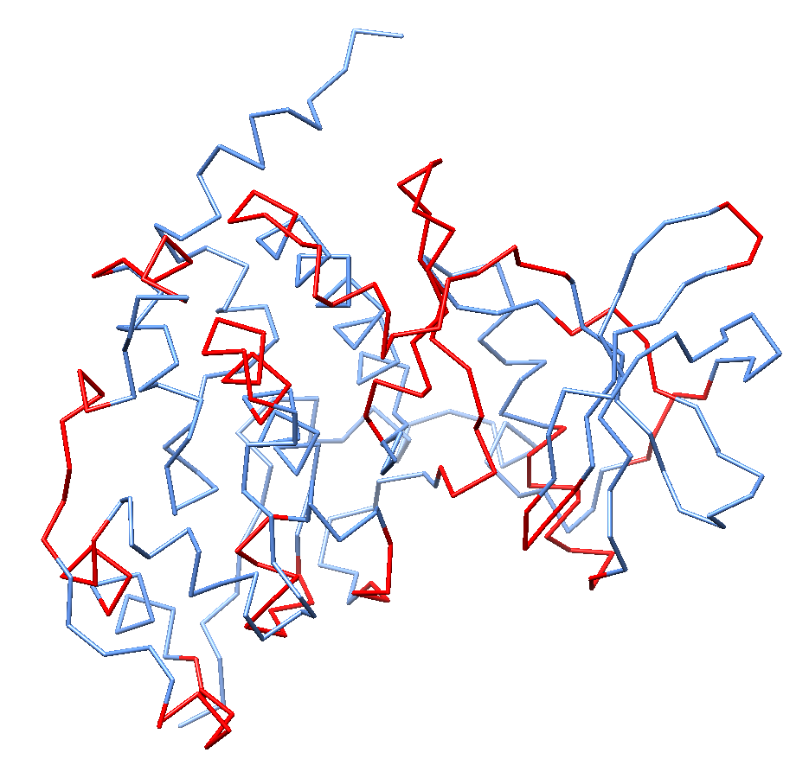
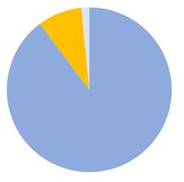
Computational Investigation of Protein Structures
Sayantoni Chaudhuri, IN791, Supervised by: Dr. Ashutosh Srivastava, Department of Biological Engineering, IIT-Gandhinagar
Introduction
5. Going 3D: Biopython and BioPDB module
6. Structural Analysis: Per Residue RMSD
7. Average B-Factor of atoms in each residues
Motivation
1. X-Ray crystallography (XRC)
Obtain crystals: “Protein Crystallization”
Diffraction experiment; obtain a diffraction pattern
Data fitting to analyze the electron density distribution
Build a model of atomic arrangement of the crystal
2. Nuclear Magnetic Resonance (NMR)
Sample preparation
Data acquisition and Spectral Processing
Structural analysis
3. Cryo-Electron Microscopy (Cryo-EM)
Negative-Stain EM Screening
Biochemical sample preparation
Sample vitrification, screening and data acquisition
3D reconstruction
Each technology has its own advantages.
Protein Data bank which is a repository of solved
structures of biomolecules use these experimental
techniques.
The three-dimensional structure of proteins and protein complexes provide great insights into the mechanism of diseases, and thereby allowing rational design of novel diagnostic and therapeutic agents.
Create structure objects from PDB files | Navigate throuh a structure object | Extract information
Objectives
Protein structure determination: XRD, NMR, Cryo-EM
The PDB and the PDB file format
Biopython and the BioPDB module
Structural analysis of 20 human CK2a proteins
Superimposition of backbones | Reference: 3war, Sample: x
Materials & Methods
Noises from lattice disorder, crystal packing effects, and type of structure refinementmay lead to a discrepancy between B-factors and the root-mean-squarefluctuations of the atoms (RMSD).
Results & Discussion
PDB Structures used: 3bqc, 3h30, 3mb7, 3nsz, 3pe1, 3war, 4kwp, 5csv, 5cu4, 5cu6, 2pvr, 5clp, 5csp, 5cvg, 3r0t, 3q9w, 3q04, 5cs6, 3owk, 4rll
From Left: Lineplots of (1) Avg. B-Factors of atoms in residues of 3war (1.04 A) (2) Avg. B-Factor comparison among CK11a solved at diff. resolutions. (3) Avg. B-Factor comparison among CK11a structures bound with different ligands (Compounds 3,5,6,10)
References
1. Srivastava, Ashutosh, et al. "Conformational dynamics of human protein kinase CK2α and its effect on function and inhibition." Proteins: Structure, Function, and Bioinformatics 86.3 (2018): 344-353.
2. Cock, Peter JA, et al. "Biopython: freely available Python tools for computational molecular biology and bioinformatics." Bioinformatics 25.11 (2009): 1422-1423.
3. Pettersen, Eric F., et al. "UCSF Chimera—a visualization system for exploratory research and analysis." Journal of computational chemistry 25.13 (2004): 1605-1612.
SC-XDR
NMR
Cryo-EM
4. File Formats:
PDB mmCIF PDBML
Regions of variability in samples with respect to reference (3war)

