Slide 1
Finance Project
P106 Group 3
1

Slide 2
Done by
Manali Nazare
Parimala Meligiri
Sayuj S Nair
Vamshi Krishna Golla
Nikhil Shivakumar Rajput
Shyam Sundar V D
Aishwarya Dharmadhikari

Slide 3

Context
LendingClub is a financial services company headquartered in San Francisco, California. It was the first peer-to-peer lender to register its offerings as securities with the Securities and Exchange Commission (SEC), and to offer loan trading on a secondary market
The following presentation is a study on the 2007-2011 loan applications and their split of payment history
To analyze the risk when investing in certain loan applications

Slide 4
KPI 1
1
Year Wise Loan Amount
Loan Amount is the amount applied by the borrower, not necessarily the amount received by them
Data from 2007 - 2011

Slide 5
Loan Amount increased 100x by 2011
Started from 2 Million in 2007 and went all the way up to 234 Million by 2011
Can be attributed partly to the increase in popularity of the enterprise

Slide 6

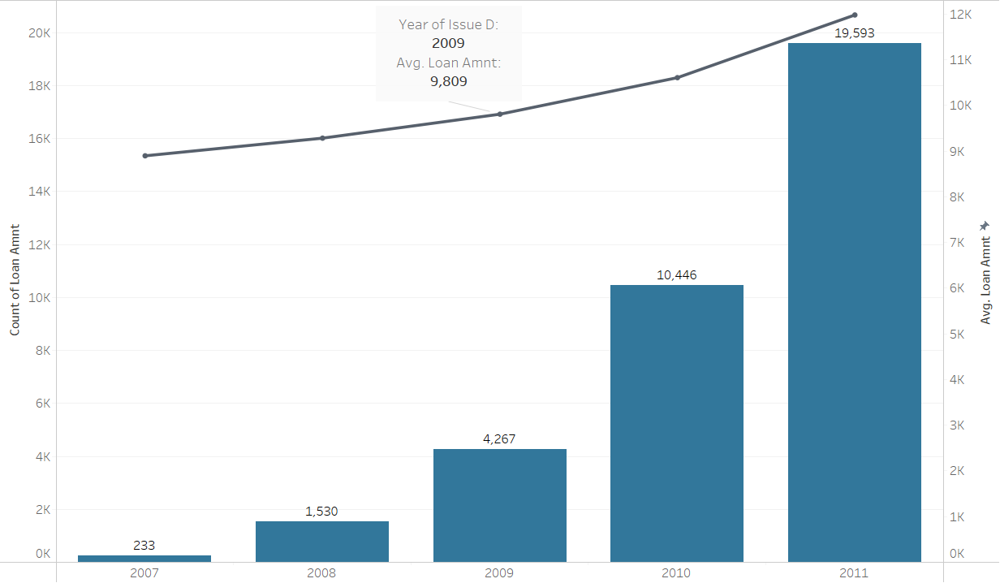
Reason : Number of Loan Applications
Exponential increase from 233 in 2007 to 19,539 in 2011 for Number of Applications
Average Loan Amount being applied for had a slight increase. But not enough to justify the increase in Total Loan Amount $8,800 – $11,900

Slide 7
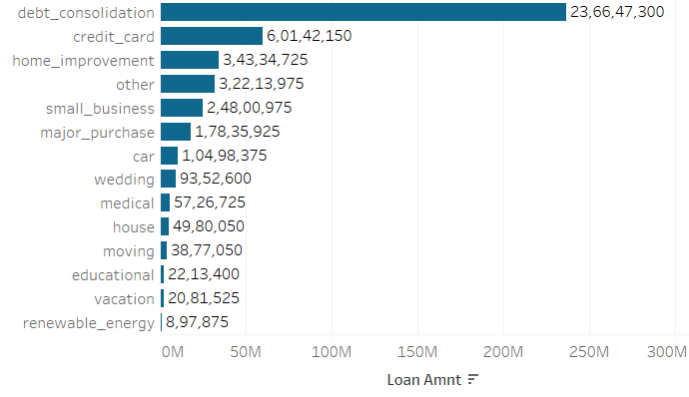
Split of Loan Amount by Purpose
Most Loan Amounts go for Purposes like :
Debt Consolidation
Credit Card Settlement
Home Improvement

Slide 8
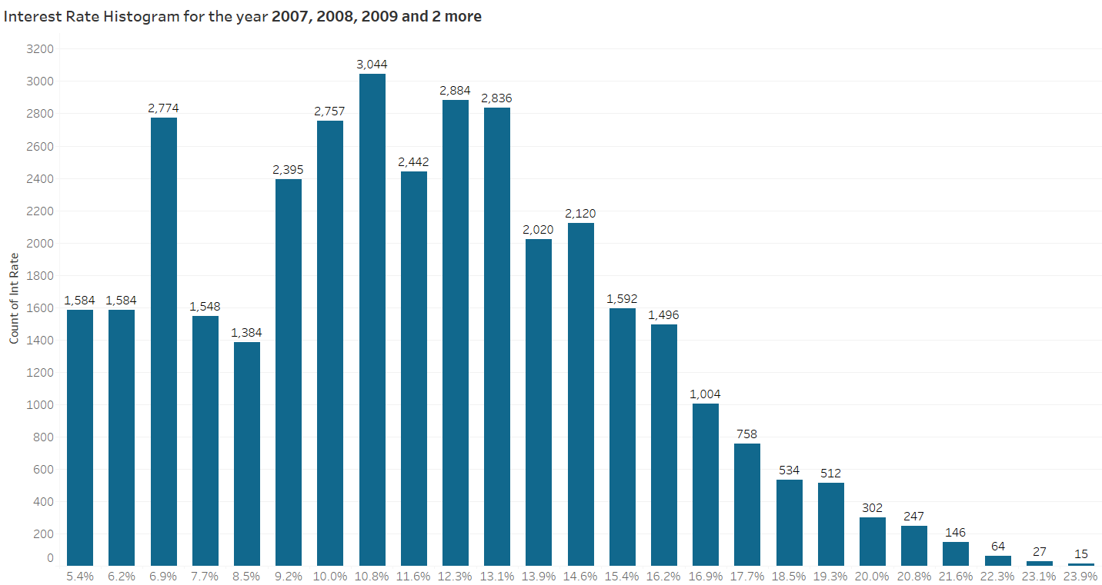
Split of Loan Amount by Interest
Most number of loans were at 9% - 14% with the data being right skewed
A disproportionally high number of loans were given at 6.9%
Higher the interest rate the better for the investor

Slide 9
KPI 2
2
Grade and Subgrade wise Revolving Balance
The revolving balance is the amount of debt that a borrower owes on their revolving credit accounts, such as credit cards.
The grade and subgrade of a loan are indicators of the creditworthiness of the borrower, with higher grades and subgrades indicating lower credit risk.

Slide 10


Borrowers in Higher Grades are a Safer Investment Option
Credit Worthiness of the average person decreases as Grades go from A to G
Becomes Riskier to invest in someone from Grade E and below

Slide 11
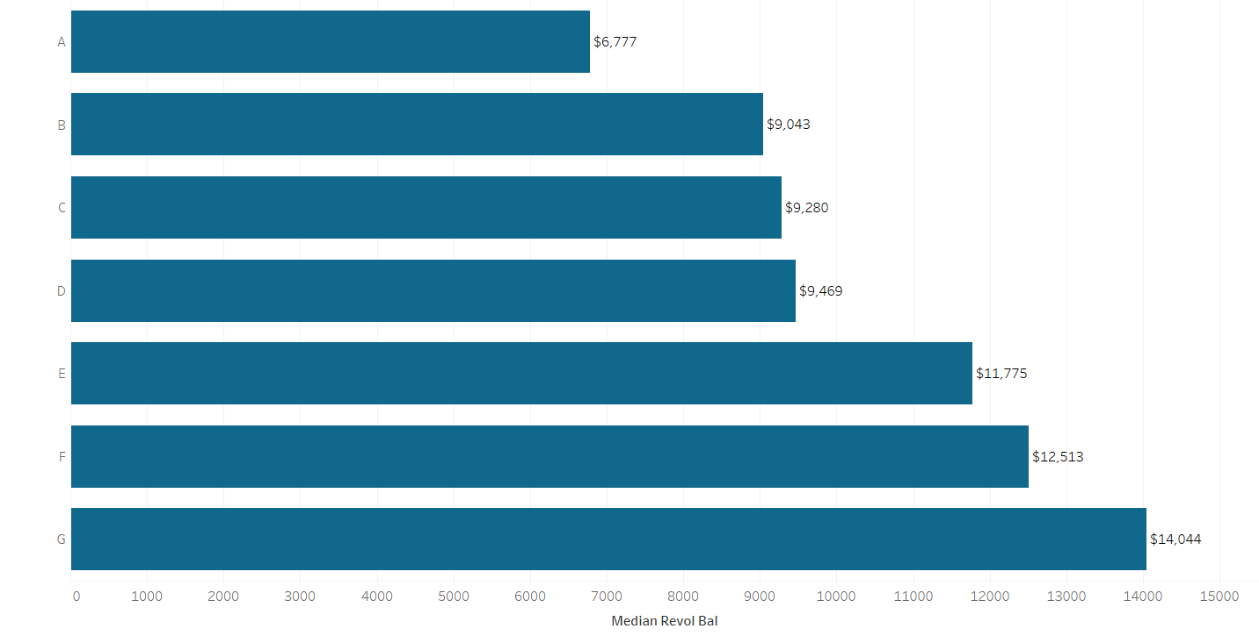
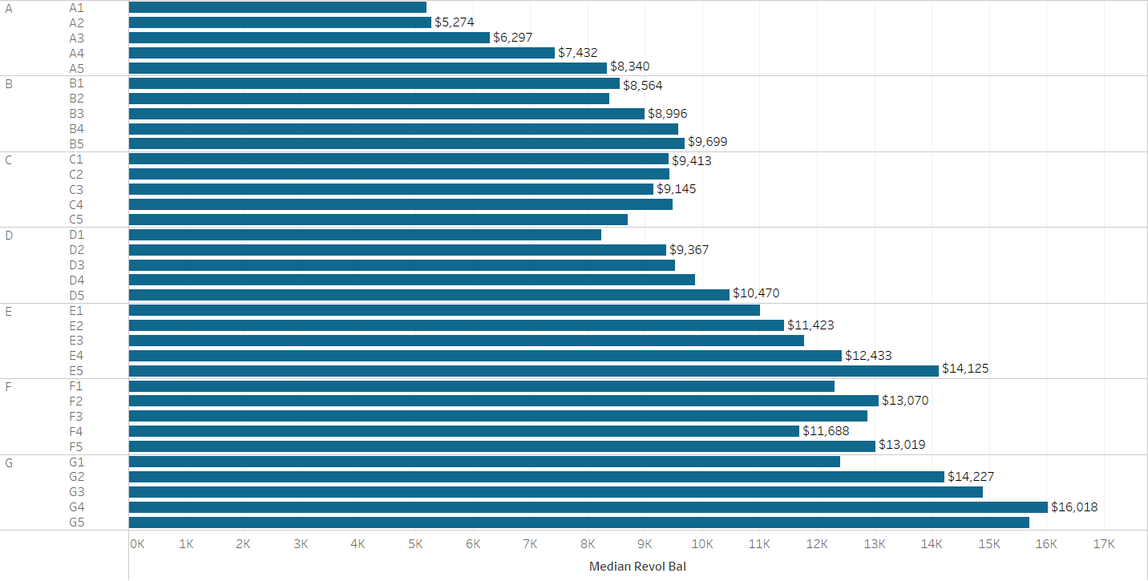
Reason : Revolving Balance Increase
The average Person from Higher Grades has Higher Revolving Balance
Possible indication of Poor Credit Handling
Best to invest in borrowers with higher Grades as this carries less risk

Slide 12
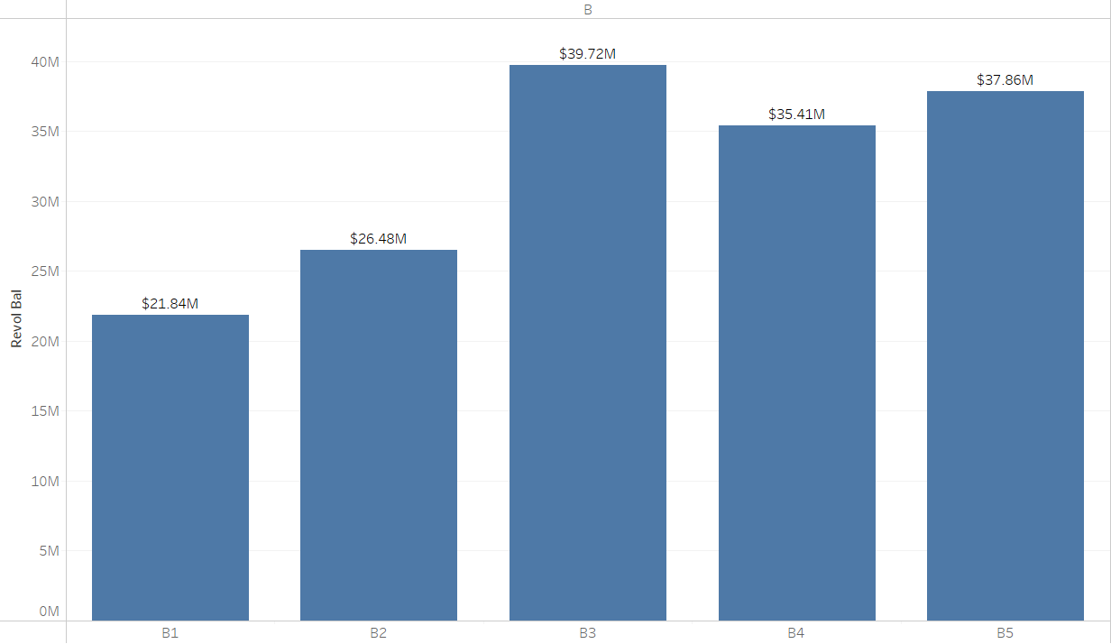
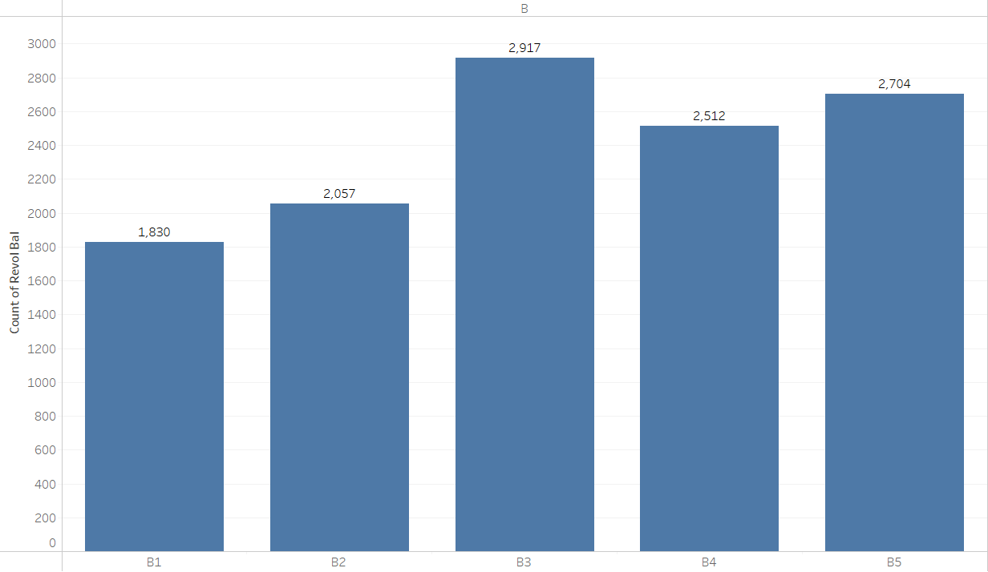
Stats of Grade B
Most Applications from Grade B
Most Total Revolving Balance therefore in Grade B

Slide 13
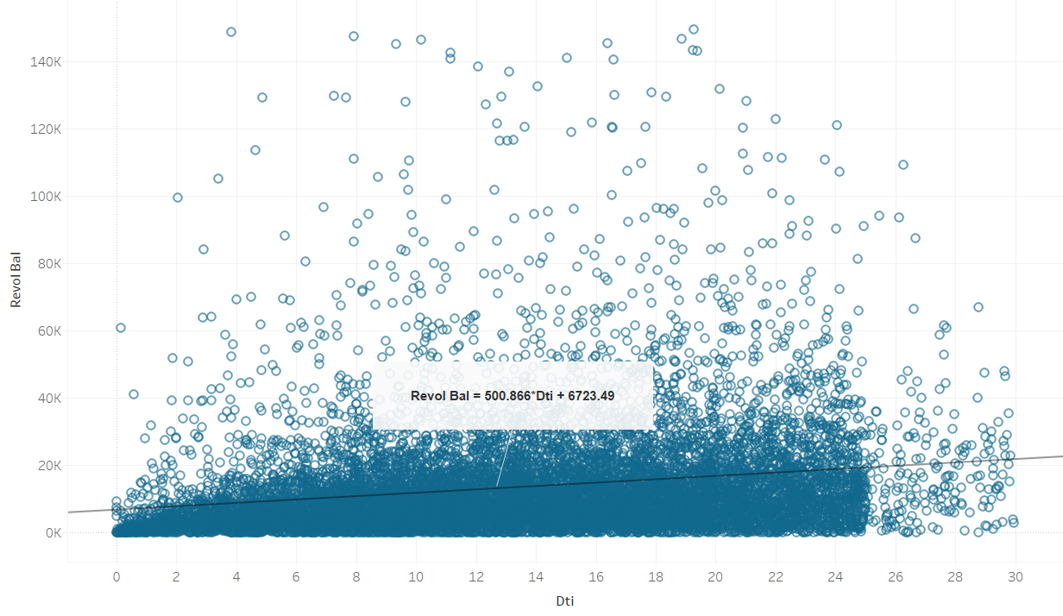
Revolving Balance and DTI
Debt to Income Ratio increases with the increase in Revolving Balance
Revolving Balance is a good indication of Credit Worthiness

Slide 14
KPI 3
3
Total Payment for Verified Vs Non Verified Status
Total Payment is the total amount of payments made by the borrower on their loan, including both principal and interest.
Verification Status is the level of verification of the borrower's income and employment information at the time of the loan application.

Slide 15
Verified Borrowers are more likely to pay back the Loan
Roughly a ~10% difference, but not too significant
Verified Borrowers have higher Total Payment when compared to Non Verified Borrowers

Slide 16
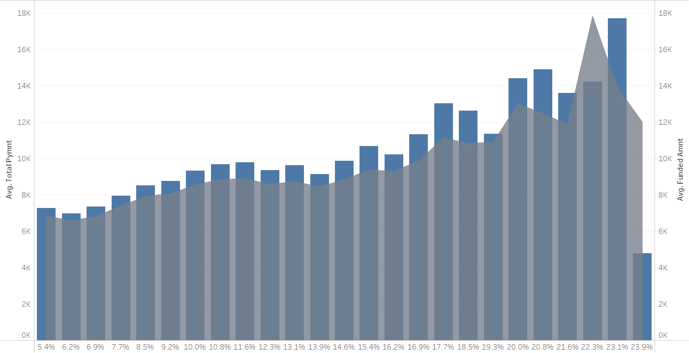
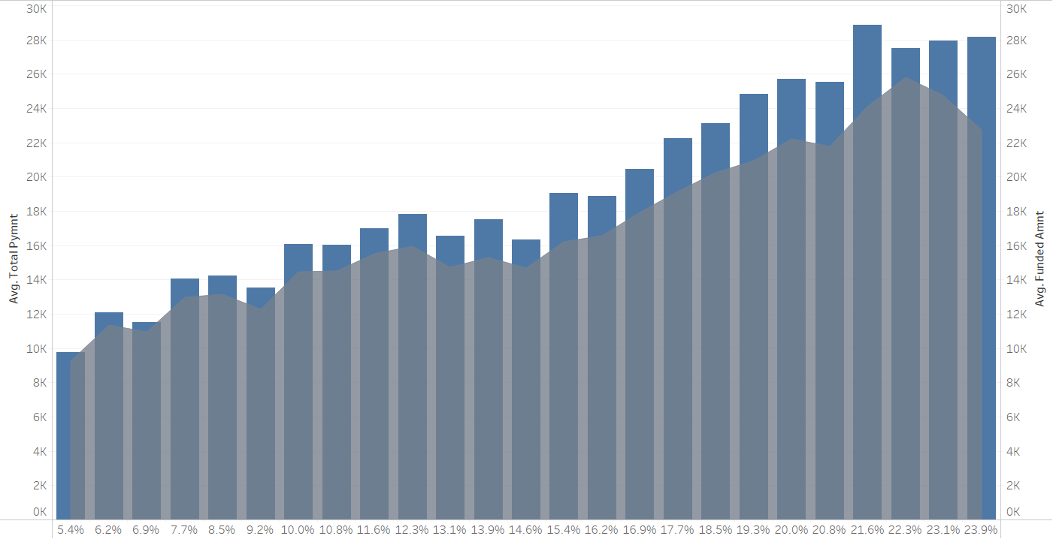
Reason : Repayment History
The Repayment History of Borrowers with Verified Status suggests a slight increase of chance of repayment than Non Verified Borrowers.
Especially true with higher interest rates.

Slide 17
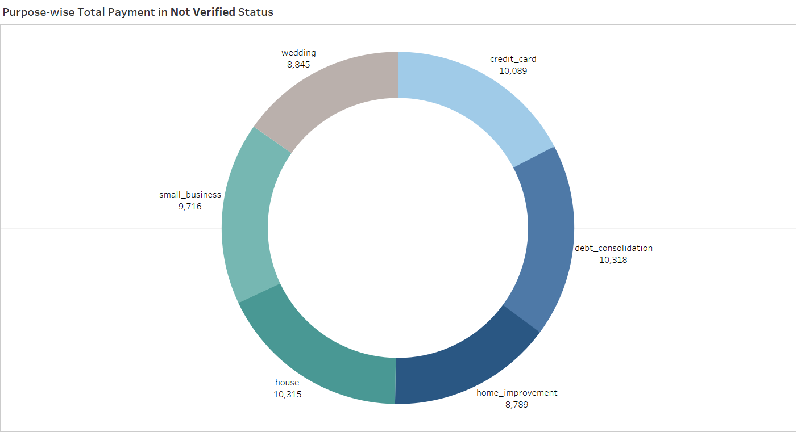
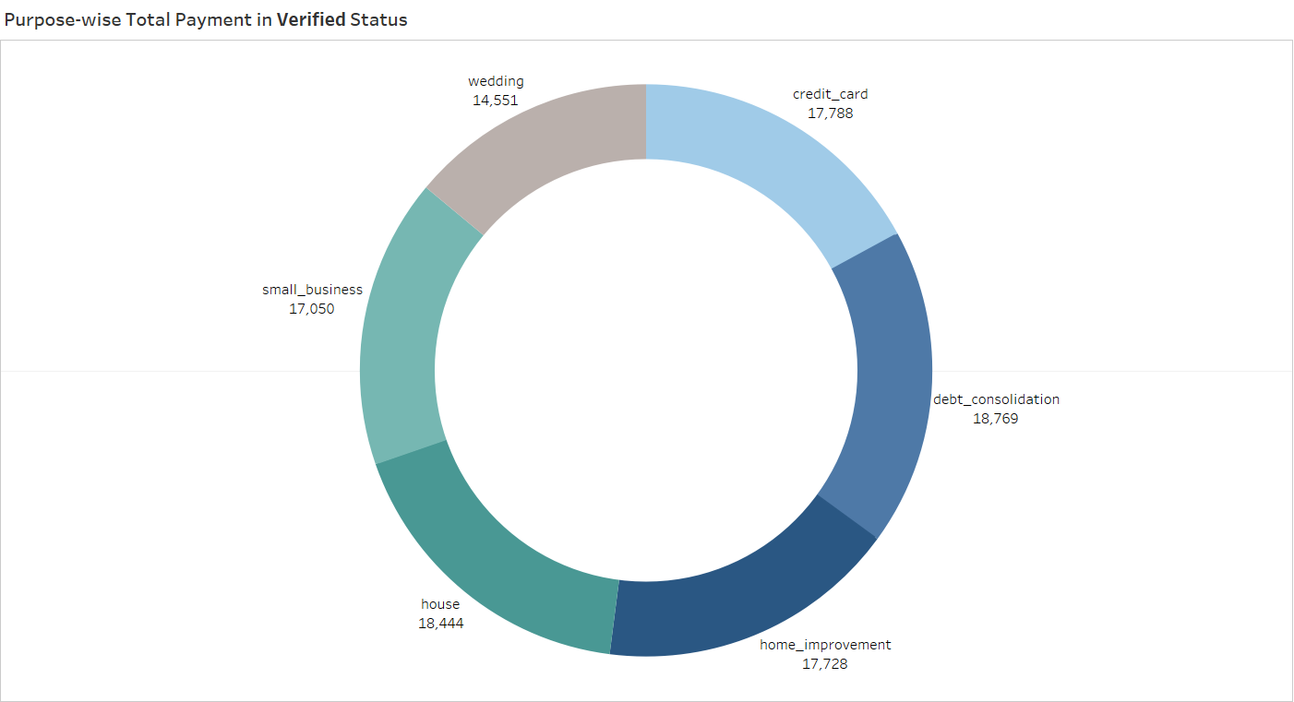
Purpose Wise Total Payment
The Total Payment of the Average Person for each Purpose of Verified Borrowers are fairly similar to that of Non Verified Status
Investing in Verified Borrowers are slightly less riskier than Non Verified Borrowers, although the difference being Not Too Significant

Slide 18
KPI 4
4
State Wise and Last Credit Pull Date Wise Loan Status
The last credit pull date is the date the borrower's credit report was last pulled.
The loan status indicates the current status of the loan.
Last Credit Pull Data from 2007 to 2016

Slide 19

California, New York, Florida and Texas : States with the highest Repayment
Highest Loan Application counts from these States.
Most of these coming in as the years progressed

Slide 20
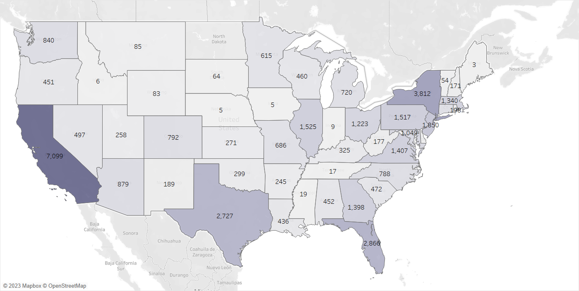
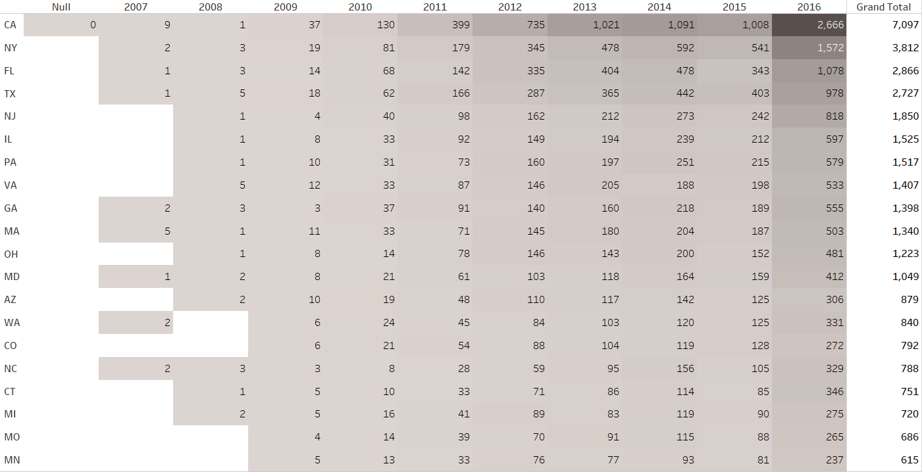
Reason : Total Number of Applications
The States with highest Repayment are evidently the States with the highest number of Credit Checks.
Advisable to invest in Borrowers with less credit checks, but in the case of State wise data would be wiser to invest in States with more activity.

Slide 21
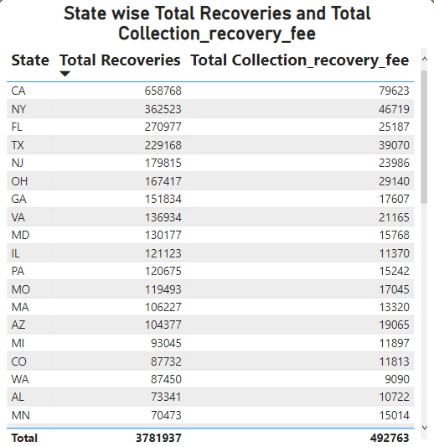
Cost Increase
States with higher activity tend to cost more from a debt collector’s perspective
But not enough to deter from investing in these States

Slide 22
KPI 5
5
Home Ownership VS Last Payment Date Stats
Home ownership refers to whether the borrower owns, rents, or has another type of housing arrangement.
Last payment date refers to the date on which the borrower made their most recent payment on the loan.
Last Payment Data from 2008 to 2016

Slide 23
Borrowers with Rented Homes, Mortgaged Homes have the highest and most frequent Payments
Highest Repayments are from Mortgage, Rent and Own in that order
Latest Repayments are from these 3

Slide 24
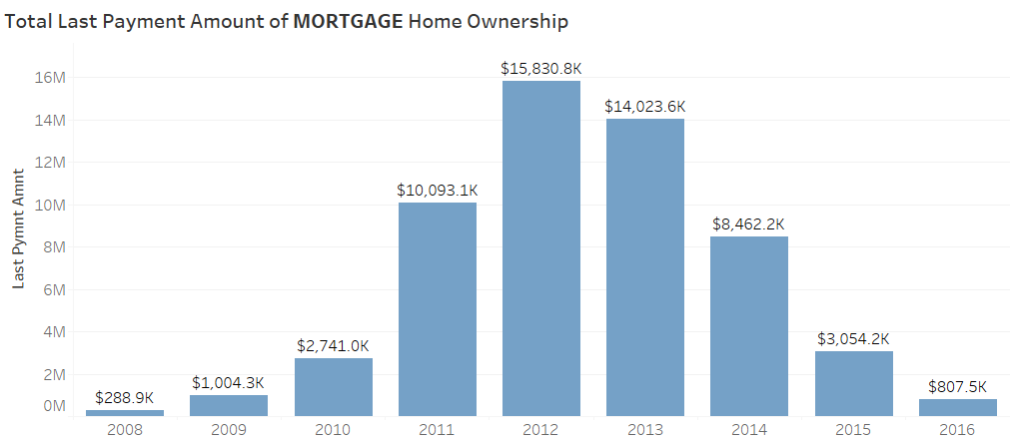
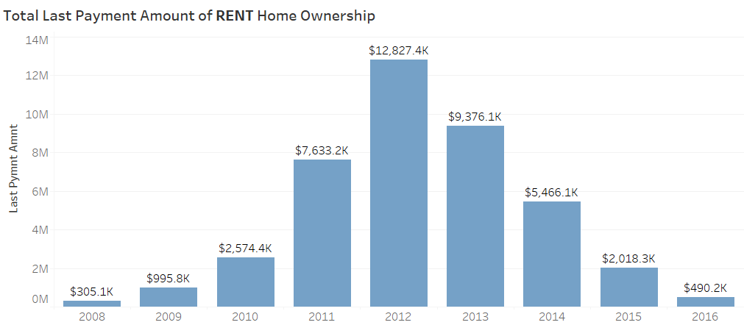
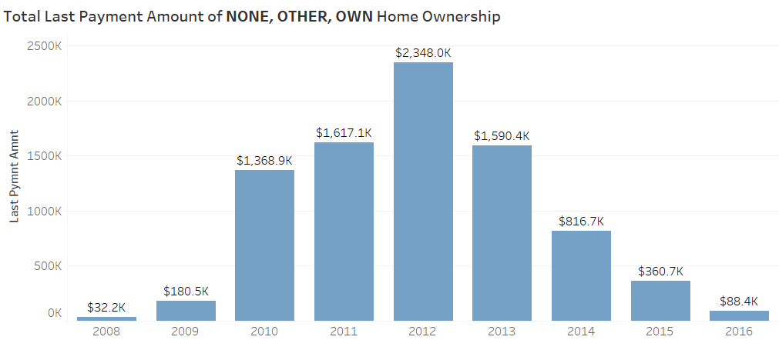
Reason : More Secure
The Repayment Amounts of Mortgage and Renting Borrowers each are significantly more than combined Repayment of Own, Other and None.
This is also because most Applications are from people who either Rent or have a Mortgage.

Slide 25
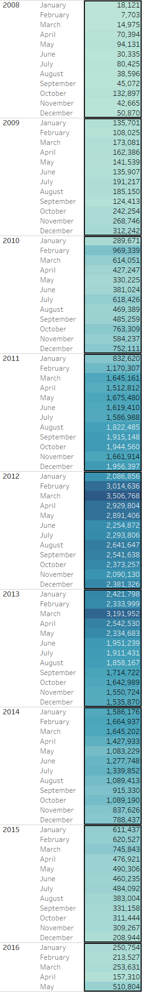
Payments by Date
Bulk of the payments in 2011 through 2014
Quarter Wise spread evenly with slight increase in the 1st Quarter

Slide 26
END OF KPI

Slide 27
Analysis Process
Acquired the csv and excel files,
Understood the General outline
Trial and error for some analysis of KPIs,
Correlation Analysis for some.
Visualized the data using Dashboards

Slide 28
TOOLS USED FOR PROJECT

Slide 29
TOOLS USED FOR PROJECT
Excel – Pivot Tables along with Dashboard for visualization
MySQL – Queries for Data Summarizing of the KPIs
Tableau – Visualization via Dashboards and Sub Dashboards
Pandas, Seaborn – Correlation Analysis of the quantitative columns
Power BI – Dashboards and Sub Dashboards fro visualization

Slide 30
THANK YOU

