Slide 1
Microsoft Azure Women Hackathon
Team Members Ayushi Srivastava
Aakansha Kowerjani
Pallabi Chakraborty
Lokapavani Gampala

Slide 2
Use case
The Indian public toilet system has been subject to a lot of criticism, especially in the rural and semi-urban areas.
Disgusting, dirty, sloppy, these are usual adjectives that strikes us when we think of the Indian public sanitation.
Apart from the lack of standard hygiene practices of the public toilets in India, these facilities continue to be in a poor shape due to low awareness about proper sanitation practices among the people.
Open defecation has been practiced in India for a long time, and it continues to exist to date.

Slide 3
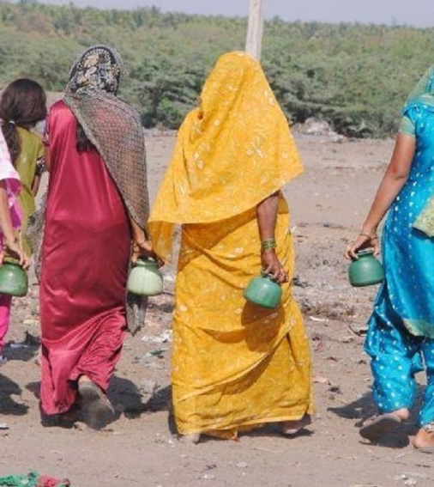
We Can’t Wait
Poor sanitation is an issue that can affect everyone, but women are often the most at risk.
A lack of access to a clean, safe toilet can impact girls’ attendance at school, increase women’s burden of work and leave females at risk of sanitation-borne diseases and even violent assault.
Waiting to use the bathroom exposes women to other health risks, such as painful and costly urinary tract infections.
Avoiding using the restroom by dehydrating oneself is also damaging for the overall health of the woman.

Slide 4
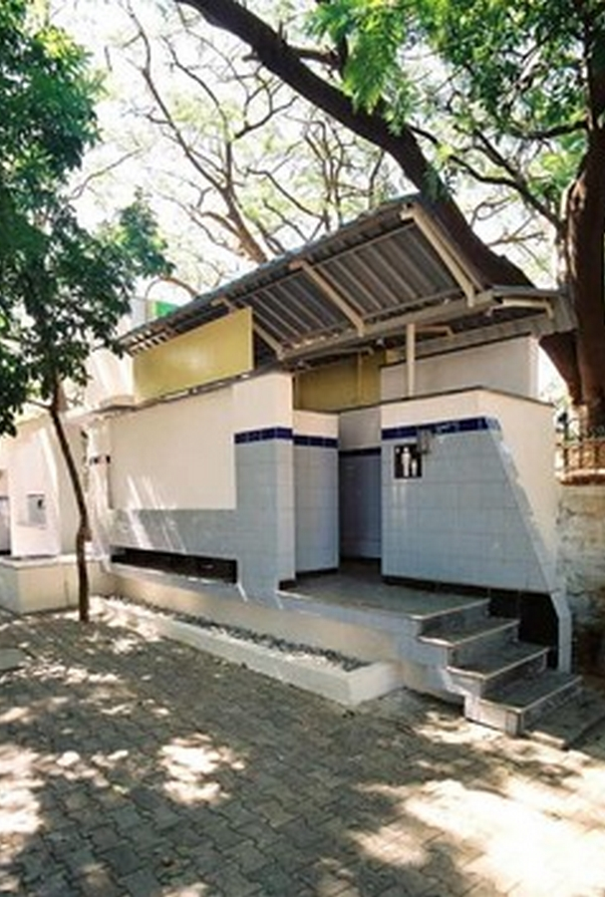
Our Application - RestMap
Locating Restroom - Detect restrooms based on our current location.
Users/Restroom-Owners can add/update or delete restrooms
Availability Of Amenities - Basic facilities( Nursing Rooms, Sanitary Napkins available or not , basic medication available or not) / washroom is paid or unpaid.
Notify Authority – Notifies authorities whenever periodic maintenance is required at the restroom.
Usage Prediction – Restroom owners can check the current utilization of the restroom and work on it accordingly. End –users can predict whether the restroom is worth to use or not.

Slide 5
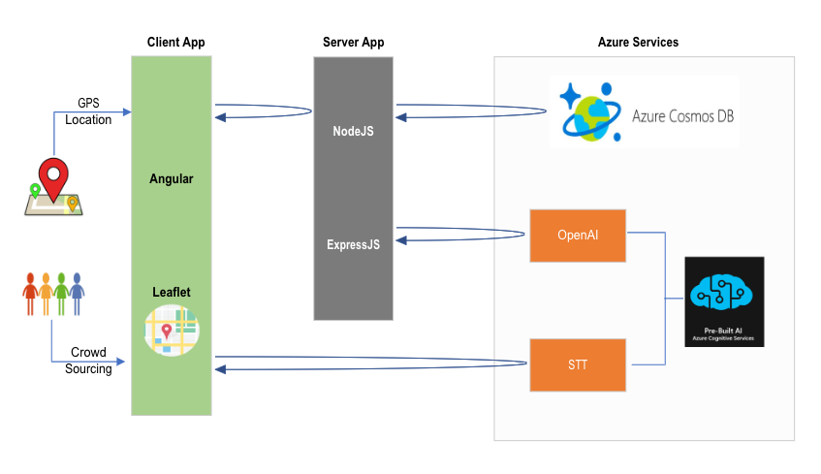
Application Architecture

Slide 6
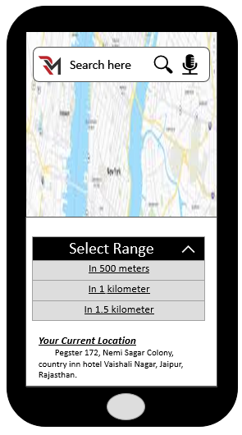
Location Of Restrooms
RestMap will help its users to locate restrooms nearest to their location once the user allows application to access their location.
It will also fetch data for restrooms located at various public places – Malls, Railway Stations, Bus Stops, Sulabh Shauchalaya and Hotels.
It will check whether the washroom is paid or unpaid / facilities available.

Slide 7
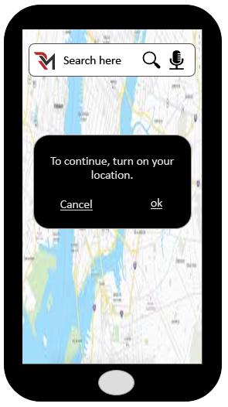
The top half shows the map of your current location.
Speech To Text – Helps in searching restroom using user’s voice
Search within required range.

Slide 8
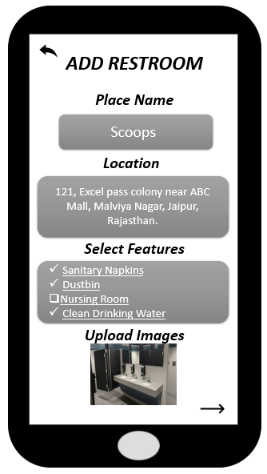
Add / Remove Restrooms
Users must be logged in to use this particular feature. Once logged in, Restroom owners can add/update and delete their restroom.
Users can add/update and delete new restroom location.
RestMap will check whether the restroom is already present in the database, if not, it will add a new restroom along with fields like Location, Facilities, Availability Options etc.

Slide 9
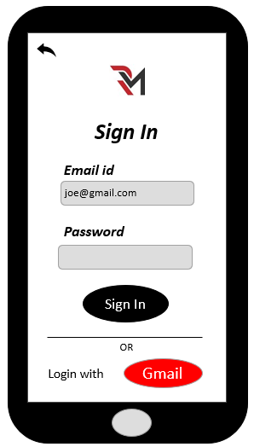

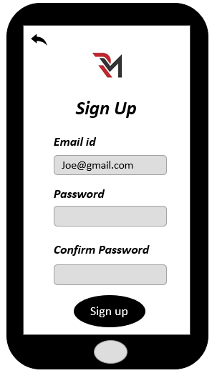
Have Account ?
Yes
Users
No
Flow ( Add Restroom )

Slide 10
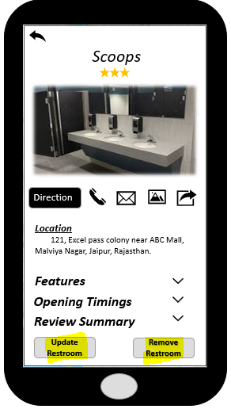
Have Account ?
Yes
Users
No
Flow ( Delete/Update Restroom )

Slide 11
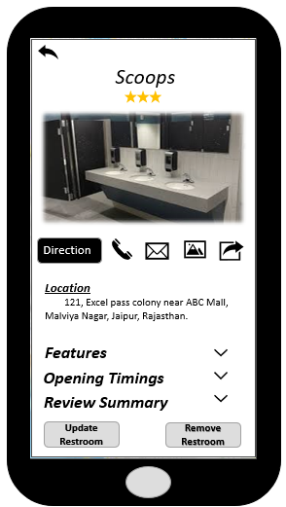
Availability Of Amenities / Notify Authorities
Features
Users will be able to navigate to the washroom using direction button. They can also have a look at the images of the restroom.
Users can see the facilities available at the restroom, along with the opening hours and review summary.
Report/Lodge Complain
End users can report/lodge complaints to the authorities based on the current situation of the washroom using the phone / email button available on the application.
Review Summary
RestMap users can add their reviews in the review summary section and can even provide ratings for the particular washroom.

Slide 12
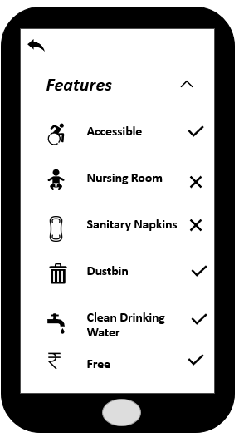
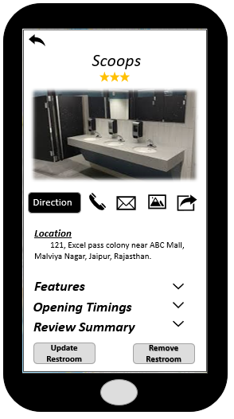
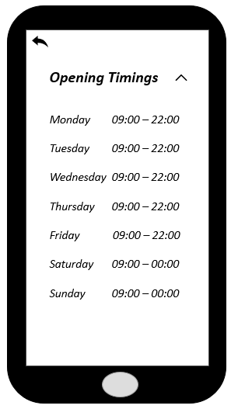
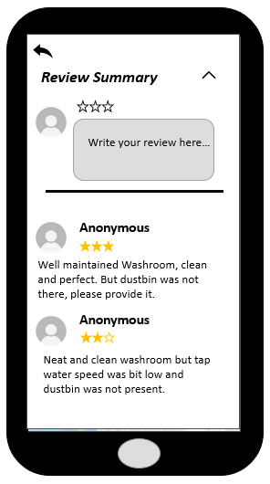

Slide 13
Usage prediction of restrooms ( AI /ML )
Usage % | Current Condition Of The Restroom
80 – 90 | Facilities are good, should be cleaned now.
50 – 80 | Facilities are moderate, no cleaning required currently.
Below 50 | Requires maintenance , upliftment in facilities or it is in remote location ( can be considered unsafe )
This feature of RestMap will help users in various ways :
Notify restrooms owners in advance to increase the facilities in the restroom if its usage is low.
Notify the authorities to clean the washroom in case the usage prediction is high, even restroom owners can keep the track of facilities during the peak usage period.
Divide the usage percentage according to the rules defined in the table.

Slide 14
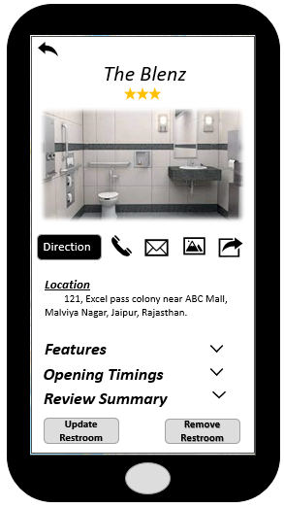
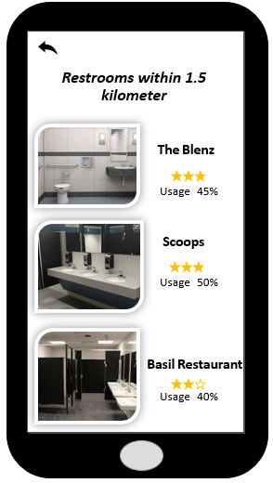
Usage prediction of restrooms ( AI /ML ) Flow
Database
Training data
(details of various restrooms and their usage %)
Learning algorithm
Input
( restroom name, location, time/season, facilities available etc. of a particular restroom)
Output
Predicted usage % of a restroom
hypothesis
Open AI

Slide 15
Azure Services
Azure Services | Description | Application
Azure Cosmos DB | A globally distributed, multi-model database service. This database enables you to elastically scale throughput and storage across any number of geographical regions. | Store data
Azure App Service | This service lets you create apps faster with a one-of-a kind cloud service to quickly and easily create enterprise-ready web and mobile apps for any platform or device and deploy them on a scalable and reliable cloud infrastructure. | Deployment
Azure Cognitive Service Speech To OpenAI Text | This service enable developers and data scientists of all skill levels to easily add AI capabilities to their apps. Speech To Text - Transcribe audible speech into readable, searchable text. OpenAI - Apply advanced language models to a variety of use cases. | STT – Search restroom using end-user voice. OpenAI – Train model to predict the usage percentage of a particular restroom.

Slide 16
Future Scope
RestMap Application can be used by various Government authorities / NGO’s which will provide them data regarding where we need to build restrooms.
It can be imbibed by other applications like TripAdvisor, Oyo Rooms, Urban Company to help women in locating restrooms when they are travelling to some unknown locations.
We can use this application to spread awareness of using restrooms especially in the rural areas of India where people still defecate in the open.

Slide 17

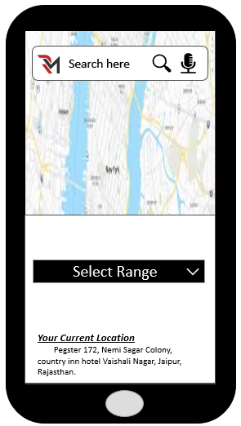

Future scope
Notify government authorities / NGOs to build more restrooms over areas which have high usage / tourist spots / remote areas
Spreading awareness among people to use washrooms.
It can be imbibed by other popular apps to help women locate restrooms when they are travelling to a new location.

Slide 18
References:
https://www.businessworld.in/article/90-Of-Indian-Women-Afraid-Of-Using-Public-Washrooms-Survey/08-08-2019-174544/
https://timesofindia.indiatimes.com/city/bengaluru/50-of-women-suffer-from-mental-stress-due-to-lack-of-public-toilets-says-survey/articleshow/87808755.cms
https://www.womenshealth.gov/a-z-topics/urinary-tract-infections#:~:text=Women%20get%20UTIs%20up%20to,one%20more%20within%20six%20months.&text=Women%20get%20UTIs%20more%20often,is%20shorter%20than%20a%20man's.

Slide 19

THANK YOU

Slide 20
THE END

