Slide 1
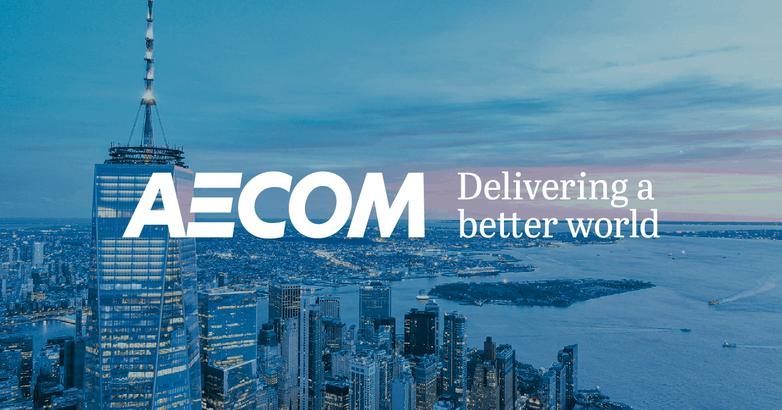

Ticker: ACM
Current share price: $84.49
Target price: $124.81
Return: 47.7%
Recommendation: Buy (2-3 years hold)
Alex Caesar-Giles | Dylan Taylor | Sayeb Salam

Slide 2

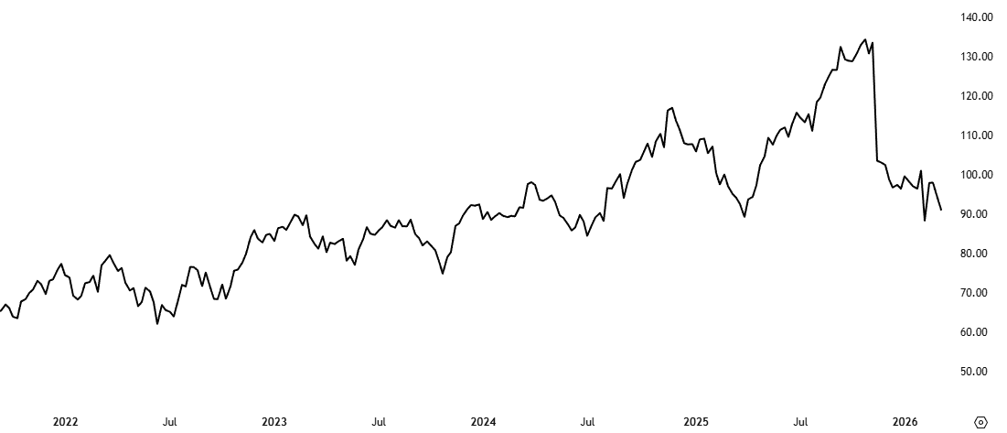

Pitch summary
AECOM is undervalued because the market is pricing it as a cyclical construction firm, while it is transitioning into a higher-margin consulting and AI-enabled infrastructure services company with growing backlog visibility and expanding margins.
Narrative
Share price analysis
What's driving demand: Global trends such as rapid urbanisation, AI infrastructure and tightening sustainability regulation are accelerating demand for large-scale developments including transportation networks, water systems, data centres and urban regeneration.
Where AECOM fits: AECOM provides governments and private clients with end-to-end services across the full project lifecycle, planning, engineering, procurement, design, and construction management. With over 30 years of expertise and consistent recognition as a go-to partner for complex, high-stakes infrastructure, AECOM is structurally positioned to capture this demand.
Why the stock is down: AECOM fell over 30% from its 52-week high following Q4 2025 results. The sell-off was driven by a combination of higher tax rates, a 225% spike in restructuring costs, US government shutdown disruptions, and a 42% collapse in Middle East regional revenue from cancelled projects, compounded by investor concern over a planned divestiture of the construction arm.
Why the market is wrong: These headwinds are temporary and largely external. Q1 2026 earnings beat expectations, forward guidance has been raised, and management reversed the construction divestiture, recognising it as a key beneficiary of infrastructure tailwinds. The market has not yet repriced for the improved outlook.
Our core thesis: AECOM is transitioning toward higher-margin advisory and AI-enabled services, structurally reducing earnings cyclicality. With a record $25.9B backlog growing at 9% YoY, revenue visibility is strong, and the market is still pricing in yesterday's headwinds.
Strong earnings guidance by management backed by increasing revenues and talks of margin expansion
1
AECOM earnings guidance disappointed investors, with losses from Middle East projects damaging the bottom line for the quarter
2
Valuation summary
3
4
5

Slide 3
Business overview – Diverse expertise from global scale with strong economic moat
Business Model Overview
Financials
Key operations
Revenue split
AECOM is a US-based global infrastructure leader that delivers professional services such as planning, design, engineering, and construction management for public and private clients worldwide
Support clients to solve urgent and complex projects spanning transportation, infrastructure, water, construction and energy
Predominantly operates as a fee-based professional services business, generating revenue through expertise
Asset-light business model with recurring revenue tied to long-term contracts with governments and private firms
AA MSCI ESG rating
Design and consulting (DCS)
Provide high-end design, architecture, engineering and consulting in markets like water, buildings and public infrastructure
Construction services (CS)
The builder of some of the most iconic buildings. With updated plans to keep this sector due to belief it is prime to capitalise on growing demand
14.38B
16.11B
16.14B
Advisory services (AS)
Unit providing strategic consulting and programme planning services, capturing higher-margin work earlier in the project lifecycle than traditional engineering.
13.15B
Management services (MS)
Works with governments across the globe supporting maintenance, design and nuclear services such as disposal and safety analysis
AECOM moats
46% of revenue
Government relations
Just under half of 2025 revenue came from public infrastructure projects tied to government contracts
Security clearance required to compete
Entrenched multi-year framework agreements
Proven track record essential to win work
80% + bid win rate
Reputation
No.1 in Industry Fortune most admired list
Consistently beating competitors to high-value contracts as shown in bid win rate
30+ years of complex project delivery
Trusted first call partner for governments
High exit cost
End-to-end services
Proprietary design knowledge accumulates per client
Replacing AECOM risks delays and redesign costs
Clients retained across all project phases through end-to-end services
Global presence
Economies of scale
Rapid deployment of specialist teams globally
Centralised procurement drives cost savings
Cross-border expertise lowers bid-risk

Slide 4
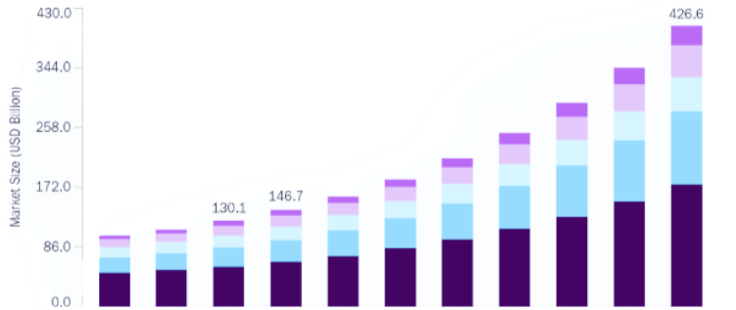
Industry overview
AECOM is under the Architectural, Engineering and Construction umbrella however its operations extend to many sub-sectors. This sector often grows parallel to broader construction and infrastructure levels due to the reliance on each other.
AECOM’s current market positioning
Strong industry growth estimates (2026-2033)
Transportation Infrastructure
Ranked #1 for 23 years globally in the sector – accounted for 38% of 2024 revenue
Major player in designing the Elizabeth line
Top competitors – Jacobs solutions, WSP
Water Infrastructure
Positioned as #1 water design firm globally by Engineering News-Record, with dominance in the UK
100%-win rate on re-compete contracts
Secured positions on AMP8 water framework in UK
Top competitors – Stantec
Environmental consulting
#1 in sustainability and ESG strategy with a 25% market share
#1 for Climate change and energy services
19.6% Market share in the overall Environmental consulting segment
Top competitors – Stantec, Jacobs Solutions
Construction management
Top-tier firm globally
Strong and growing backlog and pipeline (2028 Olympics official partner)
Strong track record – Burj Khalifa, One World Trade Centre
Top competitors – Jacobs Solution, WSP, KBR, Bechtel
Building and facilities engineering
Ranked #1 for facilities and general building
Notable projects such as the Mercedes Benz stadium
Top competitors – Jacobs Solutions, Fluor, WSP
Advisory services
Distinct unit as of 2025 within the company
In-house advisory services aimed at providing a more end-to-end service for clients
Top competitors – Arup, Deloitte, McKinsey
16.5% CAGR
Digital services
Built Environment
City Planning
Sustainability services
Technical engineering
Tailwinds
Headwinds
Porter’s 5 forces highlights AECOM’s strong position in a competitive market
Water infrastructure deficit
US alone faces $625 Billion in water infrastructure needs with global estimates for 2030 being $6.7 Trillion
Evolving regulatory landscape
Cost pressures such as 40-year high tariff rates on construction goods and tighter environmental targets increased project abandonment by 88.2% in 2025
New competition
Low: High barrier of entry due to large capital requirements, large levels of regulatory approvals and a reliance on reputation for large-scale projects
Power of buyers
High: Large buyers such as governments and corporations have strong bargaining power. Price competition from others promotes competitive bidding
Climate based infrastructure
Global grid investment projected to hit $5.8 Trillion between 2026-2035 with US accounting for $1 Trillion of this
Chronic labour shortages
Need for 499,000 new workers required in 2026 to sustain demand, with potential to lose $124 Billion in output if positions remain unfilled. Combined with 41% of workers in construction expected to retire by 2031
Power of suppliers
Moderate: Highly specialised suppliers such as technology vendors may demand premium rates. AECOM’s scale advantage allows bulk procurement and strong negotiating power
Urbanisation trends
68% of the population is expected to live in cities by 2050. Increased demand for urban construction
Threat of substitutes
Low: Engineering and consulting work cannot easily be replaced fully by software or internal teams for large and complex infrastructure projects
Competition
High: Fragmented market with heavy competition for large contracts with differentiation coming from reputation, scale and access to framework agreements

Slide 5
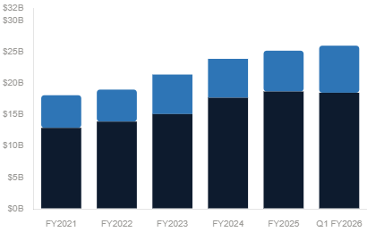
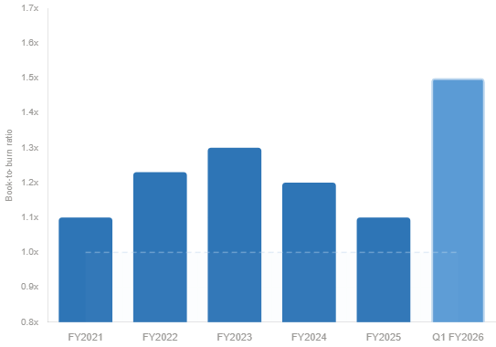
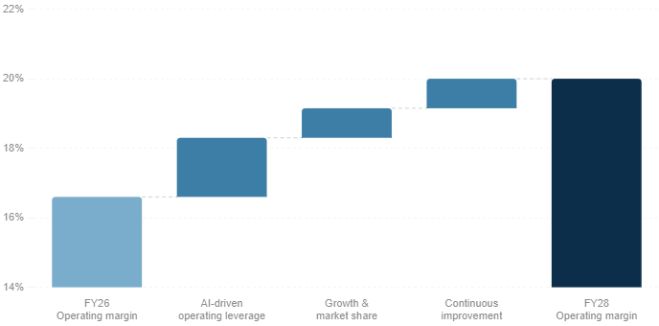
Investment thesis – Record project backlog with increasing margins, priming AECOM to capitalise on growing market
AECOM has targeted an NSR operating margin growth to 20% by 2028 with the further deployment of AECOM AI solutions and the expansion of its advisory services
Accelerating Operating Leverage through AI and Advisory services
Record-breaking backlog
AI efficiency
Advisory expansion
25.9B
Trained AI systems with both broad and targeted use potential, that independently perform specific, technical engineering tasks with speed, precision, and consistency
Potential to automate 80% of procurement and tendering processes through AI
Transforms business model from labour-intensive and high variable costs to a more automated process
30% of hours to be automated reducing analysis and modelling tasks
1.5x
An internal shift to focus on higher-margin advisory services
Advisory margins operate around 25-35%
Aims for this sector to account for 50% of NSR, raising the company’s overall margin
Reduce cyclicality with asset light operations on longer term contracts
Bridges the gap between consulting firms and engineering firms providing an integrated end-to-end service, capturing more value across the infrastructure lifecycle
Growing backlog
Book-to-Burn
AECOM has grown its global backlog to an all time high of $25.9 Billion, a 9% increase YoY
This combined with growing operating margins is putting AECOM in a strong position to benefit financially, suggesting strong revenue visibility and improving profits
A growing Book-to-Burn ratio (Up to 1.5X) indicates that AECOM is securing new contract wins at a faster pace than it is completing its existing projects
Demonstrates high demand for AECOM services and its ability to win large contracts
21st consecutive quarter of a Book-to-Burn ratio higher than 1.0
Strategic acquisition of Consigli
November 2025 AECOM acquired Consigli for $390 Million
Consigli automates space analysis, MEP loadings, plant room optimisation, BIM modelling and report generation, claiming up to 90% reduction in engineering time and cut material use by 20%
AECOM had previously partnered with Consigli as a supplier; leadership concluded the technology could disrupt the industry and acquired rather than remained exposed
AECOM is the first major AEC firm to acquire a technology company itself rather than outsource the IP
Consigli founder Janne Aas-Jakobsen joins as Head of AI Engineering, retaining the platform's creator and anchoring AECOM's proprietary AI capability
NSR operating margin expansion
0.85%
20.00%
0.85%
1.70%
16.60%

Slide 6
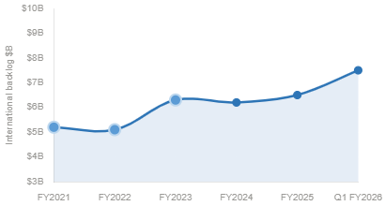
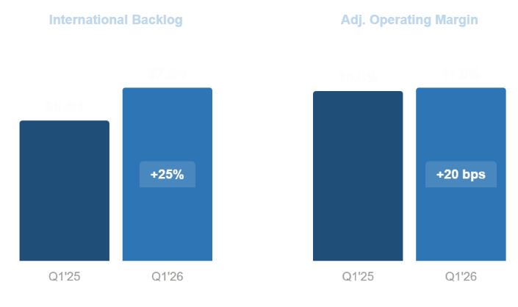
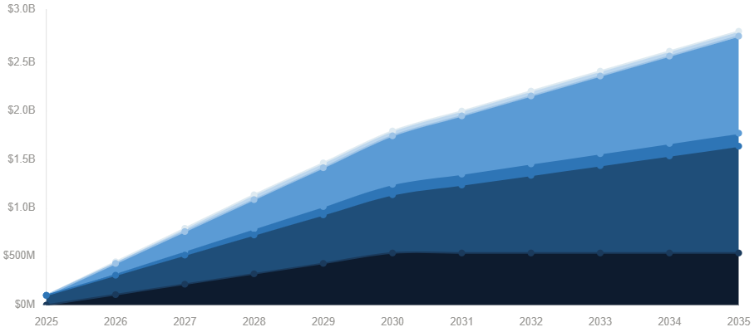
Investment thesis – Reducing cyclicality by improving quality of earnings and diversifying revenue streams
Secure revenue through long-term IDIQ and MSA contracts
Growing presence internationally
IDIQ – Grant government agencies the right to issue task orders to AECOM on-demand without running new procurement, generating revenue that sits entirely outside the reported $25.9B backlog. Factoring in this off-balance-sheet pipeline understates AECOM's true revenue visibility.
MSA – This is the same concept but for the private sector
USACE Europe District
2 contracts with AECOM being prime (main) contractor on both. IDIQ spanning five years (2030) across multiple European countries implementing horizontal infrastructure with a ceiling of $490 million, expanding European presence
OASIS+
10-year contract (2035) with no spending ceiling, with work focused on environmental compliance and remediation as well as advisory services providing AECOM clear revenue visibility into its most profitable line of work
Revenue Diversification
AECOM is diversifying revenue streams geographically to reduce reliance on one government or pool of private clients by bidding for more global contracts that are Advisory and services-based providing higher margins. This growth has been evidenced by:
AECOM is targeting more international contracts with the international backlog growing 25% in 2026
International backlog has grown from $6.5B to $7.9B
As a percentage of total backlog, this has increased from 25.8% to 28.8% (between 2025 and 2026)
SHIELD
Facility modernisation and operational readiness of infrastructure work, contracted for 10 years with total ceiling being $151 Billion spread across over 50 companies, providing massive revenue potential domestically
Cumulative IDIQ/MSA projected revenue
Prime utilisation
OASIS+
Shared
SHIELD
JV
International regulations AECOM is capturing
EU Corporate Sustainability Reporting Directive (CSRD) – Expanded disclosure obligations for sustainability. AECOM ESG advisors positioned to support private clients through CSRD adoption strategies. With reports required annually, this provides AECOM with potential for recurring revenue streams
1
UK Biodiversity Net Gain (BNG) – As of 2024 developers must provide measurable gain of at least 10% in biodiversity in planning permissions. AECOMs Environmental Consulting team directly engage with developers to guide them to the 10% goal as well as providing proprietary tools such as “eco.lift”. With this now a legal requirement for developers it primes AECOM to capitalise on expanding regulatory requirements
2

Slide 7
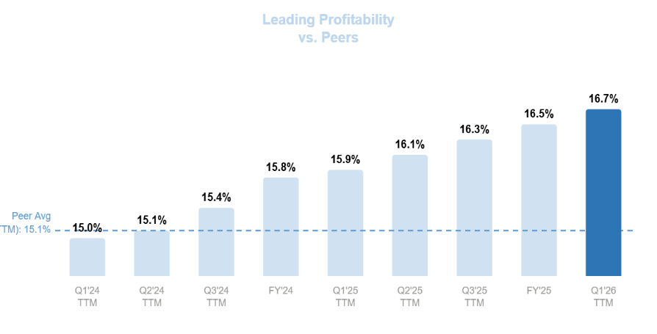
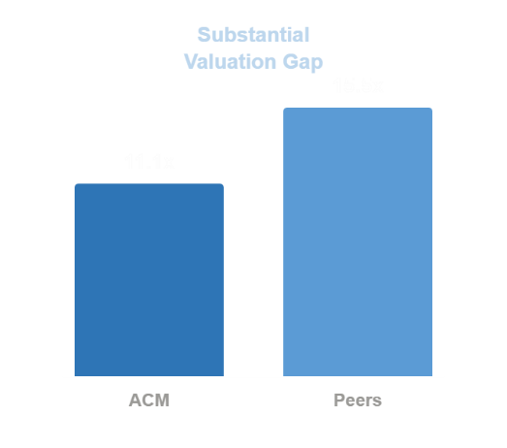
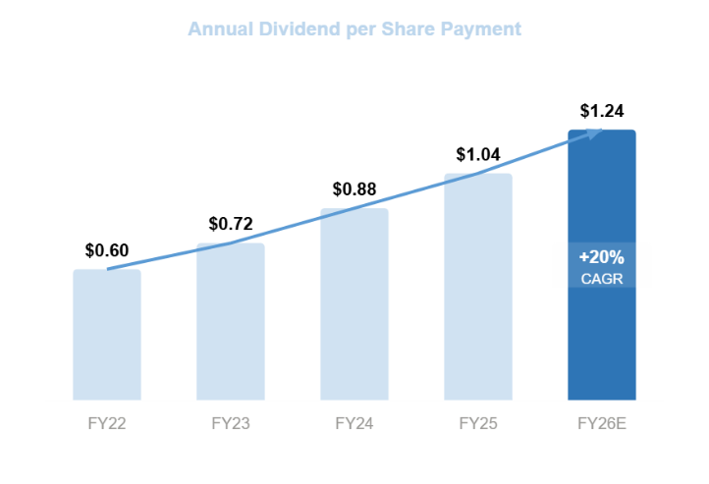
Comparable Company analysis
Company | Market cap ($B) | Revenue 2025 ($M) | ROIC% | P/E | EV/EBITDA (TTM) | NSR margin
AECOM | 10.95 | 16,139.62 | 10.77 | 18.61 | 10.48 | 16.7%
Stantec | 13.79 | 5,828.57 | 8.80 | 29.54 | 16.81 | 17.6%
Jacobs Solutions | 15.04 | 12,020.98 | 6.95 | 34.02 | 13.71 | 13.9%
Fluor | 6.31 | 15,503.00 | -1.18 | 24.59 | 11.79 | 3.25%
WSP | 21.25 | 18,290.00 | 8.09 | 31.03 | 15.28 | 18.9%
A higher performing business
Strong Profitability (NSR)
Substantial value gap (EBITDA)
15.5X
10.48X
Shareholder value creation
Since 2020 AECOM has returned $3.4 Billion to shareholders through dividends and share repurchases
A further approval of $1 Billion in share buybacks reflects confidence from AECOM in its long-term cash flow expectations and providing substantial capacity to maximise value for shareholders
Double digit annual increases in dividend payouts
After organic business investments, AECOM returns 100% of its remaining free cash flow to shareholders through strategic capital allocation such as M&A, share repurchases and dividends
Interpretation
1
AECOM generates the highest return on invested capital (ROIC) among the peer group at approximately 10.77%, demonstrating superior capital allocation and the ability to generate higher returns from its projects and operations than its competitors.
AECOM also trades at a lower P/E ratio of 18.61 compared with significantly higher multiples for peers such as Jacobs and WSP, meaning investors are paying less for each dollar of AECOM’s earnings despite its stronger operational performance.
AECOM generates revenue of $16.1 billion, placing it among the largest companies in the peer group and close to firms with significantly larger market capitalisations, such as WSP.
This combination of strong revenue, superior capital allocation, and a lower valuation multiple suggests the market may be undervaluing AECOM’s profitability, competitive positioning, and long-term growth outlook relative to competition.
Shares outstanding
Dividend growth
2
3
4

Slide 8
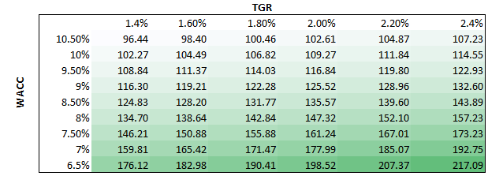
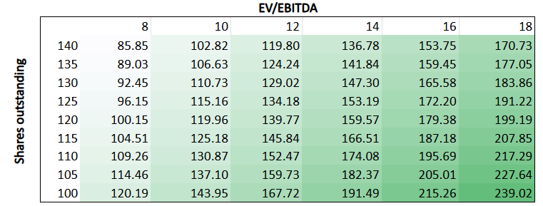
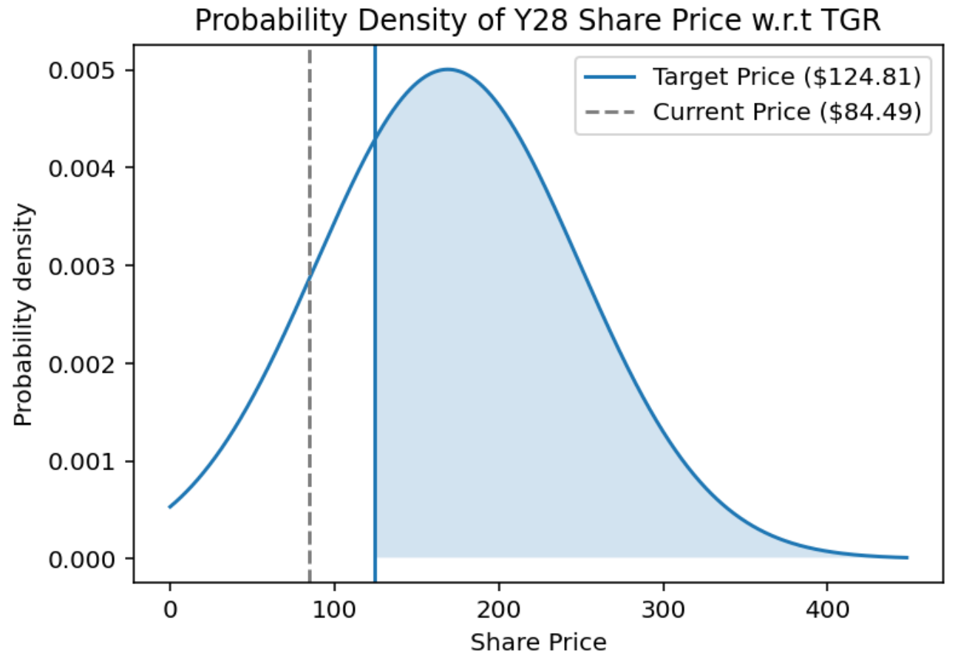
Valuation – Scenario analysis shows how there are large investment incentives within each market scenario
Key inputs from each of our DCF scenarios (2025-2028)
Sensitivity analysis
BEAR
BASE
BULL
Revenue
$16.13B $17.98B
$16.13B $18.13B
$16.13B $18.28B
EBIT
$1097M $1344M
$1097M $1417M
$1097M $1486M
Taxes
$225M $267.8M
$225M $277.4M
$225M $287M
D&A
$176M $135M
$176M $194M
$176M $246M
CapEx
$137M $183M
$137M $159M
$137M $135M
Change NWC
$-142M $-152M
$-142M $41.92M
$-142M $245M
Terminal value
$17.41B
$20.13B
$23.06B
PV of Terminal
$13.44B
$15.53B
$17.79B
Enterprise value
$16.39B
$18.69B
$21.13B
$15.34B
$17.63B
$20.07B
Probability Density of Share price for Y28 with respect to distribution of TGR using DCF valuation model. Assumes TGR follows a normal distribution and uses past ~6 years of data. Probability of Share price being greater than or equal to target price of $124.81 is 71%.
Equity Value
Estimated share price
$107.79
$124.81
$136.12
Return (%)
+27.6%
+47.7%
+61.1%

Slide 9
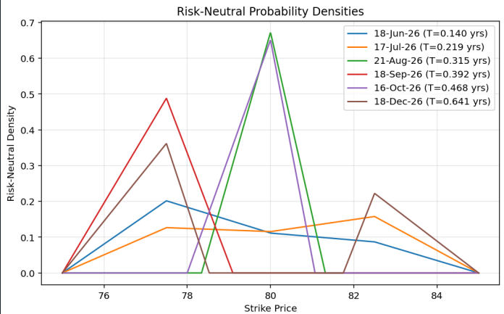
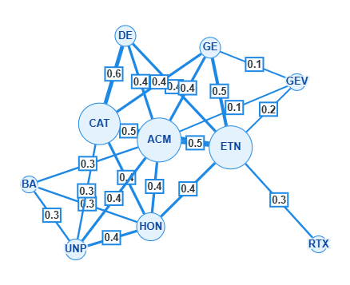
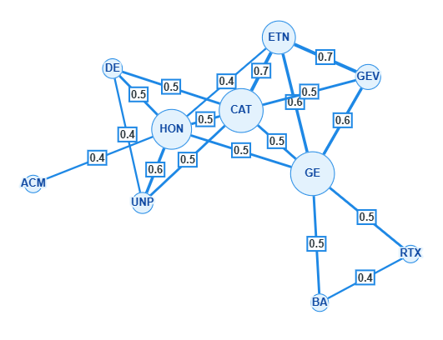
Assumptions
Our model uses conservative estimates often inspired by consensus projections to generate our base estimated share price. Despite safer estimates, there is still an attractive potential upside fuelled by internal improvements and current market mispricing
Key assumptions from our base DCF (2025-2028)
Quantitative risk analysis
MODEL
COMMENTARY
Revenue
$16.13B $18.13B
Strong revenue growth from expanding advisory sector, growing backlog and economic tailwinds
EBIT
$1097M $1417M
Margin expansions through automation and a shift towards higher margin services
Advisory rev
$200M $400M
Based on company expectations
Construction rev
$3.6B $4.03B
Expected growth through record backlog for projects
Transport rev
$5.6B $6.3B
Accounting for 38% of revenue, tied to large government contracts and public investments
Shows short term expectations do not strongly diverge from current prices therefore supporting investment stability in first 0.641-year period. Also shows that market has not yet priced in revenue diversification and improved quality of earnings.
ENV + Water rev
$2.25B $2.54B
Based on water accounting for 14% of earnings
Other rev
$4.48B $4.86B
Building, facilities and other sources of revenue
WACC
9.04%
Used 5-year average beta of 1.05 and 4% risk-free rate from US treasury returns with a 5.8% market risk premium based on average S&P returns
TGR
2.0%
Conservative estimate with US average TGR being 3.28%. We chose lower TGR to reflect Q4 downturns in economic growth
Estimated share price
$124.81
Target price driven by higher revenue and large EBIT increases, agrees with consensus estimates
Jan 23 – Dec 25
March 25 – March 26
Return (%)
+47.7%
Attractive potential upside despite conservative estimates
S
Shows statistically robust correlations between ACM and the assets in the top 10 by index weight of industrials S&P500. ACM is heavily correlated in 23-25, but little correlation in past year. Empirical evidence of successful diversification and shows the low-risk exposure to others in Industrials with ACM investment.

Slide 10
Catalysts and Potential Risks to our Thesis
Impact
Catalysts
Severity
Risks
Mitigants
Expected peak in IIJA funding (Infrastructure investment and Jobs Act)
allocating $1.2 trillion in federal infrastructure spending across America. This will add to the already large backlog for firms in the industrial industry leading to reliable revenue allowing firms to take CapEx risks.
During fiscal 2024, 2023, and 2022, approximately 46% of total revenues were derived from government contracts. Given the long-term nature of most government contracts, any budgetary changes during their tenure are expected to negatively affect AECOM's business.
AECOM is highly diversified both geographically and by clientele and does not depend solely on any one nation or agency. Also, the majority of contracts are under multi-year frameworks such as IIJA, meaning upcoming budget cuts have limited power in cancelling active work
US construction and infrastructure spending
forecast at $2.27 Trillion in 2026 with this figure representing a year-on-year growth of 5.1% with further projection for 2027 estimating a further 7% growth in this spending, providing AECOM with strong future revenue potential
AECOM's business is cyclical and vulnerable to economic downturns and client spending reductions. A broader recession could meaningfully reduce both public and private sector project figures.
AECOM has strong revenue visibility for the next 2–3 years, supported by a $25.9B backlog and a growing book-to-burn ratio. Management is proactively addressing cyclicality risk through an ongoing shift toward secular, non-discretionary demand drivers
Privately funded data centre construction
rose 190% in 2025 with a projected further $800 Billion to be invested into building and designing these data centres by 2030. With AECOM being a top developer for these centres, this provides AECOM with a stable revenue pipeline that is not subject to government risk and cyclicality
Middle East revenue uncertainty following the 42% revenue decline in the region in Q4 2025, following the reprioritisation of funding across Saudi Vision 2030 programmes
2026 saw AECOM navigate Middle East uncertainty by securing the Dubai Metro contract as well as seeing overall international backlog growth of 25% to a record high primarily driven by a 2.3 book-to-burn ratio
EU Carbon Border Adjustment Mechanism
goes live in 2026, with the UK proposing its own equivalent to take effect from 2027, creating compliance requirements across construction supply chains in two of AECOM's most important international markets. With AECOM being a leader in ESG practices, this makes it a more attractive option
If Consigli's claimed 90% reduction in engineering time fails to materialise across AECOM's complex, multi-disciplinary project portfolio, the acquisition may deliver limited productivity benefit relative to its cost.
AECOM had an established working partnership with Consigli across multiple live projects before the deal closed, providing internal validation of the technology. Founder Janne Aas-Jakobsen joins as Head of AI Engineering, retaining the platform's creator

Slide 11
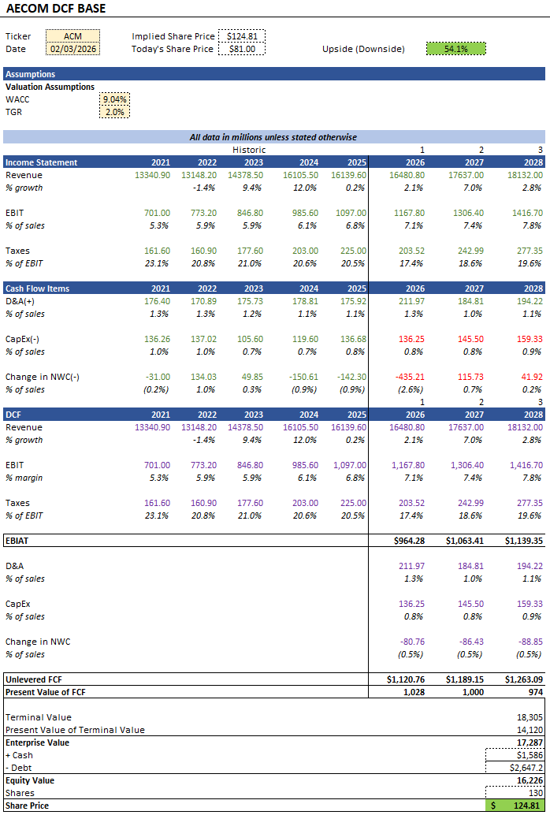
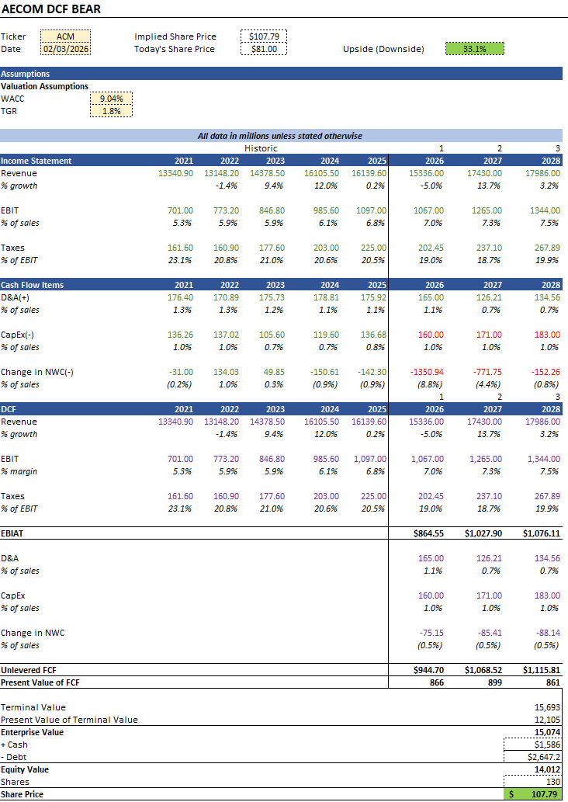
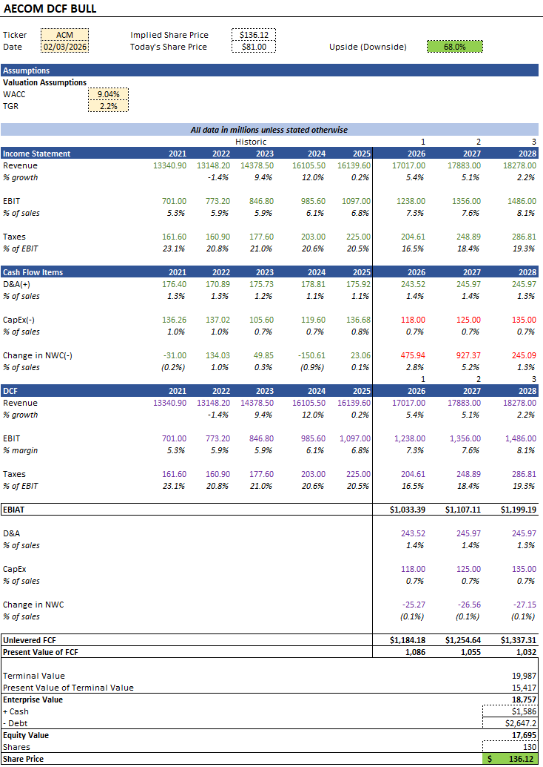
Appendix - DCF

Slide 12
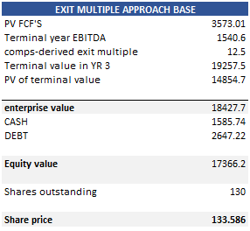
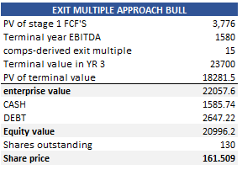
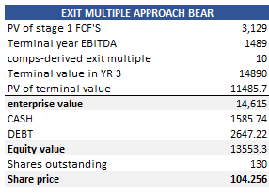
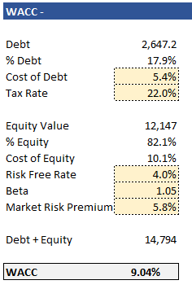
Appendix 2
(1) Statistically robust triangulated maximally filtered graph. This is a correlation network between ACM and the top 10 by index weight in the Industrials S&P500. ACM has one edge with a weight of 0.4 and the lowest communicability, showing that ACM is less exposed to other sections of the industry, as well as cyclical risk. Shows empirical evidence of ACM's risk diversification.

Slide 13
References
https://aecom.com/en-uk/
https://aecom.com/press-releases/tomtom-and-aecom-partner-to-deliver-enhanced-global-infrastructure-planning-and-road-traffic-management/#:~:text=AMSTERDAM%20(February%2012%2C%202026),a%20new%20era%20of%20transportation
https://www.dcfmodeling.com/products/acm-business-model-canvas?srsltid=AfmBOoq3bXHgLvTh_Vl8VpNc38FPvkb4vPtTRFFRiBMSZsBYr4rPm5rE
https://csimarket.com/stocks/ACM-Business
-Segments#:~:text=AECOM,%20a%20global%20premier%20infrastructure,both%20aesthetic%20and%20functional%20requirements.
https://mlq.ai/stocks/ACM/revenue-segments/
https://portersfiveforce.com/blogs/competitors/aecom
https://seekingalpha.com/symbol/ACM/peers/comparison
https://simplywall.st/stocks/us/capital-goods/nyse-acm/aecom/valuation
https://www.grandviewresearch.com/industry-analysis/architectural-engineering-construction-services-market-report#:~:text=Architectural%2C%20Engineering%2C%20And%20Construction%20Services%20Market%20Summary,transportation%20networks%2C%20and%20utility%20infrastructure.
https://media.valuethemarkets.com/investing-research/vtm-investing-research-report-aecom.pdf
https://aecom.com/markets/transportation/
https://environment-analyst.com/global/110879/energy-water-and-sustainability-services-drive-record-es-consulting-growth#:~:text=Climate%20change%20and%20energy%20services,much%20of%20this%20upward%20trend.
https://uk.investing.com/news/company-news/aecom-q1-2026-presentation-record-backlog-drives-raised-guidance-shares-climb-93CH-4499371
https://investors.aecom.com/static-files/db5f5d07-71c4-4546-a0cf-71cd0f61eba4
https://www.industrialinfo.com/iirenergy/industry-news/article/aecoms-backlog-points-to-more-business-in-2026--353237
https://www.architectsjournal.co.uk/news/aecoms-middle-east-turnover-plummets-by-42#:~:text=9%20February%202026%20·%20By%20Gino,bin%20Salman%27s%202030%20development%20drive.
https://investors.aecom.com/static-files/d33963f4-5b3a-4dd5-841c-a642c4209ad4#:~:text=After%20the%20quarter%20ended%2C%20AECOM,in%20the%20fiscal%20first%20quarter.
https://drive.google.com/file/d/19cWo5crj7cqEkJGdR4URtmrQgYTozzAM/view?usp=sharing
https://simplywall.st/community/narratives/us/capital-goods/nyse-acm/aecom/qxut9ovq-update-for-aecom
https://simplywall.st/community/narratives/us/capital-goods/nyse-acm/aecom/qxut9ovq-update-for-aecom
https://investors.aecom.com/news-releases/news-release-details/aecom-reports-first-quarter-fiscal-2026-results
https://investors.aecom.com/news-releases/news-release-details/aecom-announces-increased-financial-targets-built-further#:~:text=“Following%20more%20than%20five%20years,value%20creation%20for%20our%20investors.”
https://investors.aecom.com/static-files/701c6680-6b93-441a-9f7e-0ceb0ce2784f
der%20market%20futures%20stabilized.
https://matrixbcg.com/blogs/growth-strategy/aecom
Fluor Reports Fourth Quarter and Full Year 2025 Results | Fluor
https://www.eawater.com/regulars/waternews/trends-defining-water-innovation-in-2025-and-what-they-mean-for-the-global-water-agenda-in-2026/
https://infrastructurereportcard.org/cat-item/drinking-water-infrastructure/
https://www.jpmorgan.com/insights/sustainability/climate/grid-resilience-neglected-no-more
https://www.deloitte.com/us/en/insights/industry/engineering-and-construction/engineering-and-construction-industry-outlook.html
https://atradius.co.uk/knowledge-and-research/reports/industry-trends-global-construction-industry-trends-2025-2026
https://kpmg.com/cn/en/insights/2026/03/global-construction-survey-2025-2026.html
https://news.constructconnect.com/u.s.-put-in-place-construction-forecast-report-spring-2026-highlights
https://seekingalpha.com/comparison/new/MCUyQ2FjbSUyQ3N0biUzQWNhJTJDZmxyJTJDaiUyQ3dzcG9m
https://github.com/PavanAnanthSharma/Breeden-Litzenberger-formula-for-risk-neutral-densities
https://tradingeconomics.com/united-states/gdp-growth
https://arxiv.org/abs/2310.14881
https://aecom.com/annual-report/
https://aecom.com/wp-content/uploads/documents/safety/AECOM_Management_System_Manual.pdf
https://www.water.org.uk/investing-future/infrastructure-health
https://reports.weforum.org/docs/WEF_Bridging_the_%E2%82%AC6.5_Trillion_Water_Infrastructure_Gap_A_Playbook_2025.pdf

